Slide 1
Rust Setup
Installation, Compiling, Execution, Testing

Slide 2
First homework exercise
Check D2L! Due soon!
You will learn everything you need for it today / next class
Do it ASAP in case you encounter installation issues
If you encounter issues, contact me
  ibarland@radford.edu

Slide 3
Book Reading
Rust Book Ch. 1 : Getting started
  https://doc.rust-lang.org/book/ch01-00-getting-started.html

Slide 4
Command Line Installation
We will be using command line in this class
  Specifically, you need to know some basic Linux command line
If you are using Mac / Linux, you already have a command line installed
If you are using Windows, you should have Powershell
  Not all command are the same as Linux, but they are similar
  Please install a 3rd party Linux command line emulator, such as Cygwin, so that you can follow along with any commands I use
    https://www.cygwin.com/

Slide 5
Rust Installation
The following link provides an installer for Rust on Windows, as well as some additional instruction
  https://www.rust-lang.org/tools/install
If you are on Mac or Linux, the same link above should work.
  Your OS should automatically be detected by the site, and you will get specific command line instructions to run

Slide 6
Playground
If you want to test something out, but don’t have your Rust installation configured yet, try this:
  https://play.rust-lang.org/?version=stable&mode=debug&edition=2021
The playground should not be used as a substitute for a working Rust installation. It’s just meant for quick and simple testing.

Slide 7
IDE : VSCode
Rust does not have a good designated IDE (that I know of)
  Update 2024 – you can try “Rust Rover” by Jetbrains!
However, it does have a really good plugin for the VSCode IDE
You should really really get it
To install VSCode, go here:
  https://code.visualstudio.com/download
For detailed instructions on how to install the Rust plugin, see here:
  https://code.visualstudio.com/docs/languages/rust
This should be available on any OS!

Slide 8
First Rust Project
First, make a workspace folder, to house your Rust projects.
  Do this using the File Explorer on your OS, or command line
In VSCode
  Click File -> Open Folder
  Select the folder for your workspace
Initially, you will have a blank folder, but we will populate it!

Slide 9
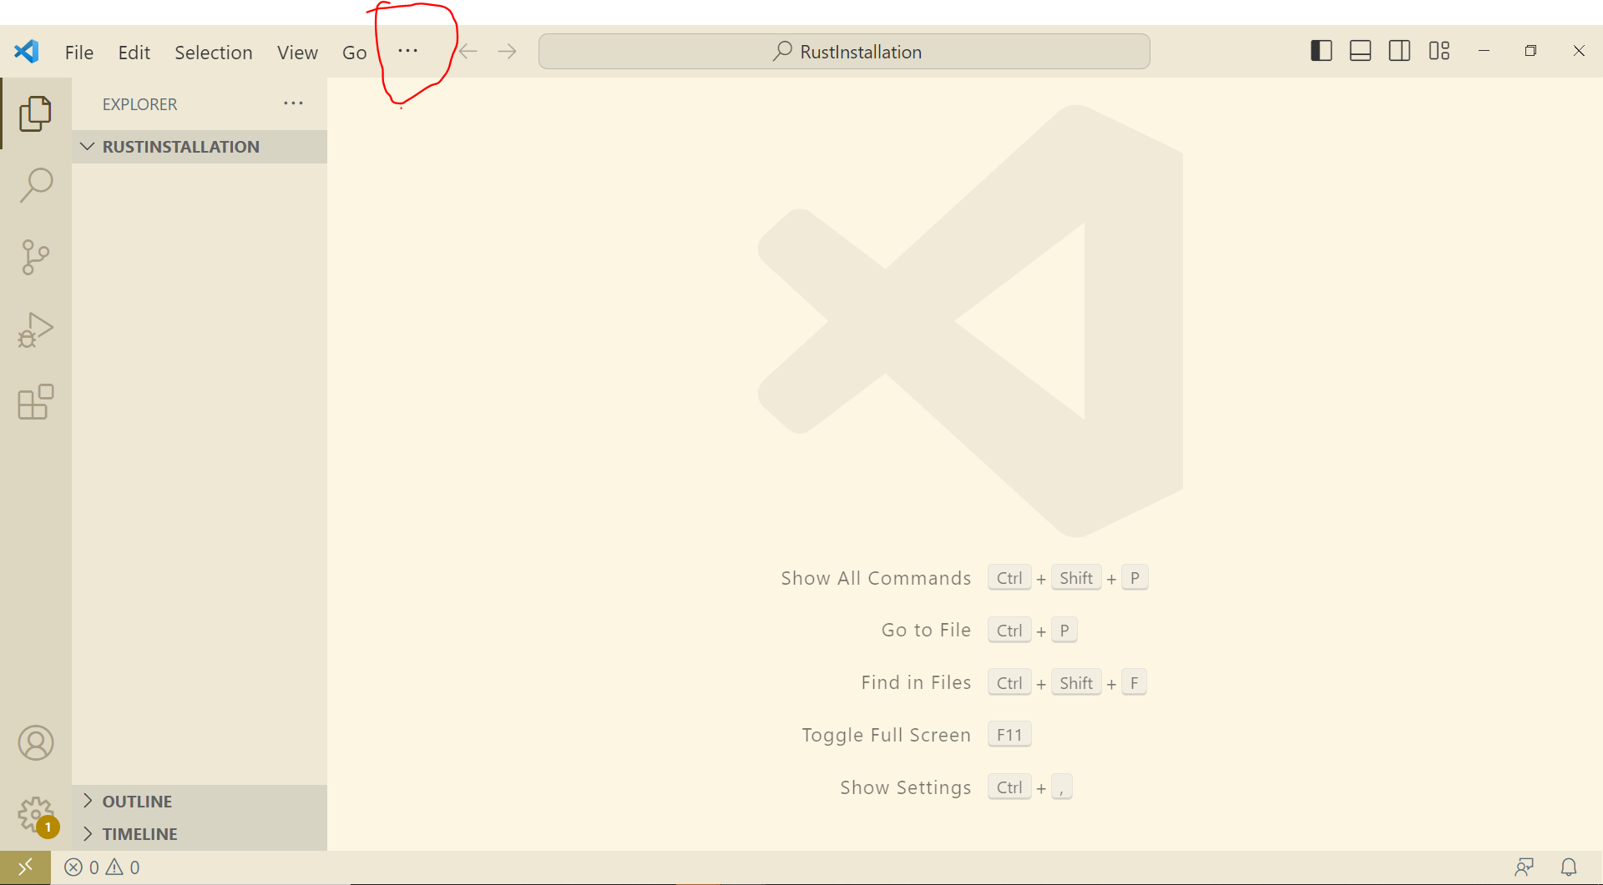
Open Terminal In VSCode
You might have to click the … at the top of the screen to find the terminal
Ctrl + Shift + ` works on Windows

Slide 10
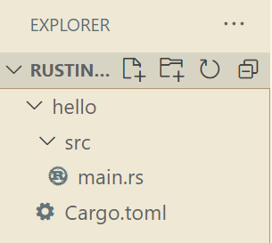
Create Rust Project
Note : Your terminal should by default be in your project directory
Run the following command in your terminal
  cargo new hello
This will create a few files:
  A src (source code) directory, with a main.rs file
  A Cargo.toml file, which contains meta-data about the project

Slide 11
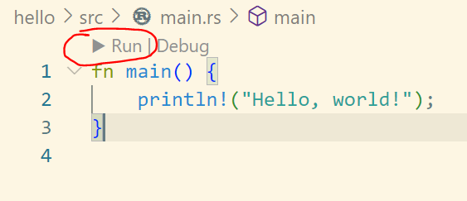
Open main.rs
You will see a hello world program, already there for you
Run the program:

Slide 12
What happens when you press Run?
First, the program is compiled
This generates a “target” directory, which contains binary machine code
Then, the program runs the machine code executable

Slide 13
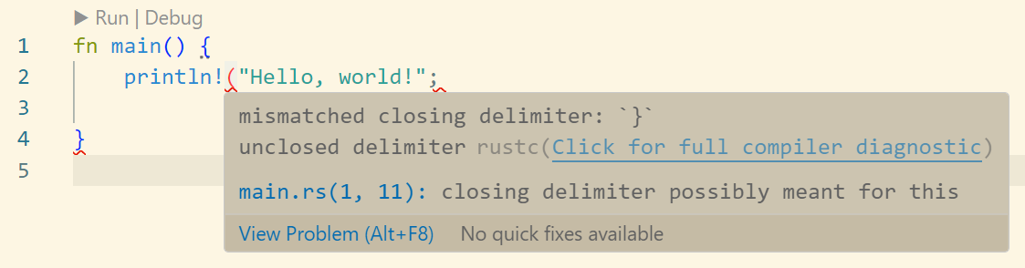
Compile Errors
Try removing a semi-colon from the hello world program
You should get some errors, highlighted in red
This is probably similar to your Java IDE

Slide 14

Running the program from command line

Slide 15
A (slightly) more complex program
Let’s write a program that has:
  An additional function called “add”, which accepts two integers and returns their sum
  A main function that:
    Declares two integers x and y
    Calls add to get the result of adding them together
    Prints x, y and the result of adding them, using descriptive output

Slide 16
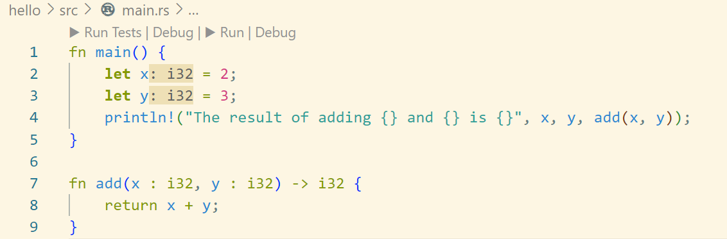
Solution

Slide 17
Writing Tests
Writing unit tests is very important
  Why?

Slide 18
Writing Tests
Writing unit tests is very important:
  Obviously you have to test at some point. Otherwise, how do you know it works?
  You could test manually, but:
    It is very time consuming
    If you change your program, then you have to, again, rerun all your tests manually
    If your test fails, it’s kind of difficult to tell where it failed, or reproduce it
The solution to this problem is unit testing

Slide 19
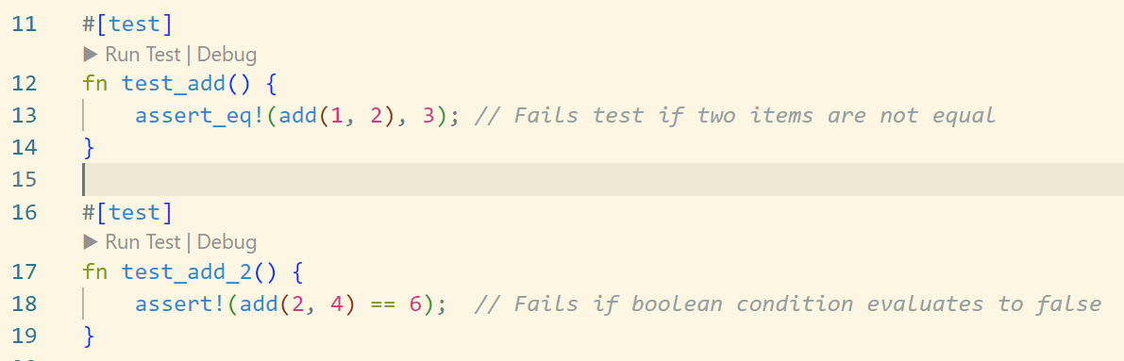
Writing Unit Tests in Rust
Any function in Rust, anywhere can be made into a test
Just add the following annotation:
  #[test]

Slide 20
Running tests
You can run tests directly from VSCode, by clicking: Run tests
You can also run a single test at a time.
You can also run tests from command line, using the command
  cargo test
  (You must be in the Rust project directory, where the .toml is)

Slide 21
Test Everything, Often
Unlike some other language…. Rust unit testing is easy
So you have no excuse not to do it
For every nontrivial function, put a test right below it
  Write the test before your write the function
  After you write the function, test it immediately
When you complete a large section of code:
  Write tests that ensure the different sub-parts of the code are all working together (integration testing)
When you change anything at all in your code
  Rerun all the tests!
Early error detection → Easier to fix errors → more efficient coding

Slide 22
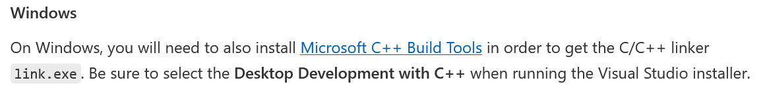
Debugger installation
Speaking of more efficient debugging…
  You should really learn how to use a debugger if you haven’t already.
You can find additional instructions for installing the debugger here:
  https://code.visualstudio.com/docs/languages/rust#_debugging
Pay special attention to this part:

Slide 23
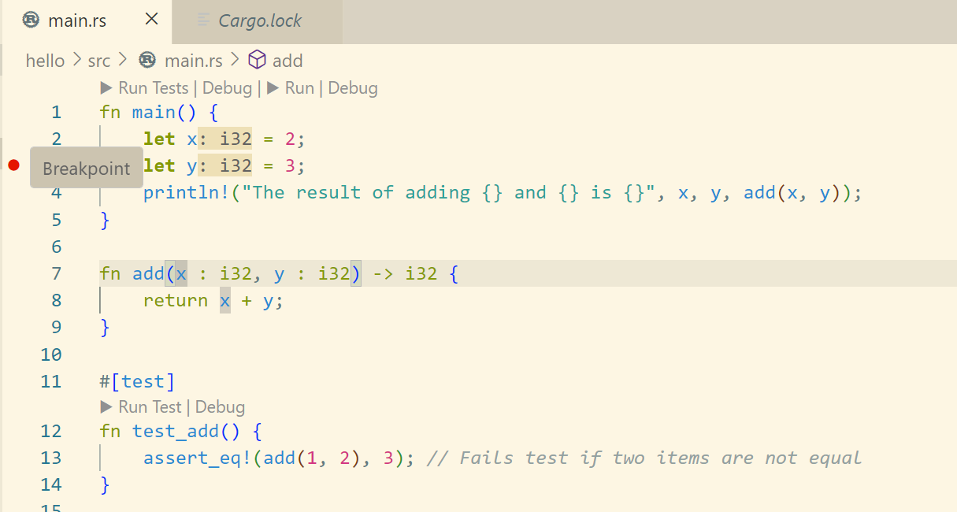
Using the Debugger!
First, add a “breakpoint” by clicking to the left of some line number

Slide 24
Using the Debugger!
A breakpoint is a place where the program will stop when you debug it
Try clicking “Debug” in VsCode, instead of “Run”
  What happens?

Slide 25
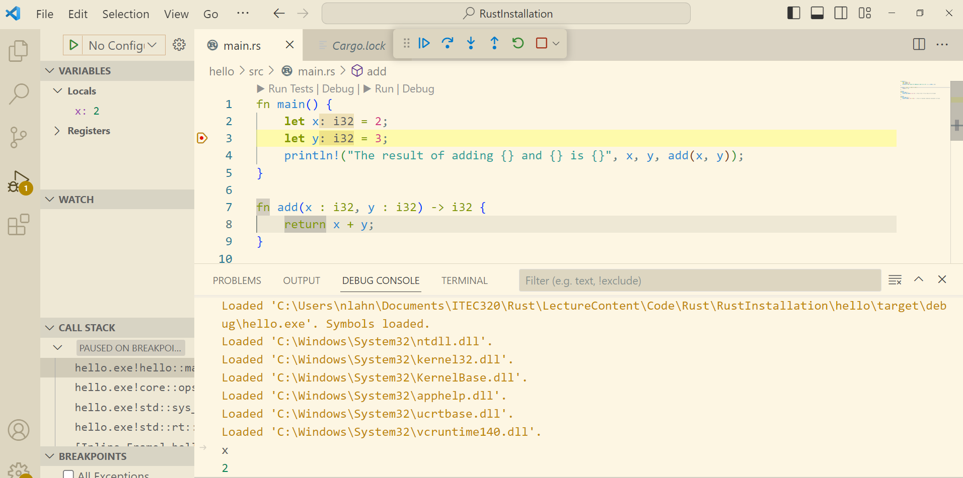

Slide 26
Some things you can do with the debugger
View the values of all variables currently visible to the current line of code
Step forward one line at a time
Skip to the next breakpoint
Go inside of functions
See the value of any expression
You can debug tests separately from the main program

