Slide 1
Variables, Types, Type Checking

Slide 2
Today
Defining a few basic concepts that have to do with variables / types
  These apply to many different languages
Explicit vs. Implicit. Conversion
Static vs. Dynamic
Inferred types
Immutable vs. Mutable

Slide 3
What is a variable?

Slide 4
What is a variable?
A named bucket (bucket holds a value; name is on outside of bucket)
Your code mentions the name in an expression; the computer gets the value from the corresponding bucket.
Your code can change the bucket's value with assignment (e.g. n = 2+3 );
general syntax: <Var> = <Expr>;
In rust, every variable has a type;
the type determines the bucket's shape (what type of values it can hold)

Slide 5
What is a type?

Slide 6
What is a type?
A type is the set of possible values a variables can hold.
Internally, compiler knows the size_of each type (the size of the bucket -- how many bytes are needed to put one on the stack or heap).
Internally: A type also implies that the bits representing it will be interpreted in a certain way.
Example : let mut x : i32 = 4;
  The value of x might change, but we know it’s always holding some i32.
  The actual data stored in this variable is 32 bits (here, 00…0100).
  Interpret those 32 bits as two’s complement.

Slide 7
Declaring Variables
Name followed by type:
let x : i32 = 3;
println!( "x holds {} right now.", x);
let isHappy : bool = true;
let numStudents : u16 = 18;
General syntax:
let <Id> : <Type> = <Expr>;

Slide 8
Declaring Variables (cont.)
Just as in Java, it's allowed to declare a variable w/o initializing it.
But it must be initialized (later) before its first use.
Good style: always initialize.
This is required for this course.
(Some languages don't even allow declare-without-initialize!)
If initial-value depends on if, you can use if-as-expression:
let x : i32 = if a>b {a} else {b};
In general if is an expression in rust, not a mere statement.
So it can be used as part of bigger expressions:
let x : i32 = 3 + (if a>b {a} else {b})*17; !!

Slide 9
What is a variable? (internal considerations)
Internally: name turns into a memory-location after compiling,
perhaps as an offset from the current stack-frame.
Internally: the type determines the size of the bucket (how many bytes the item fills, beyond the starting-memory-location)
Thus at compile-time, rust knows how many bytes are needed for the stack of every function-call. (Very important, for compiling!)

Slide 10
What is a type? (cont.)
Each type also has a corresponding set of operations
These may be defined as part of the type definition, or separately.
  Usually, the operations are functions ("methods"), but can also be operators
  (which are morally functions, but called infix rather than prefix).
Ex: A Java class has:
  Fields: the sub-types comprising the overall class-type.
  Methods: defines the allowed operations on objects of this class/type.

Slide 11

Immutable vs. Mutable Variables
By default, all Rust variables are immutable
That means you can’t assign a new value to them
To make a mutable version of a variable, use the mut keyword
This is the opposite approach from Java, where variables are mutable unless you add a keyword: final.
Immutable variables are preferred when possible –
they make debugging much easier!

Slide 12
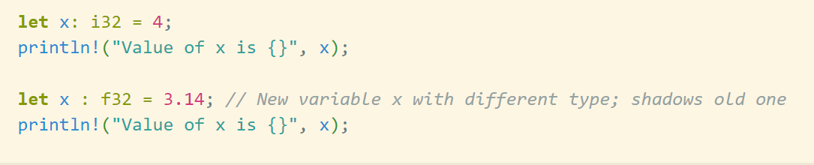
Shadowing
Rust allows “shadowing” of variables:
two different variables that happen to have the same name.
The two variables might even have a different type
This is not somehow changing the type or mutability of a variable:
  Rather, an entirely new variable is made with the same name
  The old variable is unusable: we say it is shadowed

Slide 13
Implicit vs. Explicit Conversion
Conversion: Replace a value of one type with a value of another type
Explicit conversion : You have to explicitly tell the program to do the conversion
  Sometimes known as “type casting”
  It's a function (input: bits-for-int; return: bits-for-double);
  sometimes uses special syntax instead of function-call.
Implicit conversion : The conversion-function is called automatically, without you having to say anything
  Sometimes known as type “coercion”

Slide 14

Examples:
Java uses type coercion for String addition (and for Strings, in general):
"Wall is " + Math.sqrt(25) + "ft."
What implicit conversion(s) are happening?

Slide 15
Examples:
Java uses type coercion for String addition (and for Strings, in general):
"Wall is " + Math.sqrt(25) + "ft."
"Wall is " + doubleToString(Math.sqrt(int2double(25))) + "ft."
Java privileges Strings and arrays. Other languages are far more lax:
E.g. php: an empty array can be false in a boolean context, as can an empty string or 0 (but not "0" even though it "0" gets coerced to 0 in numeric contexts).

Slide 16

Examples:
Rust: Generally requires most conversions to be explicit
To do any operations between different types, must make sure the types match first
  Can use the From / Into functions
Error : Can’t implicitly convert from integer to floating point

Slide 17
Strong vs. Weak Typing

Slide 18
Strong vs. Weak Typing
People use “strong” vs. “weak” to mean different things:
  Sometimes "few coercions" vs. "lots of coercions";
  Sometimes "statically typed" vs "dynamically typed"
Avoid using these terms
Instead of strong/weak, it’s better to talk about implicit vs. explicit conversion

Slide 19
Rust is Statically Typed
Variables in Rust are statically associated with a type
  That means:
    The type is known at compile time
    The type can never change
    Thus Rust always knows the size needed to hold or pass that variable.
There are a few exceptions involving polymorphism, but they are rare (and complicated)

Slide 20
Comparison: Static Vs. Dynamic typing
Generally, statically handling something is faster and safer
  Faster : Fewer checks needed at runtime
  Safer : Error detected when program is compiled; no debugging needed.
  (That is: if it compiles, the compiler has proven there are no type-errors!)
Dynamic handling is sometimes necessary though for flexibility.
An error might lurk, if your unit-tests weren't thorough.

Slide 21
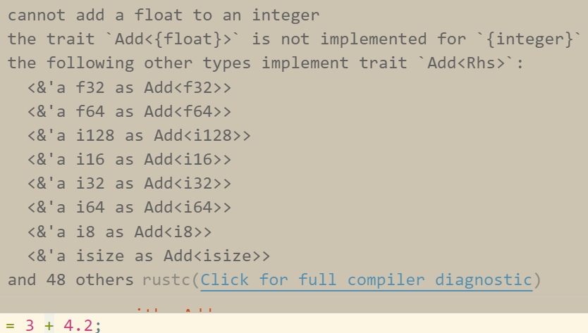
Rust examples
Can’t add floats to integer
Can’t add integers to strings
Can’t convert between floats and integers, unless you use explicit conversion (like From / Into)

Slide 22
Static Checking vs. Dynamic Checking
Static checking done at compile-time
  Examples: Ada, Java, Rust
  In Java:
    String str = "abc";
    str = 5 // Throws an error because str has type String, and can only hold String
Dynamic checking done at run-time
  Example: Python, Lisp
    str = "abc"
    str = 2 // Legal in python
    str.split() // Calling string method on int not legal; not detectable until run-time
  Requires checks at run-time, hence slower runtime (2x-10x … may not matter)

Slide 23
Java polymorphism can be dynamic
Check out dynamic.java

Slide 24
Inferred vs. Explicit Types
Rust allows for type inference
Examples
  let whats_my_type = 4;
    Automatically inferred as i32
  let whats_my_type = 1 == 1 || 4 < 2;
    Automatically inferred as bool
If it’s ambiguous, Rust compiler won’t let you do it

Slide 25
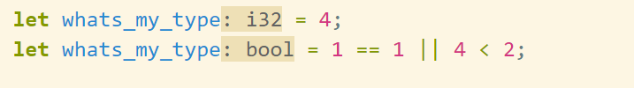
Inferred Types are
displayed by VSCode
VSCode’s Rust Analyzer Plugin lists the inferred types in dark yellow
These are not actually part of the program text
  They are placed there in the GUI automagically by the editor
Double clicking the type will actually add it to the text
I recommend that you explicitly write the type until you understand Rust well

