Slide 1
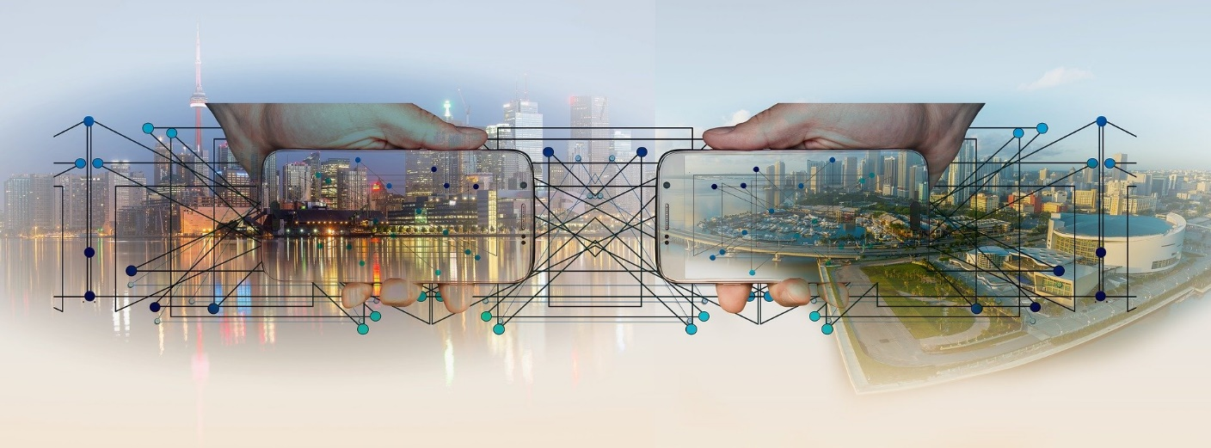
Internet?

Slide 2

Computer Networks?
A collection of autonomous computers interconnected by a single or multiple technologies
  Interconnected via:
    Copper wire
    Fiber optics
    Microwaves
    Infrared
    Communication satellites, etc.

Slide 3
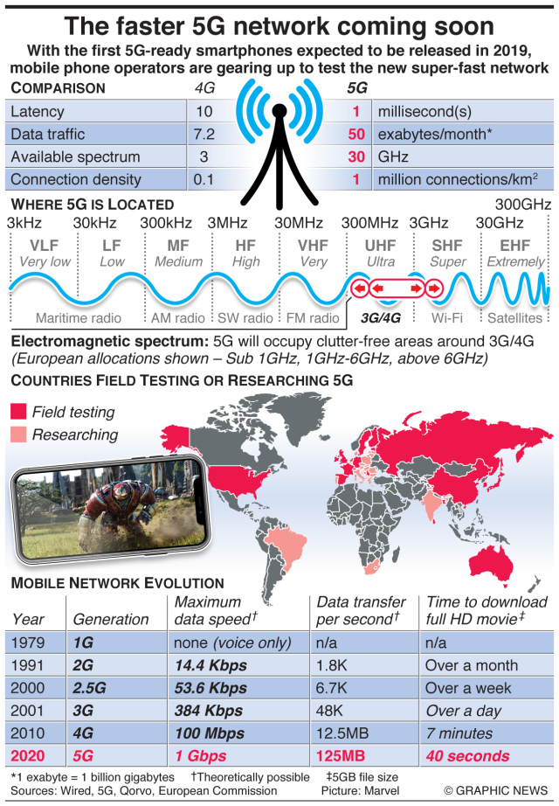
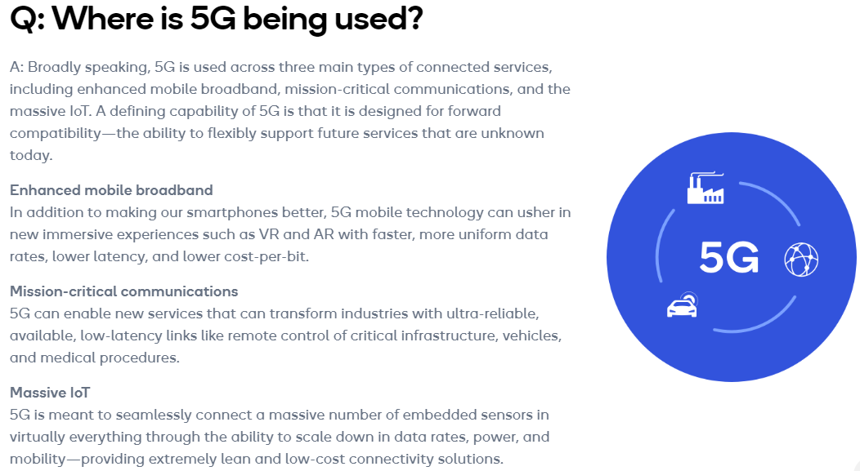
5G Network
[Source] https://www.qualcomm.com/invention/5g/what-is-5g#:~:text=A%3A%205G%20is%20the%205th,machines%2C%20objects%2C%20and%20devices.
[Source] https://engtechmag.files.wordpress.co/2018/09/gn38319c_en.jpg

Slide 4
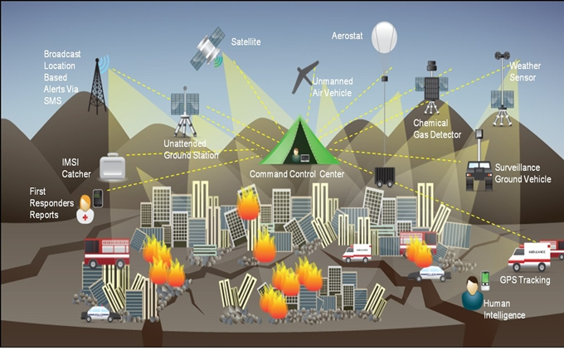
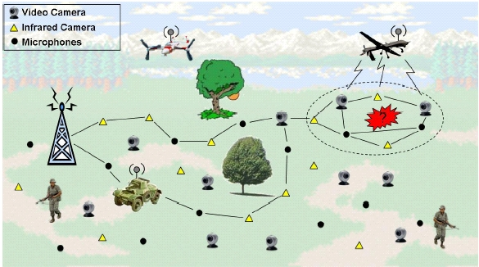
Search and Rescue Mission
This Photo by Unknown Author is licensed under CC BY
This Photo by Unknown Author is licensed under CC BY
This Photo by Unknown Author is licensed under CC BY-SA-NC

Slide 5
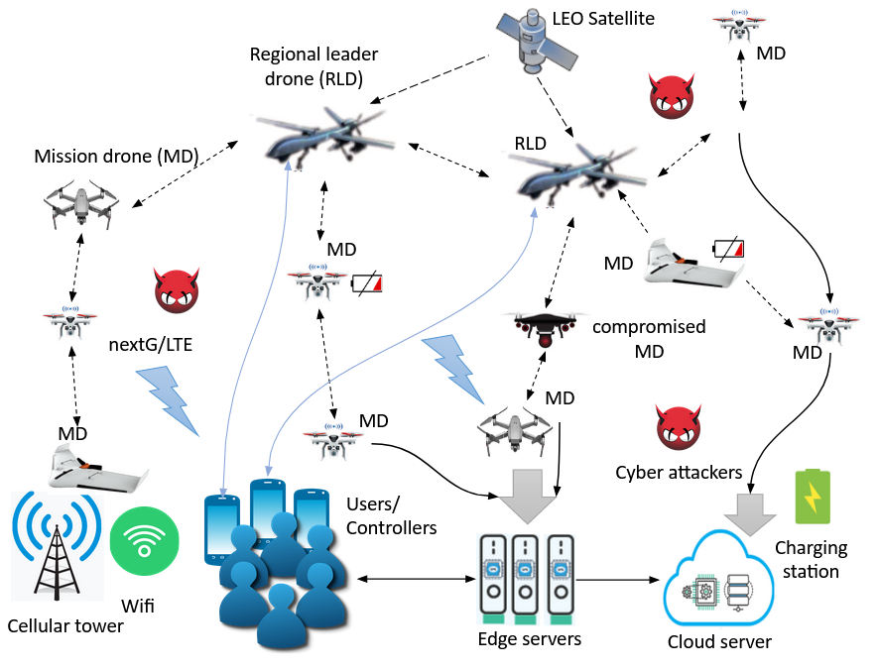
UAV-based Mission Team Network

Slide 6
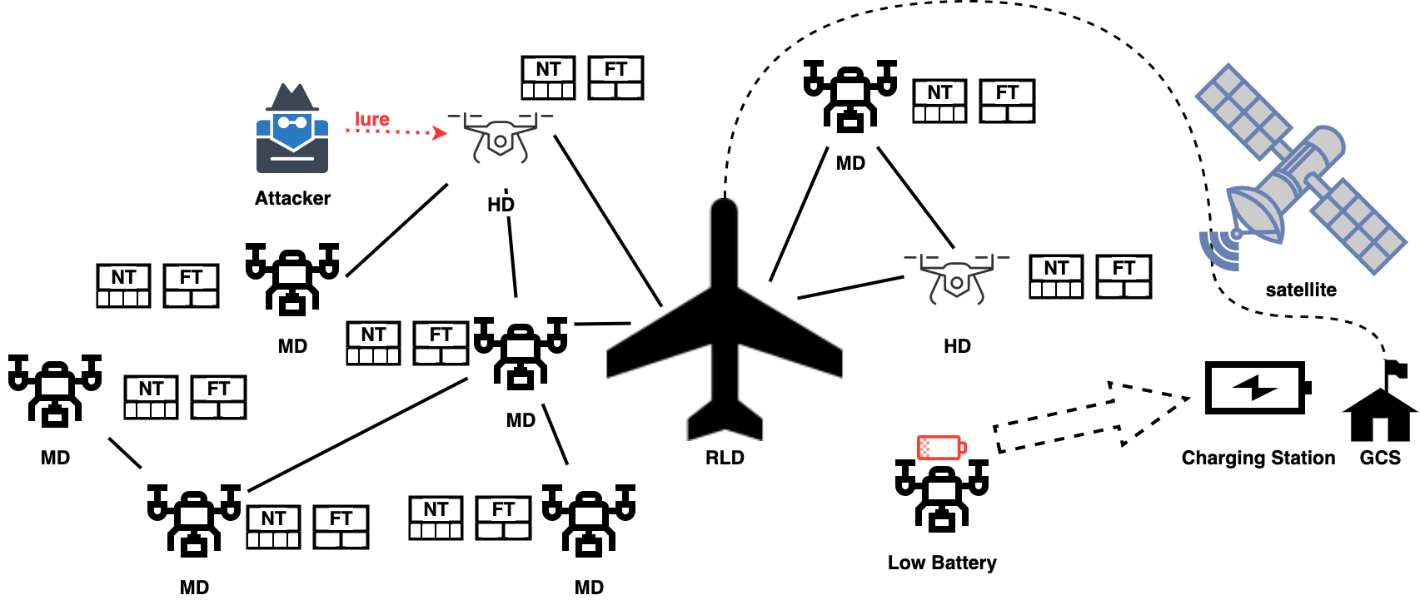
Moving Target Defense

Slide 7
Defensive Deception

Slide 8
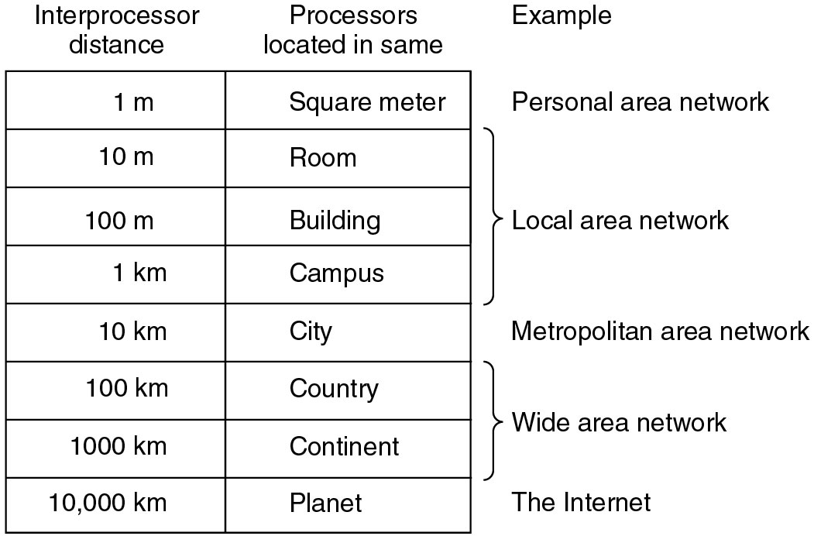
Classification of interconnected processors by scale.

Slide 9
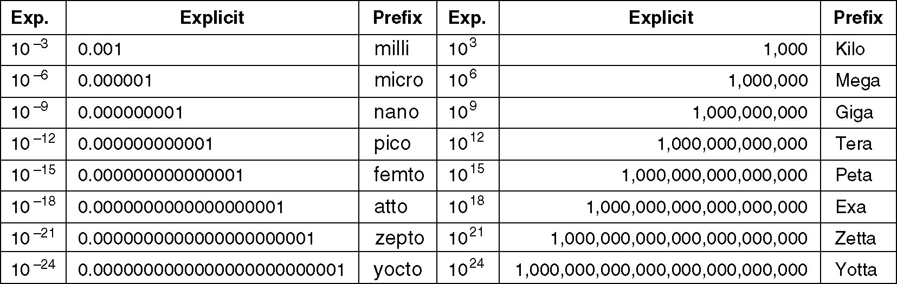
Metric Units
The principal metric prefixes.

