Slide 1
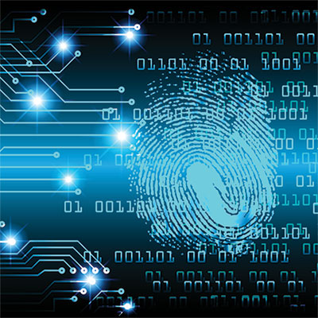
Digital Forensics
Hwajung Lee
7/22/2019

Slide 2
Contents
Part 1: What is Digital Forensics? & Murder Case
Part 2: Systematic Approach of Digital Investigation and FTK Imager
Part 3: Wireshark and Cryptography
Part 4: Digital Photo Scavenger Hunt and Steganography

Slide 3
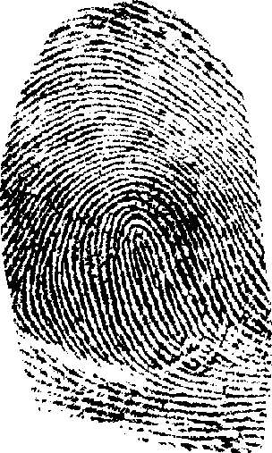
What is Digital Forensics?
Definition: Using various digital technologies to solve cases
Function: obtaining and analyzing digital information that can be inculpatory (proving guilty) or exculpatory (proving innocence)
Related fields:
  Network forensics
  Data recovery
  Disaster recovery
Computer Crime:
  Computer used as a tool in crime (E.g., Hacking, harassment, fraud, DoS attacks)
  Computer is victim of crime (E.g., Virus, spyware)
  Computer contains evidence in relation to crime (E.g., Pictures, search history, contact information)

Slide 4

Murder Case Project
Examined past digital forensics cases
Explained cases and how digital forensics was used in investigations
Importance of Forensics in BTK Murder Cases
  What software was used by the Police?
    BTK: EnCase was used on a floppy disk (found the name “Dennis Rader” and location)

Slide 5
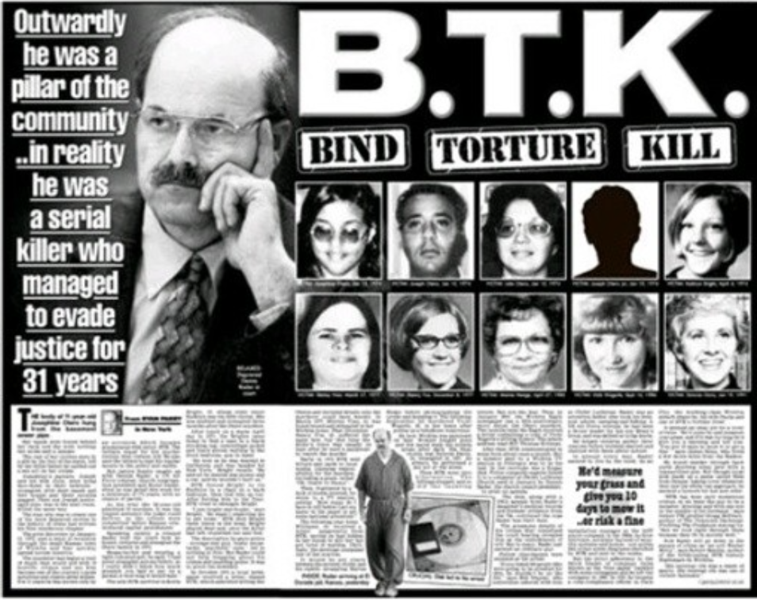
BTK Murder Case: Background
The BTK killer has been one of the biggest unsolved cases. It spanned over 30 years of confusion in America. The BTK killer killed 10 people around the Wichita, Kansas area during the period of 1974 to 1991.

Slide 6
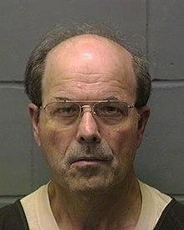
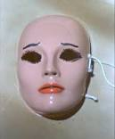
BTK Murder Case: The Crime
Committed murders for 15 years (1974-1991)
His first murder was a family of four.
He murdered six other women after that.
He sent the police notes to taunt them, often containing a puzzle, riddle, or pictures.
His first note was hidden in a book in the local public library, and included a confession along with specific details about the murder
He nicknamed himself BTK (Bind, Torture, Kill)
He wore a mask while committing the the murders.

Slide 7
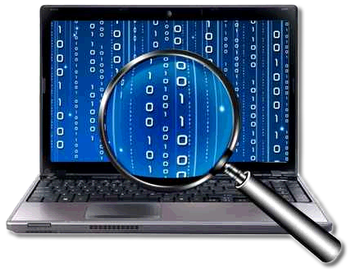
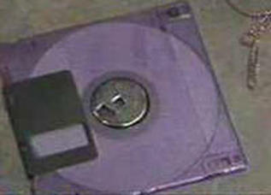
BTK Murder Case:The Outcome
The FBI and police were not able to identify Dennis Rader as the murderer until 2006.
After his last murder in 1991, he didn’t communicate with the police until 2004.
One of the things he sent was a document on a floppy disk.
Computer forensic experts recovered a deleted document from the disk.
  From the metadata (data about data), they learned the name and location of the killer.
DNA evidence and a background check of the killer were used to link him to the murders.
Dennis Rader lived a double life as the president of the church congregational council and a father in public, and a sadist in private.
The earliest date he can be released from prison is February 26, 2180.

Slide 8
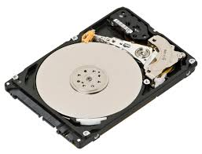
Digital Investigation: Taking a Systematic Approach
STEPS
Make an initial assessment about the type of case you are investigating.
Determine resources needed
Obtain and copy an evidence disk drive
Identifying the risks－mitigate or minimize the risks
Analyze and recover the digital evidence
  Undelete any deleted file
Investigate the data you recover
  Find out meaning of findings
Complete the case report
  Can’t contain any biased opinion
Critique the case

Slide 9
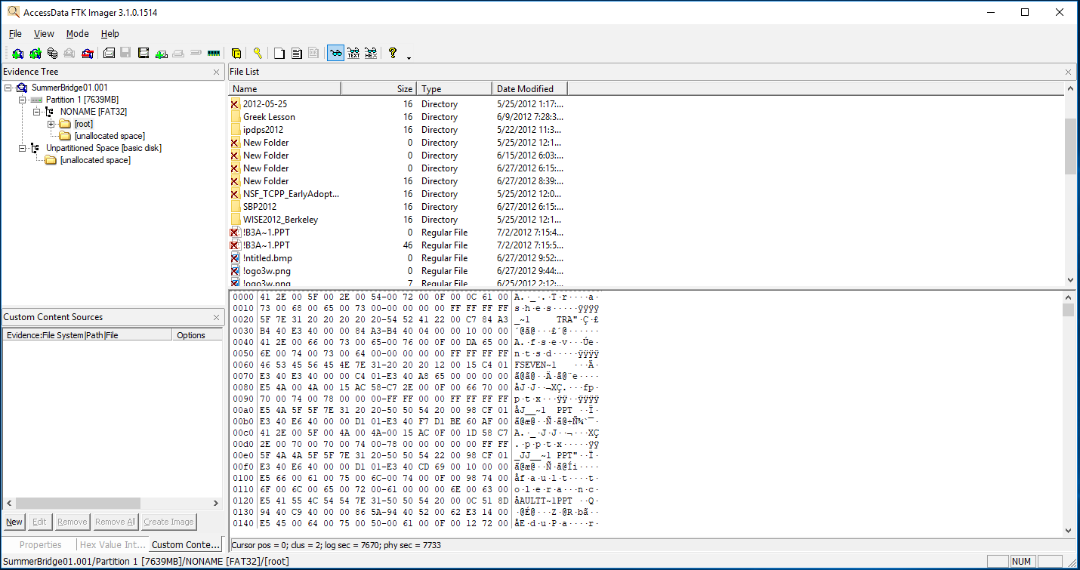
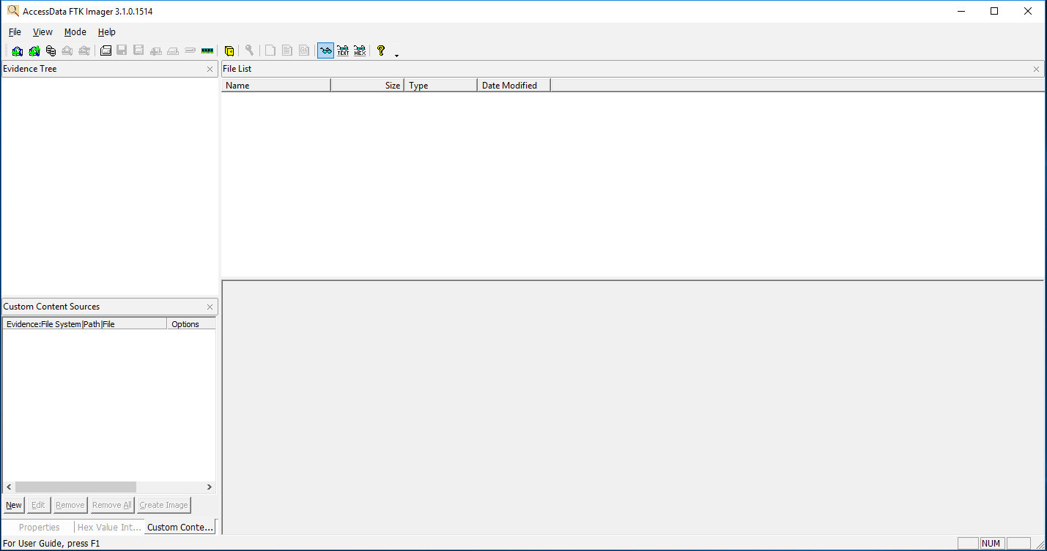
FTK Imager (Forensic Toolkits)
Used to recover deleted data
First you make a copy of the data you want to recover
Then you use the FTK software and you can see all the deleted files from the data you copied

Slide 10
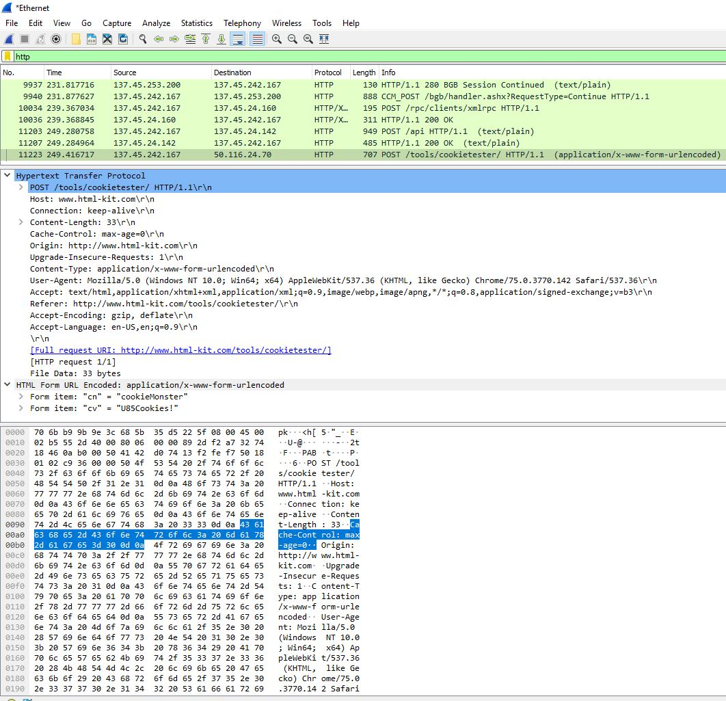
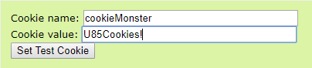
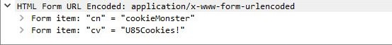
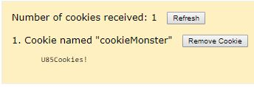
Wireshark
Captures all frame observed by its Ethernet Network Interface Card (NIC).
Sequence of frames and contents of frame can be examined in detail down to individual bytes
Used to grab and identify Cookies, passwords, …

Slide 11
Cryptography
Cryptography is used to encrypt or decrypt information
Encryption: using an algorithm to change a word/sentence into a jumble of letters and numbers (often much longer than the original message). To prevent people from decrypting it easily, a password is used
Decryption: taking the encryption and using the password and software to change the jumbled letters back into the original sentence

Slide 12
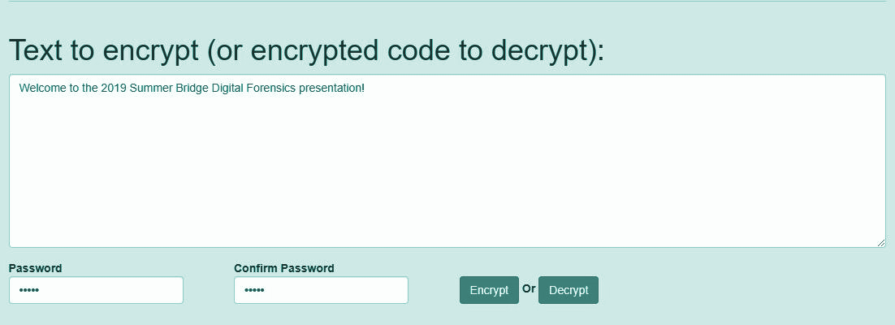
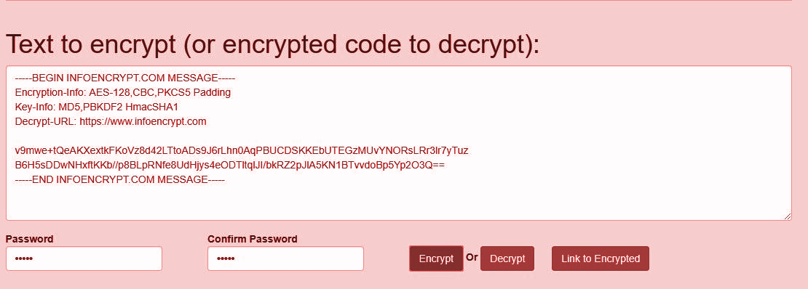
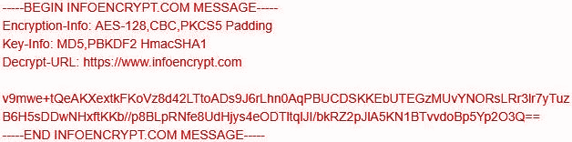
Plaintext
decrypt
encrypt
Ciphertext

Slide 13
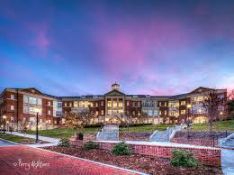
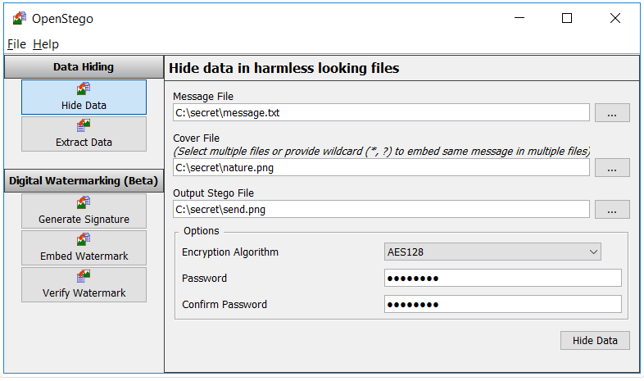
Steganography
Steganography is the science of hiding information.
Before technology people would shave their heads to hide their messages
Now people hide messages in images, sounds, and files
Regular picture
Output image
This is the regular image without any secret messages .
This is the image with the hidden message

Slide 14
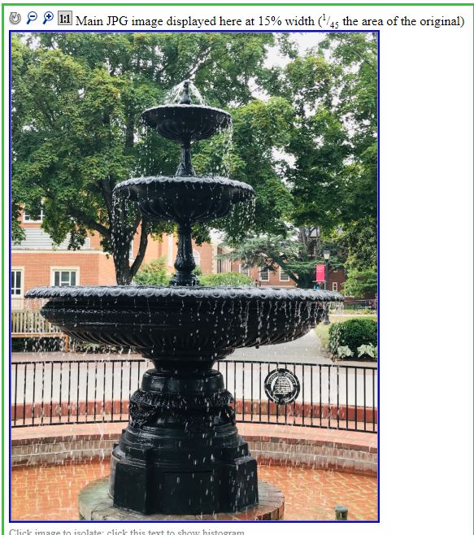
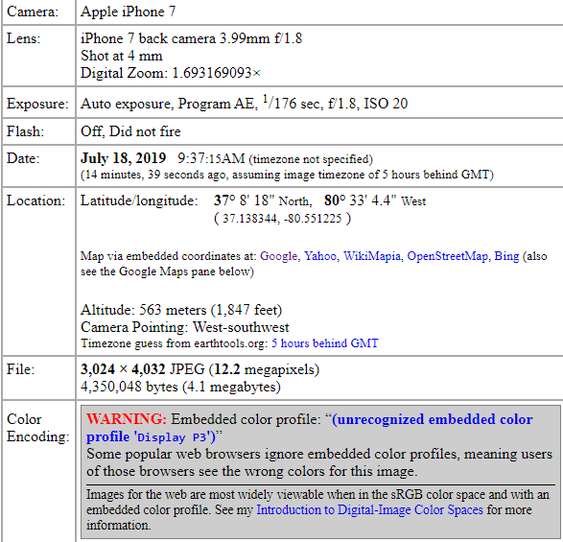
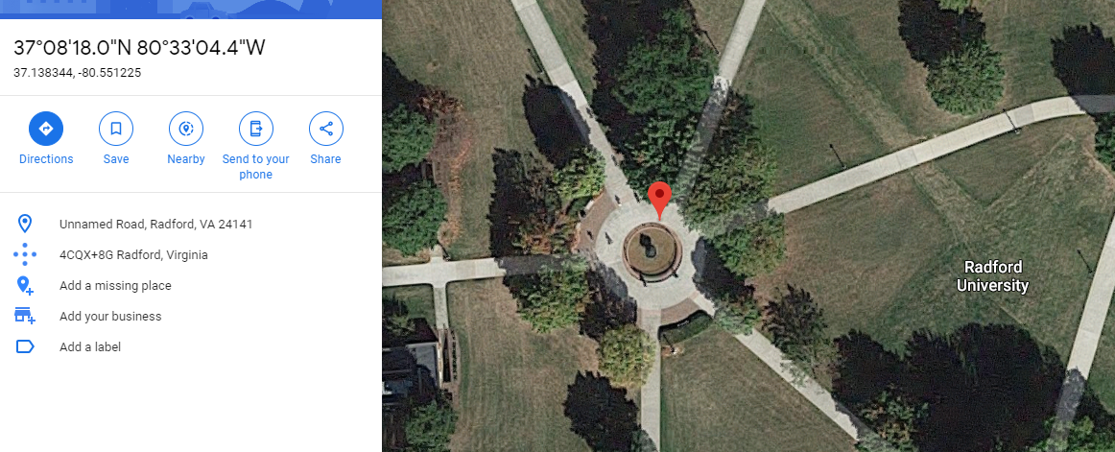
Digital Photo Scavenger Hunt
Walked around the campus and took pictures on our phones with our location on!
When returning back to the computer lab we downloaded those pictures to the computer and were able to see exactly where we were when we took the pictures at in google maps

Slide 15
Questions?
&
Concluding Remarks

