Slide 1
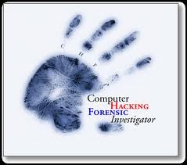
Computer Forensics
(Digital Forensic)
SUMMER BRIDGE PROGRAM
DR. HWAJUNG LEE
DR. ASHLEY PODHRADSKY
Image Source: thecomputerforensics.info

Slide 2
DAY ONE

Slide 3

Who am I?
Dr. Hwajung Lee
  Professor
    in the department of Information Technology
    at Radford University
  Email: hlee3@radford.edu
Image Source: computerforensicsinfo.org
Notes:
Korean American
I am __ years old
Christian, Bible Study Leader
I have two female dogs: Sa-rang and Coco

Slide 4

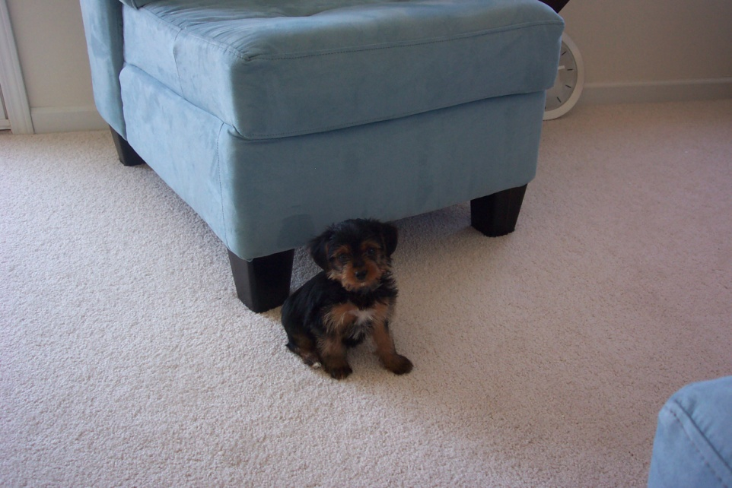
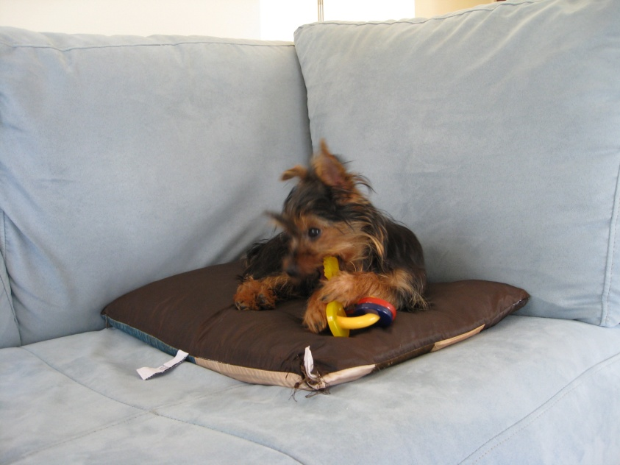
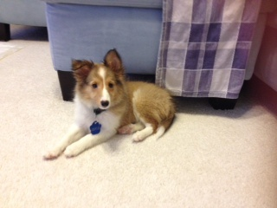
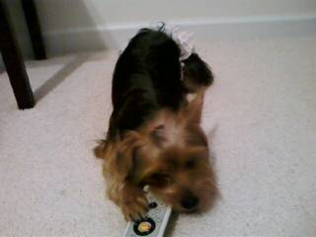
Sa-rang, Coco, and Emma

Slide 5

Who is your TA?
Mr. Collier Crisanti
Image Source: racktopsystems.com

Slide 6
Our Plan for This Week
DAY ONE (Monday)
  Lecture and TWO activities
    Activity One: Who are you?
    Activity Two: Digital Forensic Cases
DAY TWO (Tuesday)
  Lecture and ONE activity
    Activity Three: Acquiring an Image of Evidence Media and Recovering a Deleted File
DAY THREE (Wednesday)
  Lecture and THREE activities
    Activity Four: Cookies and Grabbing Passwords with Wireshark
    Activity Five: Encryptor and Decryptor
    Activity Six: Steganography
DAY FOUR (Thursday)
  Lecture and TWO activities
    Activity Seven: Digital Photo Scavenger Hunt
    Activity Nine: Preparing the Friday Presentation
DAY Five (Friday)
    Presentation in the closing session

Slide 7
Our Plan for This Week
DAY ONE (Monday)
  Lecture and TWO activities
    Activity One: Who are you?
    Activity Two: Digital Forensic Cases
DAY TWO (Tuesday)
  Lecture and ONE activity
    Activity Three: Acquiring an Image of Evidence Media and Recovering a Deleted File
    Capture the Flag Contest
DAY THREE (Wednesday)
  Lecture and THREE activities
    Activity Four: Grabbing Cookies and Passwords with Wireshark
    Activity Five: Encryption and Decryption
    Activity Six: Steganography
    Activity Seven: Digital Photo Scavenger Hunt
DAY FOUR (Thursday)
    Activity Eight: Preparing the Friday Presentation
    Activity Nine: Field Trip (Tabletop Activity)
DAY Five (Friday)
    Activity Ten: Preparing the Friday Presentation
    Presentation in the closing session

Slide 8
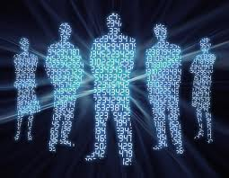
Activity ONE:
Who are you?
Image Source: newenglandcomputerforensics.com
Notes:
Activity
- Networking and banding
What is your name?
What is your school?
What is your favorite indoor/outdoor activity?
What is your favorite time of day/day of the week/month of the year? Why?
When you have 2 hours of free-time, how do you pass the time?
What do you expect from this class or Summer Bridge Program?
Anything else?

Slide 9
Activity ONE:
Who are you?
What is your name?
What is your school?
What is your favorite indoor/outdoor activity?
What is your favorite time of day/day of the week/month of the year? Why?
When you have 2 hours of free-time, how do you pass the time?
What do you expect from this class and Summer Bridge Program?
Anything else?
Image Source: newenglandcomputerforensics.com

Slide 10
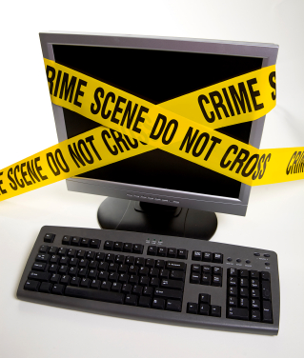
In This week,
We will talk about…
What is computer forensics?
Computer Forensics in the news
When is computer forensics used?
History of computer forensics
Describe how to prepare for computer investigations
Computer Forensics Example- AccessData FTK Imager, Wireshark, Encryptor & Decryptor
Image Source: e-crimebureau.com

Slide 11
Forensic
Adj. - “of, relating to, or used in courts of law or public debate or argument"
  From the Latin term forensis (forum)
Computer Forensics - Exceedingly poor English expression which uses the noun computer as an adjective to modify the adjective forensic as a noun
Digital Forensics – still poor English expression
I think “Forensic IT” is a better expression
Source: class note by Rob Guess
Notes:
Correct term would be “Forensic Ana~”

Slide 12
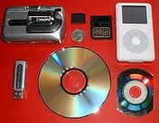
Understanding
Computer Forensics (1)
Computer forensics
  Involves obtaining and analyzing digital information
  Investigates data that can be retrieved from a computer’s hard disk or other storage media, including tasks of recovering data that users have hidden or deleted and using it as envidence. Evidence can be inculpatory (“incriminating”) or exculpatory
Image Source: en.wikipedia.org

Slide 13
Understanding
Computer Forensics (2)
Types of Evidence
  Exculpatory
    Proves Innocence
  Inculpatory
    Proves Guilt
  Tampering
    Proves Malfeasance or Mishandling
Source: class note by Rob Guess

Slide 14
Understanding
Computer Forensics (3)
Related Fields
  Network forensics
    Yields information about how a perpetrator or an attacker gained access to a network
  Data recovery
    Recovers information that was deleted by mistake or intentionally
    Typically you know what you’re looking for
  Disaster recovery
    Uses computer forensics techniques to retrieve information their clients have lost due to natural or man made disaster

Slide 15
Computer Crime
Computer as an Instrument of Crime
  Remote System Penetration
  Instrument of Fraud
  Used to Deliver Threats / Harassment
  DoS Attacks
Computer as a Victim of a Crime
  System Compromise
Repository of Evidence Incidental to Crime
  Contraband Items
  Electronic Discovery in Civil Litigation
Source: class note by Rob Guess

Slide 16
The Importance of Being Digital
People live and work in increasingly digital modes
Nearly every crime now involves some form of digital evidence
3~4% of people will commit a crime given the opportunity
Internet based crime presents a lower overall risk to the offender when compared to “real world” crime
This naturally encourages criminals to adapt digital modes
Source: class note by Rob Guess

Slide 17
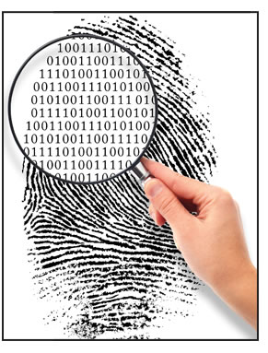
Digital Evidence
Name some examples of digital evidence
  ________________________
  ________________________
  ________________________
  ________________________
Image Source: nacvaquickread.wordpress.com
Source: class note by Rob Guess
Notes:
Hard drive
History files
Logs
Metadata
Cookies
Windows mobile cell phone
Disk

Slide 18
Sources of Digital Evidence
Open Computer Systems
  PC’s, Servers, Etc
Communication Systems
  Telecommunications Systems
  Transient Network (content) Data
  Non-transient (log) Data
Embedded Computer Systems
  PDAs, Cell Phones, iPods, iPhone, Etc
Source: class note by Rob Guess

Slide 19
Crimes Involving Digital Evidence
Traditional crimes
Theft of Trade Secrets
Harassment
Intrusion Events
Malicious Code
Child Pornography
Inappropriate Use
Others?
Source: class note by Rob Guess
Notes:
NIST Special Publication 800-61 Computer Security Incident Handling Guide
http://csrc.nist.gov/publications/nistpubs/800-61/sp800-61.pdf
Handbook for Computer Security Incident Response Teams (CSIRTs)
http://www.sei.cmu.edu/pub/documents/98.reports/pdf/98hb001.pdf

Slide 20
Crimes Involving Digital Evidence
Traditional crimes
Theft of Trade Secrets
Rights Infringement
Harassment
Intrusion Events
Tortious Interference
Malicious Code
Embezzlement
Child Pornography
Denial of Service
Extortion
Inappropriate Use
Unlawful Solicitation
Others?
Source: class note by Rob Guess
Notes:
NIST Special Publication 800-61 Computer Security Incident Handling Guide
http://csrc.nist.gov/publications/nistpubs/800-61/sp800-61.pdf
Handbook for Computer Security Incident Response Teams (CSIRTs)
http://www.sei.cmu.edu/pub/documents/98.reports/pdf/98hb001.pdf

Slide 21
Activity TWO:
Digital Forensic Cases (1)
BTK Killer
  http://precisioncomputerinvestigations.wordpress.com/2010/04/14/how-computer-forensics-solved-the-btk-killer-case/
Caylee Anthony
  http://www.christianpost.com/news/casey-anthony-trial-computer-expert-unearths-chloroform-internet-searches-50980/

Slide 22
Activity TWO:
Digital Forensic Cases (2)
The Dangers of Internet
  http://precisioncomputerinvestigations.wordpress.com/2010/04/13/the-dangers-of-the-internet/
Facebook and Skype Forensics
  Findings of a Facebook Forensic Analysis
    http://precisioncomputerinvestigations.wordpress.com/2010/03/09/findings-of-a-facebook-analysis/
  Chat History
    http://precisioncomputerinvestigations.wordpress.com/tag/skype-forensics/
Notes:
Key page:
http://precisioncomputerinvestigations.wordpress.com/tag/digital-forensics/

Slide 23
Activity TWO:
Digital Forensic Cases (3)
What Computer Forensics Can Do For You
  http://precisioncomputerinvestigations.wordpress.com/2010/04/08/what-computer-forensics-can-do-for-you/
Corporate Fraud – A Case Study
  http://precisioncomputerinvestigations.wordpress.com/2010/03/29/corporate-fraud-a-case-study/
Corporate Investigation – A Case Study
  http://precisioncomputerinvestigations.wordpress.com/2010/03/24/corporate-investigation-a-case-study/
Notes:
Key page:
http://precisioncomputerinvestigations.wordpress.com/tag/digital-forensics/

Slide 24
DAY TWO

Slide 25
Digital Investigation
:Taking a Systematic Approach
Steps for problem solving
  Make an initial assessment about the type of case you are investigating
  Determine the resources you need
  Obtain and copy an evidence disk drive
  Identify the risks- Mitigate or minimize the risks
  Analyze and recover the digital evidence
  Investigate the data you recover
  Complete the case report
  Critique the case

Slide 26
Securing Your Evidence
Use evidence bags to secure and catalog the evidence
Use computer safe products
  Antistatic bags
  Antistatic pads
Use well padded containers
Use evidence tape to seal all openings
Write your initials on tape to prove that evidence has not been tampered with
Consider computer specific temperature and humidity ranges
Notes:
an·ti·stat·ic
/ˌæntiˈstætɪk, ˌæntaɪ-/ Show Spelled[an-tee-stat-ik, an-tahy-] Show IPA
adjective pertaining to a material or procedure that disperses, or inhibits the accumulation of, static charges on textiles, phonograph records, paper products, etc.

Slide 27
Understanding Data Recovery Workstations and Software
Investigations are conducted on a computer forensics lab (or data-recovery lab)
Computer forensics and data-recovery are related but different
Computer forensics workstation
  Specially configured personal computer
  Loaded with additional bays and forensics software
To avoid altering the evidence use:
  Forensics boot disk, Write-blockers devices, Network interface card (NIC), Extra USB ports, FireWire 400/800 ports, SCSI card, Disk editor tool, Text editor tool, Graphics viewer program, Other specialized viewing tools

Slide 28
Sources of File System Evidence
File Slack
Free Space - “Unallocated” Clusters
Deleted Files
Page File / Swap Partition
Unpartitioned “Free” Space
Host Protected Areas
Source: class note by Rob Guess
Notes:
Google:
slacker

Slide 29
Understanding Bit-Stream Copies (1)
Bit-stream copy
  Bit-by-bit copy of the original storage medium
  Exact copy of the original disk
  Different from a simple backup copy
    Backup software only copy known files
    Backup software cannot copy deleted files, e-mail messages or recover file fragments

Slide 30
Understanding Bit-Stream Copies (2)
Bit-stream image
  File containing the bit-stream copy of all data on a disk or partition
  Also known as forensic copy

Slide 31
Class Activity THREE:
Acquiring an Image of Evidence Media and Recovering a Deleted File
First rule of computer forensics
  Preserve the original evidence
Conduct your analysis only on a copy of the data
Use FTK Imager to create a forensic image
  http://accessdata.com/product-download
  Your job is to recover data from deleted files
Notes:
FTK Imager
https://www.youtube.com/watch?v=5Y_ZB0l9NgY
Data Recovery: Manual Data Carving with FTK imager
https://www.youtube.com/watch?v=tFjQ9NuP33w
Find: Ctrl + F -> F3

Slide 32
Privacy and Security on the Internet
Privacy on the Internet
  https://vimeo.com/69216673
    To watch, enter “security1#”
Security on the Internet
  https://vimeo.com/69216833
    To watch, enter “security1#”
Notes:
To watch the videos, enter “security1#” as a password

Slide 33
Mini Contest:
Capture the Flag Contest
Instruction:
  [Step 1] Go to: https://137.45.192.119
  [Step 2] Register for an account. You should register as a high school team with a given team name and a given password.
    Team name: (ex) team1, team2, team3, …
    Password: (ex) secure1$, secure2$, …
  [Step 3] Once you register and login, you can start working on challenges. You will see your scores on the scoreboard. For reference you can see the scores of other high school students who have competed over the last 4 months.
Notes:
Instruction:
[Step 1] Go to: https://137.45.192.119
[Step 2] Register for an account. They should register as a high school team. Also, it is up to you if you want each student to register separately or as teams. If registering as a team, they must share one common username and password. I usually ask students to use appropriate team names and nothing foul.
[Step 3] Once they register and login, they can start working on challenges. They will see their scores on the scoreboard. For reference they can see the scores of other high school students who have competed over the last 4 months.

Slide 34
DAY THREE

Slide 35
TCP/IP Protocol Suite
HTTP
SMTP
DNS
RTP
Reliable stream service
User
datagram service
TCP
UDP
Best-effort
connectionless packet transfer
IP
Network
interface 1
Network
interface 2
Network
interface 3
Diverse network technologies

Slide 36
Web Browsing Application
World Wide Web allows users to access resources (i.e. documents) located in computers connected to the Internet
Documents are prepared using HyperText Markup Language (HTML)
A browser application program is used to access the web
The browser displays HTML documents that include links to other documents
Each link references a Uniform Resource Locator (URL) that gives the name of the machine and the location of the given document
Let’s see what happens when a user clicks on a link
Source: Communication Networks, Leon-Garcia and Widjaja

Slide 37

1. DNS
A. 64.15.247.200
Q. www.nytimes.com?
User clicks on http://www.nytimes.com/
URL contains Internet name of machine (www.nytimes.com), but not Internet address
Internet needs Internet address to send information to a machine
Browser software uses Domain Name System (DNS) protocol to send query for Internet address
DNS system responds with Internet address
Source: Communication Networks, Leon-Garcia and Widjaja

Slide 38
2. TCP
ACK
ACK, TCP Connection Request
From: 64.15.247.200 Port 80 To:128.100.11.13 Port 1127
TCP Connection Request
From: 128.100.11.13 Port 1127
To: 64.15.247.200 Port 80
Browser software uses HyperText Transfer Protocol (HTTP) to send request for document
HTTP server waits for requests by listening to a well-known port number (80 for HTTP)
HTTP client sends request messages through an “ephemeral port number,” e.g. 1127
HTTP needs a Transmission Control Protocol (TCP) connection between the HTTP client and the HTTP server to transfer messages reliably
Source: Communication Networks, Leon-Garcia and Widjaja

Slide 39
3. HTTP
Content
200 OK
GET / HTTP/1.1
HTTP client sends its request message: “GET …”
HTTP server sends a status response: “200 OK”
HTTP server sends requested file
Browser displays document
Clicking a link sets off a chain of events across the Internet!
Let’s see how protocols & layers come into play…
Source: Communication Networks, Leon-Garcia and Widjaja

Slide 40
How the layers work together: Network Analyzer Example
Internet
User clicks on http://www.nytimes.com/
Wireshark (Ethereal) network analyzer captures all frames observed by its Ethernet NIC
Sequence of frames and contents of frame can be examined in detail down to individual bytes

Slide 41
ACTIVITY FOUR:
Grabbing Cookies and Passwords with Wireshark
Wireshark
  http://www.wireshark.org/download.html
Grabbing cookies and password
  http://www.html-kit.com/tools/cookietester/
Notes:
Cookie Tester Website
http://www.html-kit.com/tools/cookietester/

Slide 42
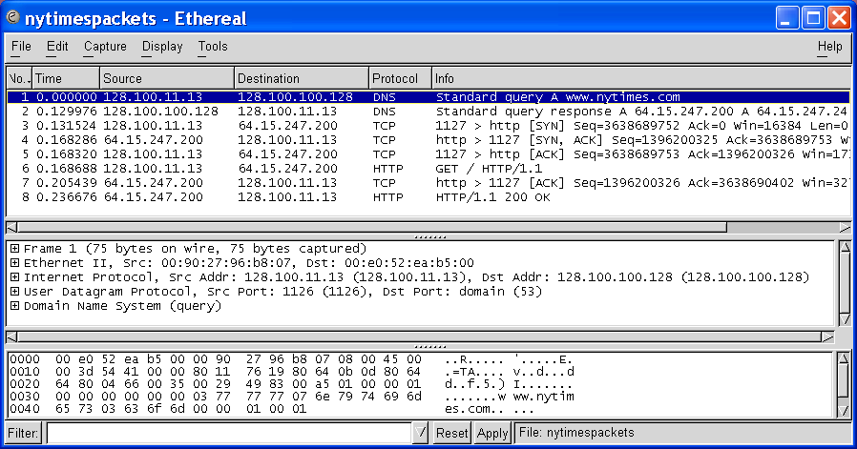
Ethereal windows
Top Pane shows frame/packet sequence
Middle Pane shows encapsulation for a given frame
Bottom Pane shows hex & text

Slide 43
Top pane: frame sequence
TCP Connection Setup
DNS Query
HTTP Request & Response

Slide 44
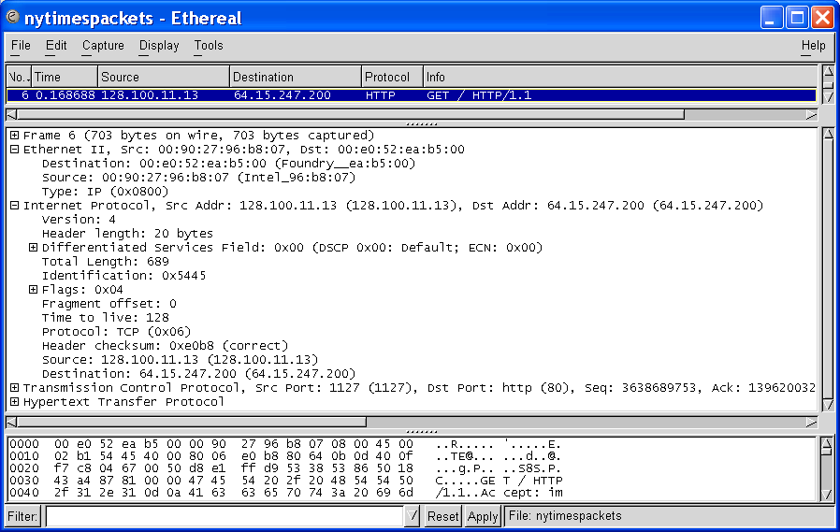
Middle pane: Encapsulation
Ethernet Frame
Ethernet Destination and Source Addresses
Protocol Type

Slide 45
Middle pane: Encapsulation
And a lot of other stuff!
IP Packet
IP Source and Destination Addresses
Protocol Type

Slide 46
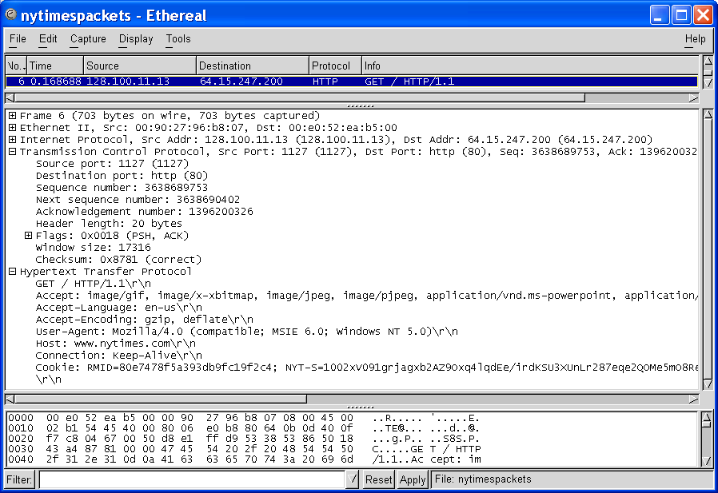
Middle pane: Encapsulation
TCP Segment
Source and Destination Port Numbers
GET
HTTP Request

Slide 47
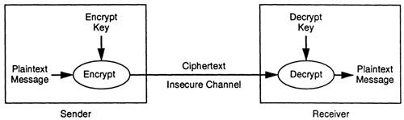
Encryption Terms
Plaintext – Original Message
Algorithm – Transformation Procedure
Key – Variable used to scramble message
Ciphertext – Resulting garbled output
Source: class note by Rob Guess
Notes:
Algorithm - A step-by-step procedure used for solving a problem

Slide 48
ACTIVITY FIVE:
Encryption and Decryption
PKI Demo
  http://infoencrypt.com/

Slide 49
Steganography (1)
The Science of Hiding Information
  History – Tablets, shaved heads
  Now - Images, sounds, other files
Data is frequently encrypted
  Frequency analysis can detect this
Source: class note by Rob Guess
Notes:
www.Stegoarchive.com
Google:
SNOW Steganography

Slide 50
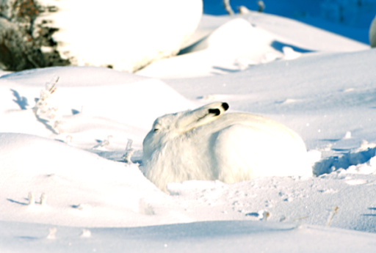
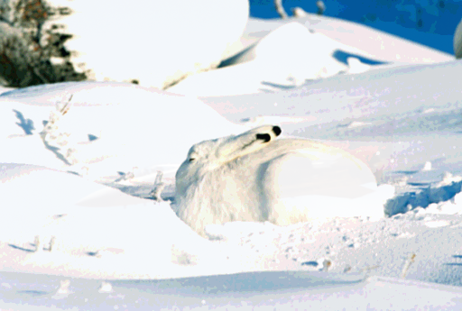
Steganography (2)
The image in which we want to hide another image:
‘Arctic hare’ – Copyright photos courtesy of Robert E. Barber, Barber Nature Photography (REBarber@msn.com)
Source: http://petitcolas.net/fabien/steganography/image_downgrading/index.html
Notes:
www.Stegoarchive.com
Google:
SNOW Steganography

Slide 51
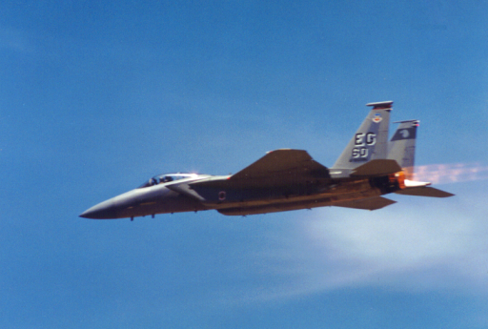
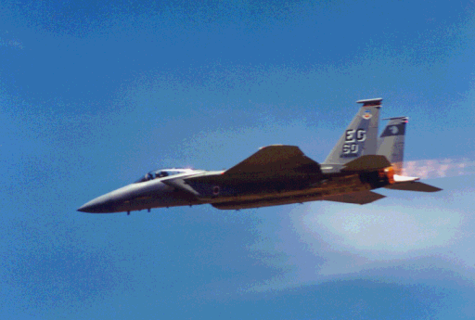
Steganography (3)
The image we wish to hide: ‘F15’ – Copyright photo courtesy of Toni Lankerd, 18347 Woodland Ridge Dr. Apt #7, Spring Lake, MI 49456, U.S.A. (tlankerd@wmis.net)
Source: http://petitcolas.net/fabien/steganography/image_downgrading/index.html
Notes:
www.Stegoarchive.com
Google:
SNOW Steganography

Slide 52
ACTIVITY SIX:
Steganography
Download Steganography software
  http://www.openstego.com/
  http://www.secretcodebreaker.com/steganography.html
Sample Execution
Notes:
http://www.secretcodebreaker.com/steganography.html

Slide 53
ACTIVITY SEVEN:
Digital Photo Scavenger Hunt
http://regex.info/exif.cgi
  First, make sure you have location based services enabled on the students phones. Then they can take their phones and snap pictures around landmarks on your campus. Afterwards, they could connect their phones and transfer the image, or email them to themselves. Then all they have to do is upload the images to the address above. The images with EXIF data will then plot on a Google Map.
Notes:
Activity Overview:
Digital Forensics: Digital Photo Scavenger Hunt
In this fun session you will make your way around campus and take pictures of the landmarks. After the hunt is over, you will come back to the lab and learn how to extract EXIF data from your images. EXIF data includes date time, GPS, and camera information. Afterwards, we will delete our pictures from the disks then learn how to recover the deleted files.
Website: http://regex.info/exif.cgi
Note: First, make sure you have location based services enabled on the students phones. Then they can take their phones and snap pictures around landmarks on your campus. Afterwards, they could connect their phones and transfer the image, or email them to themselves. Then all they have to do is upload the images to the address above. The images with EXIF data will then plot on a Google Map.

Slide 54
DAY FOUR

Slide 55
Activity Eight:
Prepare the Friday presentation
Prepare the presentation, including
  Systematic Approach of Digital Investigation
  How to use
    Digital Photo Scavenger Hunt
    Wireshark
    FTK
    Steganography

Slide 56
Activity Nine:
Field Trip (Tabletop Activity)
    10:00-10:30: Transportation
    to City Government Building
    10:30-10:45: Introduction
    10:45-11:30: Tabletop Part I
    11:30-12:15: Lunch
    12:15-3:15: Field Exercise
    3:15-4:00: Tabletop Part II
    4:00-4:30: Guest Speaker
    4:30: Wrap-up and back to campus

Slide 57
DAY FIVE

Slide 58
Activity Ten:
Prepare the Friday presentation
Prepare the presentation, including
  Systematic Approach of Digital Investigation
  How to use
    Digital Photo Scavenger Hunt
    Wireshark
    FTK
    Steganography

Slide 59
Any Questions?

