Slide 1
Computer Forensics
Day One
Morgan Rodriguez, Aimee Seo, Jailyn Riddick, Dee Harris

Slide 2
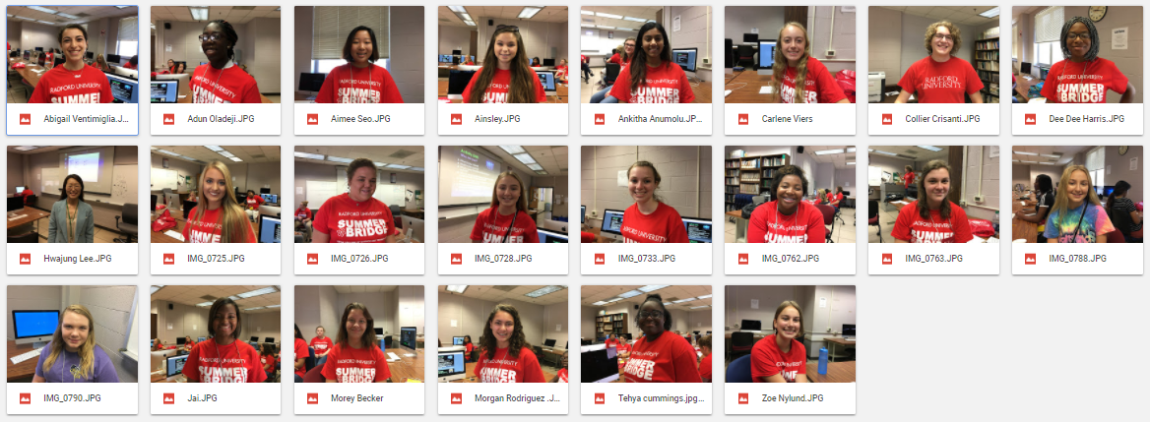
Who are You?
This activity was used as an icebreaker.
Each person had the opportunity to introduce themselves.
We all had relatively the same questions to answer.
Examples of questions include:
  What is your name?
  What is your school?
  What is your favorite indoor/outdoor activity?
  What is your favorite time of day/day of the week/month of the year and why?
  When you have 2 hours of free time, how do you pass the time?
  What do you expect from this class and the Summer Bridge Program?
Notes:
jai

Slide 3
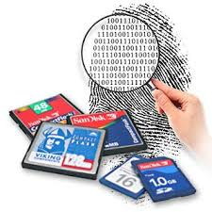
Computer (Digital) Forensics
The analysis and investigation techniques used to gather and preserve evidence that can be used in courts of law
  Evidence extracted from digital storage devices (e.g. hard disks, flash drives)
Ability for information (even deleted information) to be extracted proves its important role in contemporary investigations
Related fields
  Network Forensics: “How a perpetrator or an attacker gains access to a network”
  Data Recovery: “The recovery of information that was deleted by mistake or intentionally”
  Disaster Recovery: “The use of computer forensics techniques to retrieve information lost to natural or manmade disaster(s)”
Notes:
aimee

Slide 4
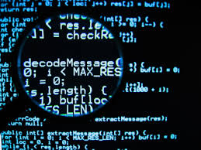
Computer (Digital) Forensics
How the computer can be used as an “instrument of crime”
  Remote system penetration
  Delivery of threats/harassment
  Denial of Service (DoS)/Distributed Denial of Service (DDoS) attacks
  Fraud
How it can also be a victim
  Viruses
  Malware
  Phishing
Notes:
Victim: (phishing) Reveal personal information
morgan

Slide 5
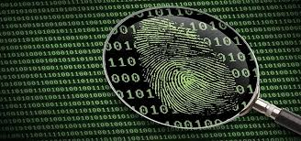
Digital Evidence
Examples of digital evidence (e.g. photos, chat logs, etc.)
Sources of digital evidence (e.g. personal computers, servers, cell phones, ipods, etc.)
There are 3 types of computer evidence:
Exculpatory - proves a person’s innocence
Inculpatory - proves a person’s guilt
Tampering - proves someone has mishandled evidence
A large variety of crimes involve digital evidence
Notes:
Dee Dee

Slide 6
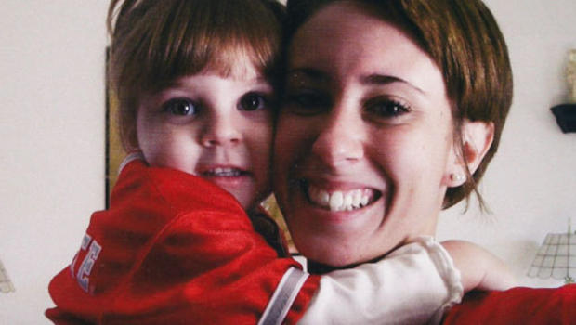
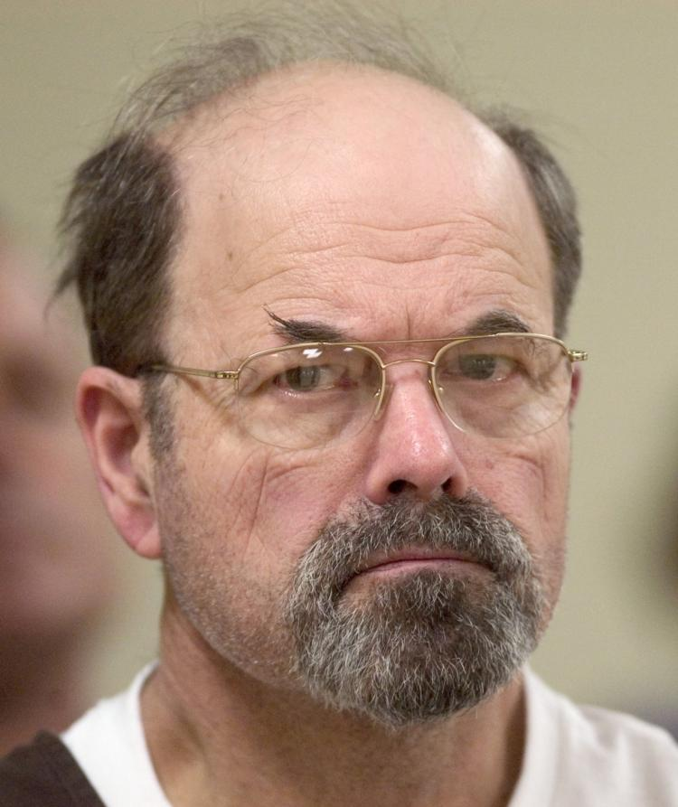
Digital Forensic Cases
The BTK Killer
After being at large for more than 30 years, the BTK killer accidentally revealed his identity to law enforcement when he left a floppy disk for them with a message on it.However, the floppy disc also had a deleted microsoft word document on it, which was recovered by the police IT experts. They found that it was edited by “Dennis” at Christ Lutheran Church and were able to track down Dennis Rader as the BTK killer.
This case is a perfect example of how digital evidence can be more helpful than traditional evidence in certain cases.
The Casey Anthony Trial
Casey Anthony was accused of killing her two year old daughter, Caylee Anthony. Although a computer forensic expert found chloroform google searches on the family computer, she was not found guilty for first degree murder. The evidence found was not enough to prosecute Casey Anthony due to the unreliable sources and couldn't prove it came directly from Casey and not from someone else.
Notes:
Dee Dee & morgan

Slide 7
Significance & Summary
Computer forensics are highly relevant because people use digital devices in their everyday lives and are almost dependent on them
Ability to hide behind the computer encourages criminal activity
  Internet based crimes have a lower risk as opposed to crimes done in real life
Nearly every crime or average person has and leaves behind some trace of digital evidence, no matter what form
Notes:
jai

Slide 8
SECURING EVIDENCE AND RECOVERING DELETED FILES
AINSLEY, ADUN, JUSTINE, KATELYNN

Slide 9
STEPS FOR PROBLEM SOLVING
› Make an initial assessment about the type of case you are investigating
› Determine the resources you need
› Obtain and copy an evidence disk drive
› Identify the risks- Mitigate or minimize the risks
› Analyze and recover the digital evidence
› Investigate the data you recover
› Complete the case report
› Critique the case

Slide 10
SECURING YOUR EVIDENCE
Put your forensic copy inside of an evidence bag
Antistatic bags and antistatic pads
Tape and seal the bag and put your initials on the tape to make sure the evidence will not be tampered with

Slide 11
FORENSIC COPY VS. A BACKUP
Creating a forensic copy is different from a backup because while a backup only covers a File Slack, a forensic copy covers:
File Slack
Free Space - “Unallocated” Clusters
Deleted Files
Page File / Swap Partition
Unpartitioned “Free” Space
Host Protected Areas

Slide 12
BIT-STREAM IMAGE AKA FORENSIC COPY
We call a forensic copy a bit-stream image because while copying the information from the computer to the disk, you have to do this process bit by bit. If done all at once, it could cause the computer to crash or not collect all of the data needed.

Slide 13
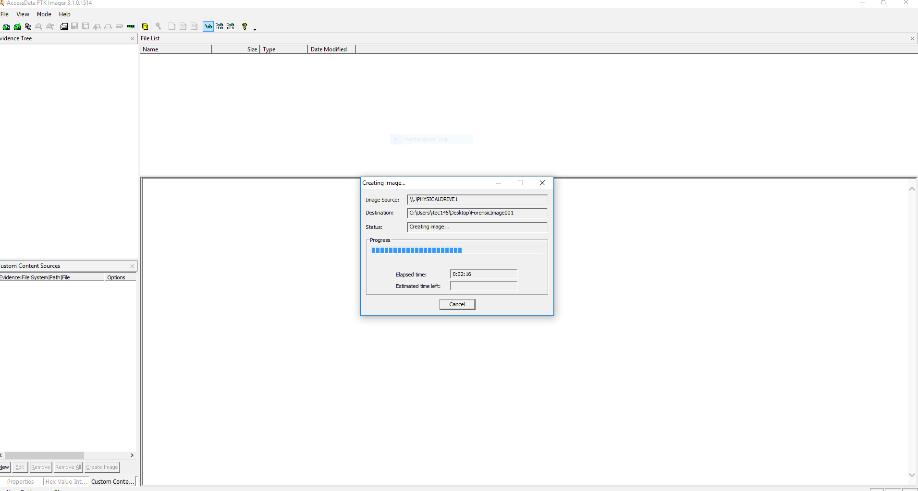
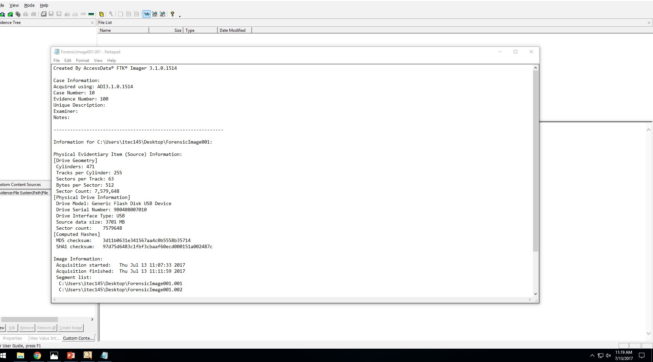
THE PROCESS
We used a software called FTK Imager which stands for “Forensic Toolkit”.
First, we created a forensic copy of the original evidence.

Slide 14
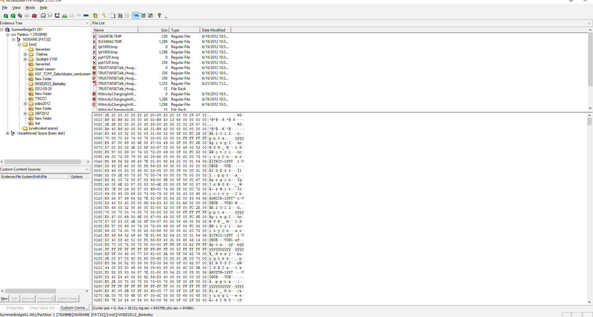
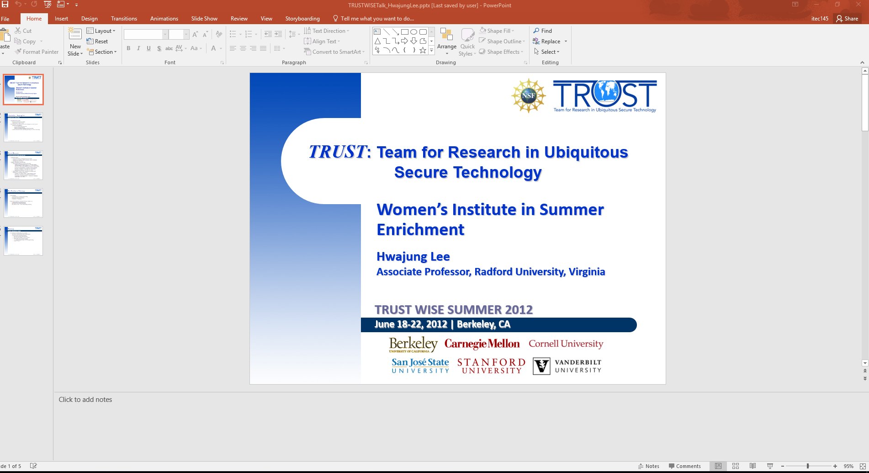
Next, we analyzed the image and, at this point, can often recover deleted files.

Slide 15
DIGITAL FORENSICS USED IN REAL LIFE
Throughout the 1970’s, Dennis Rader, aka the BTK Killer, murdered ten people. After his murders, he would send letters and pictures to the police about what he did to each victim. Then, he made a mistake. He sent his letters on a floppy disk with a deleted document on it to the police. Forensic scientists then recovered this document and used it to track the BTK’s location that led to his arrest.

Slide 16
Encryption, Decryption, & WireShark
By: Abigail, Abigail, Zoe, & Morey
Notes:
Abigail V.

Slide 17

Using Encryption
Encryption is a technique used by various different groups to secure and disguise broadcasted confidential information over a network. While it is used by people of authority for the public’s safety, (e.g. a banker with credit card information), it can also be used by criminals trying to hide compromising information.
We learned to do this on Wednesday with the assistance of Dr. Lee.
Notes:
Morey

Slide 18

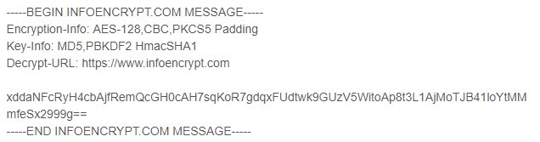
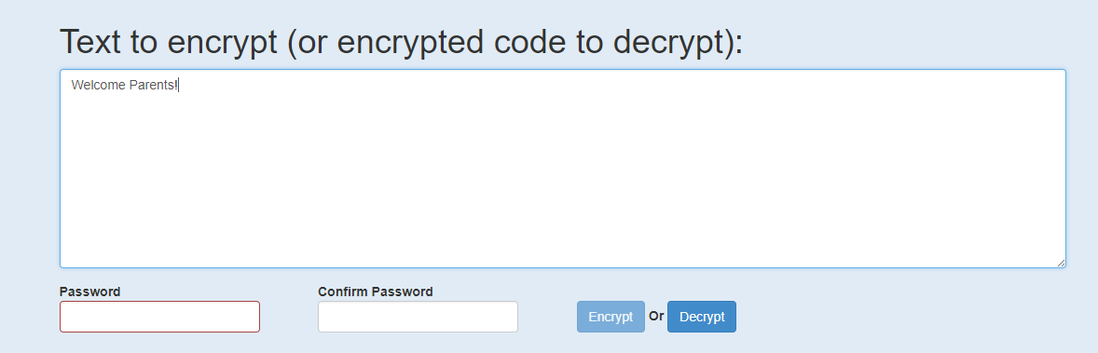
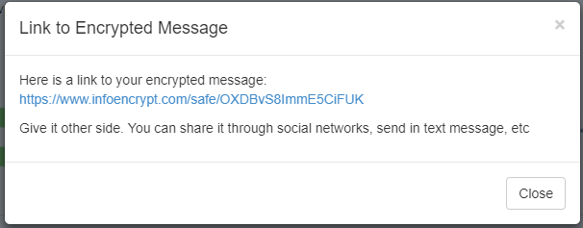
Encryption Examples
Notes:
Abigail V.

Slide 19
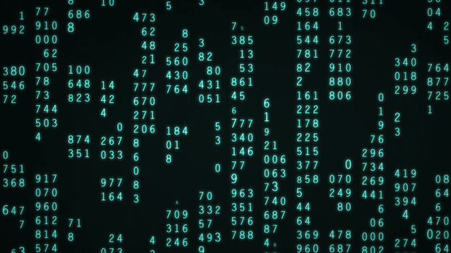
Using Decryption
Decryption is the opposite of encryption, taking disguised data and making it readable. It’s typically used by servers after the computer sends its encrypted passwords and information to retrieve access to a certain page, (when you login to Facebook). However, it can be used by digital forensic specialists to acquire hidden information sent through a network by criminals.
We learned how to read and send hidden messages on Wednesday.
Notes:
Morey

Slide 20
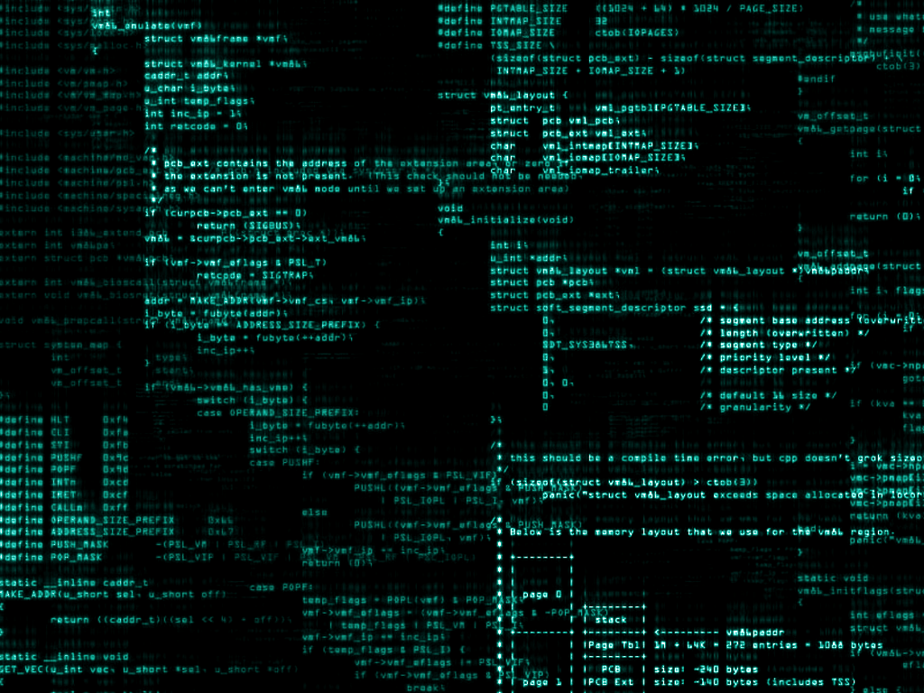
Using WireShark
We also learned how to use WireShark on Wednesday. WireShark is downloaded software that is used to monitor and analyze network traffic. It can be used to isolate traffic on certain websites, find cookies, and capture a password.
To test this software, we sent cookies to our computers and used WireShark to track them down. A “cookie” is a segment of data that is sent to a person’s computer by the website or browser they are using. Most cookies are harmless, but some can steal private information from your computer. Knowing how to use WireShark can be helpful in monitoring the safety of personal information stored on your computer.
Notes:
Zoe

Slide 21
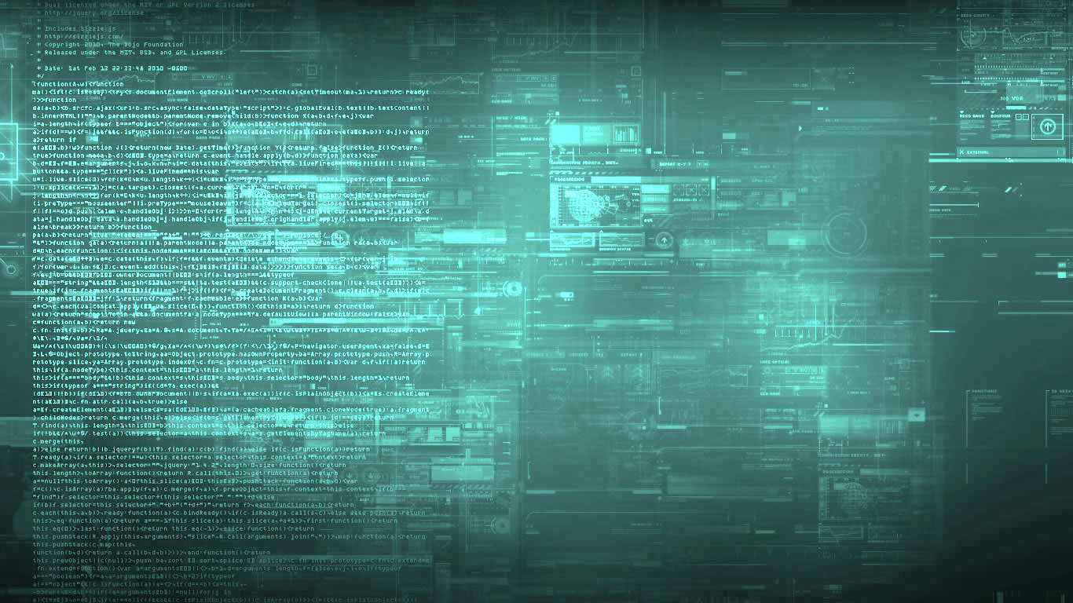
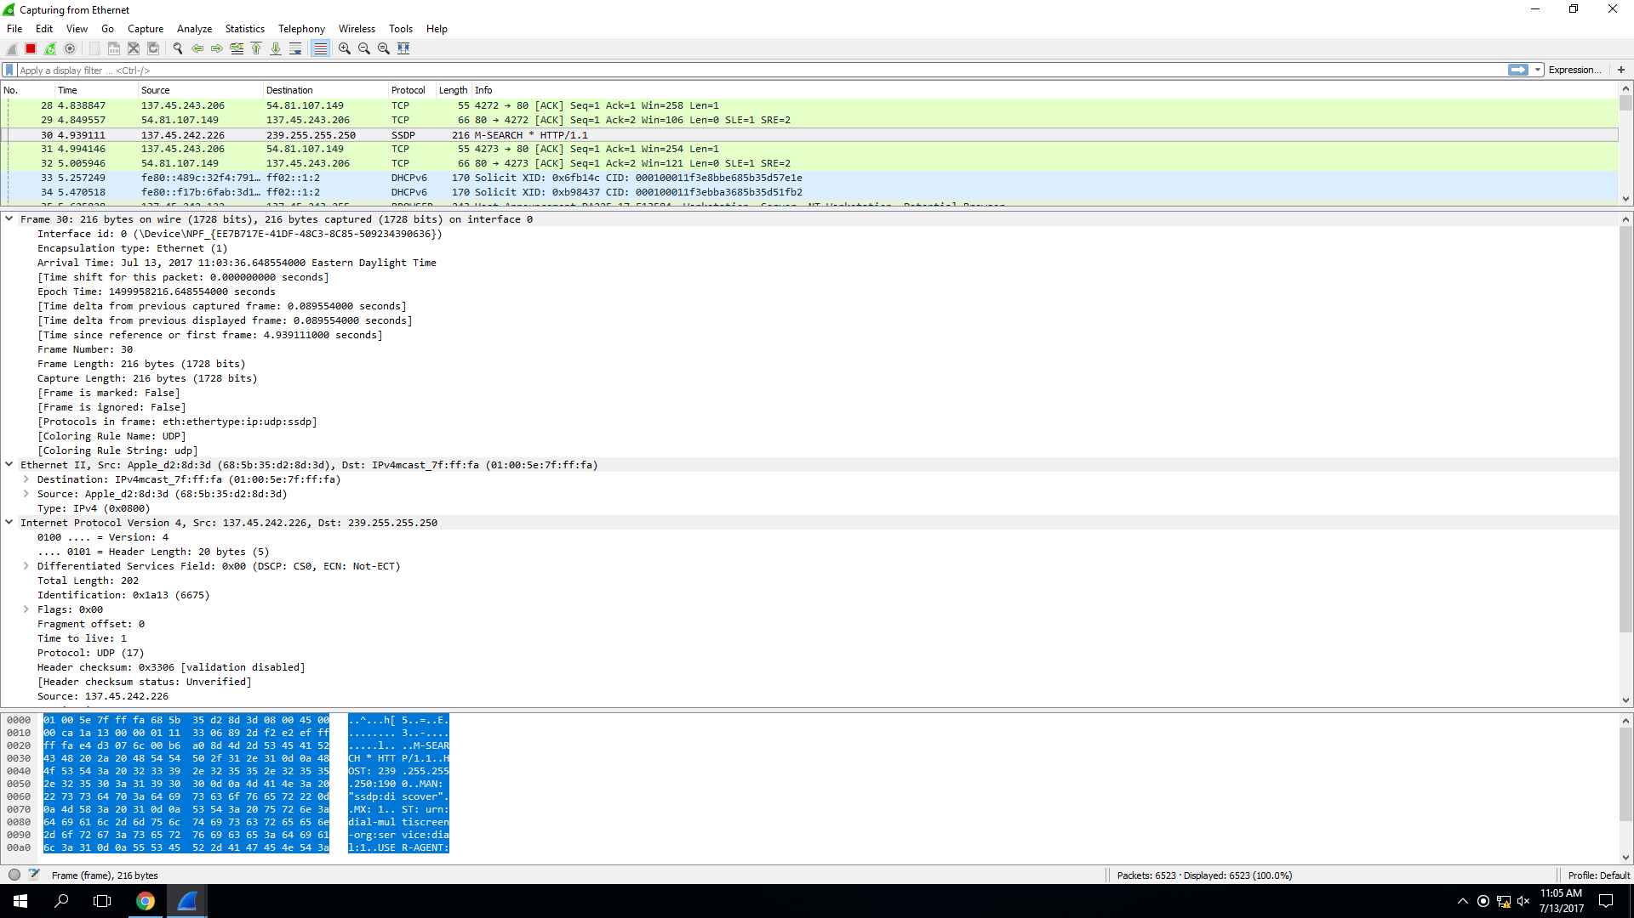
Step One: Open WireShark
First, we downloaded the software and selected the network we wanted to monitor. For this activity, we monitored the entire Radford network.
This list
shows every interaction between a computer and the Internet on the network we are monitoring.
Notes:
Morey

Slide 22
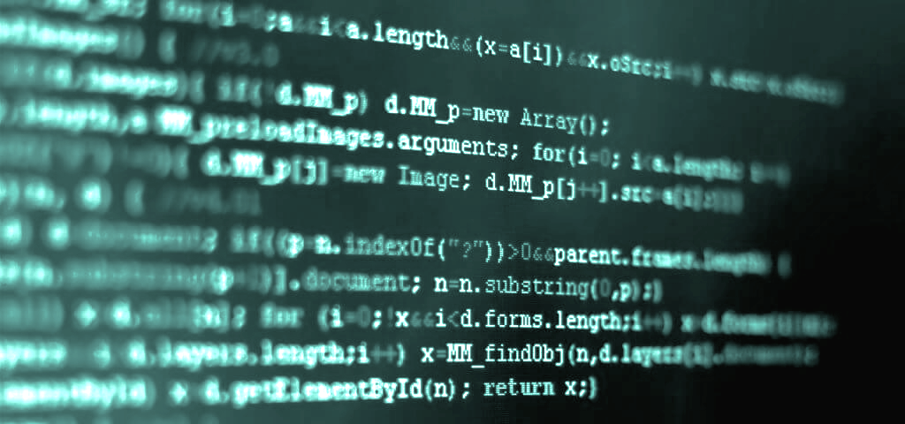

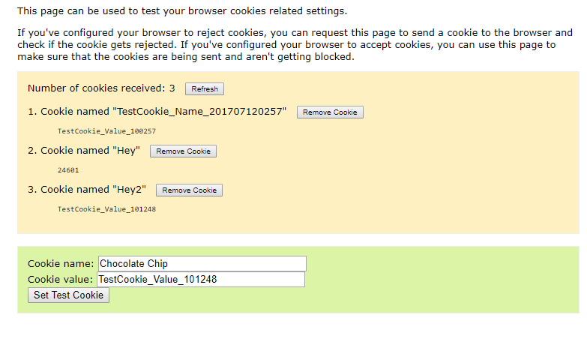
Step Two: Send a Cookie to Your Computer
Next, we used http://www.html-kit.com/tools/cookietester/ to send a cookie to the computer.
Notes:
Abigail V.

Slide 23

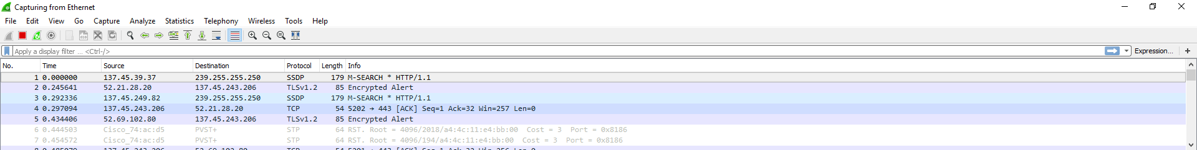
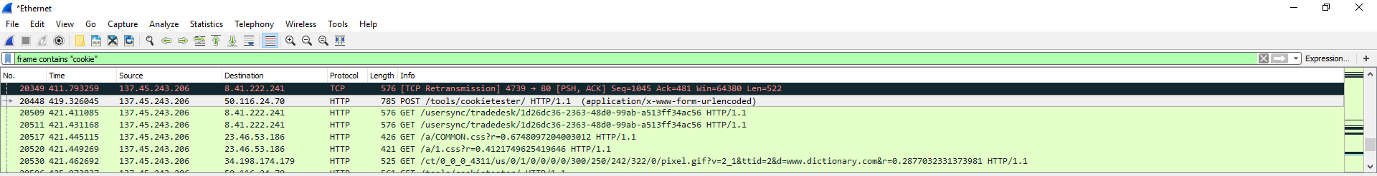
Step Three: Find the Cookies
Finally, we used the WireShark search bar to find the cookies we sent to the computer.
Notes:
Morey

Slide 24
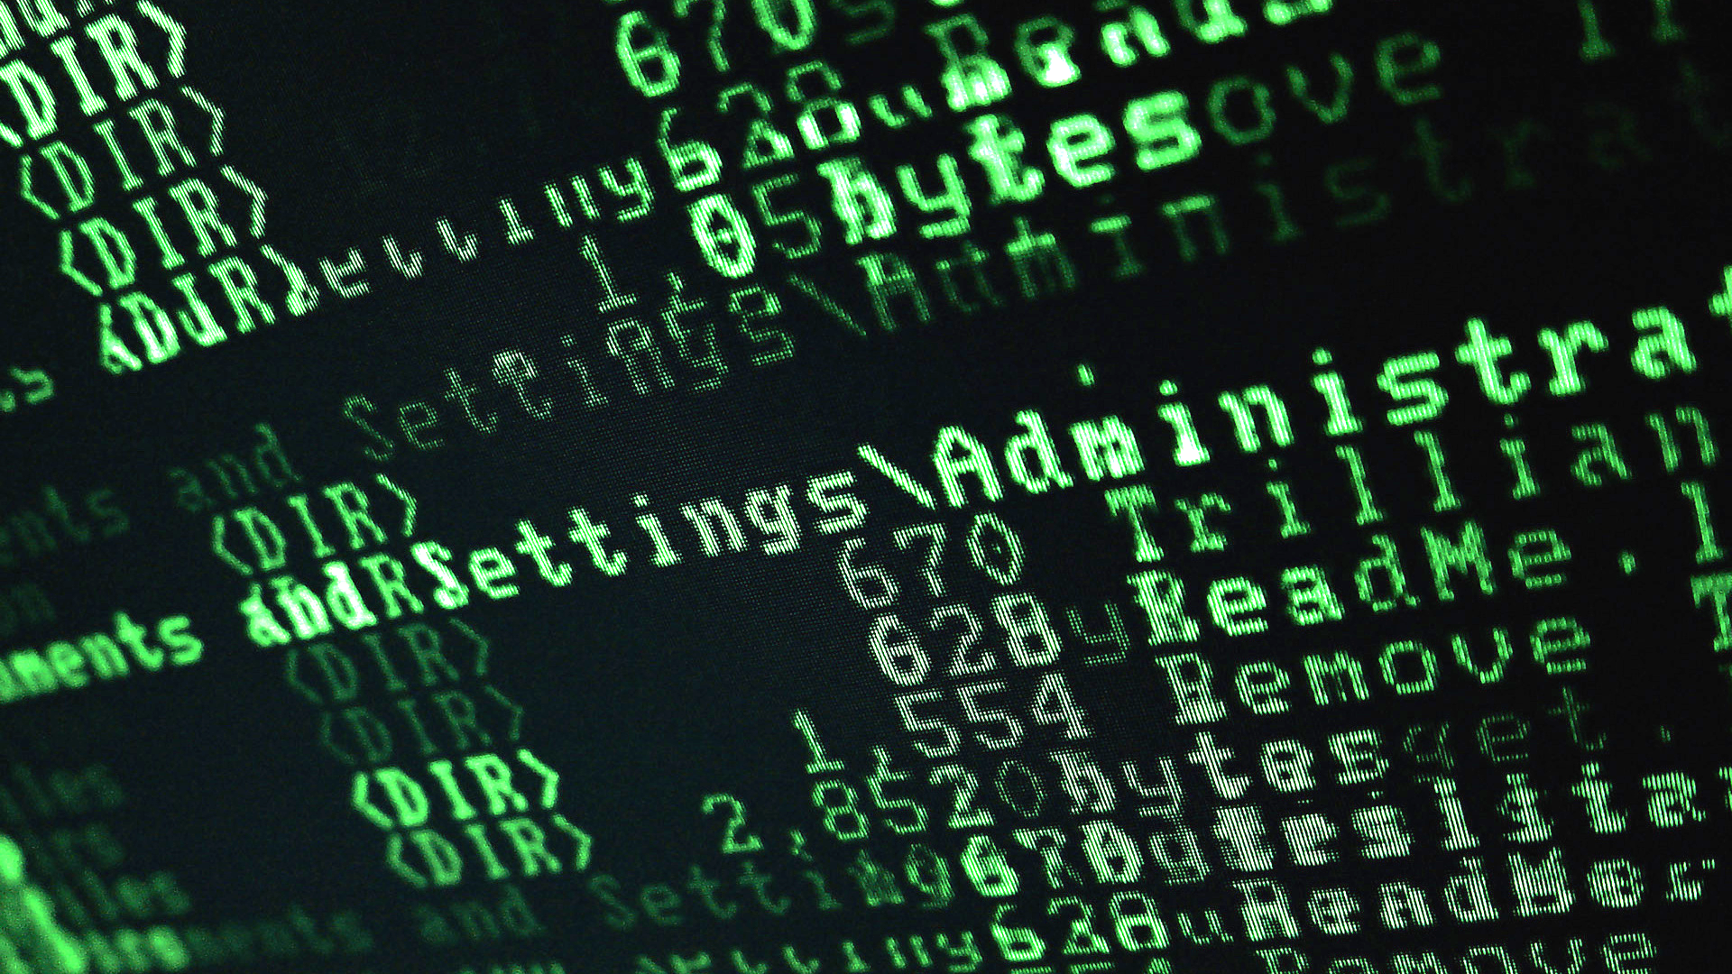
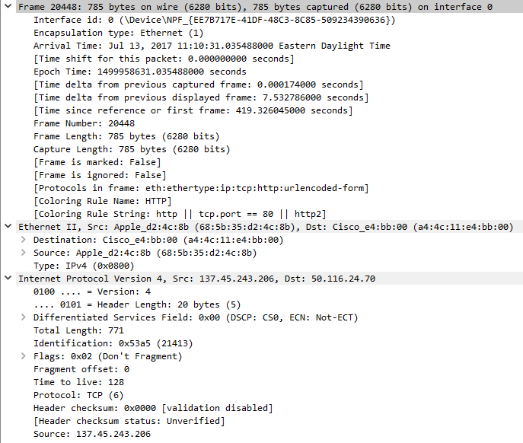
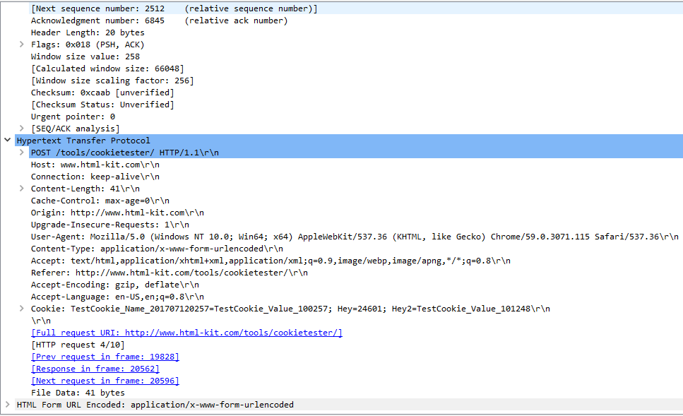
Step Four: Analyze the Cookies
Once we found our cookies, we used WireShark to find out information about them. This includes their arrival time, length, protocol, and the URL they came from.
Arrival time of cookies
Frame length
Type of computer protocol
URL of the cookie tester website
Notes:
Zoe

Slide 25
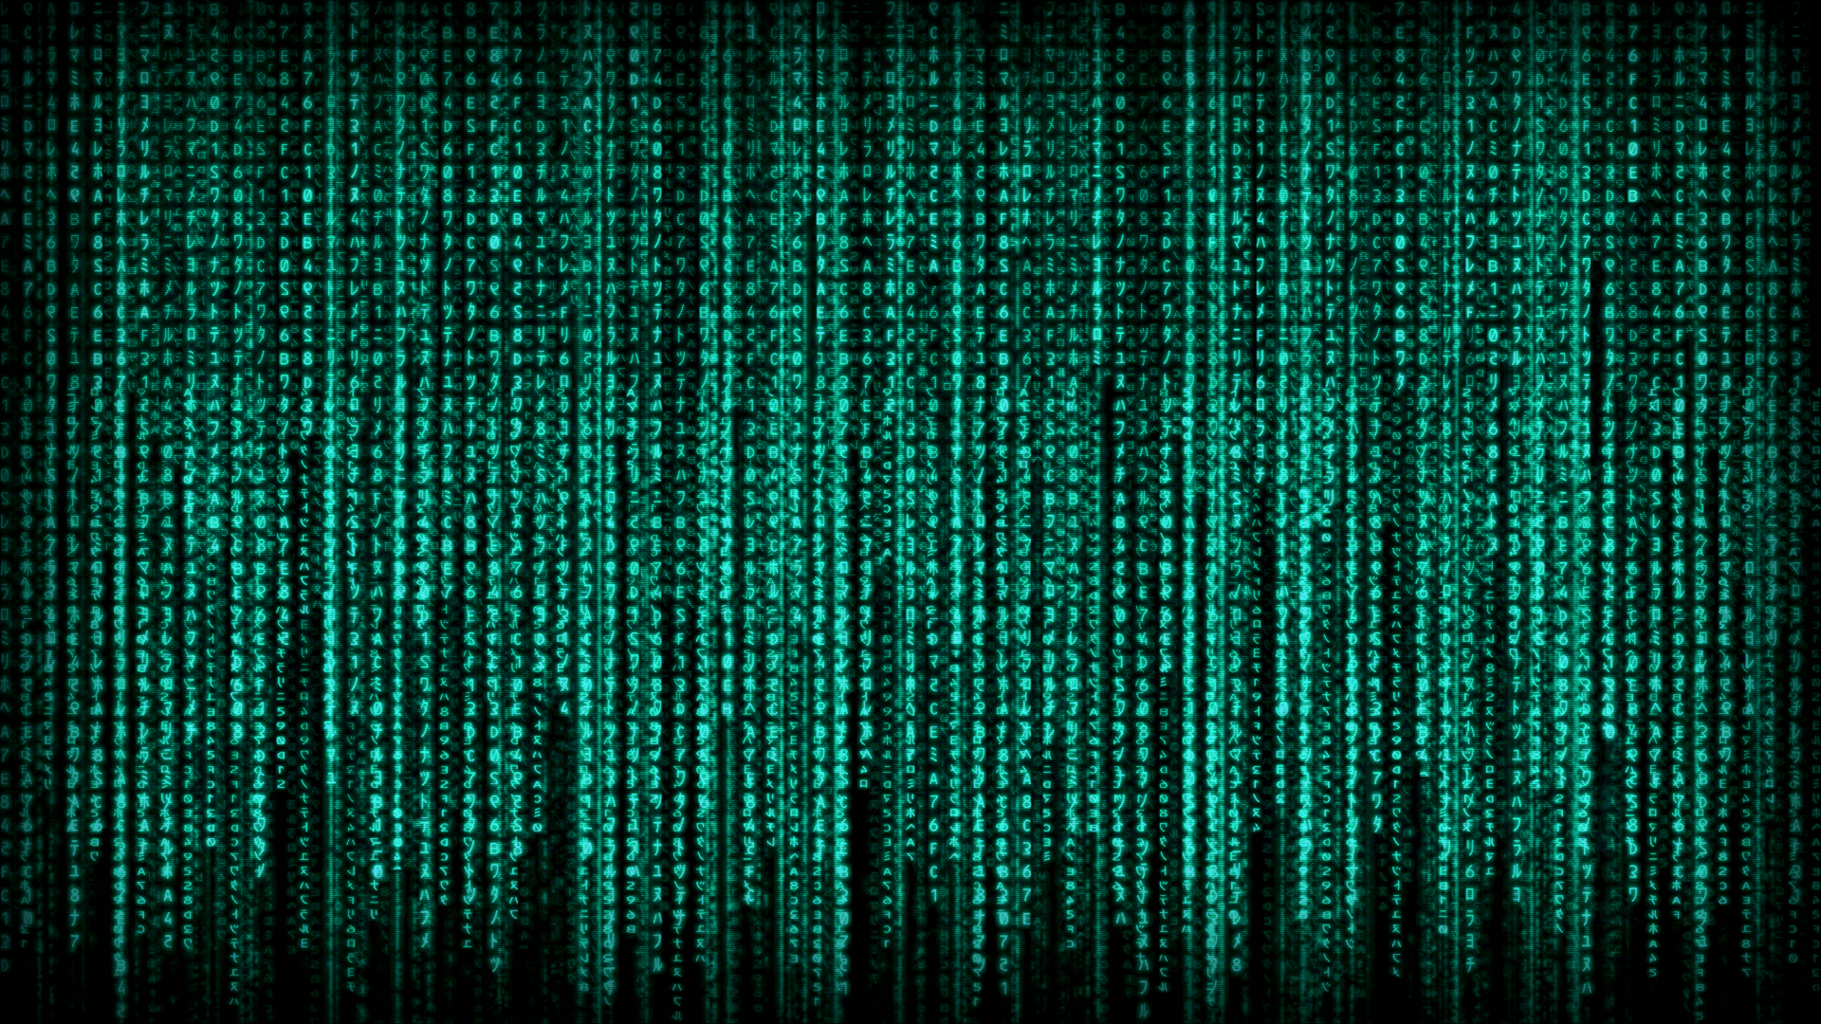
In Summary
This week, we learned about methods of hiding information using encryption and decryption. We also learned about finding information online using WireShark software.
Notes:
Abigail T.

Slide 26

Computer/Digital Forensics: Steganography
Carlene Viers, Ankitha Anumolu, Leah Cooley, Charlotte Murray

Slide 27
What is Steganography?
Steganography, by definition, is the science of hiding information. That mainly includes hiding data and recovering the hidden data from pictures, sound files, and other types of files.
Since data can be encrypted to hide detection, this technique allows the data to be decrypted.

Slide 28
Other Applications of Steganography
Steganography is also applicable to:
Confidential communication and secret data storing
Protection of data alteration
Access control system for digital content distribution
Media Database systems

Slide 29
How To
A website that can be used to decrypt this information is http://www.openstego.com/. With this, we can actually hide data within a file and also extract data from files with programs like these.

Slide 30
Here's how to use the program.

Slide 31


Slide 32
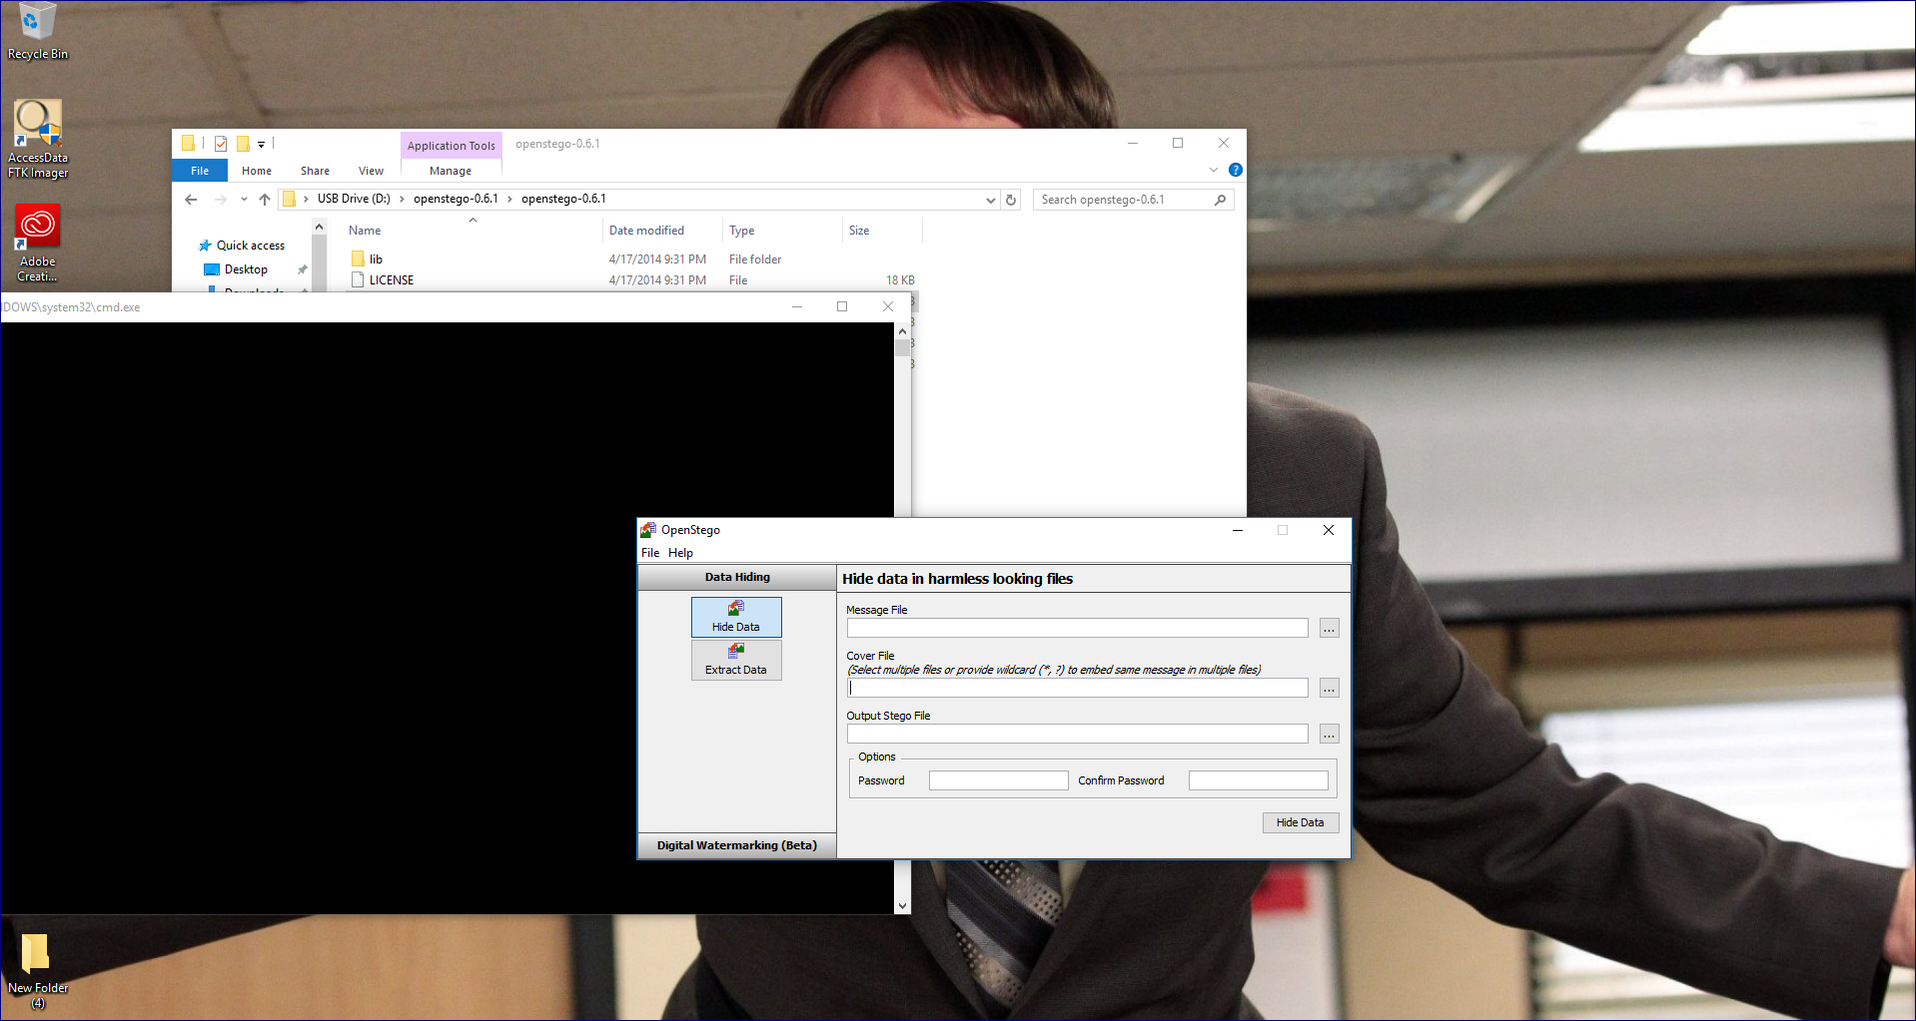

Slide 33
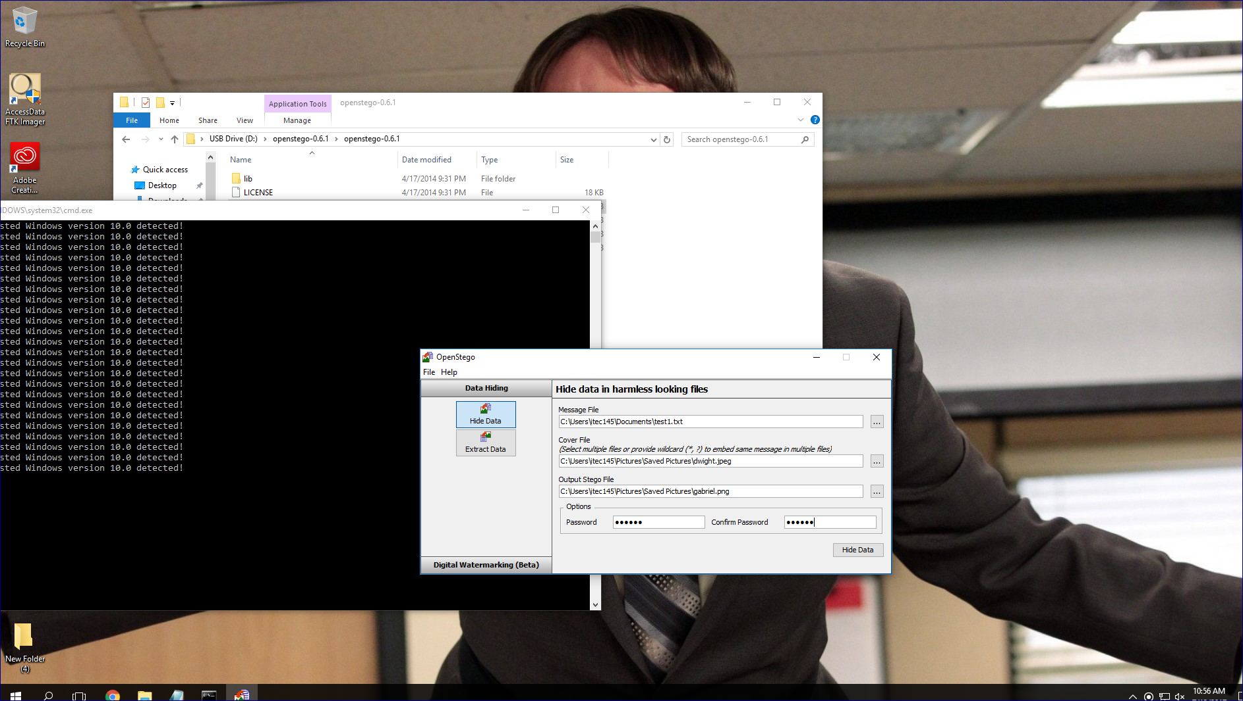

Slide 34
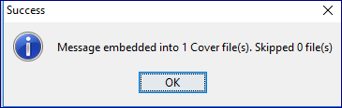

Slide 35
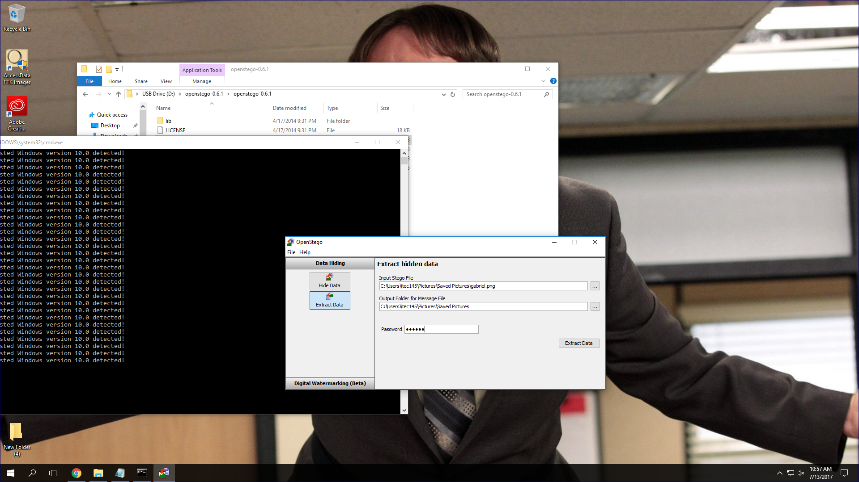

Slide 36
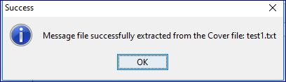

Slide 37
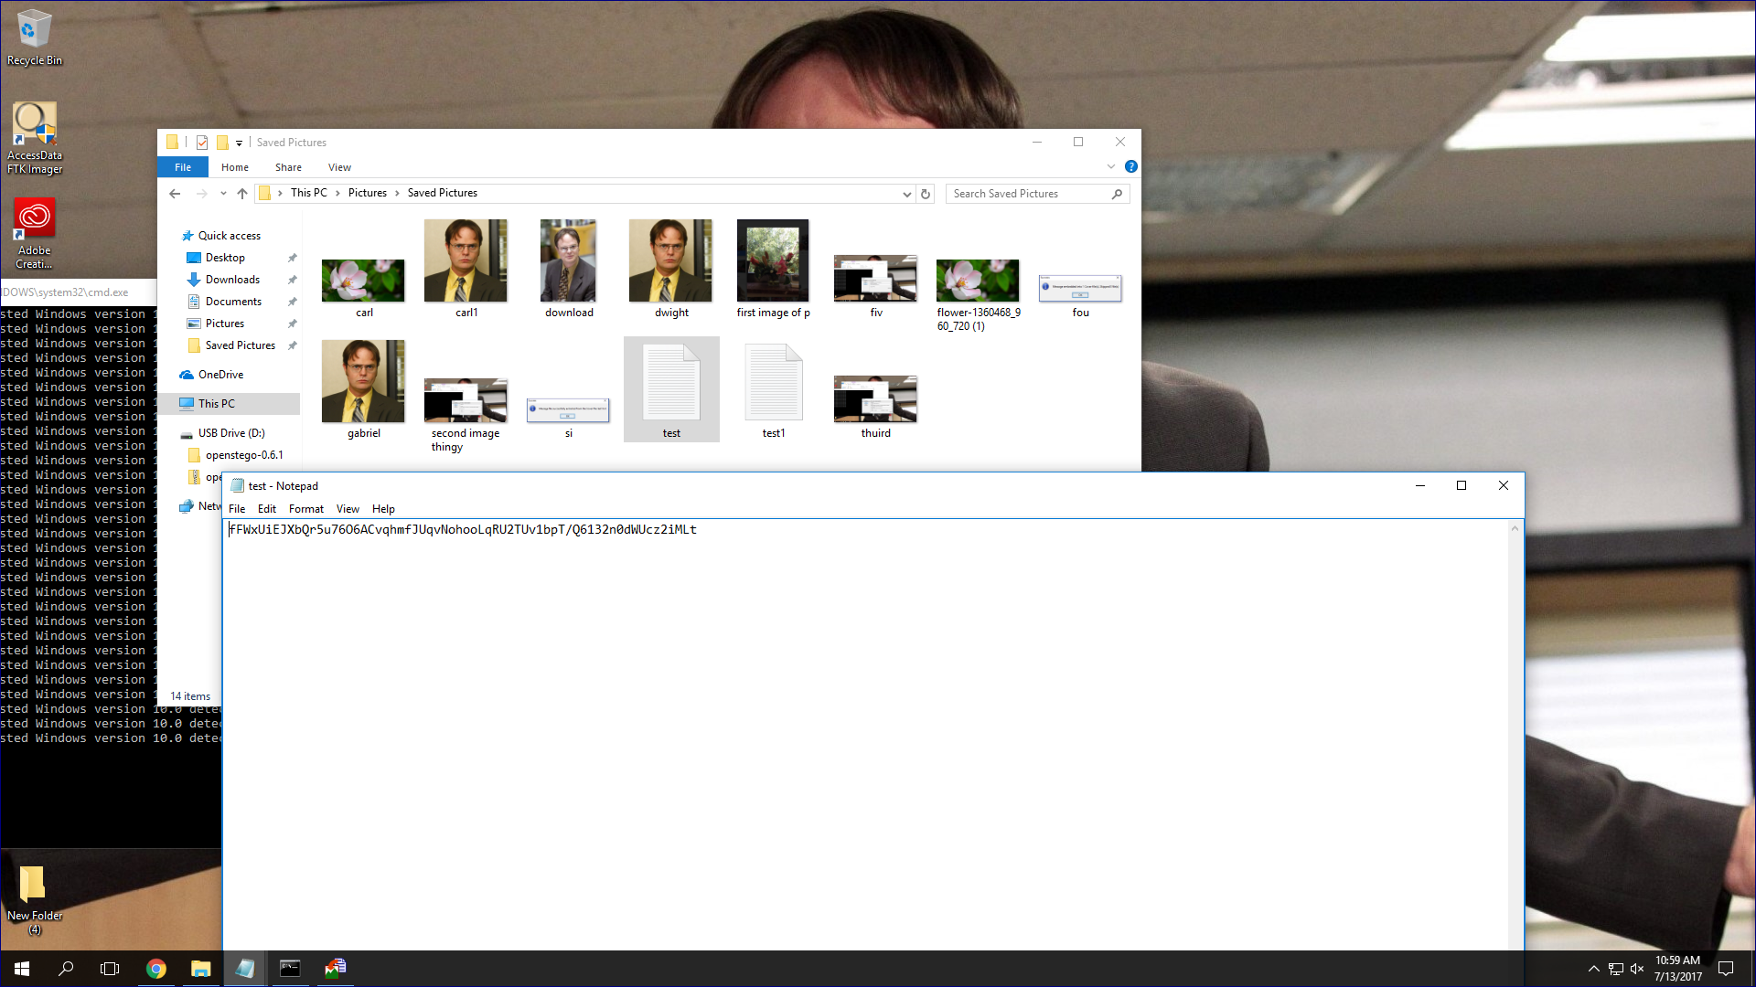

Slide 38
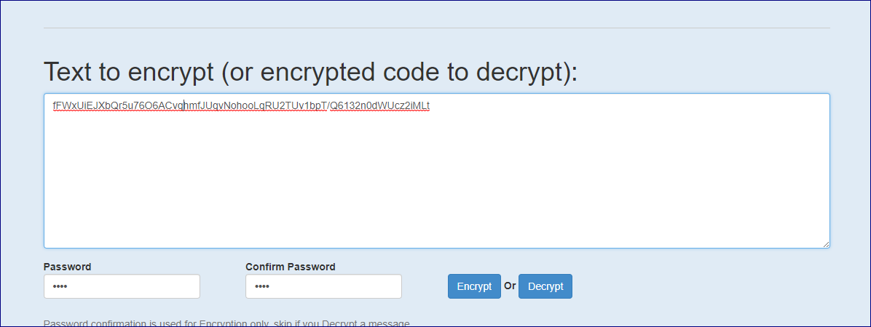

Slide 39
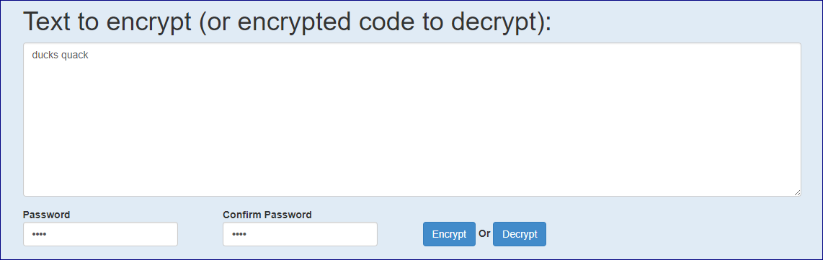

Slide 40
Summary
So far, we have talked about steganography and how to put text and hidden messages into photos.
Steganography is important in the digital forensics world to recover and conceal encrypted information.
It is very useful for sending secret messages. It can be used in cases of criminal activity, to recover hidden information, which is one of the reasons that it is a great skill to attain.
We learned that steganography has many applications, such as; confidential communication and secret data storage, protection of data alteration, digital content distribution, and media database systems.

Slide 41
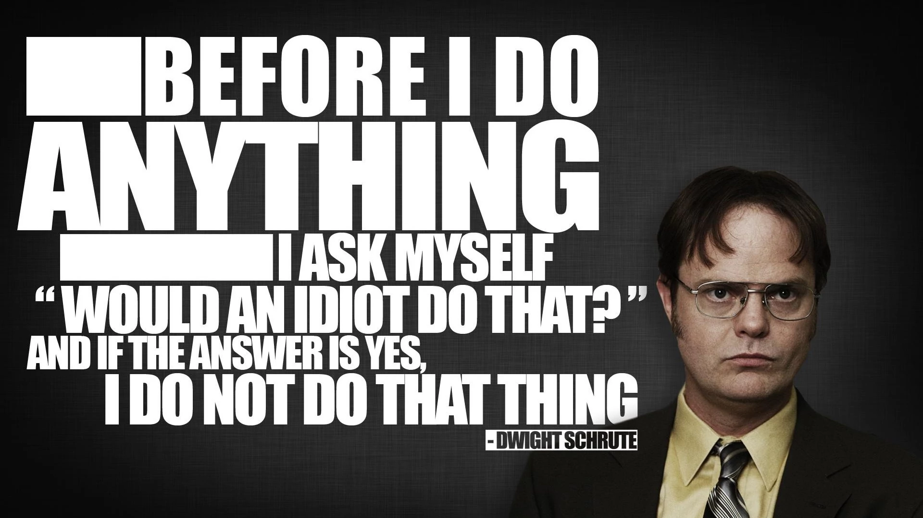

Slide 42
Thank you!

Slide 43
DIGITAL SCAVENGER HUNT
Ciana, Kellie, Kyra, & Tehya

Slide 44
PHOTO SCAVENGER HUNT
When enabling a location setting on a picture taking device, you can find out specific information about your photo.
When retrieving the information, metadata is taken from your picture

Slide 45
HOW IT WORKS
First, you would need to install a program that is able to retrieve the metadata like Jeffrey's Image Metadata Viewer
Make sure you have allowed your location to be apparent
Select a file and your information will be retrieved

Slide 46

EXAMPLE
For this photo, we were able to find out an abundance of information.
*This picture was taken in Radford, Va on July 14th, 2015 at 5:44pm.
*When captured, no flash was used and the camera was pointing South.
* This picture was taken on an iPhone 4s

Slide 47
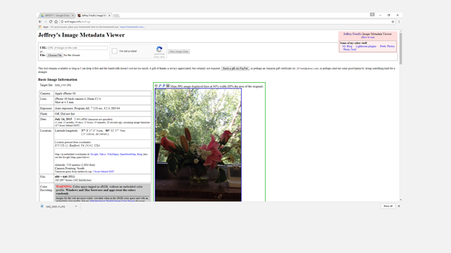

Slide 48
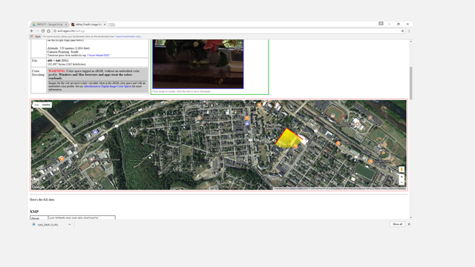

Slide 49
Concluding Remarks
Thank you!

