Slide 1
Assignment 02
By: Carroll Wongchote & Jonathan Russo
2/18/2011
ITEC 451

Slide 2
Internet Service
Verizon FiOS
150 Mbps / 35 Mbps
2 year contract for $199.99/month
Total Internet Costs: $1199.94 ($4799)
Notes:
http://smallbusiness.verizon.com/products/internet/fios/overview.aspx#plans
2 year contract for $199.99/month
10 verizon.net email addresses
Verizon Internet Security Suite
Verizon Online Backup & Sharing

Slide 3
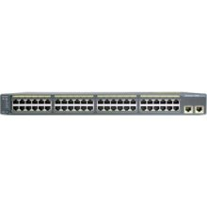
Switch
Cisco Catalyst 2960
Total cost: 1,379.99
Image from Amazon.com
Notes:
http://www.google.com/products/catalog?q=cisco+catalyst+2960&hl=en&prmd=ivns&biw=1280&bih=607&bav=on.1,or.&um=1&ie=UTF-8&cid=9676405474344439000&ei=i8JdTeOfHcPSgQeR1_DgDA&sa=X&oi=product_catalog_result&ct=result&resnum=1&ved=0CF0Q8wIwAA#
48 ports

Slide 4
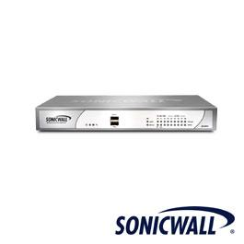
Firewall
SonicWALL NSA 24
Cost: $896.25
Notes:
http://www.firewalls.com/sonicwall/sonicwall-firewall/sonicwall-nsa-series/sonicwall-nsa-240/sonicwall-network-security-appliance-nsa-240.html
SonicWALL NSA 240: $896.25 + taxes
Supports unrestricted nodes
600 Mbps Stateful Throughput
110 Mbps UTM Throughput
150 Mbps VPN Throughput

Slide 5
VPN Software License
SonicWALL Global VPN License
Need: 10-13 licenses
Own: 50 licenses
Costs: $0.00

Slide 6
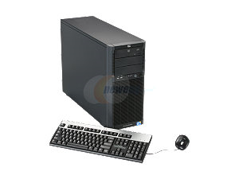
Servers
HP ProLiant ML150 G6 Intel Xeon E5506
Cost: $1,649
Total Cost: $4,947
Image from Newegg.com
Notes:
http://www.newegg.com/Product/Product.aspx?Item=N82E16859105513
HP ProLiant ML150 G6 Intel Xeon E5506: $1,649
Processor:
Intel Xeon processor E5506 (2.13 GHz, 80W, DDR3-800)
Cache Memory: 4MB L3 Cache
MAX Processors: 2
Installed Memory Size: 4GB
Hard Drive: 2 x 250GB
OS: Windows Small Business Server 2008

Slide 7
10k Total Cost
Total Internet costs: $1199.94
Switch: $1,379.99
Firewall: $896.25
VPN Licenses: $0.00
Servers: $4,947.00
--------------------------------------
Total Costs: $8,423.18
Money Left Over: $1,576.00 – (taxes)

Slide 8
Internet Service
Verizon FiOS
150 Mbps / 35 Mbps
2 year contract for $199.99/month
Total Internet Costs: $4799
Notes:
http://smallbusiness.verizon.com/products/internet/fios/overview.aspx#plans
2 year contract for $199.99/month
10 verizon.net email addresses
Verizon Internet Security Suite
Verizon Online Backup & Sharing

Slide 9
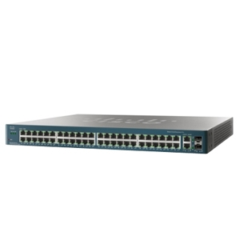
Switch
Cisco ESW-520-48P-K9
Total cost: $2,099.99
Image from tigerdirect.com
Notes:
http://www.tigerdirect.com/applications/SearchTools/item-details.asp?EdpNo=5838940&CatId=5226

Slide 10
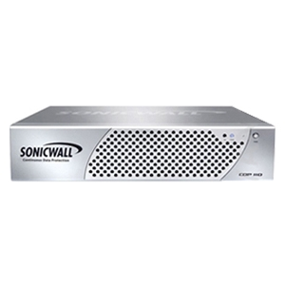
Firewall
SonicWALL CDP 210
Cost: $2,650

Slide 11
VPN Software License
SonicWALL Global VPN License 50
Costs: $505
Notes:
http://www.firewalls.com/sonicwall/sonicwall-upgrades-software/sonicwall-vpn-client/sonicwall-global-vpn-client-windows-50-license.html

Slide 12
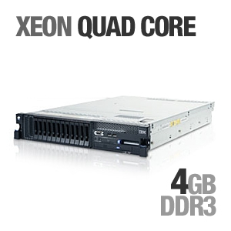
Servers
XEON Quad Core
Cost: $2,549.99
Total Cost: $7,649.97
Image from tigerdirect.com

Slide 13
20k Total Cost
Total Internet costs: $4,799.00
Switch: $2,099.99
Firewall: $2,650.00
VPN Licenses: $505.00
Servers: $ 7,649.97
--------------------------------------
Total Costs: $17,705
Money Left Over: $2,295.00

Slide 14
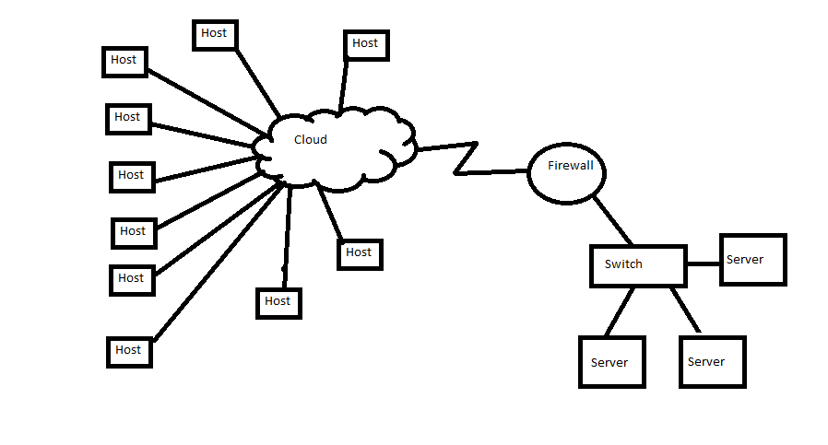
Topology

