Slide 1

Jamel Callands
Austin Chaet
Carson Gallimore

Slide 2
Index
Downloading
Recommended Specifications
Features
Reporting and Monitoring
Questions

Slide 3
Download Links
Virtual Machine (skip if using a dedicated machine)
  https://my.vmware.com/group/vmware/downloads
pfSense
  http://www.pfsense.org/mirror.php?section=downloads

Slide 4
Recommended Specifications
Dedicated PC
100 MHz Pentium Processor
1 GB HD
128MB memory

Slide 5
Features
Firewall – separates internal network from the internet by:
  Filtering traffic based on OS, address, or protocol
  Grouping and naming of all IP’s, Networks, and Ports
  Bridging interfaces
  Packet Normalization
  *Can disable the firewall if you desire

Slide 6
Features(Cont.)
State Table
  Maintains information on open network connections
NAT(Network Address Translation)
  forward ports, outbound NAT, NAT reflection
Dynamic DNS
  register public IP with service providers
Redundancy
  supports hardware failover

Slide 7
Features(Cont.)
VPN
  IPSEC, Open VPN or PPTP
Load Balancing
  Outbound
    Load balancing for outbound traffic
    WAN Failover - if connection goes down pfSense will redirect traffic through a different WAN connection.
  Inbound
    distributes the network load between multiple servers

Slide 8
Features(Cont.)
Captive Portal
  Require users to logon, pay a fee, or agree to an acceptable use contract before they get onto the internet
  URL redirection
    Sends users to a chosen page after authentication
    Allows you to brand your pages with logo and more

Slide 9
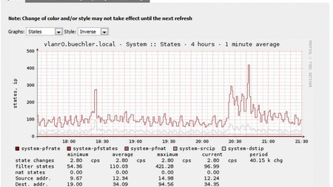
Graphs

Slide 10
Reporting and Monitoring
RRD Graphs maintaining information on the following:
  CPU utilization
  Total throughput
  Firewall states
  Individual throughput for all interfaces
  Packets per second rates for all interfaces
  WAN ping response times
  Traffic shaper queues

Slide 11
Questions?

Slide 12
Fin

