Slide 1
pfSense
Garrison Vaughan, Kyle Nester, Anthony Taliercio

Slide 2
Overview
pfSense is a distribution of FreeBSD that has been customized for use as a firewall and router.
It includes a package system that allows for further expandability without adding bloat or security vulnerabilities to the base distribution.
pfSense has more than 1 million downloads since its release.

Slide 3
Overview
The project started in 2004 as a spin off of the m0n0wall project, but focused on PC installations rather than the hardware focus of m0n0wall.
pfSense also offers an image for Compact Flash installations. It includes most all the features in more expensive commercial firewalls.

Slide 4
Features
Firewall
State Table
Network Address Translation (NAT)
Redundancy
Inbound/Outbound Load Balancing
Three options for VPN (IPsec, OpenVPN, PPTP)
PPPoE
Reporting and Monitoring through graphs and real-time monitoring
Dynamic DNS
Captive Portal
DHCP Server and Relay
New features and upgrades continually

Slide 5
Hardware for pfSense
When picking out hardware for use with pfSense, two main factors need to be considered. Throughput required and features that will be used.
The following guidelines should be used when picking hardware to support the needed throughput.

Slide 6
Hardware for pfSense
10-20 Mbps - No less than 266 MHz CPU
21-50 Mbps - No less than 500 MHz CPU
51-200 Mbps - No less than 1.0 GHz CPU
201-500 Mbps - server class hardware with PCI-X or PCI-e network adapters, or newer desktop hardware with PCI-e network adapters. No less than 2.0 GHz CPU.
501+ Mbps - server class hardware with PCI-X or PCI-e network adapters. No less than 3.0 GHz CPU.

Slide 7
Hardware for pfSense
Usually the features used do not factor into hardware choices, but there are a few that have a more significant impact on utilization.
The following considerations should be made when choosing features and hardware.

Slide 8
Hardware for pfSense
VPN - Heavy use any VPN services included in pfSense will increase CPU requirements. A 266 MHz CPU can handle about 4 Mbps of IPsec throughput, a 500 MHz CPU about 10-15 Mbps, and newer server hardware can handle over 100 Mbps.
Captive portal - Hundreds of simultaneous captive portal users require slightly more CPU power.
Large state tables - State table entries require about 1 KB of RAM each. The default state table takes up a little less than 10 MB RAM when full. Ensure adequate RAM is available as the number of table entries increase.
Packages - Some packages can increase RAM requirements significantly. Be sure to check specific package requirements before they are installed.

Slide 9
Installation
Installing pfSense is simple. It is a modified FreeBSD install and should be familiar to anyone that has installed FreeBSD previously. It can also be ran from a boot disc/usb.
Setting up pfSense is more complicated than Untangle, but also more flexible. The interface is not as straight forward as Untangle either, but with a little digging, almost any setting that an admin could want can be found.
With open source development any extra features that are needed can be quickly prototyped and tested by the community. pfSense is an extremely good alternative to Untangle when cost is an issue.

Slide 10
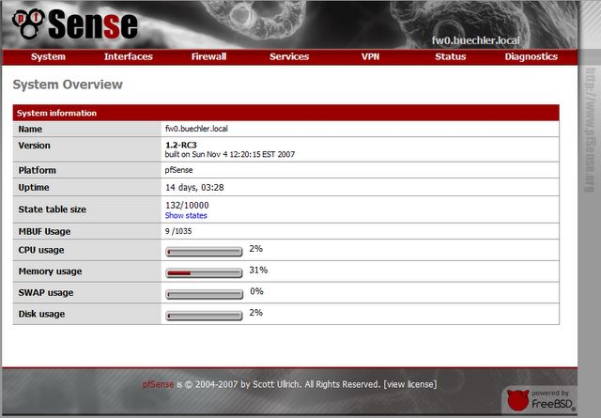
Interface – Main Page

Slide 11
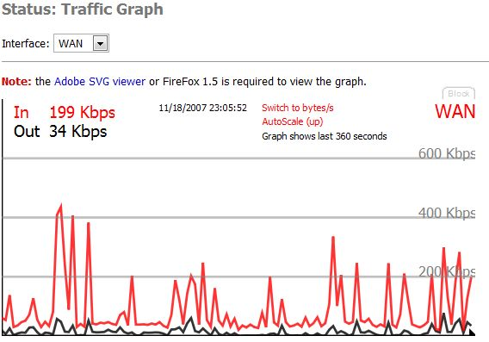
Interface – Traffic Graph

Slide 12
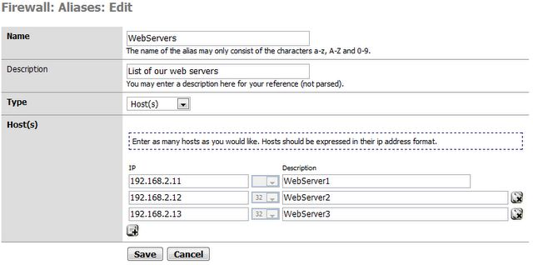
Interface – Firewall Aliases

Slide 13
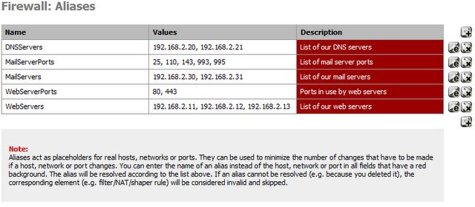
Interface – Alias List

Slide 14
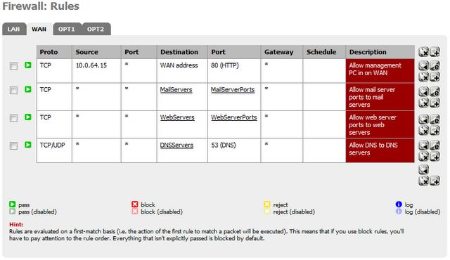
Interface – Firewall Rules

