Slide 1
Created by Ronnie julio
Introducing Untangle

Slide 2
What is Untangle
“A multifunctional firewall software that simplifies and consolidates the many network and security products that organizations need at the gateway to the Internet, making protection and filtering easy and affordable”

Slide 3
What is Untangle
Affordable – Lowest total cost of ownership of any network gateway solution on the market today.
Comprehensive – Untangle handles web filtering, spam, network control, user management, bandwidth management.
Flexible – Add apps at any time to suit the changing needs of your business by simply dragging & dropping them in.
Proven – Untangle protects 1.7 million people in over 30,000 organizations worldwide

Slide 4
Deployment options
Hardware with Untangle software pre-installed http://www.untangle.com/hardware-appliances
Build your own Untangle Server

Slide 5
Build your own untangle server
Hardware requirements
Resource | Minimum | Recommended | Actual
CPU | 1.0 GHz | 2.0+ GHz | 1.0 GHz
Memory | 512 MB | 1-2 GB | 512 MB
Hard Drive | 20 GB | 40+ GB | 40 GB
Network Cards | 2 | 3+ | 2

Slide 6
Build your own untangle server
Download Untangle software
Burn to a bootable cd
Install using the bootable cd and follow the on-screen installations

Slide 7
Network setup

Slide 8
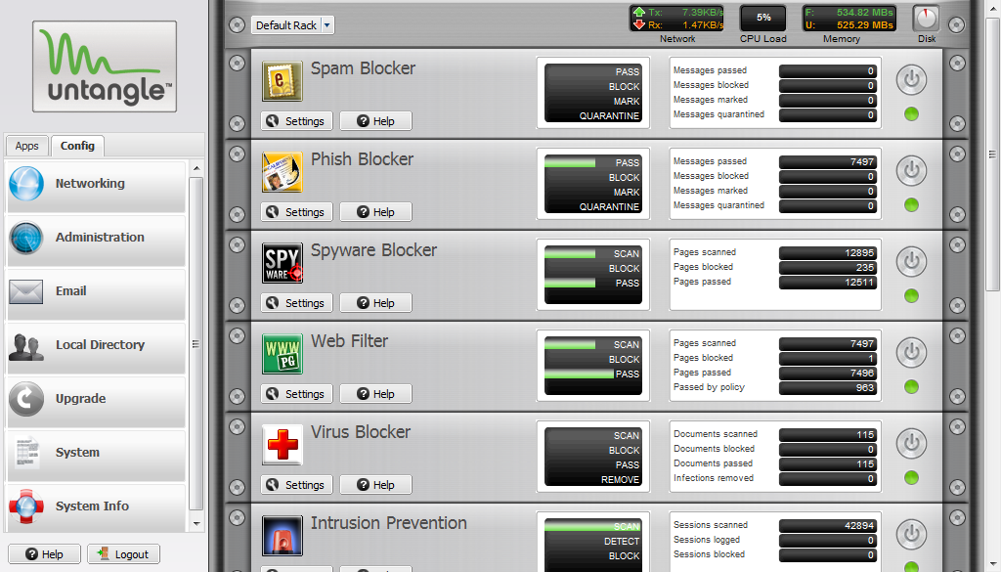
USER interface

Slide 9
References
www.untangle.com
http://www.untangle.com/pdf/Download_QuickStart.pdf

