Slide 1
pfSense
THE BASICS

Slide 2
What is pfSense?
“ A free, open source customized distribution of FreeBSD tailored for use as a firewall and router ”

Slide 3
FreeBSD, What’s that?
“ An advanced operating system for modern server, desktop and embedded computer platforms ”
BSD – Berkeley Software Distribution
free, UNIX-based, easy to install
advanced networking, performance, and security features that are still missing in other operating systems
http://www.freebsd.org/doc/en_US.ISO8859-1/books/handbook/nutshell.html#INTRODUCTION-NUTSHELL-USERS

Slide 4
Features
Firewall
Redundancy
Load Balancing
VPN
  IPsec, OpenVPN, PPTP
Captive Portal
http://www.pfsense.org/index.php?option=com_content&task=view&id=40&Itemid=43

Slide 5
Why use pfSense
Very powerful and stable
Works well with hundreds of computers operating behind the firewall
Have multiple network subnets separate from each other using firewall rules
Additional features can be downloaded

Slide 6
Deployment
Stand-alone server
Embedded platforms
Virtual Machines
Vendors

Slide 7
Hardware Comparison
 | pfSense | Untangle
CPU | 100 mHz | 800 mHz
RAM | 128 MB | 512 MB
Memory | 1 GB | 20 GB
NICs | 2 | 2

Slide 8
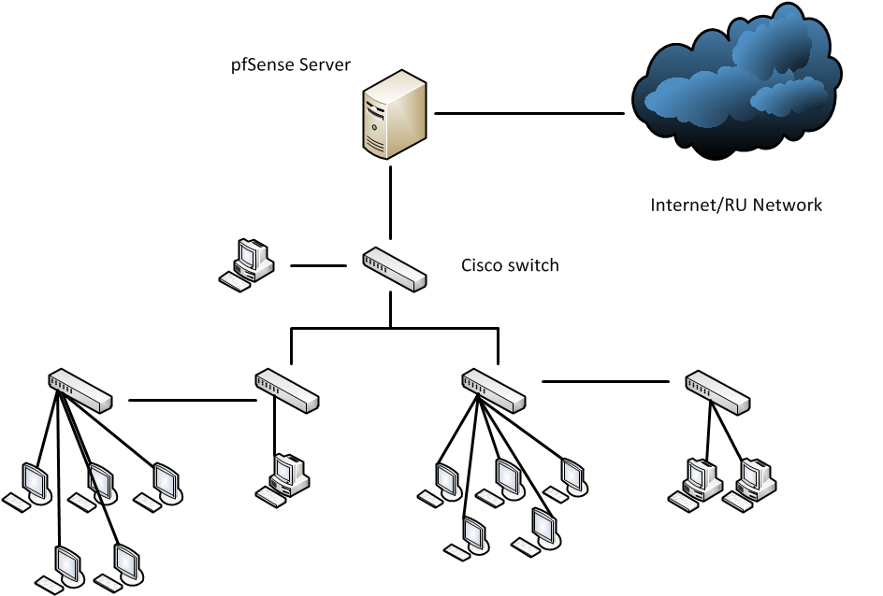
Network Topology

Slide 9
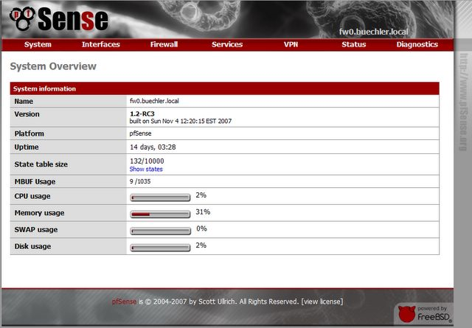

Slide 10
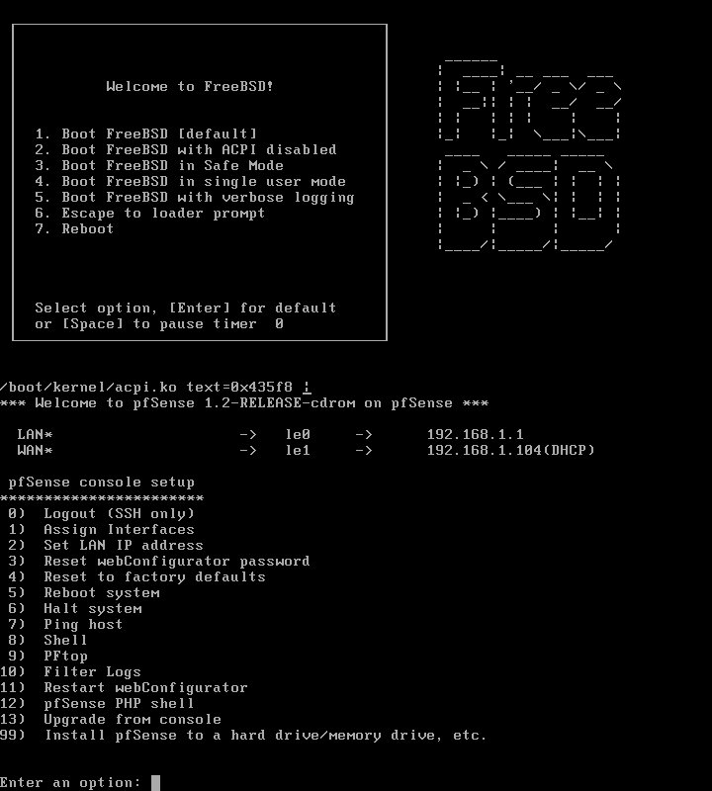

Slide 11
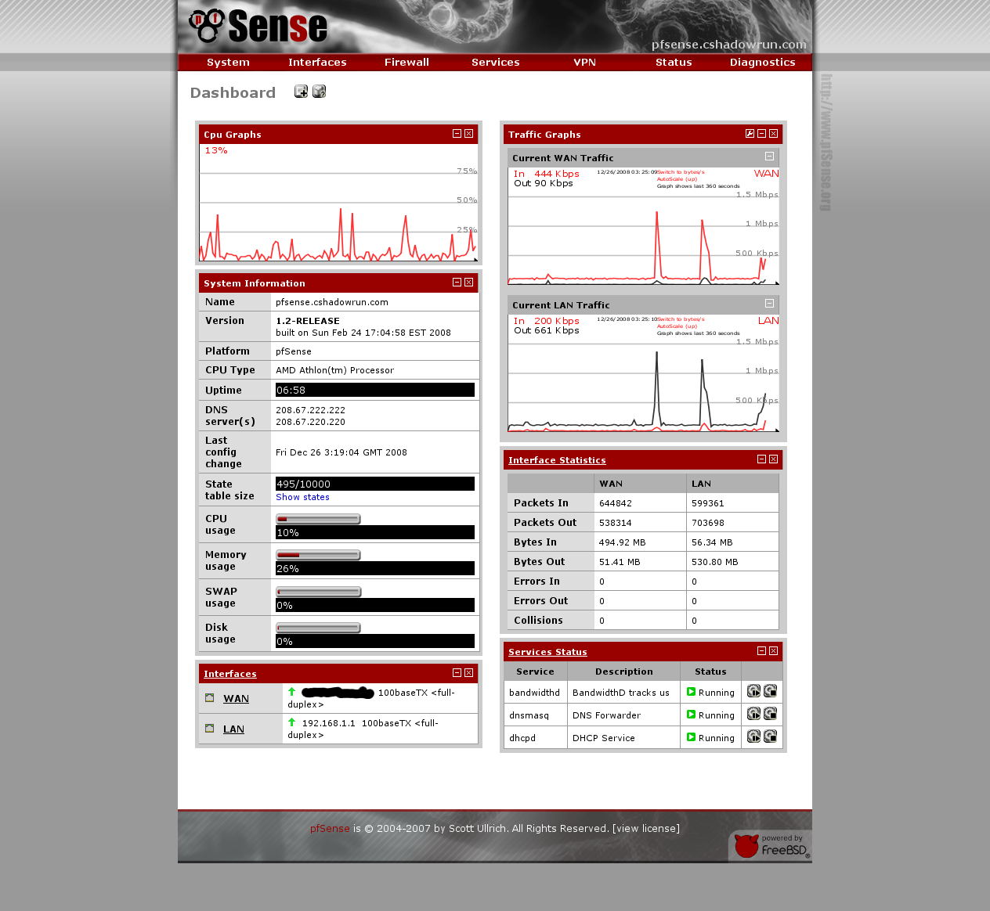

Slide 12
References
www.pfSense.org
- Documentation and tutorials
www.FreeBSD.org

