Slide 1
DOS Attacks in Wireless Sensor Networks
By Eric Bartocci & Justin Matthews

Slide 2
Table of Contents
Wireless Sensor Networks
Denial of Service (DoS) Attacks
Solutions
Game Theory Approach
Conclusion

Slide 3
Wireless Sensor Networks
WSN spatially distributed
Autonomous sensors
Monitors environmental conditions
Monitors physical conditions
Passes information back to a base station
Notes:
Justification on our topic
Background Knowledge

Slide 4
Denial of Service Attacks
Most common attack implemented on WSN’s
Can be implemented on bottom 4 layers of the OSI model with this network topology.
DOS attacks focus on stopping a service all together
Can be linked to Jamming, power outage, and even loss of data confidentiality

Slide 5
Game Theory Approach
Theory where 2 players are playing for the same goal.
Can be applied to resolve DOS attacks
Maximize payoff of nodes
Minimize payoff of attackers

Slide 6
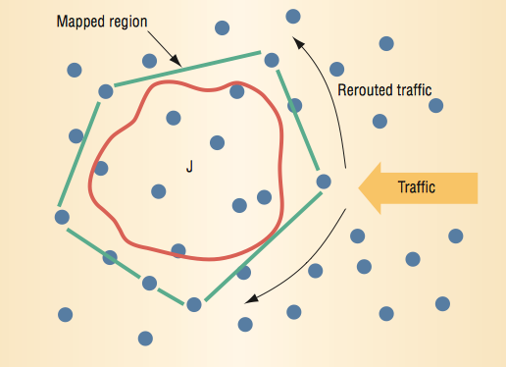
Jamming Model
Wood, A. D. and Stankovic, J. A., “Denial of Service in Sensor Networks”

Slide 7
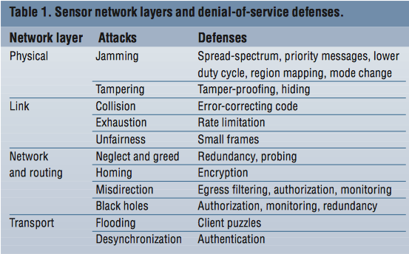
Solutions
Wood, A. D. and Stankovic, J. A., “Denial of Service in Sensor Networks”

Slide 8
Conclusion
WSN is a growing field and very interesting
Many ways this topology can be compromised(so security will be important)
Coexisting with attacks is crucial for a WSN
The applications of WSN are vast

Slide 9
References
Al-Sakib K. P. , Hyung-Woo L. , Choong S. H., Security in Wireless Sensor Networks: Issues and Challenges, Feb 20, 2006.
Shigen, S., Guangxue, Y., Qiying, C., & Fei, Y. (2011). A Survey of Game Theory in Wireless Sensor Networks Security. Journal Of Networks.
Wood, A. D. and Stankovic, J. A., “Denial of Service in Sensor Networks”, Computer, Volume 35, Issue 10, Oct. 2002 pp. 54 - 62.
Yenumula B R., Security Issues in Wireless Sensor Networks, 9-26-2011

Slide 10
Questions?

