Slide 1
Routing Security in Wireless
Ad Hoc Networks
Chris Zingraf, Charisse Scott, Eileen Hindmon

Slide 2
Mobile ad hoc Network
Collection of wireless mobile nodes
Communicate without network infrastructure
  or centralized administration
Offers unrestricted mobility and connectivity
Each node acts as host and router
Out-of-range nodes are routed through intermediate nodes

Slide 3
Wireless MANET
Security with Network
  open medium
  dynamic topology
  distributed cooperation
  constrained capability
Routing Security
  “black hole” attack
Notes:
emerging research area with practical applications

Slide 4
Literature Survey
Chundong She et al
  Path-based algorithm
Hizbullah Khattack et al
  Second shortest path
Medadian et al
  Check each node
Deng et al
  Next hop
Hongmei Deng
  Disable intermediate node reply

Slide 5
Problem
Existing problems in Path-Based Adaptive (PBA) scheme:
  Problem: high collision rate -> inability to overhear the forwarding of packets from the next hop nodes -> high false positive rate with static detection
  Solution: dynamic threshold calculation, based on the current probabilities of a collision occurring and a packet being forwarded

Slide 6
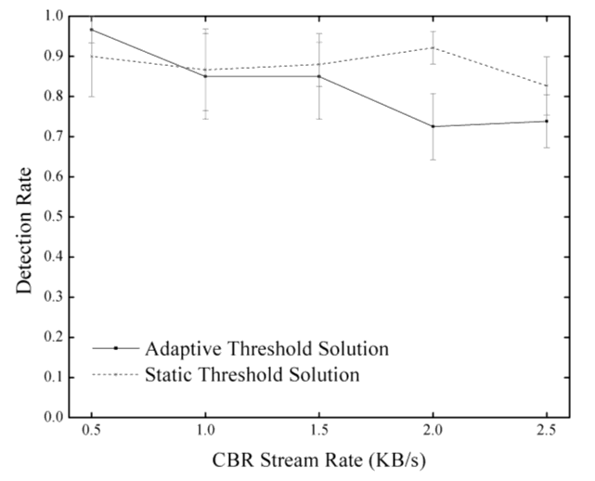
Problem
Unsolved problem: Dynamic threshold calculation provides a lower rate of false positives, but also a less competitive detection rate.
Figure - She, et al.

Slide 7
Problem
Our goal:
  To determine whether rolling over to Optimal Path & Hash based (OPH) scheme at high network load would be an improvement over the Path-based Adaptive method.

Slide 8
Approach to Solve the Problem
    Must answer two questions:
      Determine weak point in She et al.'s method—at what network load (CBR rate) does it fail? This is the point where we should switch to OPH scheme.
      How to measure the change in performance that our proposed method achieves?

Slide 9
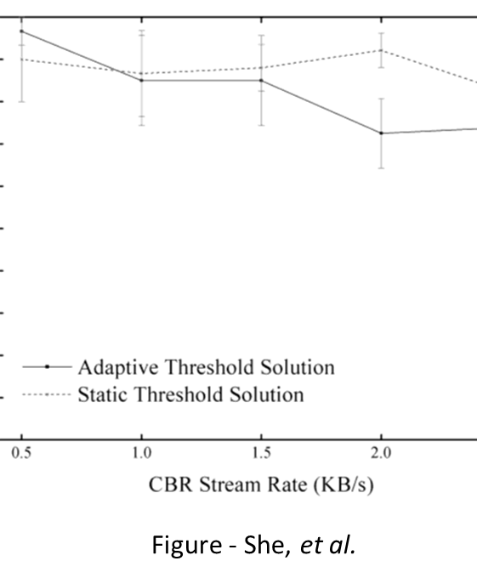
Results
Largest disparity begins at 1.5 KB/s
If OPH scheme were implemented at CBR stream rates >= 1.5 KB/s, it may narrow this disparity.

Slide 10
Results
Which metric to use to compare results?
In She et al.’s paper, overall performance of the PBA scheme is measured using detection rate
OPH involves no active detection of black holes
We decide to use overall packet delivery rate as our comparison metric

Slide 11
Conclusion
We looked at Mobile Ad-Hoc Networks and the security risks involved
Discussed Path-based Adaptive method
  Calculation on current statistics to optimize performance

Slide 12
Conclusion
Our proposal:
  Switch to Optimal Path and hash Based Scheme
Questions:
  Weak point in PBA
  How will we measure the difference?

Slide 13
Future Work
Run simulation on ns2
Record results
  Compare to Sun’s findings

