Slide 1
Distribution of Packets
Jordan Howell
Frank Geiger

Slide 2
Table of Contents
Question
Overview of example
Packets
OSI Model
Network Layer
Data Link Layer
Physical Layer
Answer

Slide 3
Question
How do packets take the best and fastest route to their destination?

Slide 4
Overview
Request Packet leaves and gets confirmed.
File is turned into packets and leave network.
Receiving computer makes sure all packets are there and if not it handles all errors.
Sending computer sends missing packets.
Receiving computer reassembles packets.
File is available to receiver.

Slide 5
What does your computer send?

Slide 6
Packets
1,000 to 1,500 bytes
Includes header and footer
Wrapper
Accountability of packets
Type
Destination

Slide 7
How does your computer send it?

Slide 8
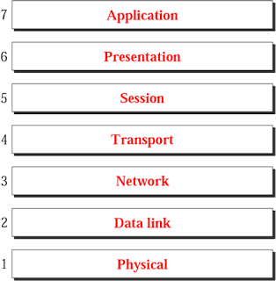
OSI(Open Systems Interconnection) Model
A Reference tool for understanding data communications between any two networked systems

Slide 9
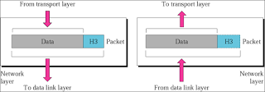
Network Layer
Breaks data up into packets.
Responsible for addressing, determining routes and managing network problems such as congestion.
Translate Logical Network Addresses and names to their physical address.
Gives packets a number

Slide 10
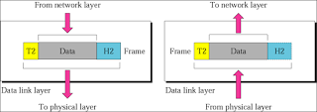
Data Link Layer
Adds wrappers to packets.
Communicates between Network Layer and Physical.
Organizes packets so they can be accounted for.
Handles issues for the physical layer.

Slide 11
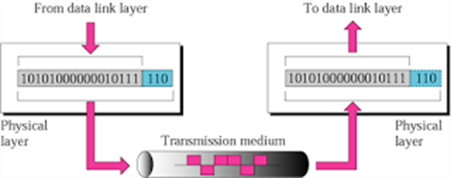
Physical Layer
Takes packets and translates them into bits to be able to go over a physical wire.
In charge of also reassembling when it receives the packets for the Data Link Layer.

Slide 12
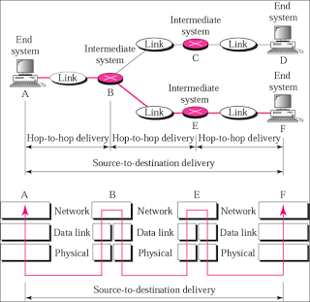
Putting it together
Confirmation packet
Information segmented
packets given destination and route
packets numbered.
packets given data type
packets given wrapper
packets turned into bits

Slide 14
How do ISPs decide traffic

Slide 15
Distance
Distance from Node
Distance from Destination

Slide 16
Traffic Shaping
QOS
  File types
    Live Stream>
    Email<
User Bandwidth

Slide 17
QUESTIONS?

