Slide 1

Modeling Wi-Fi Protected Setup Brute-Force Mitigations Using Markov Chains
Lloyd Jones

Slide 2
Outline
Introduction
Problem Statement
Background Information
Problem Solving Approach
Results

Slide 3
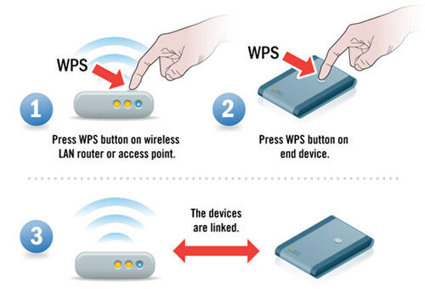
Introduction
Wi-Fi Protected Setup (WPS) – technology used for easy connection to wireless devices
  Simpler than remembering long WEP/WPA passphrase
  Push-button and PIN method
Known weaknesses in WPS
Importance

Slide 4
Problem Statement
0 < d < 5 | Access point-imposed delay between PIN attempts (seconds)
L_{(s/p)} 0 < s < 120 3 <= p <= 25 | Lockout (s) in seconds per amount of consecutive incorrect PINs (p)
t > 0 | Time limit for successful attempt (minutes)
A_{1,2,3…n} 1 < n < 11,000 | PIN attempts in numerical order
0 < v < 5 | Access point PIN validation time in seconds
0 < P₀ < 1 | Probability of client being in unauthenticated state
0 < P₁ < 1 | Probability of brute-forcing first half of PIN
0 < P₂ < 1 | Probability of brute-forcing second half of PIN
0 < P < 1 | Overall probability of successful brute-force given d, L_{(s/p)}, t, v
Compare brute-force times based on different mitigation mechanisms
Variables to consider:
  PIN verification time
  Overall time limit
  Lockouts/Delays

Slide 5
Background Information
WPS Vulnerability discovered by Stefan Viehboch in 2011
Caused by splitting PIN into two halves
  Should be 10⁷ (10,000,000)possible PINs
  Actually 10⁴ + 10³ = 11,000
1 | 2 | 3 | 4 | 5 | 6 | 7 | Checksum
First half of PIN |  |  |  | Second half of PIN

Slide 6
Background Information
WPS Exchange Structure
Message | Direction | Purpose
M4 | Enrollee -> Registrar | Send first half of PIN
M5 | Registrar-> Enrollee | ACK/NACK for first half of PIN
M6 | Enrollee -> Registrar | Send second half of PIN
M7 | Registrar-> Enrollee | ACK/NACK for second half of PIN

Slide 7
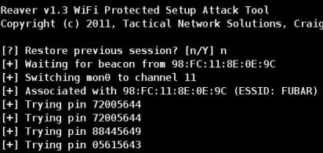
Background Information
Open source tools available to take advantage of this vulnerability
Reaver, Bully, and others
Other tools available to detect if WPS is enabled

Slide 8




Problem Solving Approach
$$x=\frac{t}{\left(v+d)(\frac{s}{p})\right)}$$
Model and compare scenarios
  Baseline
  Per PIN delay
  Lockout of s seconds per p PINs
  Combination
Equations Used
P = $\sum_{n=0}^{x}{\frac{1}{11000−n}}$
$P_{1}=\sum_{n=0}^{x}{\frac{1}{10000−n}}$
$P_{2}= \sum_{n=0}^{x}{\frac{1}{1000−n}}$

Slide 9

Problem Solving Approach
Markov Chain Representation
P = $\left[\begin{matrix}P_{0}→P_{0} & P_{0}→P_{1} & P_{0}→P_{2} \\ P_{1}→P_{0} & P_{1}→P_{1} & P_{1}→P_{2} \\ P_{2}→P_{0} & P_{2}→P_{1} & P_{2}→P_{2}\end{matrix}\right]$
States Used:
P₀ – unassociated/unauthenticated
P₁ – First half of PIN correct
P₂ – Second half of PIN correct

Slide 10
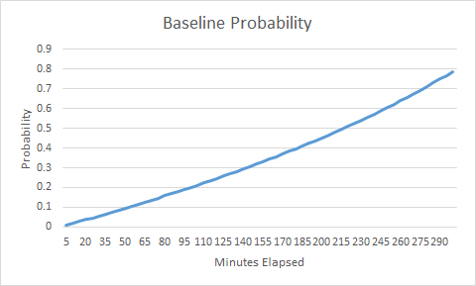
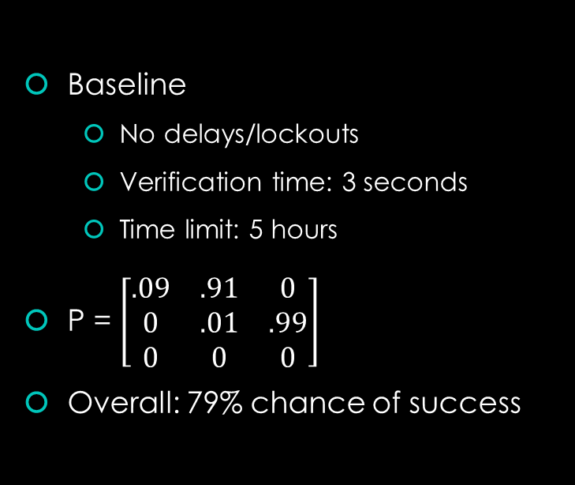
Results
Baseline
  No delays/lockouts
  Verification time: 3 seconds
  Time limit: 5 hours
P = $\left[\begin{matrix}.09 & .91 & 0 \\ 0 & .01 & .99 \\ 0 & 0 & 0\end{matrix}\right]$
Overall: 79% chance of success

Slide 11
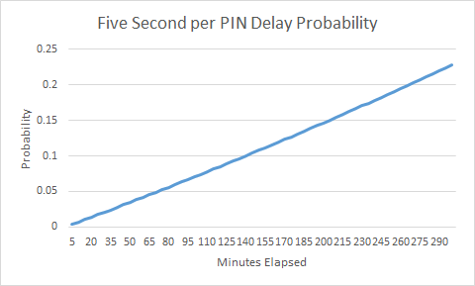
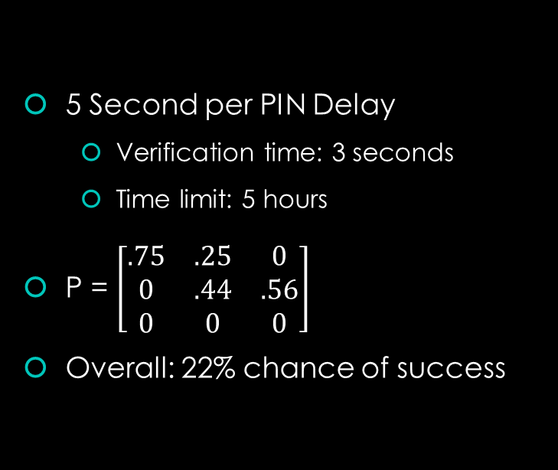
Results
5 Second per PIN Delay
  Verification time: 3 seconds
  Time limit: 5 hours
P = $\left[\begin{matrix}.75 & .25 & 0 \\ 0 & .44 & .56 \\ 0 & 0 & 0\end{matrix}\right]$
Overall: 22% chance of success

Slide 12
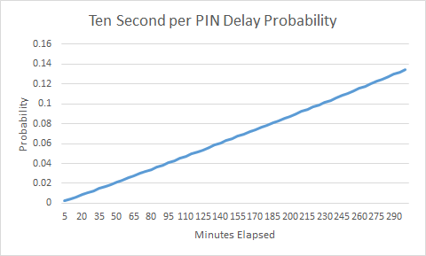
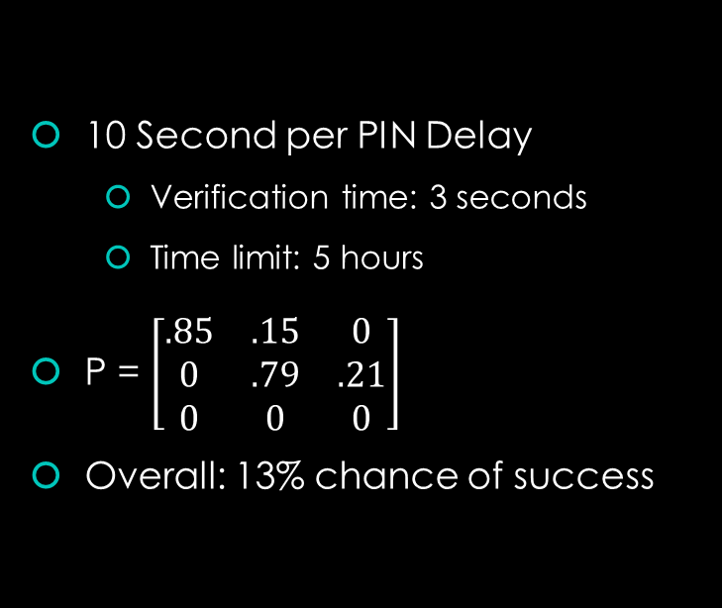
Results
10 Second per PIN Delay
  Verification time: 3 seconds
  Time limit: 5 hours
P = $\left[\begin{matrix}.85 & .15 & 0 \\ 0 & .79 & .21 \\ 0 & 0 & 0\end{matrix}\right]$
Overall: 13% chance of success

Slide 13
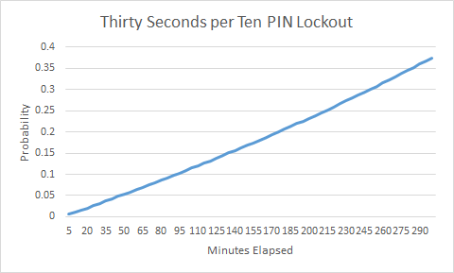
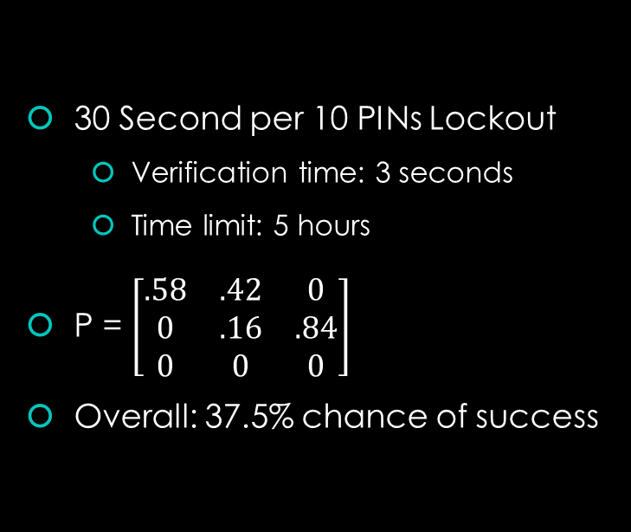
Results
30 Second per 10 PINs Lockout
  Verification time: 3 seconds
  Time limit: 5 hours
P = $\left[\begin{matrix}.58 & .42 & 0 \\ 0 & .16 & .84 \\ 0 & 0 & 0\end{matrix}\right]$
Overall: 37.5% chance of success

Slide 14

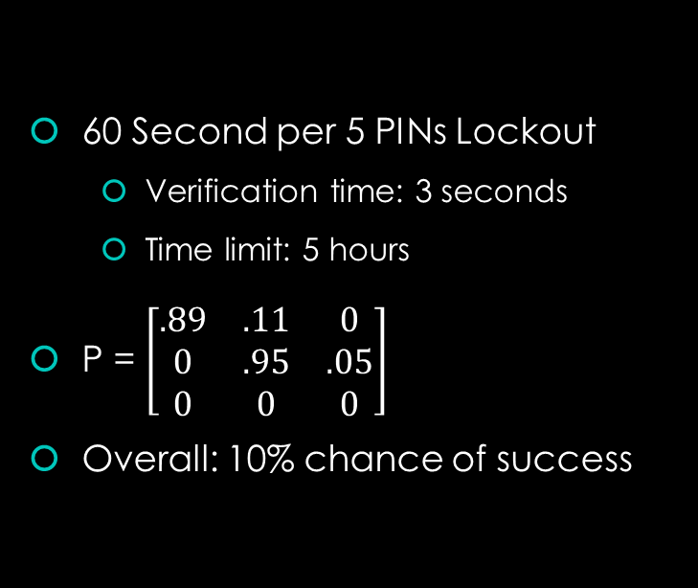
Results
60 Second per 5 PINs Lockout
  Verification time: 3 seconds
  Time limit: 5 hours
P = $\left[\begin{matrix}.89 & .11 & 0 \\ 0 & .95 & .05 \\ 0 & 0 & 0\end{matrix}\right]$
Overall: 10% chance of success

Slide 15
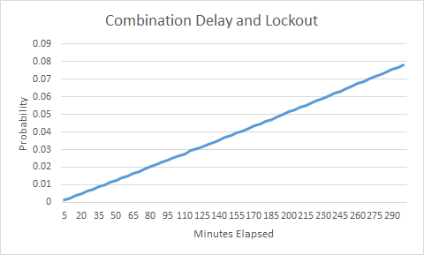
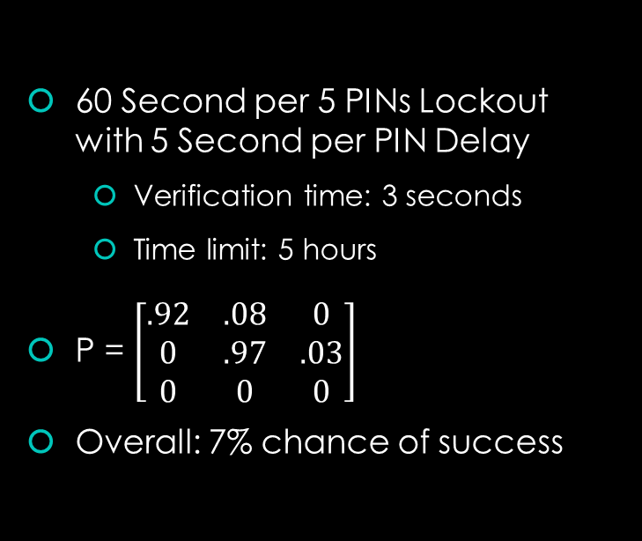
Results
60 Second per 5 PINs Lockout with 5 Second per PIN Delay
  Verification time: 3 seconds
  Time limit: 5 hours
P = $\left[\begin{matrix}.92 & .08 & 0 \\ 0 & .97 & .03 \\ 0 & 0 & 0\end{matrix}\right]$
Overall: 7% chance of success

Slide 16
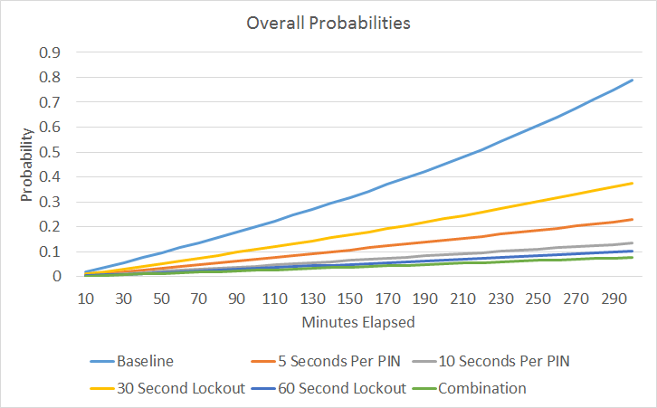
Results

Slide 17
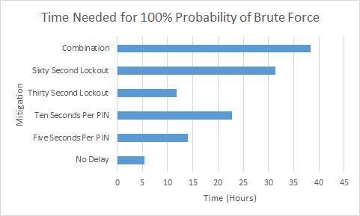
Results

Slide 18

Results
Lockout mechanisms are not necessarily better than delay mechanisms, and vice-versa
Neither can protect against an attacker with lots of time on his/her hands
Both are more of a bandage on a gaping wound

Slide 19
Questions?

