Slide 1
Private Cloud or Dedicated Hosts
Mason Mabardy & Matt Maples

Slide 2
Overview
Problem
Justification
Background
Approach
Results

Slide 3
Problem
Virtual machines are cheaper to run than dedicated machines, but what is the trade off in performance?

Slide 4
Justification
Businesses small or large are always trying to expand.
  A privatized cloud would allow Businesses to better use their unallocated resources to perform tasks that would take a large server.
  Allowing a business to save a large sum of money.

Slide 5
Background
The idea of cloud computing is very popular today.
  For smaller businesses the cloud is a life line, especially to those with 50 or less employees.
  For larger businesses and researchers cloud computing has allowed for ease of access to that power.

Slide 6
Approach
set up an array of virtual machines to host a game server, a web server and a file server.
Measuring the performance difference when using physical machines vs. virtual using private cloud with open stack.
Each machine tested to its limits until server crashes.

Slide 7
Approach – Game server
The game server running Minecraft
  The reason for picking mine craft over another game was to stress test CPU and Minecraft is a CPU hog.
  The idea is increment the number of TNT blocks and detonate them until a crash
  The reason using TNT is the ease of manageability and the stress it causes on the CPU during detonation

Slide 8
Approach – File server
The File server will have a 10 GB file.
  The server will receive download requests.
  The idea was to test how many request the server could handle until a crash

Slide 9
Approach – Web server
The game server running Apache.
  The server will host a small page.
  Testing will consist of performing a DDoS.
  Measuring how long the server can handle the huge volume until a crash.

Slide 10
Results – Game server
During the course of testing
  We discovered that the server was incredibly resilient to attacks
  The server was able to withstand thousands of blocks of TNT
  We found that it was impossible to crash the server with the test we lined up

Slide 11
Results – Game server
During the course of testing
  However we discover that it is possible to crash a server outside of the game using an application to flood the server with requests.

Slide 12
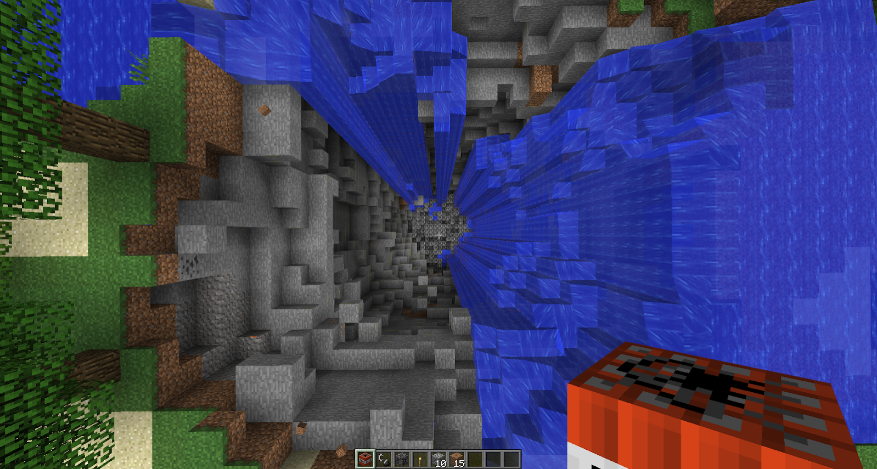
Results – Game server
Graph and or tables
  asdf

Slide 13
Results – Game server

Slide 14
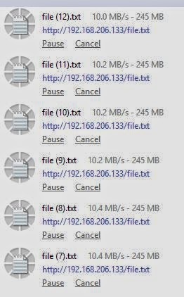
Results – File server
The file server was the easiest to crash
  While simulating 10 users all trying to download a 10GB file we were able to see drastic connection slowdowns for the clients.

Slide 15
Results – web server
The Web server was surprisingly tolerant
  When running a test on the apache default page
  Using a application called “Low Orbit Ion Cannon”
    Designed to deform DoS attacks
  we could not cause the service to crash either as a virtual machine or a dedicated machine.

Slide 16
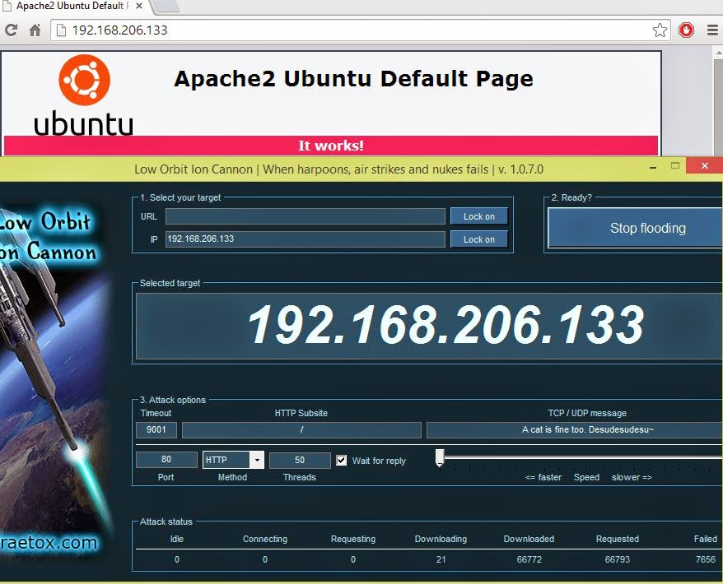
Results – web server
Graph and or tables
  asdf

Slide 17
References
[1] J. Cory “Vitual Machines (VM)” http://www.techopedia.com/definition/4805/virtual-machine-vm [April 16, 2014]
[2] S. Sebastian “Physical Vs Virtual server : Which one should you choose?” http://bobcares.com/blog/virtualization-or-physical-server/ [April 16, 2014]
[3] C. Hall “What Is The Cloud? (And Why Small Businesses Need To Care)” http://www.huffingtonpost.com/2013/11/06/amex-what-is-the-cloud-and-why_n_3964066.html [April 16, 2014]

Slide 18
References
[4] A. Wittmann “Research: 2014 Private Cloud Survey” http://reports.informationweek.com/abstract/6/11795/Data-Center/Research:-2014-Private-Cloud-Survey.html [April 16, 2014]
[5] J. Smith “The architecture of virtual machines” http://ieeexplore.ieee.org/xpl/articleDetails.jsp?tp=&arnumber=1430629&url=http%3A%2F%2Fieeexplore.ieee.org%2Fxpls%2Fabs_all.jsp%3Farnumber%3D1430629 [April 16, 2014]
[6] M. Armbrust, A. Fox, R. Griffith “A View of Cloud Computing” http://cacm.acm.org/magazines/2010/4/81493-a-view-of-cloud-computing/fulltext [April 16, 2014]

