Slide 1
Routing Security in Wireless
Ad Hoc Networks
Chris Zingraf, Charisse Scott, Eileen Hindmon

Slide 2
Mobile ad hoc Network
Collection of wireless mobile nodes
Communicate without network infrastructure
  or centralized administration
Offers unrestricted mobility and connectivity
Each node acts as host and router
Out-of-range nodes are routed through intermediate nodes

Slide 3
Wireless MANET
Security with Network
  open medium
  dynamic topology
  distributed cooperation
  constrained capability
Routing Security
  “black hole” attack
Notes:
emerging research area with practical applications

Slide 4
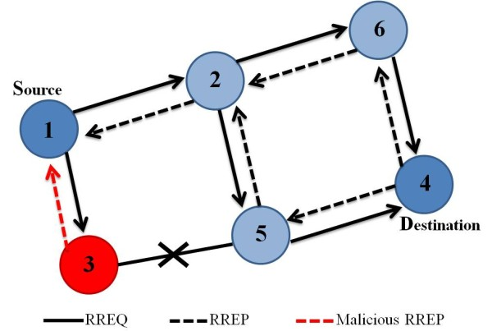
“black hole” Attack
Black hole attacks work by tricking other nodes
in the network about their routing information.

Slide 5
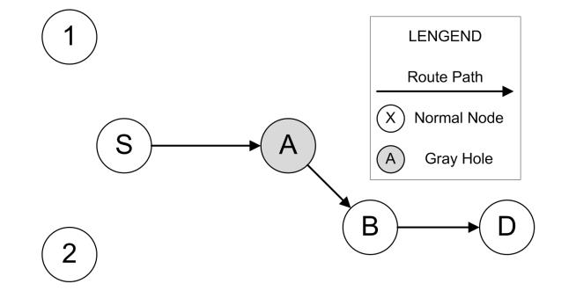
Proposed Solutions
She, Yi, Wang, Yang – July 2013
Each node only monitors the next hop
Packet forwarded—good node!
Too many packets “dropped”— bad node!

Slide 6
Proposed Solutions
High collision rates can make it hard to “overhear” packet forwarding – false positives!
Algorithm adapts a “threshold” to fix this
Problem: threshold lowers under high network load
→ lower detection
rate → susceptible to DDoS?
How to maintain detection rate,
even at high network load?

Slide 7
Our Solution
Another (unimplemented) solution: “Optimal Path”
Discard the first and select the second shortest path
Difficult for a black hole to determine how to make itself “second-best”
By itself, would slow down network
Perhaps as a rollover?

Slide 8
ns-2
Network Simulator
Ns is a discrete event simulator targeted at networking research.
Ns provides substantial support for simulation of TCP, routing, and multicast protocols over wired and wireless (local and satellite) networks.
http://nsnam.isi.edu/nsnam/index.php/User_Information

Slide 9
References
http://nsnam.isi.edu/nsnam/index.php/User_Information
http://www.csee.umbc.edu/~wenjia1/699_report.pdf
http://web.mst.edu/~bckd2/CpE349/project/routing%20security%20in%20wireless%20adhoc.pdf
http://www.cs.fsu.edu/~levan/papers/Security%20Issues%20of%20Mobile%20Ad%20hoc%20Networks%20(SPRINGER05).pdf
https://www.cs.tcd.ie/hitesh.tewari/papers/netsec00_manet_sec.pdf
http://en.wikipedia.org/wiki/Mobile_ad_hoc_network

