Slide 1

Modeling Wi-Fi Protected Setup Brute-Force Mitigations Using Markov Chains
Progress Summary
Lloyd Jones

Slide 2
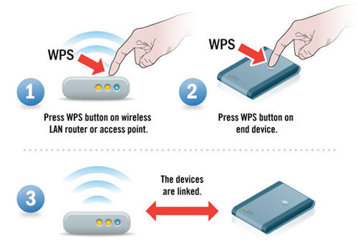
Topic Background
Wi-Fi Protected Setup (WPS) – technology used for easy connection to wireless devices
Simpler than remembering long WEP/WPA passphrase
Push-button and PIN method
Known weaknesses in WPS, susceptible to brute-force attacks
Goal is to model how different wireless router mechanisms can mitigate these attacks

Slide 3
Progress Made Since Proposal
Refined problem solving approach by defining variables and equation that will be used
Researched common consumer router WPS delays/lockouts
Defined states for Markov chains (Not associated, M5 ACK, M7 ACK)
0 < d < 5 | Access point-imposed delay between PIN attempts (seconds)
L_{(s/p)} 0 < s < 120 3 <= p <= 25 | Lockout (s) in seconds per amount of consecutive incorrect PINs (p)
t > 0 | Time limit for successful attempt (minutes)
A_{1,2,3…n} 1 < n < 11,000 | PIN attempts in numerical order
0 < v < 5 | Access point PIN validation time in seconds
0 < P₀ < 1 | Probability of client being in unauthenticated state
0 < P₁ < 1 | Probability of brute-forcing first half of PIN
0 < P₂ < 1 | Probability of brute-forcing second half of PIN
0 < P < 1 | Overall probability of successful brute-force given d, L_{(s/p)}, t, v

Slide 4
Next Steps
Model “ideal” scenario with Markov Chains and graph results
Start to model other likely scenarios for comparison
Elaborate on Problem Statement and Literature Survey
Possibly perform real world testing?
✓

Slide 5
Questions?

