Slide 1
Internet Routing Protocols,
DHCP, and NAT
Hwajung Lee
Modified from Slides Courtesy of
Cisco Networking Academy and
the book titled Communication Networks by Leon-Garcia

Slide 2
Contents
Basic Routing
Single Area Open Shortest Path First (OSPF)
Dynamic Host Configuration Protocol (DHCP)
Network Address Translation (NAT)
Summary
Notes:
*In networks with redundancy STP helps prevent:
Switching Loops
Layer 2 Broadcast Storms
*BID (Bridge ID) = Used to determine the Root Bridge:
1. Bridge Priority Number = 32768 (default) Lowest
2. Extended System ID = ID for VLANs
3. MAC Address = Lowest MAC Address
*Port Costs:
10 Gig = 2
1 Gig = 4
100 Mb = 19
10 Mb = 100
*Port Designations:
Root Port = Closest to the root bridge
Designated Port = Forwarding
Non-Designated Port = Blocking

Slide 3
Contents
Basic Routing
Routing Information Protocol (RIP)
Open Shortest Path First (OSPF)
Border Gateway Protocol (BGP)
Dynamic Host Configuration Protocol (DHCP)
Network Address Translation (NAT)
Summary
Notes:
*In networks with redundancy STP helps prevent:
Switching Loops
Layer 2 Broadcast Storms
*BID (Bridge ID) = Used to determine the Root Bridge:
1. Bridge Priority Number = 32768 (default) Lowest
2. Extended System ID = ID for VLANs
3. MAC Address = Lowest MAC Address
*Port Costs:
10 Gig = 2
1 Gig = 4
100 Mb = 19
10 Mb = 100
*Port Designations:
Root Port = Closest to the root bridge
Designated Port = Forwarding
Non-Designated Port = Blocking

Slide 4
Autonomous Systems
Global Internet viewed as collection of autonomous systems.
Autonomous system (AS) is a set of routers or networks administered by a single organization
Same routing protocol need not be run within the AS
But, to the outside world, an AS should present a consistent picture of what ASs are reachable through it
Stub AS: has only a single connection to the outside world.
Multihomed AS: has multiple connections to the outside world, but refuses to carry transit traffic
Transit AS: has multiple connections to the outside world, and can carry transit and local traffic.

Slide 5
AS Number
For exterior routing, an AS needs a globally unique AS 16-bit integer number
Stub AS, which is the most common type, does not need an AS number since the prefixes are placed at the provider’s routing table
Transit AS needs an AS number
Request an AS number from one of the five RIRs (Regional Internet Registries)
  ARIN: American Registry for Internet Numbers
  RIPE NCC: Réseaux IP Européens Network Coordination Centre
  APNIC: Asia Pacific Network Information Centre
  LACNIC: Latin America and Caribbean Network Information Centre
  AFRINIC: African Network Information Centre

Slide 6
Inter and Intra Domain Routing
Interior Gateway Protocol (IGP): routing within AS
  RIP, OSPF, IGRP, EIGRP, IS-IS
Exterior Gateway Protocol (EGP): routing between AS’s
  BGPv4
Border Gateways perform IGP & EGP routing
IGP
R
EGP
IGP
R
R
R
R
R
AS A
AS C
R
R
IGP
AS B

Slide 7
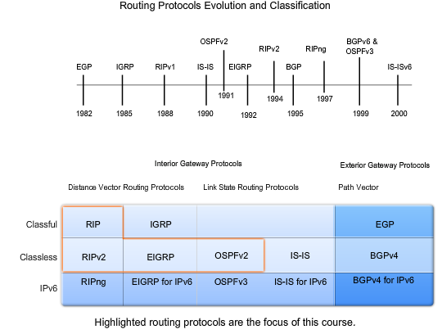
Inter and Intra Domain Routing
Image Source: www.netacad.com
Notes:
Course Overview
The primary focus of this course is on routing and routing protocols. The goal is to develop an understanding of how a router learns about remote networks and determines the best path to those networks. This course includes both static routing and dynamic routing protocols. By examining multiple routing protocols, you will gain a better understanding of each of the individual routing protocols and a better perspective of routing in general. Learning the configuration of routing protocols is fairly simple. Developing an understanding of the routing concepts themselves is more difficult, yet is critical for implementing, verifying, and troubleshooting routing operations.
Each static routing and dynamic routing protocol chapter uses a single topology throughout that chapter. You will be using that topology to configure, verify, and troubleshoot the routing operations discussed in the chapter.
The labs and Packet Tracer activities used in this course are designed to help you develop an understanding of how to configure routing operations while reinforcing the concepts learned in each chapter.
Chapter 1 Introduction to Routing and Packet Forwarding - In Chapter 1, you will be introduced to the router, its role in the networks, its main hardware and software components, and the packet forwarding process. You will also be given an overview of directly connected networks, static routing, and dynamic routing protocols, along with a brief introduction to the routing table. Each of these topics is discussed in more detail in later chapters. Chapter1 also includes a review of basic Cisco IOS commands.
Chapter 2 Static Routing - Chapter 2 focuses on the role and configuration of static routes. The routing table process is introduced, and you will be shown how to verify route entries as they are added and deleted from the routing table. This chapter also discusses Cisco Discovery Protocol, which is a tool that you can use to help verify network operations.
Chapter 3 Introduction to Dynamic Routing Protocols - Chapter 3 provides an overview of routing protocol concepts and the various dynamic routing protocols available for routing in IP networks. In this chapter, you will examine the role of routing protocols. There is an overview of the classification of dynamic routing protocols. This overview is useful for comparing and contrasting the different protocols. Most of the information in this chapter is examined in more detail in later chapters.
Chapter 4 Distance Vector Routing Protocols - Chapter 4 presents two different types of routing protocols: distance vector and link-state. You will examine distance vector concepts and operations, including network discovery, routing table maintenance, and the issue of routing loops. In this chapter, you will also be introduced to the concepts used in RIPv1, RIPv2, and EIGRP routing protocols. These routing protocols are discussed in more detail in later chapters.
Chapter 5 RIP version 1 - Chapter 5 is the first chapter that focuses on a specific dynamic routing protocol. In this chapter, you will learn about RIP (Routing Information Protocol) version 1. RIPv1, a classful, distance vector routing protocol, was one of the first IP routing protocols. You will examine the characteristics, operations, and limitations of RIPv1. You will also learn about RIPv1 configuration, verification, and troubleshooting techniques.
Chapter 6 VLSM and CIDR - Chapter 6 reviews the VLSM (Variable Length Subnet Mask) and CIDR (Classless Inter-Domain Routing) concepts that were presented in the Network Fundamentals course. You will explore the benefits of VLSM along with the role and benefits of CIDR in today’s networks. Next, you will be introduced to the role of classless routing protocols. Classless routing protocols RIPv2, EIGRP, and OSPF are examined in later chapters.
Chapter 7 RIPv2 - Chapter 7 examines the next routing protocol presented in this course, RIPv2. RIPv2 is a classless, distance vector routing protocol. You will see how RIPv2 demonstrates the advantages and operations of a classless routing protocol. The chapter begins with a discussion of the limitations of the classful routing protocol, RIPv1. Then RIPv2 is introduced, to show how a classless routing protocol can be used to overcome these limitations. In this chapter, you will also learn the commands necessary to configure and verify RIPv2.
Chapter 8 The Routing Table: A Closer Look - Chapter 8 examines Cisco’s IPv4 routing table in detail. The chapter begins with a discussion of the structure of the routing table. While examining the routing table, you will learn about the lookup process, how the routing table process determines the best match with a packet’s destination IP address, and how to enter a route in the routing table. The chapter concludes with a discussion about the differences between classful and classless routing behaviors.
Chapter 9 EIGRP - Chapter 9 focuses on Cisco EIGRP (Enhanced Interior Gateway Routing Protocol). EIGRP is a classless, enhanced distance vector routing protocol. You will examine the advantages and operations of EIGRP’s DUAL (Diffusing Update Algorithm). Then you will learn about the configuration of EIGRP, including verification and troubleshooting commands.
Chapter 10 Link-State Routing Protocols - Chapter 10 examines link-state routing protocol concepts. You will be introduced to link-state terminology and the link-state routing process. The chapter discusses the benefits and advantages of a link-state routing protocol compared to a distance vector routing protocol. You will then examine the Shortest Path First (SPF) algorithm and how it is used to build a topology map of the network. The link-state routing protocol OSPF is discussed in the following chapter.
Chapter 11 OSPF - The final chapter in this course is an examination of the classless, link-state routing protocol OSPF (Open Shortest Path First). In this chapter, you will examine OSPF operations and configuration, including verification and troubleshooting commands. By the end of this course, you should feel confident in your knowledge of routing and routing protocols. With continued study and practice, you will be able to put your new skills to work.
--
Chapter 3
The Evolution of Dynamic Routing Protocols
Dynamic routing protocols have been used in networks since the early 1980s. The first version of RIP was released in 1982, but some of the basic algorithms within the protocol were used on the ARPANET as early as 1969.
As networks have evolved and become more complex, new routing protocols have emerged. The figure shows the classification of routing protocols.
One of the earliest routing protocols was Routing Information Protocol (RIP). RIP has evolved into a newer version RIPv2. However, the newer version of RIP still does not scale to larger network implementations. To address the needs of larger networks, two advanced routing protocols were developed: Open Shortest Path First (OSPF) and Intermediate System-to-Intermediate System (IS-IS). Cisco developed Interior Gateway Routing Protocol (IGRP) and Enhanced IGRP (EIGRP), which also scales well in larger network implementations.
Additionally, there was the need to interconnect different internetworks and provide routing among them. Border Gateway Routing (BGP) protocol is now used between ISPs as well as between ISPs and their larger private clients to exchange routing information.
With the advent of numerous consumer devices using IP, the IPv4 addressing space is nearly exhausted. Thus IPv6 has emerged. To support the communication based on IPv6, newer versions of the IP routing protocols have been developed (see the IPv6 row in the table).
Note: This chapter presents an overview of the different dynamic routing protocols. More details about RIP, EIGRP, and OSPF routing protocols will be discussed in later chapters. The IS-IS and BGP routing protocols are explained in the CCNP curriculum. IGRP is the predecessor to EIGRP and is now obsolete.
Reference: IS-IS
http://en.wikipedia.org/wiki/IS-IS

Slide 8
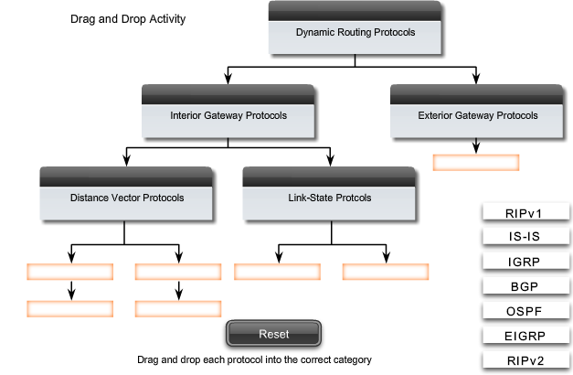
Inter and Intra Domain Routing

Slide 9
Open Shortest Path First
RFC 2328 (v2)
Fixes some of the deficiencies in RIP
Enables each router to learn complete network topology
Each router monitors the link state to each neighbor and floods the link-state information to other routers
Each router builds an identical link-state database
Allows router to build shortest path tree with router as root
OSPF typically converges faster than RIP when there is a failure in the network

Slide 10
OSPF Features
Multiple routes to a given destination, one per type of service
Support for variable-length subnetting by including the subnet mask in the routing message
Distribution of traffic over multiple paths of equal cost
Uses notion of area to partition sites into subsets
Support host-specific routes as well as net-specific routes
Designated router to minimize table maintenance overhead

Slide 11
Flooding
Used in OSPF to distribute link state (LS) information
Forward incoming packet to all ports except where packet came in
Packet eventually reaches destination as long as there is a path between the source and destination
Generates exponential number of packet transmissions
Approaches to limit # of transmissions:
  Use a TTL at each packet; won’t flood if TTL is reached
  Each router adds its identifier to header of packet before it floods the packet; won’t flood if its identifier is detected
  Each packet from a given source is identified with a unique sequence number; won’t flood if sequence number is same

Slide 12
Example OSPF Topology
10.5.1.2
10.5.1.4
10.5.1.1
10.5.1.6
10.5.1.3
10.5.1.5
At steady state:
All routers have same LS database
Know how many routers in network
Interfaces & links between routers
Cost of each link
Occasional Hello messages (10 sec) & LS updates sent (30 min)

Slide 13
OSPF Network
To improve scalability, AS may be partitioned into areas
  Area is identified by 32-bit Area ID
  Router in area only knows complete topology inside area & limits the flooding of link-state information to area
  Area border routers summarize info from other areas
Each area must be connected to backbone area (0.0.0.0)
  Distributes routing info between areas
Internal router has all links to nets within the same area
Area border router has links to more than one area
Backbone router has links connected to the backbone

Slide 14
OSPF Areas
To another AS
N1
R1
N5
N2
R3
R6
N4
R7
R2
N6
R4
R5
N3
Area 0.0.0.0
Area 0.0.0.2
Area 0.0.0.1
R8
ABR: 3, 6, 8
IR: 1,2,7
BR: 3,4,5,6,8
N7
R = router N = network
Area 0.0.0.3

Slide 15
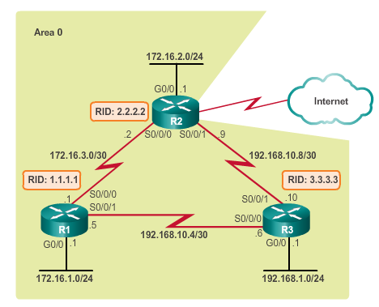
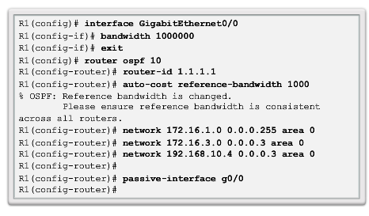
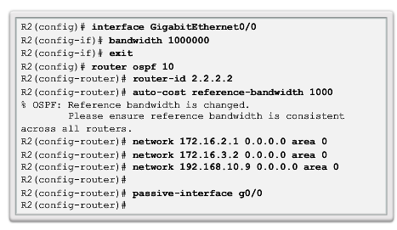
Routing in the Distribution and Core Layers
Configuring Single-Area OSPF
Notes:
5.1.1.5 Configuring Single-Area OSPF
Question> Auto-cost reference-bandwidth 1000?
Sol>https://learningnetwork.cisco.com/message/211993#211993

Slide 16
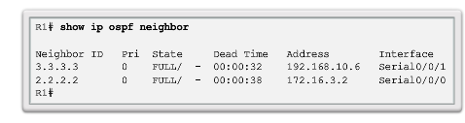
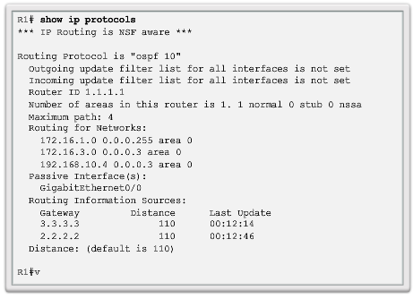
Routing in the Distribution and Core Layers
Verifying Single-Area OSPF
Notes:
5.1.1.6 Verifying Single-Area OSPF

Slide 17
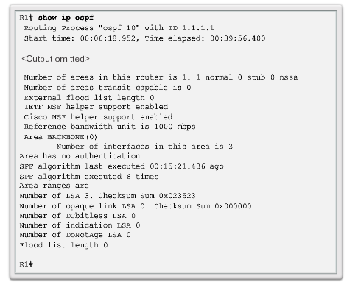
Routing in the Distribution and Core Layers
Verifying Single-Area OSPF (cont.)
Notes:
5.1.1.6 Verifying Single-Area OSPF

Slide 18
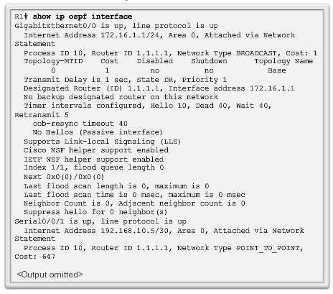
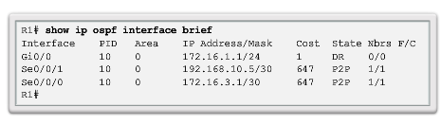
Routing in the Distribution and Core Layers
Verifying Single-Area OSPF (cont.)
Notes:
5.1.1.6 Verifying Single-Area OSPF

Slide 19
DHCP
Dynamic Host Configuration Protocol (RFC 2131)
BOOTP (RFC 951, 1542) allows a diskless workstation to be remotely booted up in a network
  UDP port 67 (server) & port 68 (client)
DHCP builds on BOOTP to allow servers to deliver configuration information to a host
  Used extensively to assign temporary IP addresses to hosts
  Allows ISP to maximize usage of their limited IP addresses

Slide 20
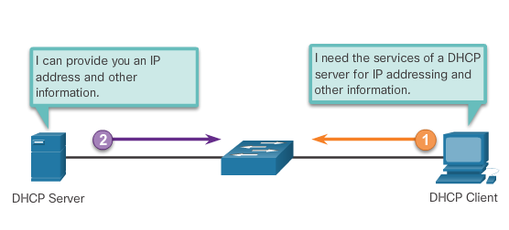
DHCPv4 Operation
Introducing DHCPv4
DHCPv4:
  assigns IPv4 addresses and other network configuration information dynamically
  useful and timesaving tool for network administrators
  dynamically assigns, or leases, an IPv4 address from a pool of addresses
A Cisco router can be configured to provide DHCPv4 services.
Administrators configure DHCPv4 servers so that leases expire. Then the client must ask for another address, although the client is typically reassigned the same address.
Notes:
8.1 – Dynamic Host Configuration Protocol v4
8.1.1 – DHCPv4 Operation
8.1.1.1 – Introduction DHCPv4

Slide 21
DHCP Operation
Host broadcasts DHCP Discover message on its physical network
Server replies with Offer message (IP address + configuration information)
Host selects one offer and broadcasts DHCP Request message
Server allocates IP address for lease time T
  Sends DHCP ACK message with T, and threshold times T1 (=1/2 T) and T2 (=.875T)
At T1, host attempts to renew lease by sending DHCP Request message to original server
If no reply by T2, host broadcasts DHCP Request to any server
If no reply by T, host must relinquish IP address and start from the beginning

Slide 22
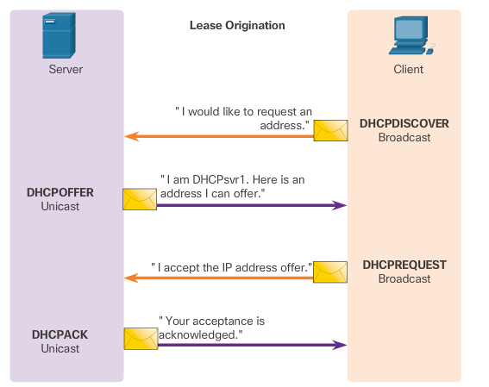
DHCPv4 Operation
DHCPv4 Operation
Notes:
8.1 – Dynamic Host Configuration Protocol v4
8.1.1 – DHCPv4 Operation
8.1.1.2 – DHCPv4 Operation

Slide 23
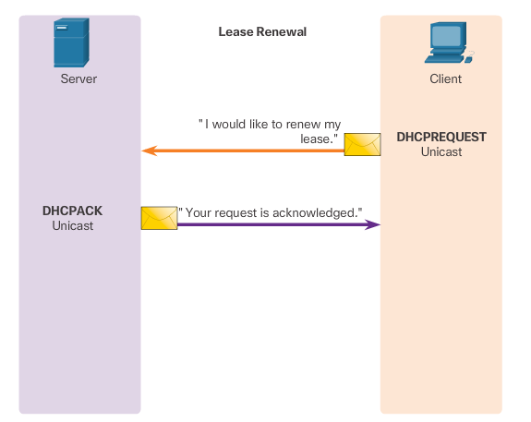
DHCPv4 Operation
DHCPv4 Operation (cont.)
Notes:
8.1 – Dynamic Host Configuration Protocol v4
8.1.1 – DHCPv4 Operation
8.1.1.2 – DHCPv4 Operation

Slide 24
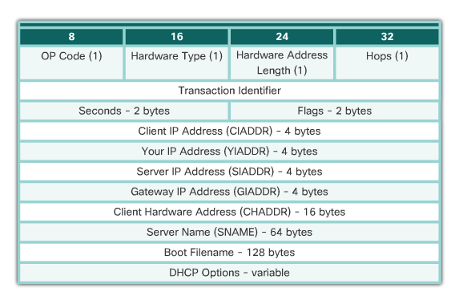
DHCPv4 Operation
DHCPv4 Message Format
Notes:
8.1 – Dynamic Host Configuration Protocol v4
8.1.1 – DHCPv4 Operation
8.1.1.3 - DHCPv4 Message Format

Slide 25
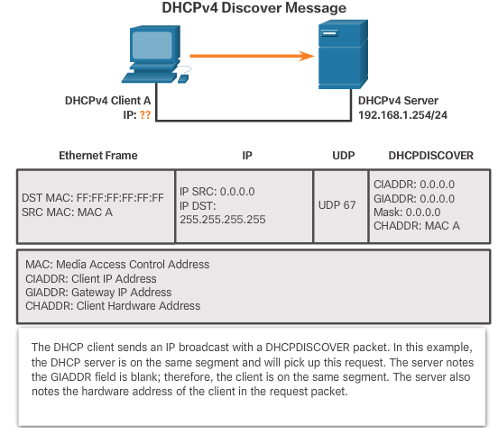
DHCPv4 Operation
DHCPv4 Discover and Offer Messages
Notes:
8.1 – Dynamic Host Configuration Protocol v4
8.1.1 – DHCPv4 Operation
8.1.1.4 - DHCPv4 Discover and Offer Messages

Slide 26
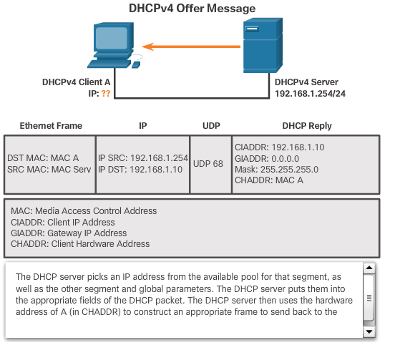
DHCPv4 Operation
DHCPv4 Discover and Offer Messages (cont.)
Notes:
8.1 – Dynamic Host Configuration Protocol v4
8.1.1 – DHCPv4 Operation
8.1.1.4 - DHCPv4 Discover and Offer Messages (cont.)

Slide 27
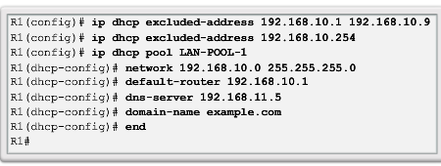
Configure DHCPv4 Server
Configure a Basic DHCPv4 Server
A Cisco router running the Cisco IOS software can be configured to act as a DHCPv4 server. To set up DHCP:
  Exclude addresses from the pool.
  Set up the DHCP pool name.
  Define the range of addresses and subnet mask. Use the default-router command for the default gateway. Optional parameters that can be included in the pool – dns server, domain-name.
To disable DHCP, use the no service dhcp command.
Notes:
8.1 – Dynamic Host Configuration Protocol v4
8.1.2 – Configure DHCPv4 Server
8.1.2.1 - Configure a Basic DHCPv4 Server

Slide 28
Network Address Translation (NAT)
Class A, B, and C addresses have been set aside for use within private internets
  Packets with private (“unregistered”) addresses are discarded by routers in the global Internet
NAT (RFC 1631): method for mapping packets from hosts in private internets into packets that can traverse the Internet
  A device (computer, router, firewall) acts as an agent between a private network and a public network
  A number of hosts can share a limited number of registered IP addresses
    Static/Dynamic NAT: map unregistered addresses to registered addresses
    Overloading: maps multiple unregistered addresses into a single registered address (e.g. Home LAN)

Slide 29

NAT Operation (Overloading)
Address Translation Table: 192.168.0.10; x 128.100.10.15; y
192.168.0.13; w 128.100.10.15; z
192.168.0.10;x
128.100.10.15;y
Private Network
NAT Device
Public Network
192.168.0.13;w
128.100.10.15; z
Hosts inside private networks generate packets with private IP address & TCP/UDP port #s
NAT maps each private IP address & port # into shared global IP address & available port #
Translation table allows packets to be routed unambiguously

Slide 30
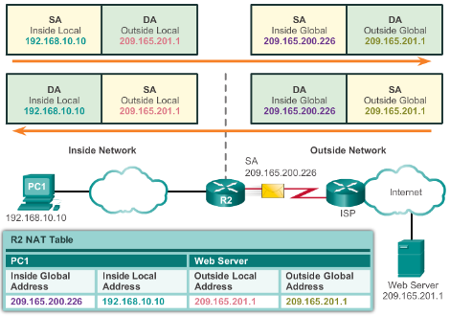
NAT Operation
NAT Characteristics
IPv4 Private Address Space
  10.0.0.0 /8, 172.16.0.0 /12, and 192.168.0.0 /16
What is NAT?
  Process to translate network IPv4 address
  Conserve public IPv4 addresses
  Configured at the border router for translation
NAT Terminology
  Inside address
  Inside local address
  Inside global address
  Outside address
  Outside local address
  Outside global address
Notes:
9.1 – NAT Operation
9.1.1 – NAT Characteristics

Slide 31
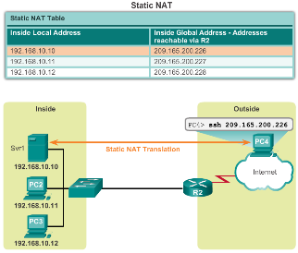
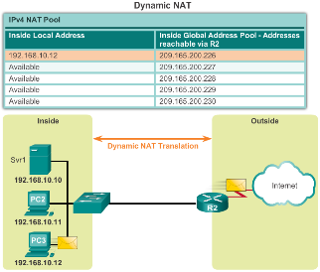
NAT Operation
Types of NAT
Static NAT
  One-to-one mapping of local and global addresses
  Configured by the network administrator and remain constant.
Dynamic NAT
  Uses a pool of public addresses and assigns them on a first-come, first-served basis
  Requires that enough public addresses for the total number of simultaneous user sessions
Port Address Translation (PAT)
  Maps multiple private IPv4 addresses to a single public IPv4 address or a few addresses
  Also known as NAT overload
  Validates that the incoming packets were requested
  Uses port numbers to forward the response packets to the correct internal device
Notes:
9.1 – NAT Operation
9.1.2 – Types of NAT

Slide 32
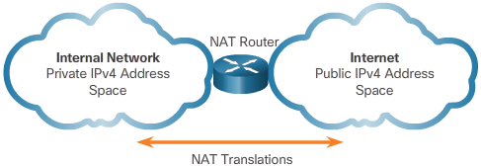
NAT Operation
NAT Advantages
Advantages of NAT
  Conserves the legally registered addressing scheme
  Increases the flexibility of connections to the public network
  Provides consistency for internal network addressing schemes
  Provides network security
Disadvantages of NAT
  Performance is degraded
  End-to-end functionality is degraded
  End-to-end IP traceability is lost
  Tunneling is more complicated
  Initiating TCP connections can be disrupted
Notes:
9.1 – NAT Operation
9.1.3 – NAT Advantages

Slide 33
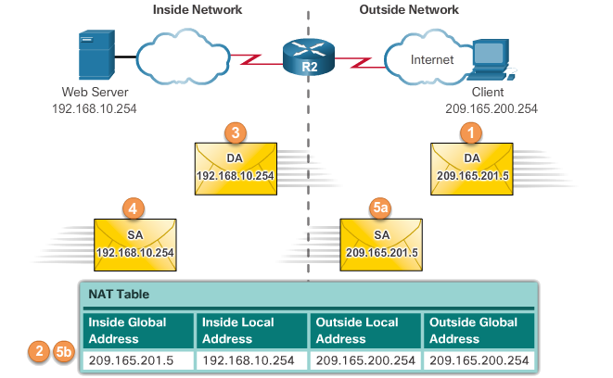
Configuring NAT
Configuring Static NAT
Configuring Static NAT
  Create the mapping between the inside local and outside local addresses
    ip nat inside source static local-ip global-ip
  Define which interfaces belong to the inside network and which belong to the outside network
    ip nat inside
    ip nat outside
Analyzing Static NAT
Verifying Static NAT
  show ip nat translations
  show ip nat statistics
  clear ip nat statistics
Notes:
9.2 – Configuring NAT
9.2.1 – Configuring Static NAT

Slide 34
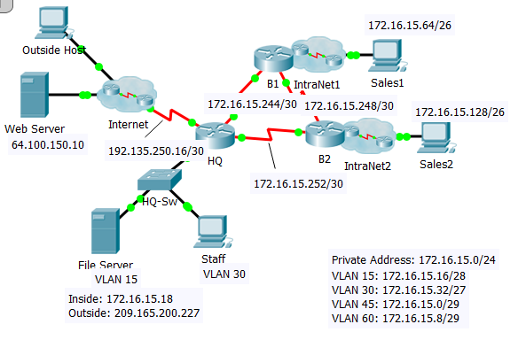
NAT – Sample Configuration
access-list 1 permit 172.16.15.0 0.0.0.255
ip nat pool TEST 209.165.200.225 209.165.200.226 netmask 255.255.255.252
ip nat inside source list 1 pool TEST overload
[ip nat inside source list 1 s 0/1/0 overload]
ip nat inside source static 172.16.15.18 209.165.200.227
interface s0/0/0
ip nat inside
interface s0/0/1
ip nat inside
interface s0/1/0
ip nat outside

Slide 35
Configuring NAT
Configuring Dynamic NAT
Dynamic NAT Operation
  The pool of public IPv4 addresses (inside global address pool) is available to any device on the inside network on a first-come, first-served basis.
  With dynamic NAT, a single inside address is translated to a single outside address.
  The pool must be large enough to accommodate all inside devices.
  A device is unable to communicate to any external networks if no addresses are available in the pool.
Notes:
9.2 – Configuring NAT
9.2.2 – Configuring Dynamic NAT

Slide 36
Configuring NAT
Configuring Dynamic NAT (Cont.)
Configuring Dynamic NAT
  Create the mapping between the inside local and outside local addresses
    ip nat pool name start-ip end-ip {netmask netmask | prefix-length prefix-length}
  Create a standard ACL to permit those addresses to be translated
    access-list access-list-number permit source [source-wildcard]
  Bind the ACL to the pool
    ip nat inside source list access-list-number pool name
  Identify the inside and outside interfaces
    ip nat inside
    ip nat outside
Notes:
9.2 – Configuring NAT
9.2.2 – Configuring Dynamic NAT

Slide 37
NAT – Sample Configuration
access-list 1 permit 172.16.15.0 0.0.0.255
ip nat pool TEST 209.165.200.225 209.165.200.226 netmask 255.255.255.252
ip nat inside source list 1 pool TEST
ip nat inside source static 172.16.15.18 209.165.200.227
interface s0/0/0
ip nat inside
interface s0/0/1
ip nat inside
interface s0/1/0
ip nat outside

Slide 38
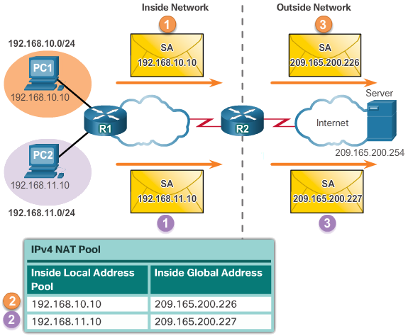
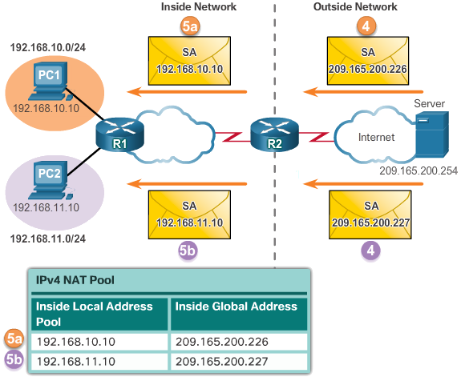
Configuring NAT
Configuring Dynamic NAT (Cont.)
Analyzing Dynamic NAT
Verifying Dynamic NAT
  show ip nat translations
  show ip nat translations verbose
  clear ip nat statistics
  clear ip nat translations *
Notes:
9.2 – Configuring NAT
9.2.2 – Configuring Dynamic NAT

Slide 39
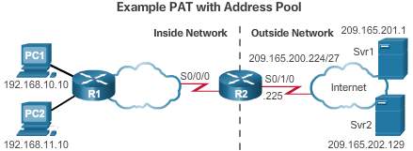
Configuring NAT
Configuring Port Address Translations (PAT)
Configuring PAT: Address Pool
  Create the mapping between the inside local and outside local addresses
    ip nat pool name start-ip end-ip {netmask netmask | prefix-length prefix-length}
  Create a standard ACL to permit those addresses to be translated
    access-list access-list-number permit source [source-wildcard]
  Bind the ACL to the pool
    ip nat inside source list access-list-number pool name overload
  Identify the inside and outside interfaces
    ip nat inside
    ip nat outside
Notes:
9.2 – Configuring NAT
9.2.3 – Configuring Port Address Translations (PAT)

Slide 40
NAT – Sample Configuration
access-list 1 permit 172.16.15.0 0.0.0.255
ip nat pool TEST 209.165.200.225 209.165.200.226 netmask 255.255.255.252
ip nat inside source list 1 pool TEST overload
[ip nat inside source list 1 s 0/1/0 overload]
ip nat inside source static 172.16.15.18 209.165.200.227
interface s0/0/0
ip nat inside
interface s0/0/1
ip nat inside
interface s0/1/0
ip nat outside

Slide 41
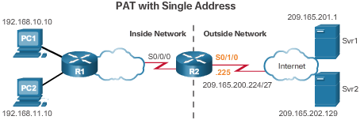
Configuring NAT
Configuring Port Address Translations (PAT) (Cont.)
Configuring PAT: Single Address
  Define a standard ACL to permit those addresses to be translated
    access-list access-list-number permit source [source-wildcard]
  Establish dynamic source translation, specify the ACL, exit interface, and overload option
    ip nat inside source list access-list-number interface type name overload
  Identify the inside and outside interfaces
    ip nat inside
    ip nat outside
Notes:
9.2 – Configuring NAT
9.2.3 – Configuring Port Address Translations (PAT)

Slide 42
NAT – Sample Configuration
access-list 1 permit 172.16.15.0 0.0.0.255
ip nat pool TEST 209.165.200.225 209.165.200.226 netmask 255.255.255.252
ip nat inside source list 1 pool TEST overload
[ip nat inside source list 1 s 0/1/0 overload]
ip nat inside source static 172.16.15.18 209.165.200.227
interface s0/0/0
ip nat inside
interface s0/0/1
ip nat inside
interface s0/1/0
ip nat outside

Slide 43
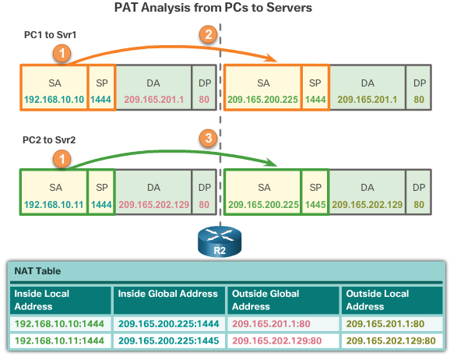
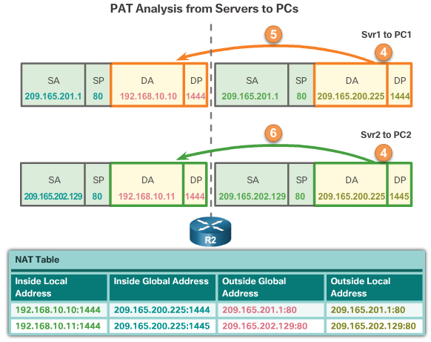
Configuring NAT
Configuring Port Address Translations (PAT) (Cont.)
Analyzing PAT
Verifying PAT
  show ip nat translations
  show ip nat statistics
  slear ip nat statistics
Notes:
9.2 – Configuring NAT
9.2.3 – Configuring Port Address Translations (PAT)

Slide 44
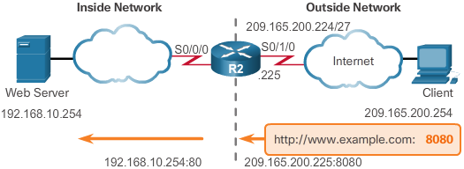
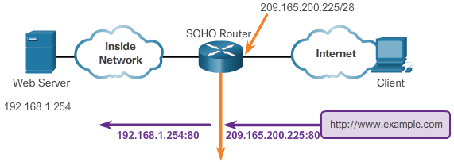
Configuring NAT
Port Forwarding
Port Forwarding
  Port forwarding is the act of forwarding a network port from one network node to another.
  A packet sent to the public IP address and port of a router can be forwarded to a private IP address and port in inside network.
  Port forwarding is helpful in situations where servers have private addresses, not reachable from the outside networks.
Wireless Router Example
Configuring Port Forwarding with IOS
  ip nat inside source [static {tcp | udp local-ip local-port global-ip global-port} [extendable]
Notes:
9.2 – Configuring NAT
9.2.4 – Port Forwarding

Slide 45
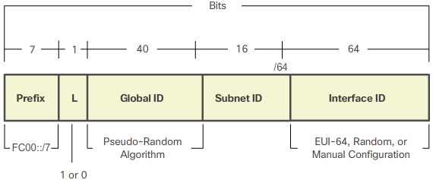
Configuring NAT
Configuring NAT and IPv6
NAT for IPv6?
  IPv6 with a 128-bit address provides 340 undecillion addresses.
  Address space is not an issue for IPv6.
  IPv6 makes IPv4 public-private NAT unnecessary by design; however, IPv6 does implement a form of private addresses, and it is implemented differently than they are for IPv4.
IPv6 Unique Local Address
  IPv6 unique local addresses (ULAs) are designed to allow IPv6 communications within a local site.
  ULAs are not meant to provide additional IPv6 address space.
  ULAs have the prefix FC00::/7, which results in a first hextet range of FC00 to FDFF.
  ULAs are also known as local IPv6 addresses (not to be confused with IPv6 link-local addresses).
Notes:
9.2 – Configuring NAT
9.2.5 – Configuring NAT and IPv6

Slide 46
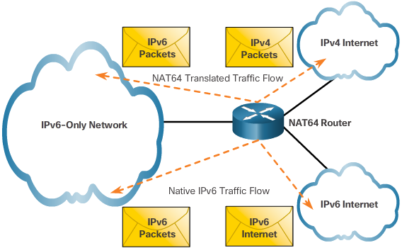
Configuring NAT
Configuring NAT and IPv6 (Cont.)
NAT for IPv6
  IPv6 also uses NAT, but in a much different context.
  In IPv6, NAT is used to provide transparent communication between IPv6 and IPv4.
  NAT64 is not intended to be a permanent solution; it is meant to be a transition mechanism.
  Network Address Translation-Protocol Translation (NAT-PT) was another NAT-based transition mechanism for IPv6, but is now deprecated by IETF.
  NAT64 is now recommended.
Notes:
9.2 – Configuring NAT
9.2.5 – Configuring NAT and IPv6

Slide 47
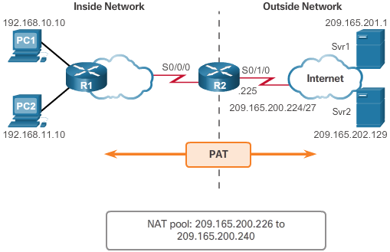
Troubleshooting NAT
Troubleshooting NAT Configurations
Troubleshooting NAT: show commands
  clear ip nat statistics
  clear ip nat translations *
  show ip nat statistics
  Show ip nat translations
Troubleshooting NAT: debug commands
  debug ip nat
Notes:
9.3 – Troubleshooting NAT
9.3.1 – Troubleshooting NAT Configurations

Slide 48
Review:
Routable and Nonroutable Addresses
Nonroutable Address [RFC 1918]
  Internet Router ignore the following addresses.
    10.0.0.0 – 10.255.255.255
    172.16.0.0 – 172.31.255.255
    192.168.0.0 – 192.168.255.255
  Millions of networks can exist with the same nonroutable address.
  “Intranet” : Internal Internet
  NAT (Network Address Translation) router
  Side benefit : “Security”

Slide 49
Summary
This chapter described:
Basic Routing
Open Shortest Path First (OSPF)
Dynamic Host Configuration Protocol (DHCP)
Network Address Translation (NAT)
Notes:
Chapter 3 Summary

Slide 50
Summary
This chapter described:
Basic Routing
Routing Information Protocol (RIP)
Open Shortest Path First (OSPF)
Border Gateway Protocol (BGP)
Dynamic Host Configuration Protocol (DHCP)
Network Address Translation (NAT)
Notes:
Chapter 3 Summary

