Slide 1

Financial Budget Report for Network builds at $10,000 and $20,000
Class of ITEC 451:
Carlie Addicks, Dontey Branch, Chase Brittain, Ben Doerflinger, Talal Fuad, Steven Heath, Jeffrey Reoch, Wijdan Sindi, Cole Stanley, Cameron Tatum, Don Whitteker

Slide 2
$10,000 Budget Components
Server: PowerEdge R230 Rack Server
Switch: Netgear 24-port Gigabit Smart managed Pro Switch
Router: Cisco RV345 Dual WAN Gigabit VPN router
Firewall Device: Cisco ASA 5505 Security Plus Model: ASA5505-SEC-BUN-K9
Network Services: Google Fiber 100 Mbps/sec
Emergency Supply System: APC Smart-UPS C 1500VA RM 2U 120V
Desktop Accessories: Dell 20 Monitor|p2018H

Slide 3
$10,000 Budget Overview
Category | Component | Unit Price | Total Price
Server x 3 | PowerEdge R230 Rack Server | $1,633.29 x 3 | $4,899.87
Firewall | Cisco ASA 5505 Security Plus | $350 | $350
Switch | Netgear 24-port Gigabit | $229.53 | $229.53
Router | Cisco RV345 Dual WAN Gigabit VPN | $284.25 | $284.25
Network Service | Google Fiber | $250 x 12 | $3,000
Emergency PSU | APC Smart-UPS C | $579 | $579
Desktop Accessories | Dell 20 Monitor|P2018H | $199.99 x 3 | $599.97
Total cost |  |  | $9,942.62 ($57.38)

Slide 4
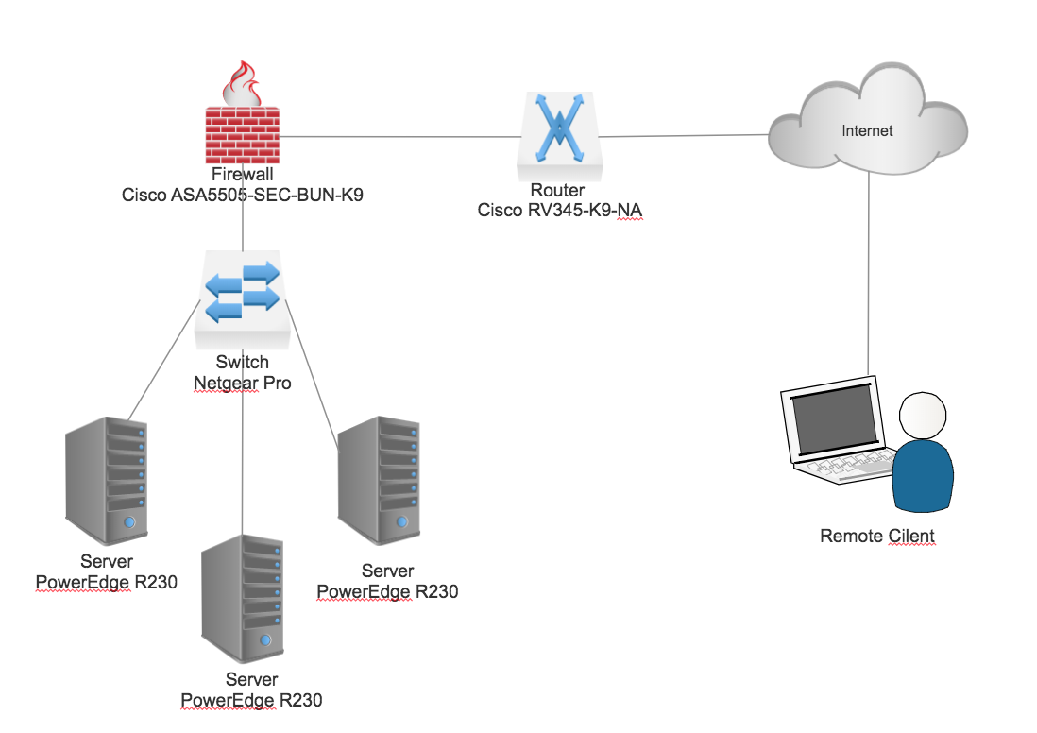
10k Network Topography

Slide 5
$20,000 Budget Components
Server: Cisco B200 M5 Blade server Model: UCS-SP-B200M5-S1
Switch: Netgear 24-port Gigabit Smart managed Pro Switch
Router: Cisco 1941 Wireless Router
Firewall Device: Cisco ASA5510 Model: ASA5510-SEC-BUN-K9
Network Services: Google Fiber 100 Mbps/sec
Emergency Supply System: APC Smart UPS C 1500Va RM 2U
Desktop Accessories: Dell U2417H Monitor (3)

Slide 6
$20,000 Budget Overview
Category | Component | Unit Price | Total Price
Server x 3 | Cisco B200 M5 Blade | $5,165.51 x 3 | $15,496.53
Firewall | Cisco ASA5510 | $979.93 | $979.93
Switch | Netgear 24-port Gigabit | $229.53 | $229.53
Router | Cisco 1941 Wireless | $459 | $459
Network Service | Google Fiber | $250 x 12 | $3,000
Emergency PSU | APC Smart-UPS C | $579 | $579
Desktop Accessories | Dell U2417H Monitor | $269.99 x 3 | $809.97
Total Cost |  |  | $21,553.96 (+$1,553.96)

Slide 7
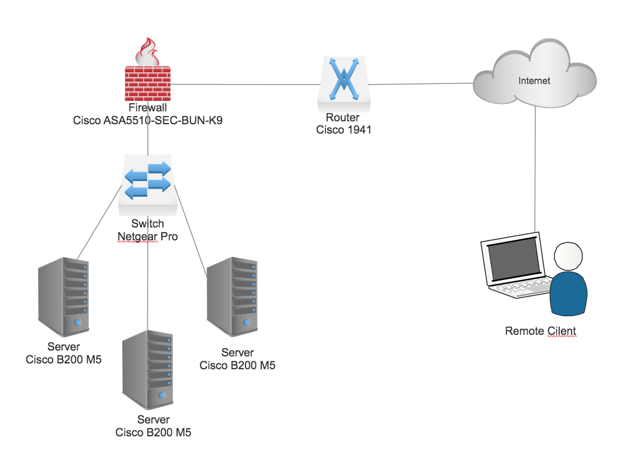
20k Network Topography

