Slide 1
ITEC 451 Project 2
Charisse, Chris, Eileen

Slide 2
Build Small Office Network
Three Servers
Firewall Device
Switch & Router
10 VPN Network
Budget
  $10,000
  $20,000

Slide 3
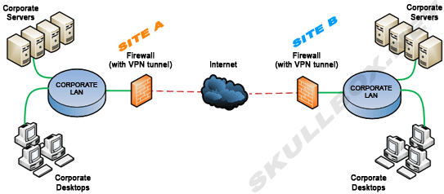
TOPOLOGY
Taken from http://www.skullbox.net/vpns/sitetosite.gif

Slide 4
BUDGET
$10,000
$20,000
WatchGuard XTM 26
WatchGuard XTM 26 3-year security software suite
Dell PowerEdge T320
Dell PowerEdge T320
Dell PowerEdge T110 II
Cisco RV016 Multi-WAN VPN Router
Cisco ASA 5512-X Firewall
Avatar A-Workstation Mid-Tower ATX
Lenovo ThinkServer TS140
Lenovo ThinkServer TS140

Slide 5
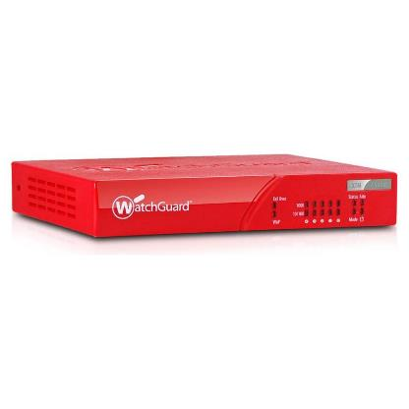
$10,000 Budget
Router/firewall/switch
WatchGuard XTM 26
5x 10/100/1000 Interfaces
Up to 40 VPN connections
Firewall protection
  Packet inspection
  Blocks spyware, DoS attacks, etc.
Item cost: $851

Slide 6

Firewall Software
WatchGuard XTM 26 3-year Security Software Suite
Comprehensive threat management including
  Gateway AntiVirus
  IPS
  SpamBlocker
  WebBlocker
  Reputation Enabled Defense
  Application Control
LiveSecurity 12x5 support is included
Item cost: $1,030
Total: $1,881

Slide 7
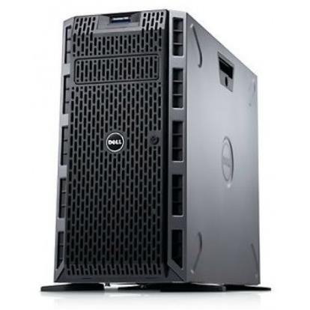
Database Server
Dell PowerEdge T320
Intel Xeon E5-2430L 2.00GHz 6 core
4 x 4GB RDIMM
Fedora Linux
2 x 2TB 7.2l RPM SATA
On-Board Broadcom 5720 Dual Port 1GB LOM
Item cost: $2,098
Total: $3,979

Slide 8
Mail Server
Dell PowerEdge T320
Intel Xeon E5-2420 1.90GHz 6 Core
2 x 4GB RDIMM
Windows Server 2012, Standard Edition
2 x 2TB SATA – RAID 0
On-Board Broadcom 5720 Dual Port 1GB LOM
Item cost: $2,190
Total: $6,169

Slide 9
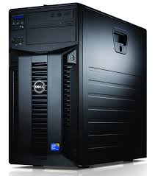
Web Server
Dell PowerEdge T110 II
Intel Xeon E3-1220v2 3.10 GHz Quad Core
16 GB Memory (2 x 8GB)
Windows Server 2012, Essentials Edition
2 x 500GB – RAID 0
On-Board Gigabit network adapter
Item cost: $1,369
Total: $7,538

Slide 10
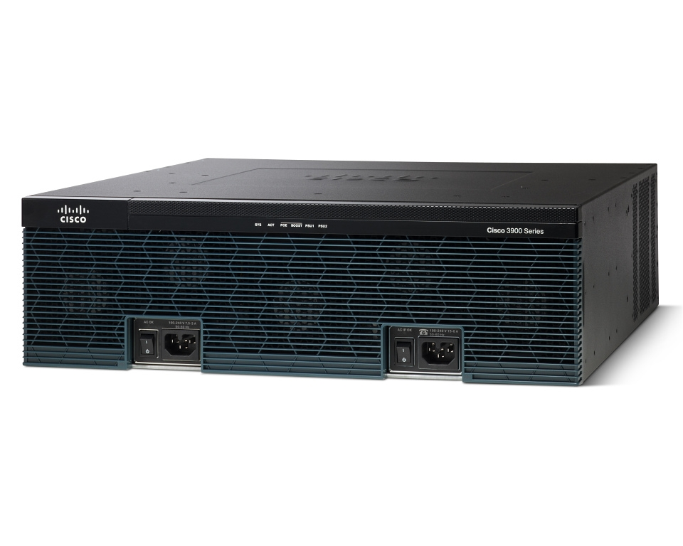
$20,000 budget
Cisco 3925-SEC/k9 Integrated Services Router Bundle w/ Security license
Supports VMware ESXi, and MS hypervisor
Up to 98 LAN switch ports, 4 Enhanced High-Speed WAN Interface Card slots
4 GB Flash Memory
Security
  Embedded hardware-accelerated VPN encryption and Cisco Cloud Web Security
  Integrated threat control using Cisco IOS Firewall and Cisco IOS IPS
Item Cost: $5995.99

Slide 11
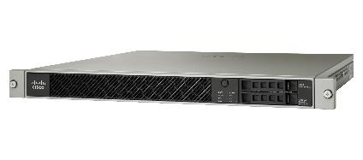
Firewall
Cisco ASA 5512-X Firewall
3Gbps Stateful inspection throughput
Triple Data Encryption Standard/Advanced Encryption Standard (3DES/AES) VPN
IPsec VPN peers (2500 Users)
Cisco AnyConnect Premium VPN peers (included; 2500maximum)
Memory 12GB/Flash Memory 8GB
Multibus architecture
Item cost: $10,299.99
Total: $ 16295.98

Slide 12
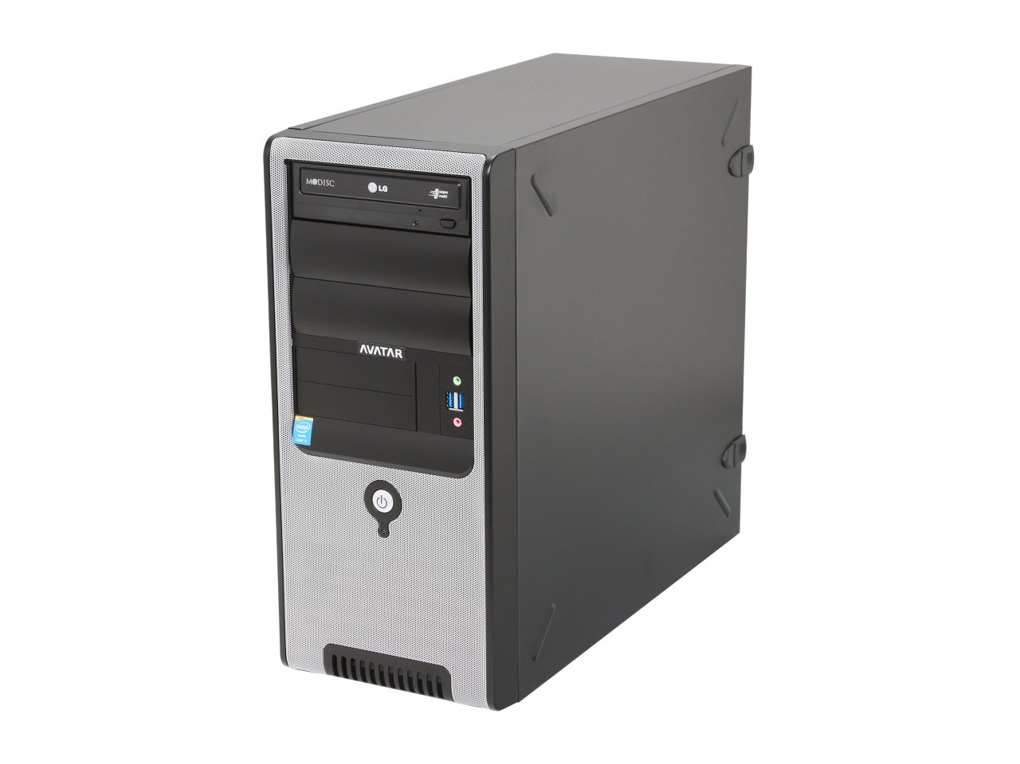
Mail Server
Avatar A-Workstation Mid-Tower ATX Server System
Intel Core i7-4770 3.4GHz 4 core
16 GB RAM
120 GB SDD (boot up drive)
2TB SATAIII 7200RPM HDD
OS: Windows Exchange Server 2012
Item cost: $1349.99
Total: $17645.97

Slide 13
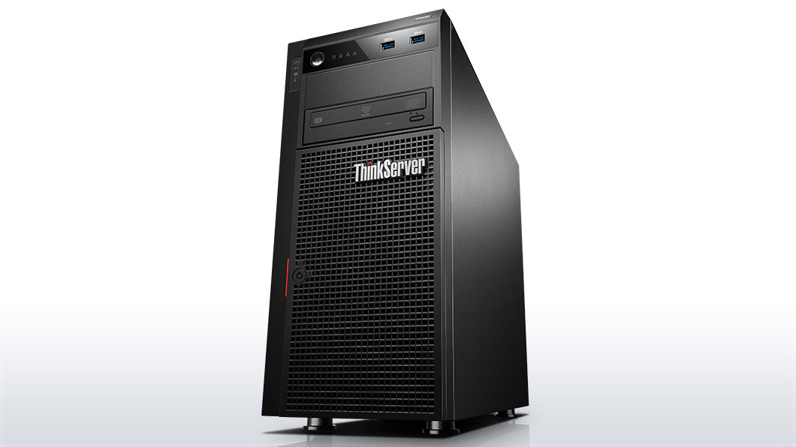
Database Server
Lenovo ThinkServer TS140 Tower Server System
Intel Xeon E3-1225 v3 3.2GHz
4GB Ram
2x 500 GB 7200 RPM 3.5”
OS: Apache
Item cost: $1109.99
Total: $18755.96

Slide 14
Web Server
Lenovo ThinkServer TS140 Tower Server System
Intel Xeon E3-1225 v3 3.2GHz
4GB Ram
2x 500 GB 7200 RPM 3.5”
OS: Apache
Item cost: $1109.99
Total: $19865.95

Slide 15
References
http://www.skullbox.net/vpns/sitetosite.gif
http://cdn.shopify.com/s/files/1/0158/8830/products/watchguard_9288431_large.png?v=1340563938
www.newegg.com
www.microsoft.com
http://www.cisco.com/c/en/us/products
www.dell.com/us/business/p/servers
http://www.watchguard.com/products/xtm-2/overview.asp
http://i.dell.com/das/dih.ashx/232w/sites/imagecontent/business/smb/product/en/PublishingImages/2769_poweredge_t420_232x249.png
http://i.dell.com/das/xa.ashx/global-site-design%20WEB/35ed4767-7b18-f967-7d86-2a8279327c0c/1/OriginalPng?id=Dell/Product_Images/Dell_Enterprise_Products/Enterprise_Systems/PowerEdge/PowerEdge_T310/hero/server-poweredge-t310-left-hero-504x350.png
http://www.watchguard.com/images/ripley/product/xtm2_lt_lrg.jpg

