Slide 1

Wireless Networks
5G Technologies
Notes:
[List of Acronyms in alphabetic order]
CSI Channel State Information
DL Downlink
DRX Discontinuous Reception
eMBB enhanced Mobile Broadband
FDD Frequency Division Duplex
FR Frequency Range
GEO Geosynchronous Orbit
HAP High-Altitude Platform
HARQ Hybrid Automatic Repeat Request
LEO Low Earth Orbit
LTE-M Long Term Evolution - Machine Type Communication
MIMO Multiple-Input and Multiple-Output
NB-IoT Narrow Band-Internet of Things
NC-JT Noncoherent Joint Transmission
NTN Non-Terrestrial Network
PAPR Peak to Average Power Ratio
QoE Quality of Experience
RAN Radio Access Network
SI Study Item
SR Scheduling Request
TCI Transmission Configuration Indicator
TDD Time Division Duplex
TRP Transmission Reception Point
UE User Equipment
UL Uplink
URLCC Ultra-Reliable Low-Latency Communication
V2X Vehicle-to-Everything
WI Work Item
XR eXtended Reality
3GPP 3rd generation partnership project

Slide 2
Table of Contents
Why 5G Communications?
Possible Applications using 5G
Network Fundamentals
Before 5G Communications
5G Communications
Security Issues
Assignment 1: Research
Assignment 2: Hands-on
Summary

Slide 3
Table of Contents
Why 5G Communications?
Possible Applications using 5G
Network Fundamentals
Before 5G Communications
5G Communications
Security Issues
Summary

Slide 4
Why 5G Communications?

Slide 5

Why 5G Communications?
eMBB (Enhanced Mobile Broadband)
  Faster Throughput and Bandwidth
URLLC (Ultra-reliable and Low Latency Communication)
  4G is not enough for real-time response.
  Uninterrupted Services
mMTC (massive Machine Type Communication)
  Exponentially Increasing # of Users/Devices
More Flexible Architecture
Intelligent Network
Energy Efficiency
More Secure than 4G
Notes:
ITU
https://www.itu.int/en/membership/documents/missions/gva-mission-briefing-5g-28sept2016.pdf
Why 5G communication?
1. ultra-reliable and low latency communications and
2. massive machine-type communications

Slide 6
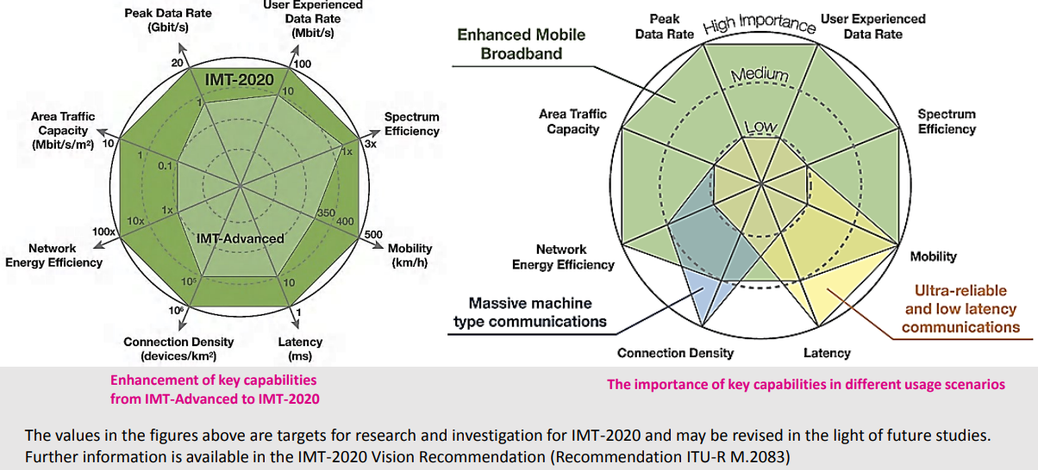
5G Capability Perspectives from the ITU-R IMT-2020 Vision Recommendation
Emerging Trends in 5G/IMT2020, ITU, https://www.itu.int/en/membership/documents/missions/gva-mission-briefing-5g-28sept2016.pdf

Slide 7
Possible Applications using 5G

Slide 8
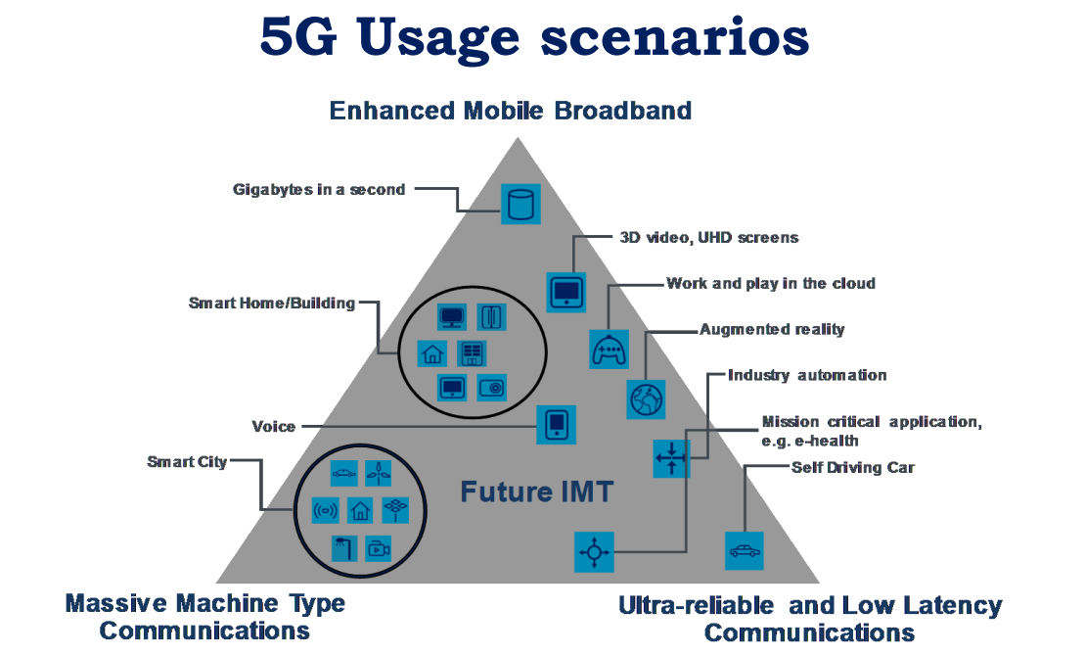
5G Usage Scenarios (1)
Emerging Trends in 5G/IMT2020, ITU, https://www.itu.int/en/membership/documents/missions/gva-mission-briefing-5g-28sept2016.pdf
Notes:
eMBB
mMTC
uRLLC

Slide 9
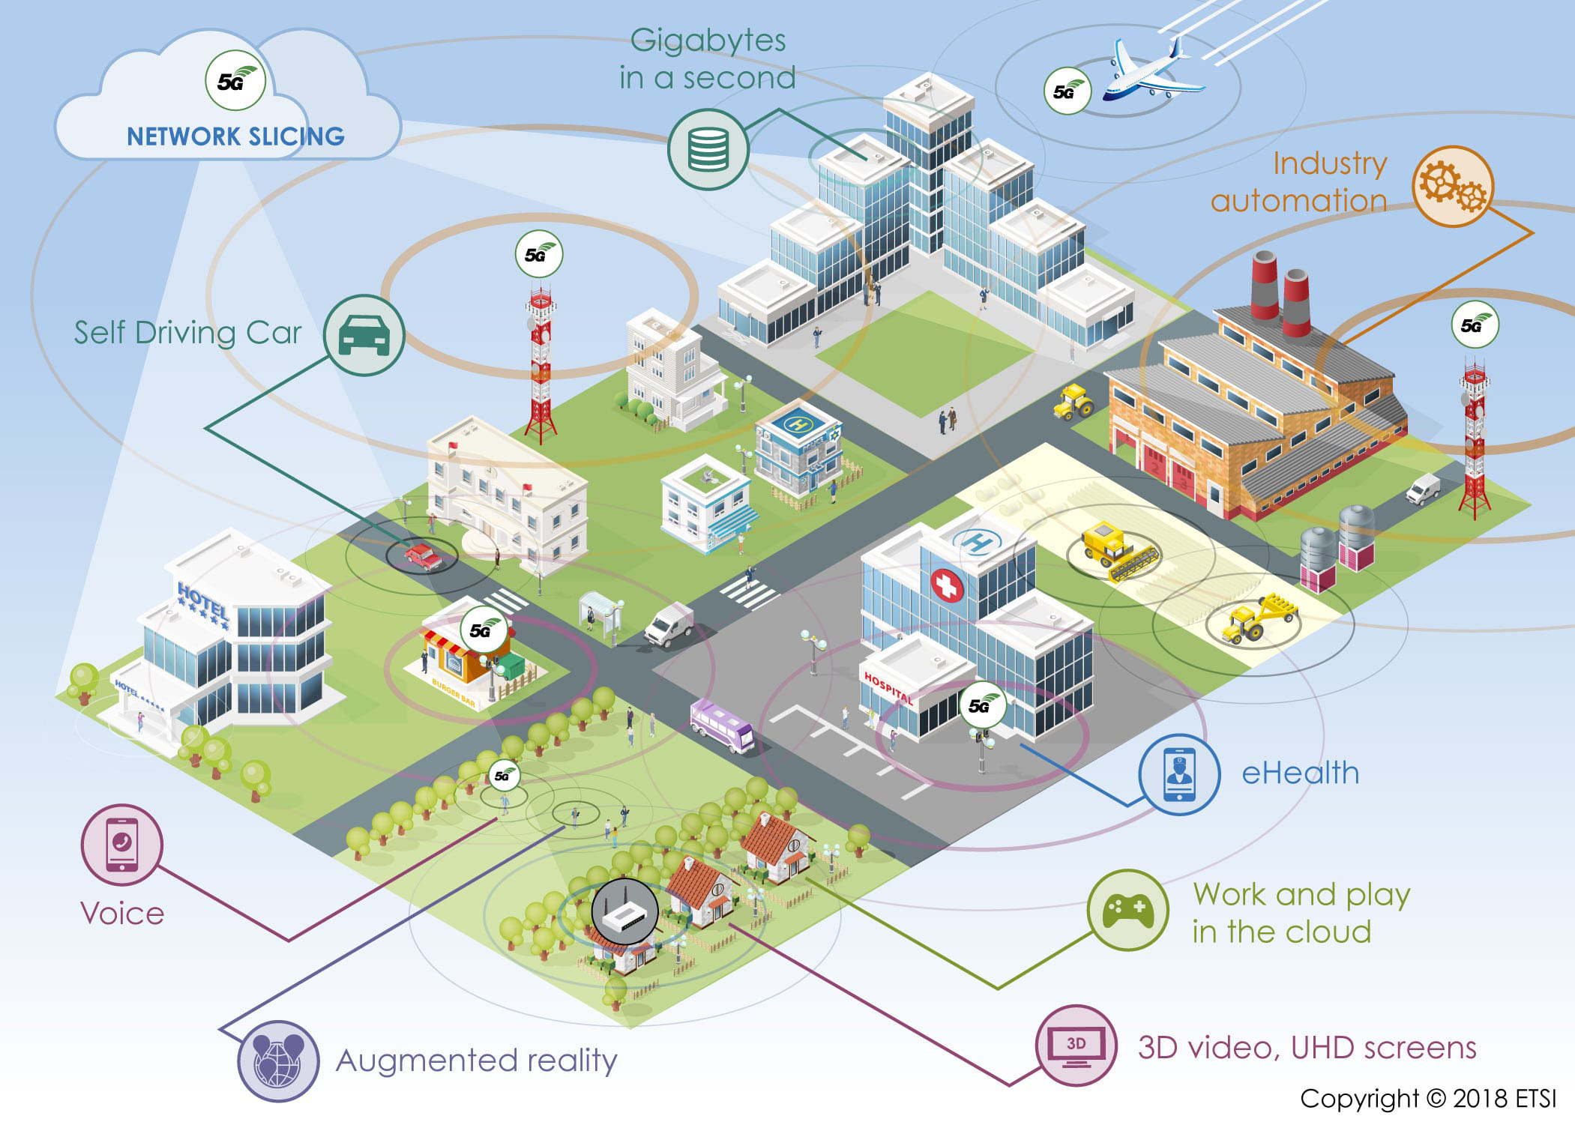
5G Usage Scenarios (2)
European Telecommunications Standards Institute (ESTI), https://www.etsi.org/technologies/5G

Slide 10
Network Fundamentals

Slide 11

What is Computer Networks?
A collection of autonomous computers interconnected by a single or multiple technologies
  Interconnected via:
    Copper wire
    Fiber optics
    Microwaves
    Infrared
    Communication satellites, etc.

Slide 12
What is a protocol?
Communications between computers requires very specific unambiguous rules
A protocol is a set of rules that governs how two or more communicating parties are to interact
  Internet Protocol (IP)
  Transmission Control Protocol (TCP)
  HyperText Transfer Protocol (HTTP)
  Simple Mail Transfer Protocol (SMTP)

Slide 13
What is a communication network?
The equipment (hardware & software) and facilities that provide the basic communication service
Virtually invisible to the user; Usually represented by a cloud
Equipment
  Routers, servers, switches, multiplexers, hubs, modems, …
Facilities
  Copper wires, coaxial cables, optical fiber
  Ducts, conduits, telephone poles …
How are communication networks designed and operated?

Slide 14
Communication Network Architecture
Network architecture: the plan that specifies how the network is built and operated
Architecture is driven by the network services
Overall communication process is complex
Network architecture partitions overall communication process into separate functional areas called layers

Slide 15
OSI Reference Model
Application
Application
Layer
Presentation
Layer
Session
Layer
Transport
Layer
Network
Layer
Data Link
Layer
Physical
Layer

Slide 16
OSI Reference Model & TCP/IP Protocol Stack
OSI 7 Layers
TCP/IP Protocol
Application
Application
Application
Layer
Application
Layer
Presentation
Layer
Session
Layer
Transport
Layer
TCP
UDP
Network
Layer
IP Layer
Data Link
Layer
Network
Interface
Layer
Physical
Layer

Slide 17
Headers & Trailers
Application
APP DATA
Application
Application
Layer
AH
APP DATA
Application
Layer
Transport
Layer
Transport
Layer
TH
AH
APP DATA
Network
Layer
NH
TH
AH
APP DATA
Network
Layer
Data Link
Layer
Data Link
Layer
DH
NH
TH
AH
APP DATA
CRC
Physical
Layer
bits
Physical
Layer

Slide 18
Layers, Services & Protocols
n+1
entity
n+1
entity
n-SDU
n-SDU
n-SAP
n-SAP
n-SDU
H
n entity
n entity
H
n-SDU
n-PDU

Slide 19
Connectionless & Connection-Oriented Services
Connection-Oriented
  Three-phases:
    Connection setup between two SAPs to initialize state information
    SDU transfer
    Connection release
  e.g. TCP, ATM
Connectionless
  Immediate SDU transfer
  No connection setup
  e.g. UDP, IP

Slide 20
Segmentation & Reassembly
Segmentation
Reassembly
n-SDU
n-SDU
n-PDU
n-PDU
n-PDU
n-PDU
n-PDU
n-PDU

Slide 21
Multiplexing
n+1
entity
n+1
entity
n+1
entity
n+1
entity
n-SDU
n-SDU
n-SDU
H
n entity
n entity
H
n-SDU
n-PDU

Slide 22
Multiplexing
FDM (Frequency Division Multiplexing)
TDM (Time Division Multiplexing)

Slide 23
Before 5G Communications

Slide 24
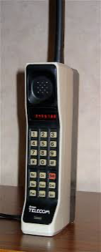
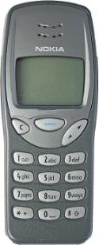
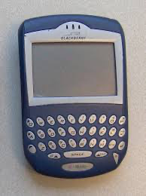
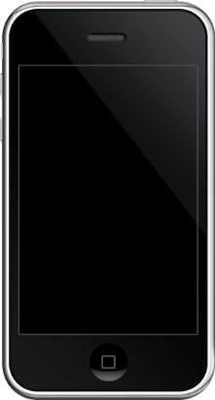
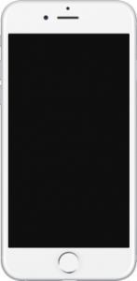
Before 5G Communications
1G
1979~
4G
2009~
5G
2019~
2G
1991~
3G
2001~
Image Source: https://www.cengn.ca/information-centre/innovation/timeline-from-1g-to-5g-a-brief-history-on-cell-phones/
Notes:
https://commsbrief.com/what-do-the-terms-1g-2g-3g-4g-and-5g-really-mean/#:~:text=1G%2C%202G%2C%203G%2C%204G%20and%205G%20are%20the%20five,Stands%20for
Timeline & History of 1g, 2g, 3g, 4g, and 5g
https://www.cengn.ca/information-centre/innovation/timeline-from-1g-to-5g-a-brief-history-on-cell-phones/

Slide 25
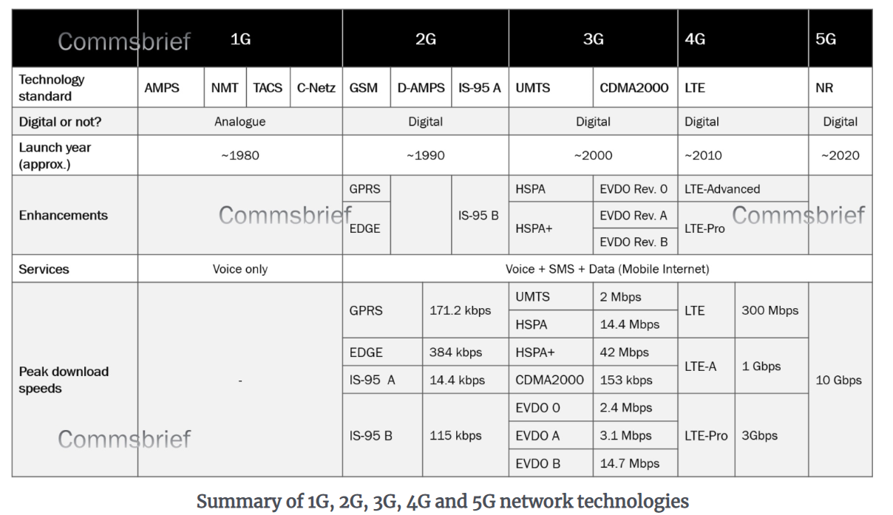
Before 5G Communications
Adnan Ghayas, “What do the terms 1G, 2G, 3G, 4G and 5G really mean?,” COMMSBRIEF, March 3, 2020
https://commsbrief.com/what-do-the-terms-1g-2g-3g-4g-and-5g-really-mean/#:~:text=1G%2C%202G%2C%203G%2C%204G%20and%205G%20are%20the%20five,Stands%20for
Notes:
https://commsbrief.com/what-do-the-terms-1g-2g-3g-4g-and-5g-really-mean/#:~:text=1G%2C%202G%2C%203G%2C%204G%20and%205G%20are%20the%20five,Stands%20for

Slide 26
5G Communications

Slide 27

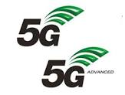

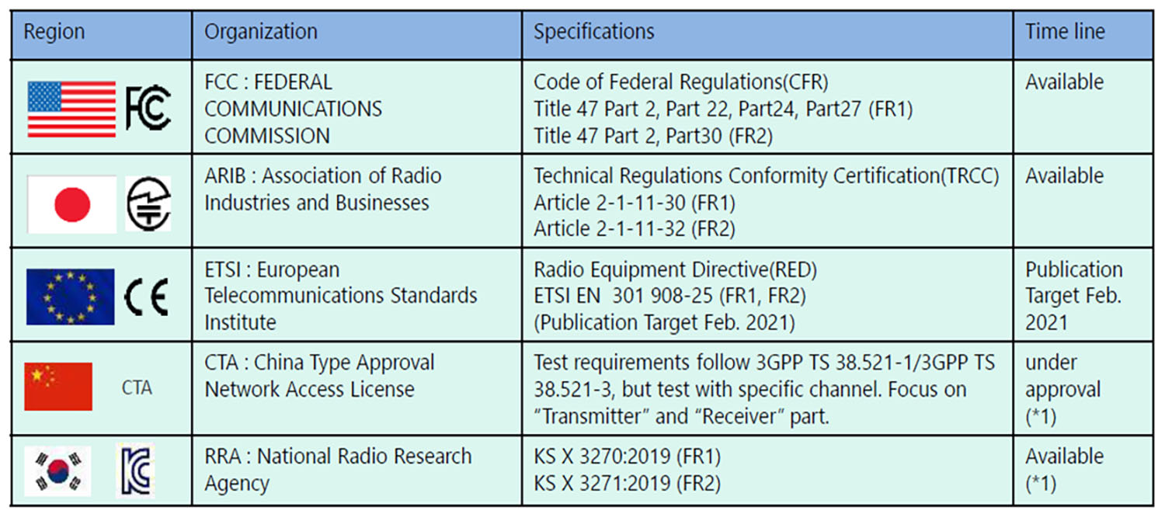
5G Standard and Specification
International Telecommunication Union (ITU)
Overall Concepts
The 3rd Generation Partnership (3GPP)
Specifications
2G | Phases 1, 2, 2+, Releases 97, 98
3G | Releases 99, Release 4, 5, 6, 7
4G | Releases 8, 9, 10, 11, 12, 13, 14
5G | Releases 15, 16, 17, 18, 19
https://www.5gtechnologyworld.com/5g-radios-increase-emphasis-on-compliance-testing/

Slide 28
5G Capability Perspectives from the ITU-R IMT-2020 Vision Recommendation
Emerging Trends in 5G/IMT2020, ITU, https://www.itu.int/en/membership/documents/missions/gva-mission-briefing-5g-28sept2016.pdf

Slide 29
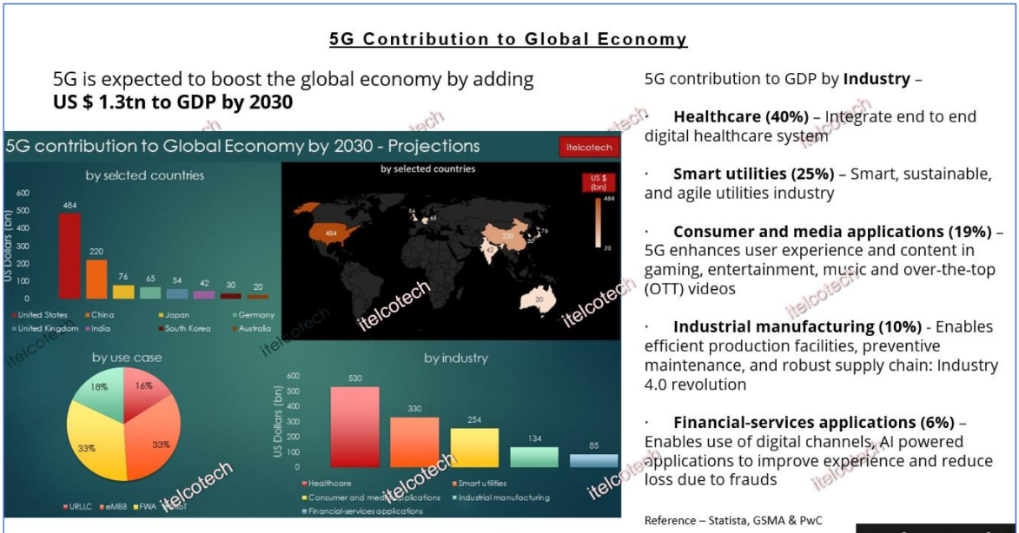
Reference

Slide 30
5G Network Architecture
Notes:
UMTS: Universal Mobile Telecommunications Service
eNodeB: evolved Node Base-station
DU: Distributed Unit
CU: Central Unit

Slide 31
5G NR (New Radio) Architecture
Notes:
RAN: Radio Access Network
RF
PHY
MAC
RLC: Radio Link Control
SDAP
RRC

Slide 32
Radio
Unit
Analog to Digital / Digital to Analog
Distributed
Unit
Modulation, Coding and Rate Matching
Scheduling, HARQ (Hybrid Automatic Repeat Request), Multiplexing/Demultiplexing
ARQ, Segmentation
Central
Unit
Robust Header Compression (RoHC), Security
QoS Flow Handling
Public Land Mobile Network (PLMN) ID selection, SIB, Mobility, 5GC Connect
Notes:
SIB: System Information Block
https://www.techplayon.com/5g-nr-system-information-type1-sib-1/

Slide 33
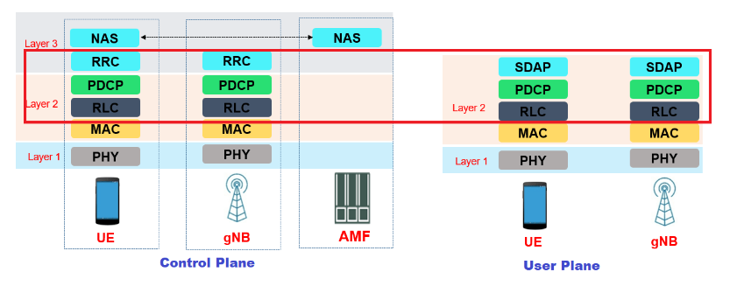
“5G NR Layer 2 – Packet Data Convergence Protocol (PDCP) Overview,” January 5, 2022,
https://www.techplayon.com/5g-nr-layer-2-packet-data-convergence-protocol-pdcp-overview/
Notes:
https://en.wikipedia.org/wiki/Non-access_stratum
Non-access stratum (NAS) is a functional layer in the NR, LTE, UMTS and GSM wireless telecom protocol stacks between the core network and user equipment. This layer is used to manage the establishment of communication sessions and for maintaining continuous communications with the user equipment as it moves. The NAS is defined in contrast to the Access Stratum which is responsible for carrying information over the wireless portion of the network.

Slide 34
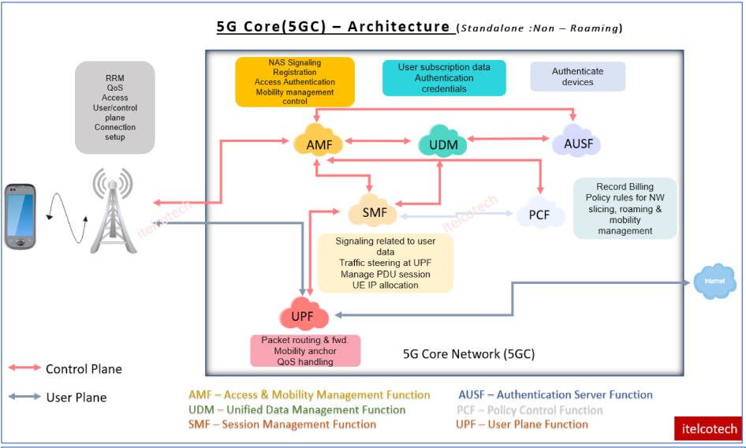
Reference: 5G Core
Note 7
Notes:
Note 7
다시 공부해서 꼭 필요한 부분만 설명해주기
Network Slide가 뭔지 설명해주기

Slide 35
5G Core Architecture

Slide 36
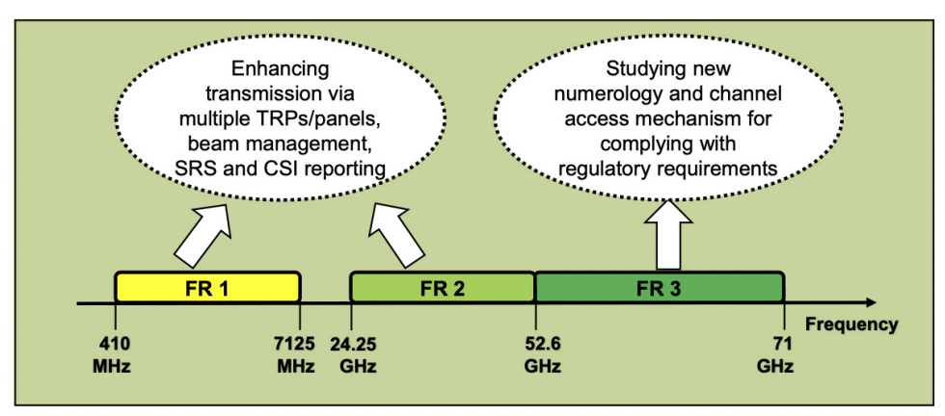
Frequency Bands & SUL Coverage
Frequency Bands
SUL (supplementary Uplink) Coverage
Hua Shou, “New Features in the Next Release of 5G New Radio,”
https://ofinno.com/wp-content/uploads/2020/08/OFNO_White_Sheet_082120.pdf
Notes:
Numerology: Numerology in 5G/NR refers to Sub Carrier Spacing (SCS).
What is the advantage of numerology in 5G?
It allows the 5G base station (known as the gNB) to allocate radio resources in a more flexible way. As a first step, the sub-carrier spacing can be increased from 15 to 30 kHz. To put it very simply, that means that we double the resources in the frequency domain.
What is numerology 0 in 5G?
In 5G NR, subcarrier spacing of 15, 30, 60, 120 and 240 KHz are supported. As you see here, each numerology is labled as a parameter (u, mu in Greek). The numerology (u = 0) represents subcarrier spacing of 15 kHz which is same as LTE.

Slide 37
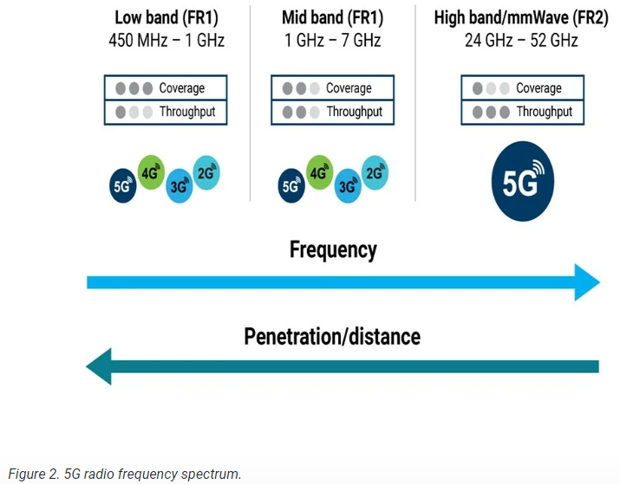
https://www.exfo.com/es/recursos/blog/rf-5g-new-radio-top-5-questions/

Slide 38
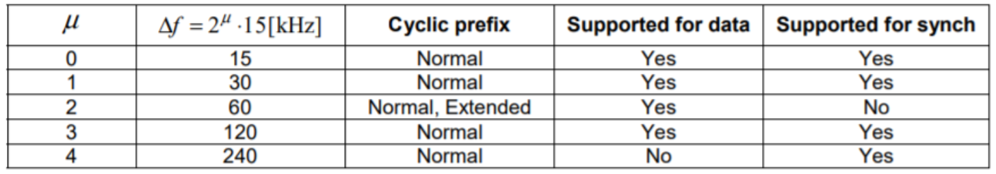
Numerology: Subcarrier Spacing (SPS)
5G NR frame structure with multiple numerology parameters
Supported Transmission Numerology
Notes:
https://info-nrlte.com/2020/04/25/introduction-to-numerology/
Numerology corresponds to one subcarrier spacing in the frequency domain. NR supports a flexible numerology with a range of subcarrier spacings, based on scaling a baseline subcarrier spacing of 15 kHz. By scaling a reference subcarrier spacing by an integer N, different numerologies can be defined.
Numerology: Numerology in 5G/NR refers to Sub Carrier Spacing (SCS).
What is the advantage of numerology in 5G?
It allows the 5G base station (known as the gNB) to allocate radio resources in a more flexible way. As a first step, the sub-carrier spacing can be increased from 15 to 30 kHz. To put it very simply, that means that we double the resources in the frequency domain.
What is numerology 0 in 5G?
In 5G NR, subcarrier spacing of 15, 30, 60, 120 and 240 KHz are supported. As you see here, each numerology is labled as a parameter (u, mu in Greek). The numerology (u = 0) represents subcarrier spacing of 15 kHz which is same as LTE.

Slide 39
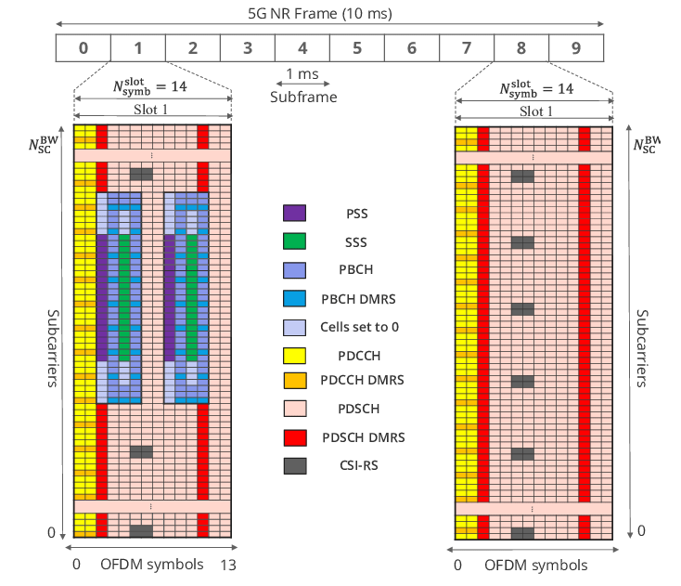
Jose Luis Carcel, Belkacem Mouhouche, Manuel Fuentes, and Edurado Garro, “IMT-2020 Key Performance Indicators: Evaluation and Extension Towards 5G New Radio Point-to-Multipoint,”
IEEE International Symposium on Broadband Multimedia Systems and Broadcasting, 2019, DOI:10.1109/BMSB47279.2019.8971948

Slide 40
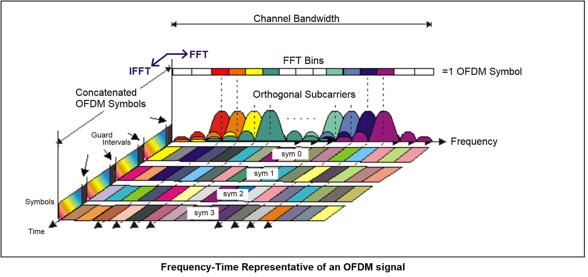
OFDMA
(Orthogonal Frequency Division Multiple Access)
Combined time/frequency domain view of OFDM signal. (Image: Keysight Technologies)
https://www.5gtechnologyworld.com/the-basics-of-5gs-modulation-ofdm/

Slide 41
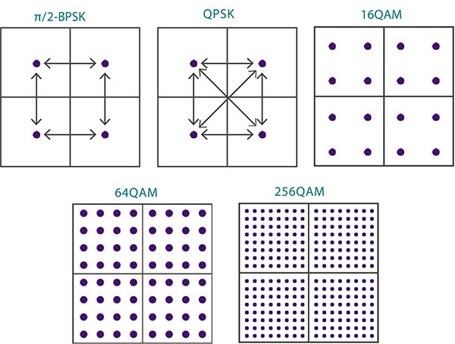
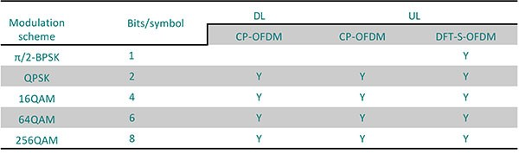
Modulation
Houman Sadeghi Kaji, “Understanding 5G, A Practical Guide to Deploying and Operating 5G Networks, 5G New Radio,”Sept 1, 2021
https://www.linkedin.com/pulse/understanding-5g-practical-guide-deploying-operating-new-houman

Slide 42
Duplex Schemes
TDD
  Uplink and downlink transmission use the same carrier frequency and are separated in different time slices
FDD
  Uplink and downlink transmission use the different frequencies simultaneously

Slide 43
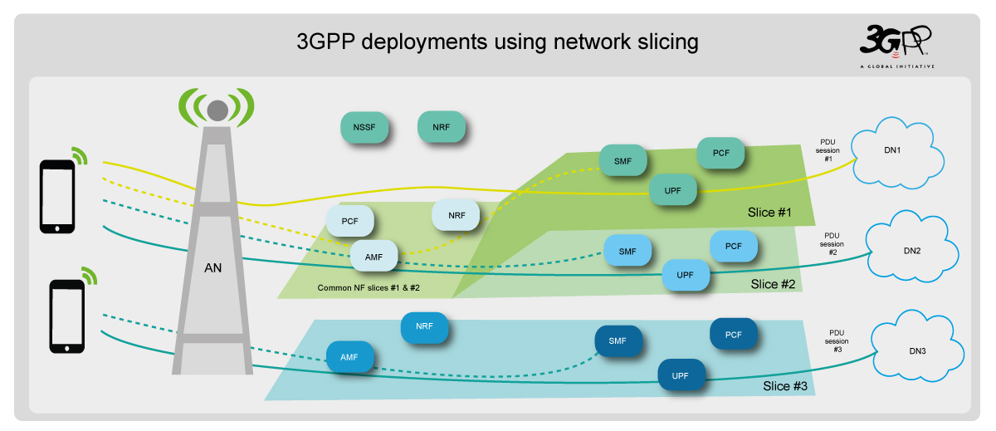
Network Slicing
https://www.3gpp.org/news-events/3gpp-news/sys-architecture

Slide 44
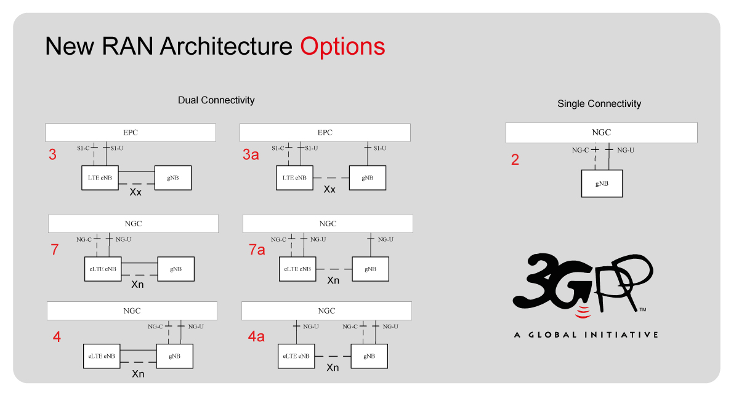
Deployment Options:
Standalone vs. Non-Standalone
- - - Control Plane
___ User Plane
https://www.3gpp.org/news-events/3gpp-news/sys-architecture

Slide 45
Antenna: MIMO
(Multiple Input Multiple Output)
Spatial Diversity: Improve Coverage
Spatial Multiplexing: Higher Data Rate (Spectral Efficiency)
=> mMIMO (massive MIMO)
  Standard MIMO usually uses 2 or 4 antennas.
  mMIMO uses as many as 96 to 128 antennas.
Tx arrays | Rx arrays | MIMO
2 | 2 | 2*2
4 | 2 | 4*2
2 | 4 | 2*4
4 | 4 | 4*4
8 | 8 | 8*8

Slide 46
Beaming
Spatial Multiplexing - MIMO

Slide 47
Beamforming and Coverage

Slide 48
5G Security Issues
[References] https://en.wikipedia.org/wiki/5G

Slide 49
The attack surface is getting bigger
  IoT devices, enabled by 5G technology, from 7 billion in 2018 to 21.5 billion by 2025:
    (ex) the capacity for DDoS attacks, cryptojacking, and other cyberattacks
  "immature and insufficiently tested," and "enables the movement and access of vastly higher quantities of data, and thus broadens attack surfaces“
Fears of potential espionage of users of foreign equipment vendors
Electromagnetic Interference
Reference: "A Formal Analysis of 5G Authentication,“ ETH Zurich, the University of Lorraine and the University of Dundee, October 18, 2018
Notes:
https://en.wikipedia.org/wiki/5G
Health:
According to the New York Times, one origin of the 5G health controversy was an erroneous unpublished study that physicist Bill P. Curry did for the Broward County School Board in 2000 which indicated that the absorption of external microwaves by brain tissue increased with frequency.^{[136]}
According to experts this was wrong, the millimeter waves used in 5G are safer than lower frequency microwaves because they cannot penetrate the skin and reach internal organs.

Slide 50
"The Clean Network"
  Launched in August, 2020
    the U.S. State Department launched "The Clean Network" as a U.S. government-led, bi-partisan effort to address:
      "the long-term threat to data privacy, security, human rights and principled collaboration posed to the free world from authoritarian malign actors".
  More than 60 nations had publicly committed by December 2020
    The United States announced that:
      more than 60 nations, representing more than two thirds of the world's gross domestic product,
      and 200 telecom companies
    This alliance of democracies included:
      27 of the 30 NATO members; 26 of the 27 EU members, 31 of the 37 OECD nations, 11 of the 12 Three Seas nations as well as South Korea, Japan, Israel, Australia, Singapore, Taiwan, Canada, Vietnam, and India.
Notes:
"The Clean Network"
In August, 2020, the U.S. State Department launched "The Clean Network" as a U.S. government-led, bi-partisan effort to address what it described as "the long-term threat to data privacy, security, human rights and principled collaboration posed to the free world from authoritarian malign actors".
In December 2020, the United States announced that more than 60 nations, representing more than two thirds of the world's gross domestic product, and 200 telecom companies, had publicly committed to the principles of The Clean Network. This alliance of democracies included 27 of the 30 NATO members; 26 of the 27 EU members, 31 of the 37 OECD nations, 11 of the 12 Three Seas nations as well as Japan, Israel, Australia, Singapore, Taiwan, Canada, Vietnam, and India.

Slide 51
Assignments

Slide 52
Assignment 1: Research
Write a one-page summary on possible applications using 5G technologies, the topics might include, but not limited, to the following:
Emerging Trends in 5G/IMT2020, ITU, https://www.itu.int/en/membership/documents/missions/gva-mission-briefing-5g-28sept2016.pdf

Slide 53
Assignment 2: Hands-on Activity
Guide to get started
Build a network router
  You will receive a Raspberry PI 4 Kit in May.
  A hands-on activity will be posted in D2L.
  Extra zoom session in June or July: Only For those who need to work on the activity.

Slide 54
Summary & Wrap-up

Slide 55
Summary
Why 5G Communications?
Possible Applications using 5G
Network Fundamentals
Before 5G Communications
5G Communications
Security Issues
Assignment 1: Research
Assignment 2: Hands-on
Summary

Slide 56
Summary
Why 5G Communications?
Possible Applications using 5G
Network Fundamentals
Before 5G Communications
5G Communications
Security Issues
Summary

