Slide 1
Student Computer Recommendations

Slide 2
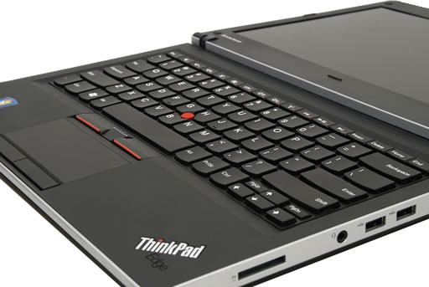
Undeclared New Fresh Man
$630.00
  Lenovo ThinkPad Edge 15" Laptop
  Hardware specification:
  Processor
    Intel Core i3-370M Processor (2.40GHz, 3MB L3, 1066MHz FSB)
  Display type
    15.6" HD AntiGlare, Midnight Black Smooth
  System graphics
    Mobile Intel 5 Series Integrated GFX Chipsets
  Total memory
    2 GB PC3-8500 DDR3 SDRAM 1067MHz SODIMM Memory (1 DIMM)
  Pointing Device
    UltraNav without fingerprint reader
  Hard Drive
    500 GB Hard Disk Drive, 7200rpm
  Optical device
    DVD Recordable 8x Max Dual Layer
  Battery
    6 cell 2.2Ah Li-Ion Battery
  Integrated WiFi wireless LAN adapters
    ThinkPad bgn Wireless
  Operating System
    Genuine Windows 7 Home Premium 64
    Microsoft office will be needed.
Source: http://shop.lenovo.com/SEUILibrary/controller/e/web/LenovoPortal/en_US/catalog.workflow:category.details?current-catalog-id=12F0696583E04D86B9B79B0FEC01C087&current-category-id=99C4BAF867E7467F9E0FAD4487A0A719
Notes:
Why? Since the user is a freshman, he will be living in the dorms. The dorms are usually pretty small and fitting a desktop might be an issue. Also, if the new freshman likes to use technology to assist with school work, carrying a laptop to class will be nice. In that case, you don’t want a huge screen on your laptop; you want something not too big and not too small. You always want to get quality product but with a normal price. In this case, I chose Lenovo. Since Radford supports the Lenovo technology, if you run into issues, the IT Support on campus will be able to help out. The model of the laptop would be ThinkPad Edge 15" Laptop with Intel Processor. The price of this product is only $630.

Slide 3
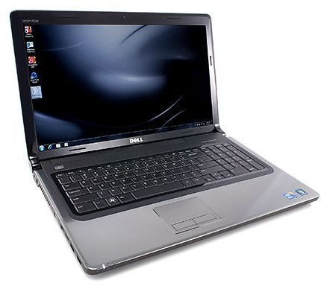
An IT Major
Dell Inspiron 17R
  Processor
    Intel® CoreTM i5 460M (2.53GHz/3MB cache)
  Operating System
    Genuine Windows® 7 Professional 64-Bit
  Memory²
    4GB Shared Dual Channel DDR3
  Chipset
    Mobile Intel® 5 Series Express Chipset (HM57)
  Video Card
    ) ATI HD5470 Mobility RadeonTM Integrated Intel® HD
  Display
    17.3 inch display (1600X900)
  Audio and Speakers
    4-Watt (2 x 2W) High Definition Audio 2.0 Stereo Speakers with SRS Premium Sound™
  Hard Drive
    Up to 640GB³ hard drive (5400RPM)
  Optical Drive
    Internal tray-load DVD+/-RW or Blu-ray Disc™ Combo (Read BD, BurnCD/DVD) Drive
  Power
    9 cell 90 WHr Li-Ion Battery
  Camera
    1.3MP Integrated Webcam
  Wireless
    Opt. Intel® Centrino® Advanced-N + WiMAX 6250 802.11 a/g/n
  Bluetooth
    Dell Wireless 365 Bluetooth Internal (2.1) mini-card
$899.99
  Externally Accessible
    (3) USB 2.0
    (1) combo E-SATA/USB 2.0
    HDMI™ Port
    Standard 7-in-1 Media Card Reader
    Digital (SD) Memory Card
    Hi-Capacity Secure Digital (SDHC)
    Hi-Density Secure Digital (SDHD)
    Multi Media Card (MMC)
    Memory Stick (MS)Memory Stick PRO (MS Pro) xD Picture Card (xD)
Source:
http://www.dell.com/us/p/inspiron-17r/pd
http://echochamber.me/viewtopic.php?f=36&t=43013
Notes:
Why? In the IT field, you will have to write a lot of coding. If you did not go to school and had a full time job, I would recommend a desktop, especially if you like working at home all the time. However, since you are a student, you want something portable. You work a lot in group and the best way to meet up with your members and get things done would be working on your laptop. You need a bigger screen on the laptop just so you can be seeing few windows at once. You need more RAM and HD space because you will have more software and more files that will be taking a lot of space on your laptop. In my opinion, Inspiron 17R Dell will be a perfect choice. In most cases, the people in the IT field usually have some type of interest or background towards technology. You could build your Dell laptop the way you want it and you can decide on how much it’s going to cost.

Slide 4
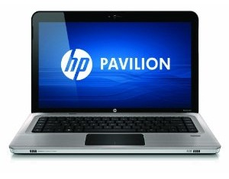
An Interior Design Major
Hp Pavillion dv6-3052nr 15.6 Entertainment laptop
  Processor
    Intel® Core™ i7-720QM processor 1.60GHz with Turbo Boost Technology up to 2.80 GHz
  Operating System
    Genuine Windows® 7 Home Premium 64-bit
  Display
    15.6" diagonal High-Definition HP BrightView LED Display (1366 x 768)
  Memory (RAM)
    6GB DDR3
  Hard Drive
    500GB (7200RPM) SATA with HP ProtectSmart Hard Drive Protection
  Weight & Dimensions (w x d x h)
    5.35 lbs; 14.88" x 9.65" x 1.21"/1.37"
  Battery Life
    Up to 5.15 hours
  Wireless
    Wireless LAN 802.11b/g/n WLAN
  Optical Drive
    LightScribe SuperMulti 8X DVD±R/RW with Double Layer Support
  Video Graphics
    ATI Mobility Radeon™ HD 5650 graphics with 1024MB DDR3 with up to 3738MB
  Software and OS specifications:
    Microsoft Office Suite
    Adobe CS3 or CS4
    Autodesk Architecture Suite
    SketchUp Pro
    Painting/Art software tools.
$945.99
Source:
http://www.amazon.com/dp/B003Y73P44?tag=procompcom-20&camp=213381&creative=390973&linkCode=as4&creativeASIN=B003Y73P44&adid=1TDBJ25C6GE5R3ZKQGMS&
http://art.uga.edu/index.php?pt=1&id=169
Notes:
Why? Recommended that students purchase laptop computers. While these cost more than desktop computers they have significant advantages. Students can bring their computers to work in any studio. They can work both on and off campus, in and out of town. Further, we can help trouble-shoot hardware and software problems on laptops in ways we obviously can not with desktop computers. Macs would probably be more preferable to this case however a PC is always cheaper. You will probably need a big screen and a good graphic card on your machine. HP has known for their design tool that they provide and the quality of the image on their machines. As the result, I would say to buy HP Pavilion dv6-3052nr 15.6-Inch Entertainment Laptop.

Slide 5
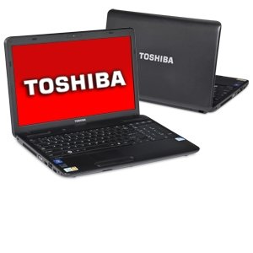
A Business Major
Toshiba Satellite C655-S5090 15.6-Inch Laptop
  Hardware:
    Intel Celeron processor 900 2.2 GHz, 1MB L2 Cache, 800MHz FSB
    Configured with 2GB DDR3 (max 8GB)
    320GB (5400 RPM) Serial ATA hard disk drive, DVD SuperMulti drive supporting 11 formats
    15.6" diagonal widescreen TruBrite TFT display at 1366 x 768 native resolution (HD) with native support for 720p content, Intel Graphics Media Accelerator 4500M with 128MB- 829MB dynamically allocated shared graphics memory
    Genuine Windows 7 Home Premium 64-bit with a 6 cell/48Wh Lithium Ion battery pack; Battery Life (measured by MobileMark 2007): 4 hours, 35 minutes.
  Software:
    Microsoft office
    Maybe some specific software that is requested by the teacher.
$500.00
Source:
http://www.amazon.com/dp/B0041O492Q/ref=asc_df_B0041O492Q1414288?smid=ATVPDKIKX0DER&tag=dealt179907-20&linkCode=asn&creative=395093&creativeASIN=B0041O492Q
http://www.consumersearch.com/cheap-laptops/toshiba-satellite-c655
Notes:
Why? Since it’s always about the money, I will say a college student can have a laptop for a Business Major. It is not like you are running a business on your machine at school; you just have to do the business school related assignments. You can have a very simple laptop. It doesn’t have to be big or have a lot of memory and HD space on it. The laptop I would recommend would be Toshiba Satellite C655-S5090 15.6-Inch Laptop. I have something that is very similar to this laptop, but instead of Toshiba, I have Lenovo. The only reason why I have it, it is because I got my laptop for the same price on black Friday. Other than that, I would have gotten something in this area but with less quality. You have to know when to buy the right product at the right time.

