Slide 1
Computer Recommendations
By: Jonathan Russo and Carroll Wongchote
Date: 02/03/2011
ITEC 451

Slide 2
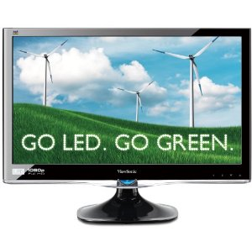
Assumptions
Microsoft Office
Windows 7
Viewsonic: $169
Resolution: 1920 x 1080
Image courtesy of amazon.com

Slide 3
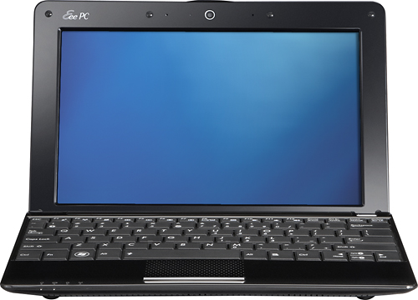
Undeclared Laptop
Asus Netbook
$259.99
Image courtesy of Bestbuy.com
Notes:
http://www.bestbuy.com/site/Asus+-+Eee+PC+Netbook+/+Intel%26%23174%3B+Atom%26%23153%3B+Processor+/+10.1%22+Display+/+1GB+Memory+/+160GB+Hard+Drive+-+Black/1222971.p?id=1218237710153&skuId=1222971

Slide 4
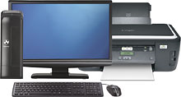
Undeclared Desktop
Gateway SX2803-25e
$599
Image courtesy of Bestbuy.com
Notes:
1+Printer+Package/9999147800050002.p?id=pcmprd147800050002&skuId=9999147800050002

Slide 5
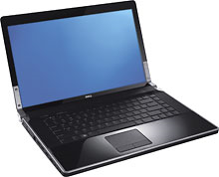
ITEC Laptop
Dell XPS
$1,149.99
Image courtesy of Bestbuy.com
Notes:
http://www.bestbuy.com/site/Dell+-+Studio+XPS+Laptop+/+Intel%26%23174%3B+Core%26%23153%3B+i5+Processor+/+15.6%22+Display+/+4GB+Memory+/+640GB+Hard+Drive+-+Obsidian+Black/1063218.p?id=1218215932284&skuId=1063218&st=labtops&cp=2&lp=15
http://www.bestbuy.com/site/Gateway+SX2803-25e+Desktop%2C+20%22+LCD+Monitor+%26+Wireless+3-in-

Slide 6
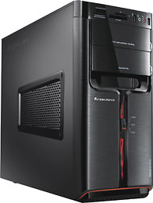
ITEC Desktop
Lenovo K320-30192MU
$999
Image courtesy of Bestbuy.com
Notes:
http://www.bestbuy.com/site/Lenovo+-+Ideacentre+Desktop+/+Intel%26%23174%3B+Core%26%23153%3B+i7+Processor+/+8GB+Memory+/+1TB+Hard+Drive/1492867.p?id=1218262975566&skuId=1492867

Slide 7
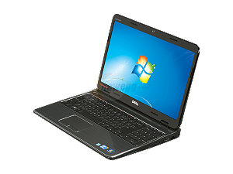
Interior Design Laptop
Dell Inspiron
$679
Image courtesy of newegg.com
Notes:
http://www.newegg.com/Product/Product.aspx?Item=N82E16834200061

Slide 8
Interior Design Desktop
    “All incoming [interior design] students are required to have laptops.” http://id-f.asp.radford.edu/computer-recom.html

Slide 9
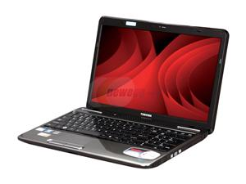
Business Laptop
Toshiba Satellite
$529
No Macs
Image courtesy of newegg.com
Notes:
http://www.newegg.com/Product/Product.aspx?Item=N82E16834214188

Slide 10
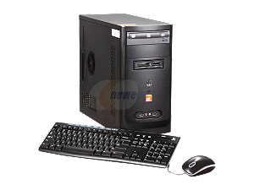
Business Desktop
ZT Element
$379
Image courtesy of Bestbuy.com
Notes:
http://www.newegg.com/Product/Product.aspx?Item=N82E16883241036

