Slide 1

A Network Management Software
Kwan, Chris, & Jonathan
ITEC451 – H. Lee

Slide 2


Contents
What is Untangle?
Packages and Apps
Home Screen
Virus Blocker
Spam Blocker
Web Filter
Misc Apps

Slide 3

What is Untangle?
Founded in 2003 by John Irwin and Dirk Morris, Untangle was originally created under the name Metavize
Software was created to provide full network management in a friendly user interface
Users can purchase apps individually through the main website or purchase specific packages to suit their needs

Slide 4
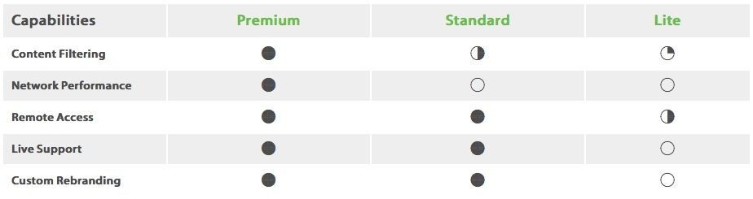
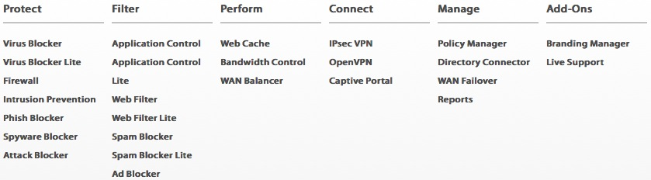
Packages and Apps
One Year
$540.00 1-10 PCs
$432.00 1-10 PCs
FREE

Slide 5
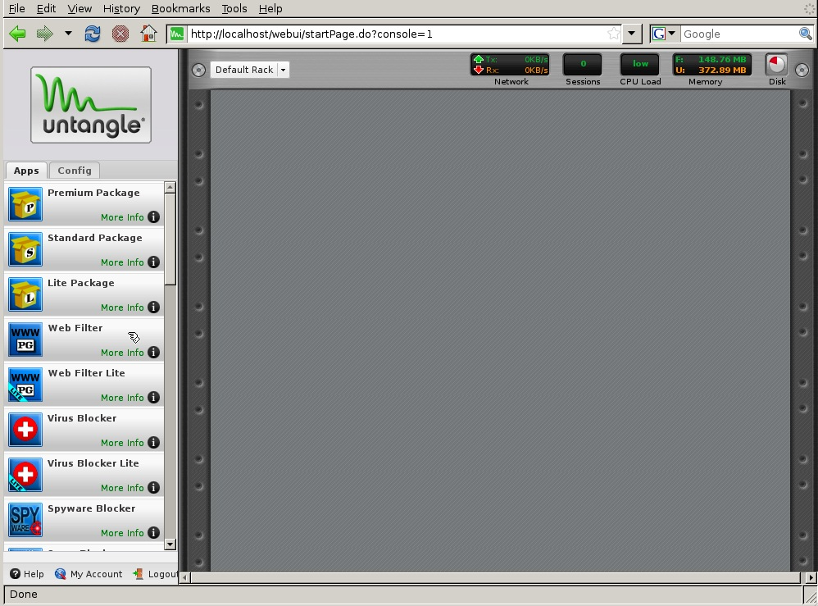
Home Screen UI

Slide 6
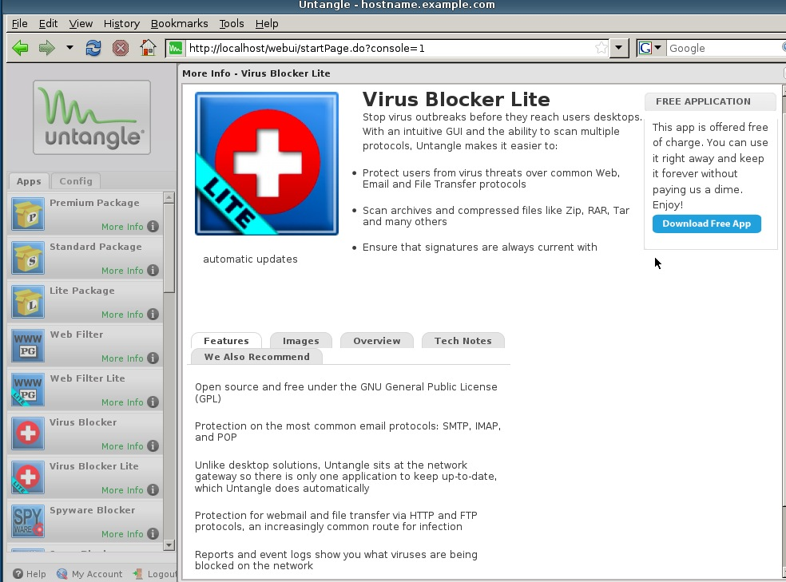
Virus Blocker App

Slide 7
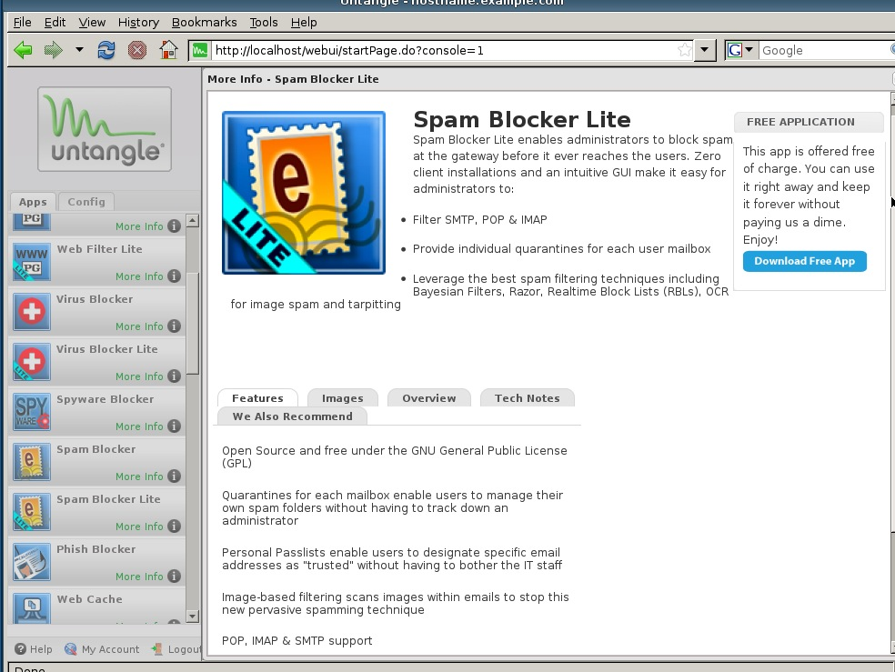
Spam Blocker App

Slide 8
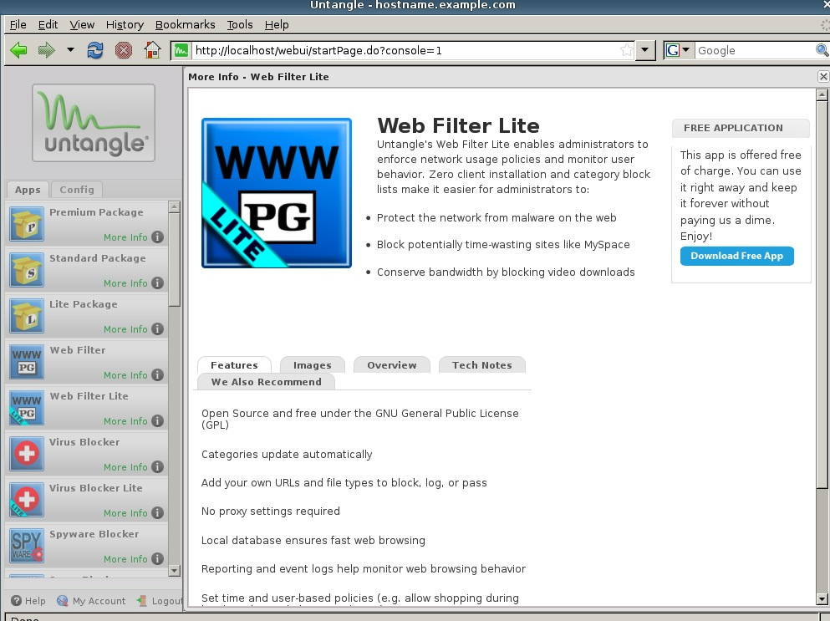
Web Filter App

Slide 9
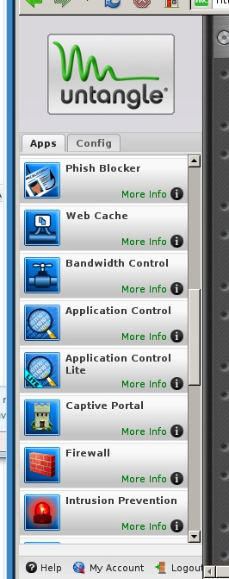
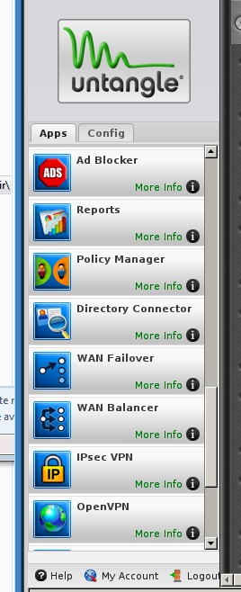
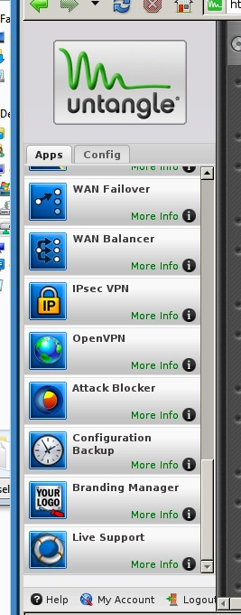
Misc Apps

Slide 10


