Slide 1

An Open Source Firewall/Router Software
Kwan – Chris – Jonathan
ITEC451 – H. Lee

Slide 2
Contents:
What is pfSense?
How does it work?
Why should we use it?
What type of hardware is needed?
Demo walkthrough

Slide 3
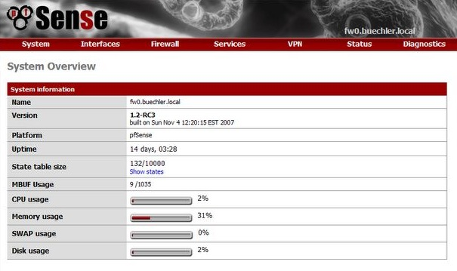
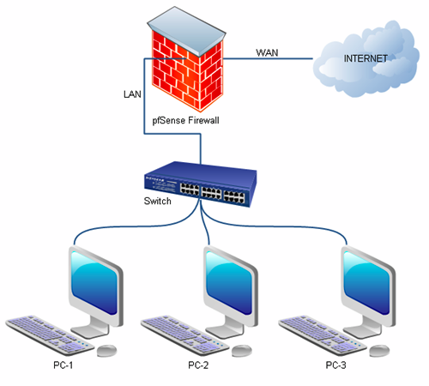
What is pfSense?
Open source operating system software designed to act as a firewall and router based on FreeBSD
Project originally started in 2004, budding off of the m0n0wall project by Chris Buechler and Scott Ullrich
Instead of being distributed as an embedded software like its predecessor, pfSense focused on full PC installations
Its name was received from how it made OpenBSD packet filtering make more sense to non technical users

Slide 4
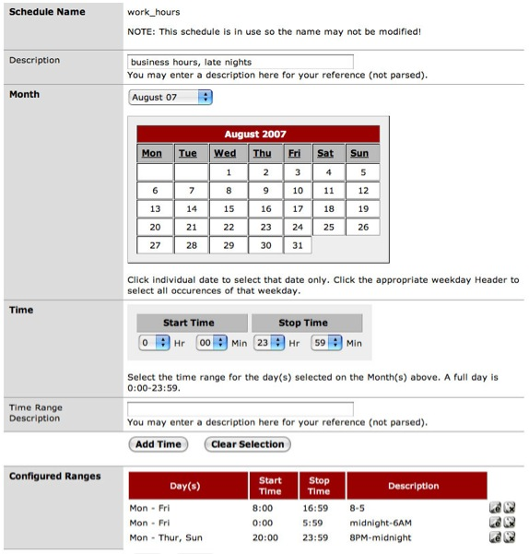
How does it work?
pfSense is installed on a standalone personal computer, then configured to the user’s rule set
The computer is then placed on the network perimeter of the facility
pfSense then monitors traffic flow using the various user enabled configurations

Slide 5
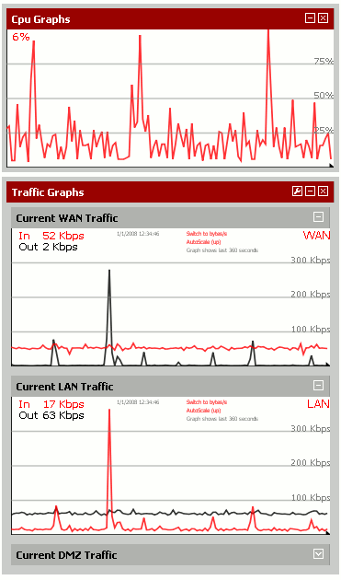
Why should we use it?
pfSense offers corporate level firewall and router functionality
It has been reviewed by top IT news source techrepublic.com “If you want a high-availability and highly reliable firewall, pfSense is definitely something to seriously consider”
The interface is browser based and very user friendly
It is completely open source, making it free for public and commercial use

Slide 6
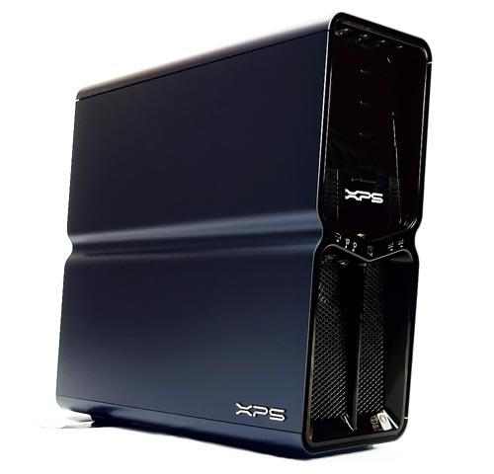
Type of hardware is needed?
Recommended system would be any modern low budget tower system will be sufficient
pfSense website suggests that higher quality NIC should be purchased due to its high reliance on the device card
pfSense also recommends that hardware should scale up if network traffic begins to grow

Slide 7

Live Demonstration!

