Slide 1
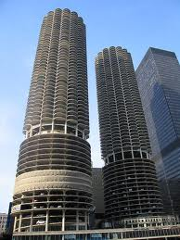
Our Small Company
Jamel Callands, Austin Chaet and Carson Gallimore

Slide 2
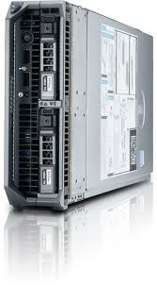
Servers: Dell PowerEdge M520
$3,567.00 for all 3 servers
Xeon 1.8 Ghz Processor
2GB ram

Slide 3
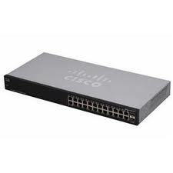
Switch: Cisco SR2024T 24 port 10/100/1000 gigabit Switch
Great scalability for our small company if we grow over the next few years.
Price: $247.97

Slide 4

Employee Laptops: Dell D620 model
2GB ram
60GB HD
1.8 Ghz processor
Windows 7
We found a bundle of 10 on Ebay for only $1,799.97

Slide 5
We spent a total of $7,652.94 for our small company saving ourselves $2,347.06 out of our $10,000.00 budget.

Slide 6
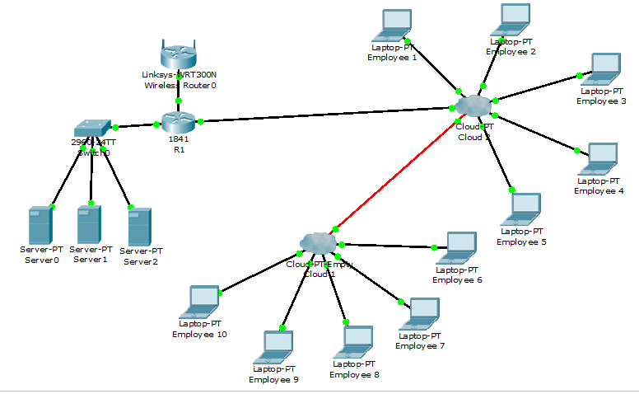
Network Topology

