Slide 1
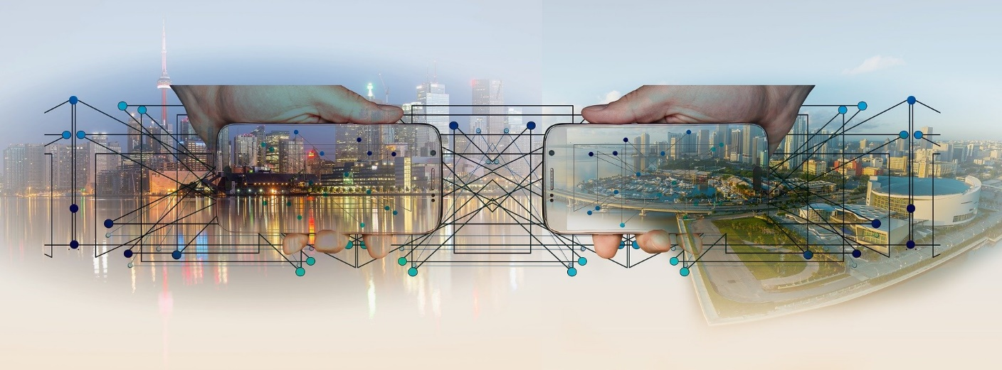
Lecture 1
Review of Computer Network Fundamentals

Slide 2

What is Computer Networks?
A collection of autonomous computers interconnected by a single or multiple technologies
  Interconnected via:
    Copper wire
    Fiber optics
    Microwaves
    Infrared
    Communication satellites, etc.

Slide 3
OSI Reference Model & TCP/IP Protocol Stack
Application
Application
Layer
Presentation
Layer
Session
Layer
Transport
Layer
Network
Layer
Data Link
Layer
Physical
Layer

Slide 4
OSI Reference Model & TCP/IP Protocol Stack
OSI 7 Layers
TCP/IP Protocol
Application
Application
Application
Layer
Application
Layer
Presentation
Layer
Session
Layer
Transport
Layer
TCP
UDP
Network
Layer
IP Layer
Data Link
Layer
Network
Interface
Layer
Physical
Layer

Slide 5
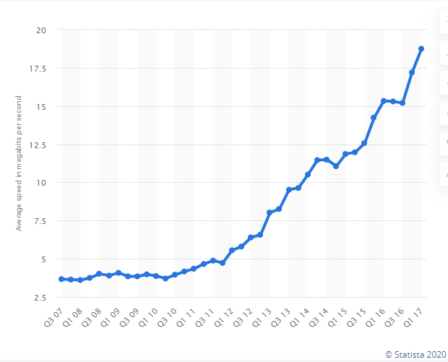
Network Architecture Evolution
?
Information transfer
per second (bits/second)
Telegraph
networks
Next
Generation
Internet
Telephone
networks
Internet, Optical
& Wireless
networks
[Source] https://www.statista.com/statistics/616210/average-internet-connection-speed-in-the-us/
    https://ourworldindata.org/internet

Slide 6
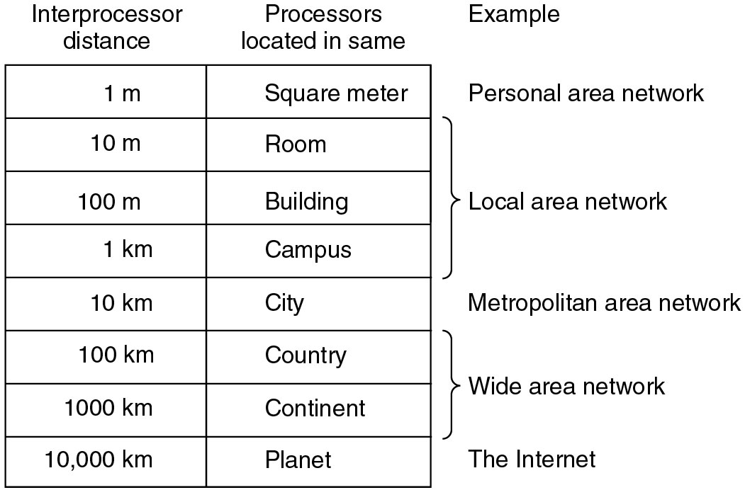
Classification of interconnected processors by scale.

Slide 7
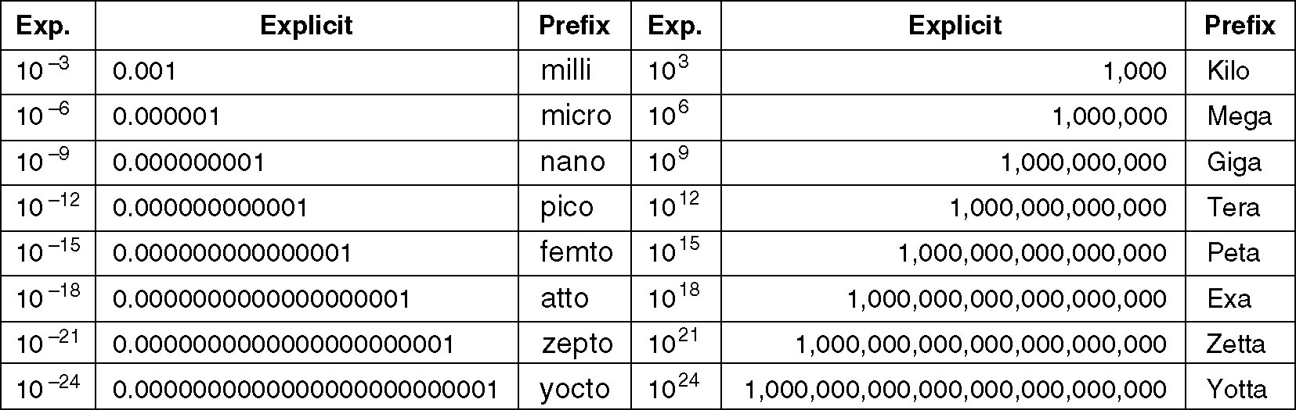
Metric Units
The principal metric prefixes.

Slide 8
IP Addresses
An IP Packet can be sent to
  A single workstation (unicast)
    Efficient for data between pairs of addresses
  A specific list of workstations (multicast)
    Efficient for specific groups, but must specify all individual workstations IP addresses
  All stations on a network (broadcast)
    Efficient for large (unknown) group – use special broadcast IP address.
IP addresses have a special broadcast address
Class .vs. Classless Addressing.
Internet Assigned Numbers Authority (IANA)
Notes:
The Internet Assigned Numbers Authority (IANA) manages the IP address space allocations globally and delegates five regional Internet registries (RIRs) to allocate IP address blocks to local Internet registries (Internet service providers) and other entities.

Slide 9
IP Address Ranges, Or “Classes”
From: | To: | Description
1.x.x.x | 126.x.x.x | Class A license
127.x.x.x | 127.x.x.x | Loop back
128.x.x.x | 191.x.x.x | Class B license (172.16 thru 31. 0. 0 reserved for private addresses)
192.x.x.x | 223.x.x.x | Class C license (192. 168. x. 0 reserved for private addresses)
224.0.0.0 | 224.0.0.255 | Multicast: Reserved Link Local Addresses
224.0.1.0 | 238.255.255.255 | Multicast: Globally Scoped Addresses
239.0.0.0 | 239.255.255.255 | Multicast: Limited Scope Addresses
240.x.x.x | 255.255.255.254 | Experimental
255.255.255.255 |  | Broadcast

Slide 10
IP Addressing and Subnetting

Slide 11
“Anding” a Binary Subnet Mask
10001001001011010110100010101100
11111111111111111111111100000000
10001001001011010110100000000000
subnet ID = (137.45.104.0)

Slide 12

Recap: Network Classes
IANA (Internet Assigned Numbers Authority)
Class A
  IP address := <8bits>.<24bits>
  16 Million hosts in a class A network domain
Class B
  IP address = <16bits>.<16bits>
  65534 hosts in a class B network domain
Class C
  IP address = <24bits>.<8bits>
  256 hosts in a class C network domain
➔ Waste of Address Range~!

Slide 13
Note on Classful vs. Classless
Note that, in classful subnetting, we lose quite a few blocks of addresses.
RFC 1519 (Classless Inter-Domain Routing = CIDR) was introduced in 1993 to deal with rapid depletion of IP address space due to “Classful Fragmentation”
Problem:
  Given the entire internet was “classful” in 1993, how to transition to classless methods?
  What exactly is the impact to internet protocols (in all the millions of devices and hosts) of such a change?

Slide 14
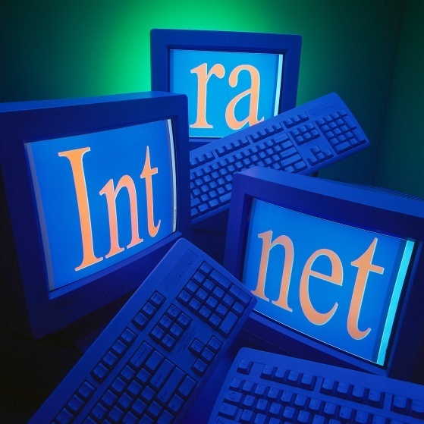
Routable and Nonroutable Addresses
Nonroutable Address [RFC 1918]
  Internet Router ignore the following addresses.
    10.0.0.0 – 10.255.255.255
    172.16.0.0 – 172.31.255.255
    192.168.0.0 – 192.168.255.255
  Millions of networks can exist with the same nonroutable address.
  “Intranet” : Internal Internet
  NAT (Network Address Translation) router
  Side benefit : “Security”

Slide 15
VLSM (Variable Length Subnet Masking)
Can support variable length of subnet id in a single domain
How?
  Decide the necessary number of bits for a host id first
  Then, get the number of bits for a subnet id

Slide 16
VLSM: Sample Question
[Given] IP Addr 192.3.4.0/24
  AtlantaHQ: 58 hosts
  PerthHQ: 26 hosts
  SydneyHQ: 10 hosts
  CorpusHQ:10 hosts
  WAN1: 2 IP addresses
  WAN2: 2 IP addresses
  WAN3: 2 IP addresses
Give a subnet address, an address range, a broadcast address, and a network prefix
Reference: Cisco Network Fundamental course

Slide 17
Standards
New technologies very costly and risky
Standards allow players to share risk and benefits of a new market
  Reduced cost of entry
  Interoperability and network effect
  Compete on innovation
  Completing the value chain
    Chips, systems, equipment vendors, service providers
Example
  802.11 wireless LAN products

Slide 18
Standards Bodies
Internet Engineering Task Force
  Internet standards development
  Request for Comments (RFCs): www.ietf.org
International Telecommunications Union
  International telecom standards
IEEE 802 Committee
  Local area and metropolitan area network standards
  https://en.wikipedia.org/wiki/IEEE_802
Industry Organizations
  MPLS Forum, WiFi Alliance, World Wide Web Consortium

Slide 19
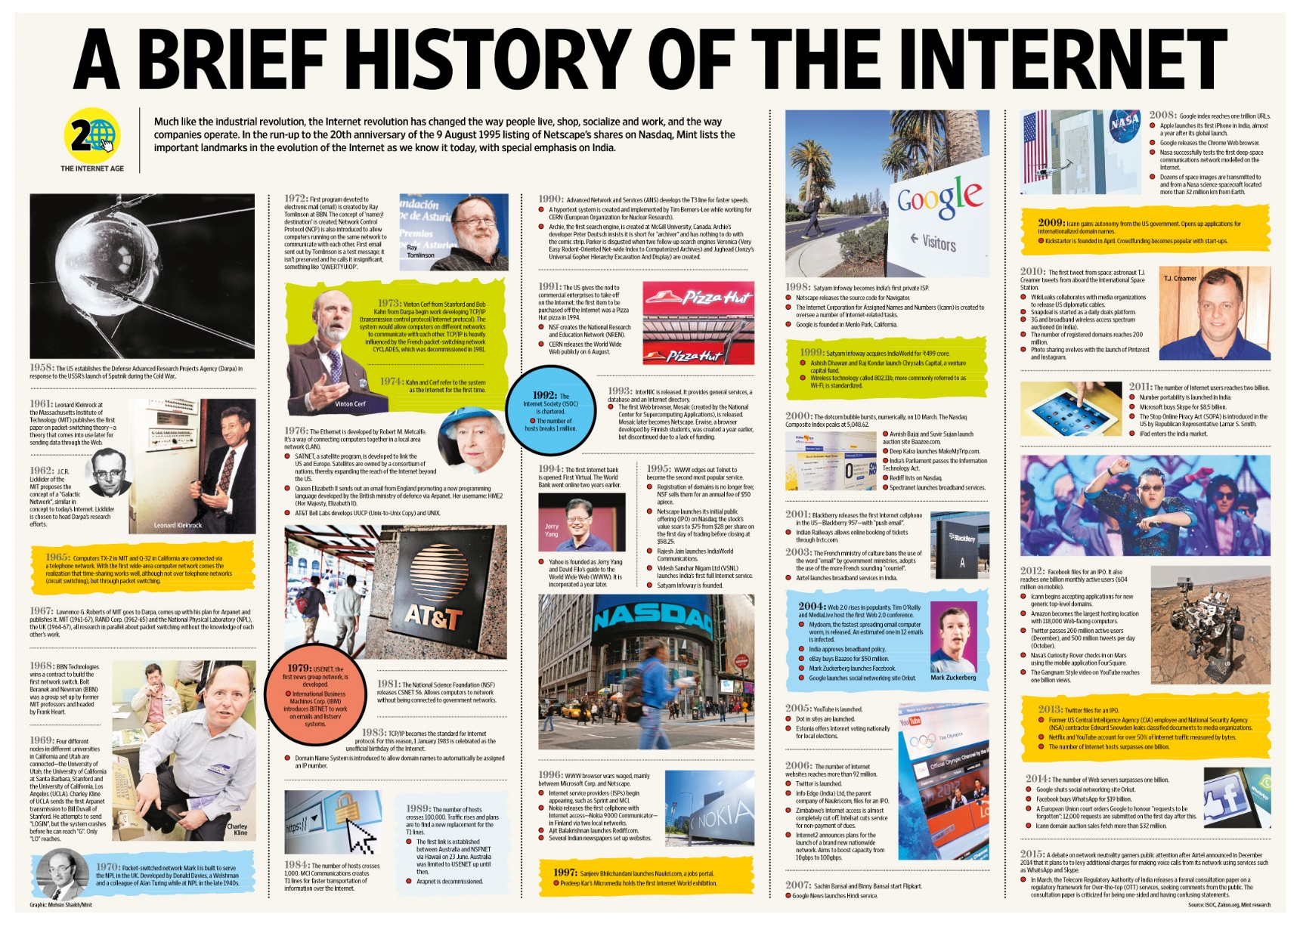
Brief History of the Internet
[Source] https://www.dugcampbell.com/history-of-the-internet/

Slide 20
Brief History of the Internet

Slide 21
Brief History of the Internet

Slide 22
Brief History of the Internet

Slide 23
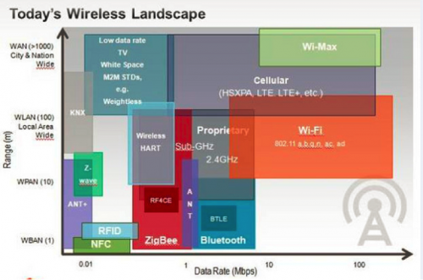
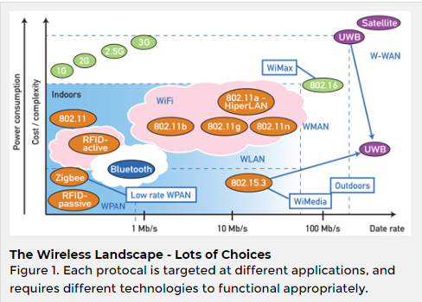
Wireless Communication Landscape
[Source] https://gblogs.cisco.com/uki/wireless-wireless-everywhere/
[Source] https://www.controlglobal.com/articles/2013/verhappen-wireless/

Slide 24
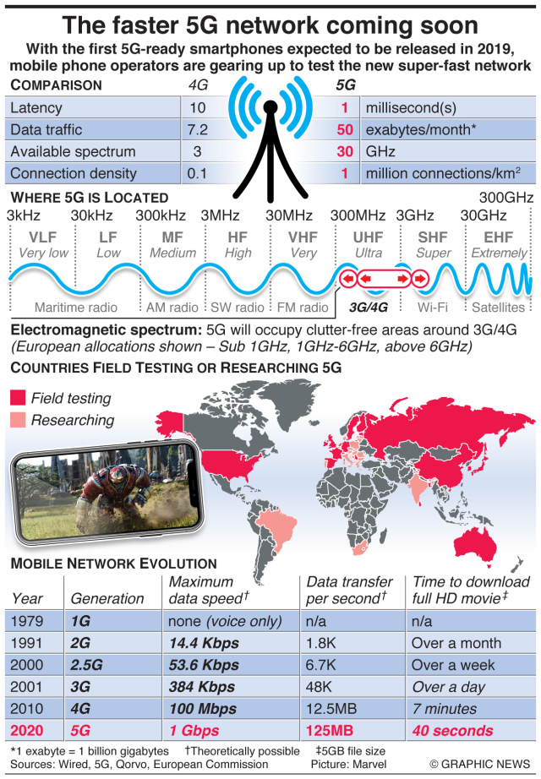
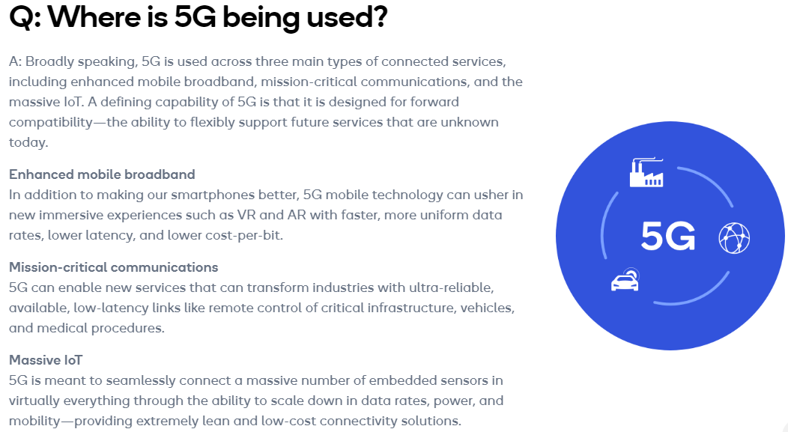
5G Network
[Source] https://www.qualcomm.com/invention/5g/what-is-5g#:~:text=A%3A%205G%20is%20the%205th,machines%2C%20objects%2C%20and%20devices.
[Source] https://engtechmag.files.wordpress.co/2018/09/gn38319c_en.jpg

Slide 25
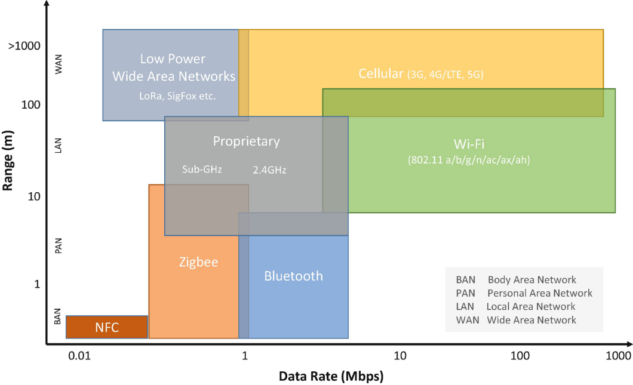
5G Network
[Source] https://link.springer.com/chapter/10.1007/978-1-4842-2896-8_5 (August 14, 2019)

