Slide 1
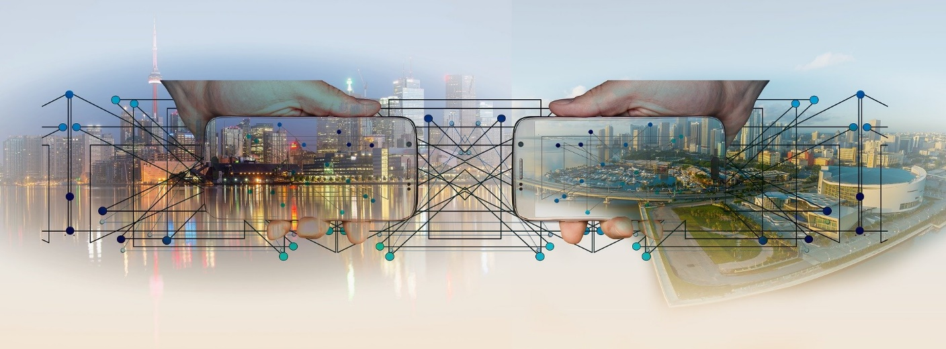
Lecture 6
Distributed Computing

Slide 2
Why distributed systems ?
Fact: Processor population is exploding. Technology has dramatically reduced the price of processors.
Geographic distribution of processes
Resource sharing as used in P2P networks
Computation speed up (as in a grid)
Fault tolerance

Slide 3
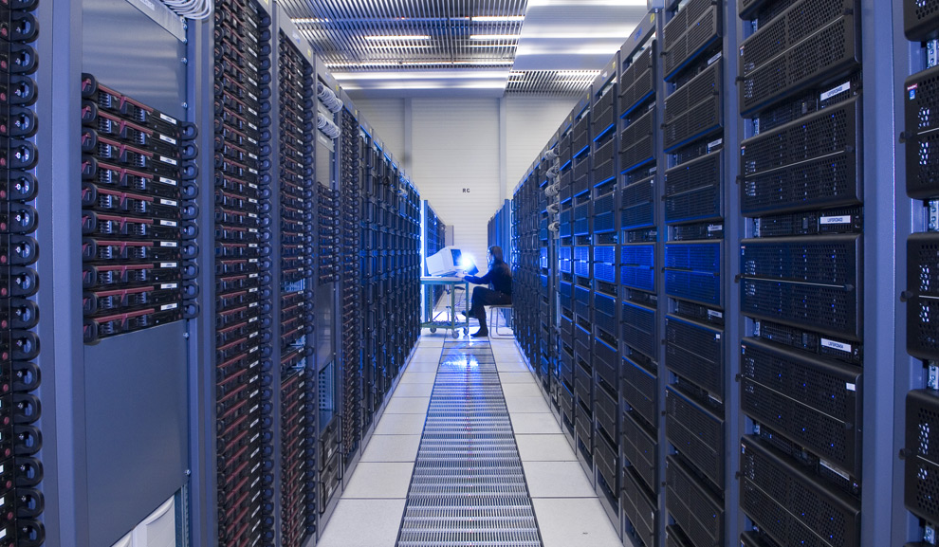
What is Distributed Systems?

Slide 4
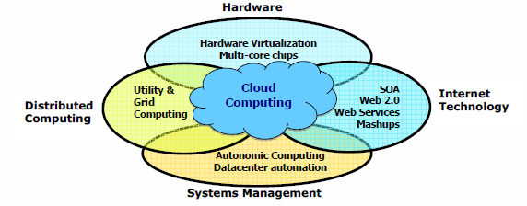
Data Deluge Enabling New Challenges
(Courtesy of Judy Qiu, Indiana University, 2011)

Slide 5
From Desktop/HPC/Grids to Internet Clouds in 30 Years
HPC moving from centralized supercomputers
to geographically distributed desktops, desksides,
clusters, and grids to clouds over last 30 years
R/D efforts on HPC, clusters, Grids, P2P, and virtual
machines has laid the foundation of cloud computing
that has been greatly advocated since 2007
Location of computing infrastructure in areas with
lower costs in hardware, software, datasets,
space, and power requirements – moving from
desktop computing to datacenter-based clouds

Slide 6
Interactions among 4 technical challenges:
Data Deluge, Cloud Technology, eScience,
and Multicore/Parallel Computing
(Courtesy of Judy Qiu, Indiana University, 2011)
Notes:
E-Science or eScience is computationally intensive science that is carried out in highly distributed network environments, or science that uses immense data sets that require grid computing; the term sometimes includes technologies that enable distributed collaboration, such as the Access Grid.

Slide 7
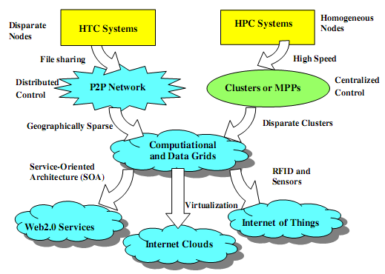
Evolutionary Trend toward Clouds and Internet of Things
HPC: High-Performance Computing
HTC: High-Throughput Computing
P2P: Peer to Peer
MPP: Massively Parallel Processors
Source: K. Hwang, G. Fox, and J. Dongarra,
Distributed and Cloud Computing,
Morgan Kaufmann, 2012.

Slide 8
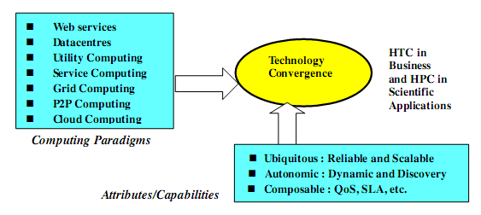
Technology Convergence toward HPC for Science and HTC for Business
(Courtesy of Raj Buyya, University of Melbourne, 2011)
Notes:
Computing Paradigms
Some common characteristics: design objectives
Major technological challenges
(to build distributed system that explore massive parallelism at all processing levels.)
New network-efficient processors
Scalable memory and storage schemes
Distributed OSes
Middleware for machine virtualization
New programming models
Efficient resource management
Application program development

Slide 9
Major technological challenges to build distributed system
New network-efficient processors
Scalable memory and storage schemes
Distributed OSes
Middleware for machine virtualization
New programming models
Efficient resource management
Application program development

Slide 10
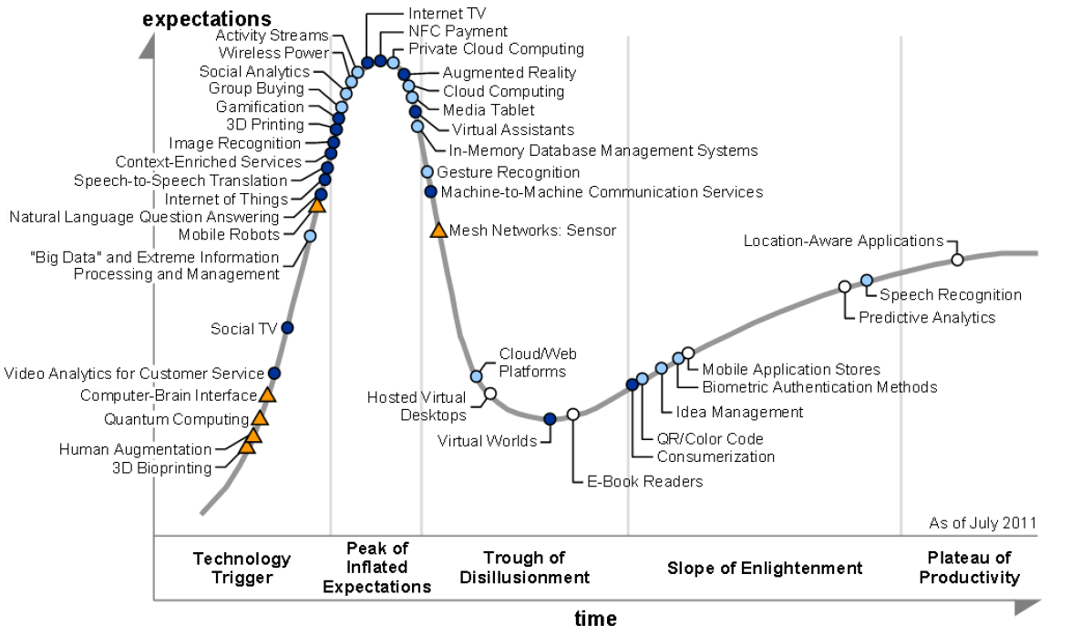
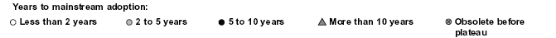
2011 Gartner “IT Hype Cycle” for Emerging Technologies
2010
2009
2011
2008
2007
What is Gartner Hype cycle? https://en.wikipedia.org/wiki/Gartner_hype_cycle

Slide 11
Hype Cycle
(https://www.gartner.com/)
Each Hype Cycle drills down into the five key phases of a technology’s life cycle.
Innovation Trigger:
  A potential technology breakthrough kicks things off. Early proof-of-concept stories and media interest trigger significant publicity. Often no usable products exist and commercial viability is unproven.
Peak of Inflated Expectations:
  Early publicity produces a number of success stories — often accompanied by scores of failures. Some companies take action; many do not.
Trough of Disillusionment:
  Interest wanes as experiments and implementations fail to deliver. Producers of the technology shake out or fail. Investments continue only if the surviving providers improve their products to the satisfaction of early adopters.
Slope of Enlightenment:
  More instances of how the technology can benefit the enterprise start to crystallize and become more widely understood. Second- and third-generation products appear from technology providers. More enterprises fund pilots; conservative companies remain cautious.
Plateau of Productivity:
  Mainstream adoption starts to take off. Criteria for assessing provider viability are more clearly defined. The technology's broad market applicability and relevance are clearly paying off.

Slide 12
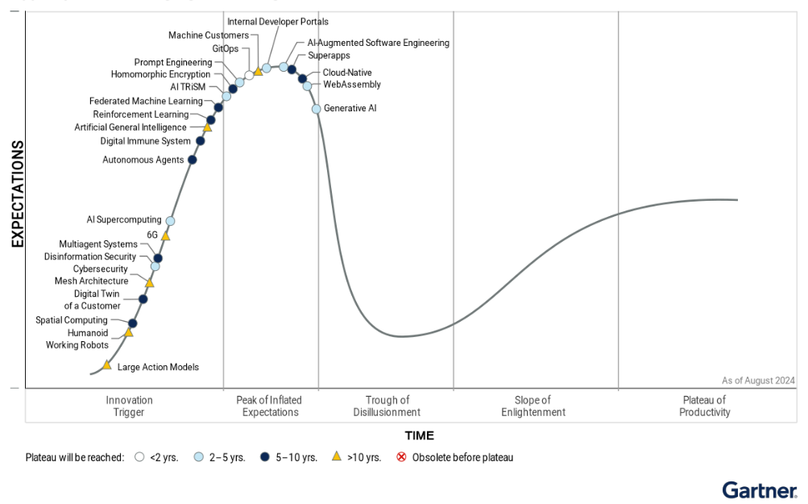
Hype Cycle for Emerging Technologies 2024
Notes:
https://www.gartner.com/en/articles/what-s-new-in-the-2023-gartner-hype-cycle-for-emerging-technologies
How do Hype Cycles work?
Each Hype Cycle drills down into the five key phases of a technology’s life cycle.
Innovation Trigger: A potential technology breakthrough kicks things off. Early proof-of-concept stories and media interest trigger significant publicity. Often no usable products exist and commercial viability is unproven.
Peak of Inflated Expectations: Early publicity produces a number of success stories — often accompanied by scores of failures. Some companies take action; many do not.
Trough of Disillusionment: Interest wanes as experiments and implementations fail to deliver. Producers of the technology shake out or fail. Investments continue only if the surviving providers improve their products to the satisfaction of early adopters.
Slope of Enlightenment: More instances of how the technology can benefit the enterprise start to crystallize and become more widely understood. Second- and third-generation products appear from technology providers. More enterprises fund pilots; conservative companies remain cautious.
Plateau of Productivity: Mainstream adoption starts to take off. Criteria for assessing provider viability are more clearly defined. The technology's broad market applicability and relevance are clearly paying off.

Slide 13
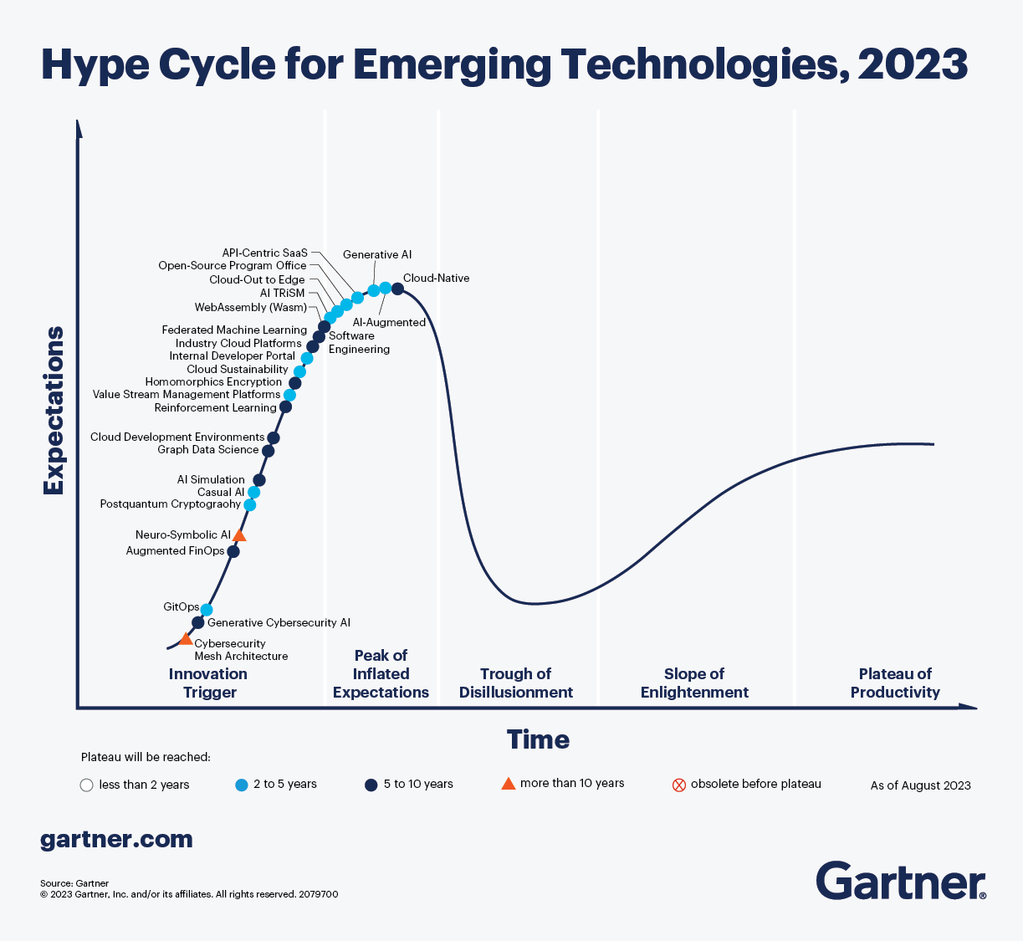
Hype Cycle for Emerging Technologies 2023
Notes:
https://www.gartner.com/en/articles/what-s-new-in-the-2023-gartner-hype-cycle-for-emerging-technologies
How do Hype Cycles work?
Each Hype Cycle drills down into the five key phases of a technology’s life cycle.
Innovation Trigger: A potential technology breakthrough kicks things off. Early proof-of-concept stories and media interest trigger significant publicity. Often no usable products exist and commercial viability is unproven.
Peak of Inflated Expectations: Early publicity produces a number of success stories — often accompanied by scores of failures. Some companies take action; many do not.
Trough of Disillusionment: Interest wanes as experiments and implementations fail to deliver. Producers of the technology shake out or fail. Investments continue only if the surviving providers improve their products to the satisfaction of early adopters.
Slope of Enlightenment: More instances of how the technology can benefit the enterprise start to crystallize and become more widely understood. Second- and third-generation products appear from technology providers. More enterprises fund pilots; conservative companies remain cautious.
Plateau of Productivity: Mainstream adoption starts to take off. Criteria for assessing provider viability are more clearly defined. The technology's broad market applicability and relevance are clearly paying off.

Slide 14
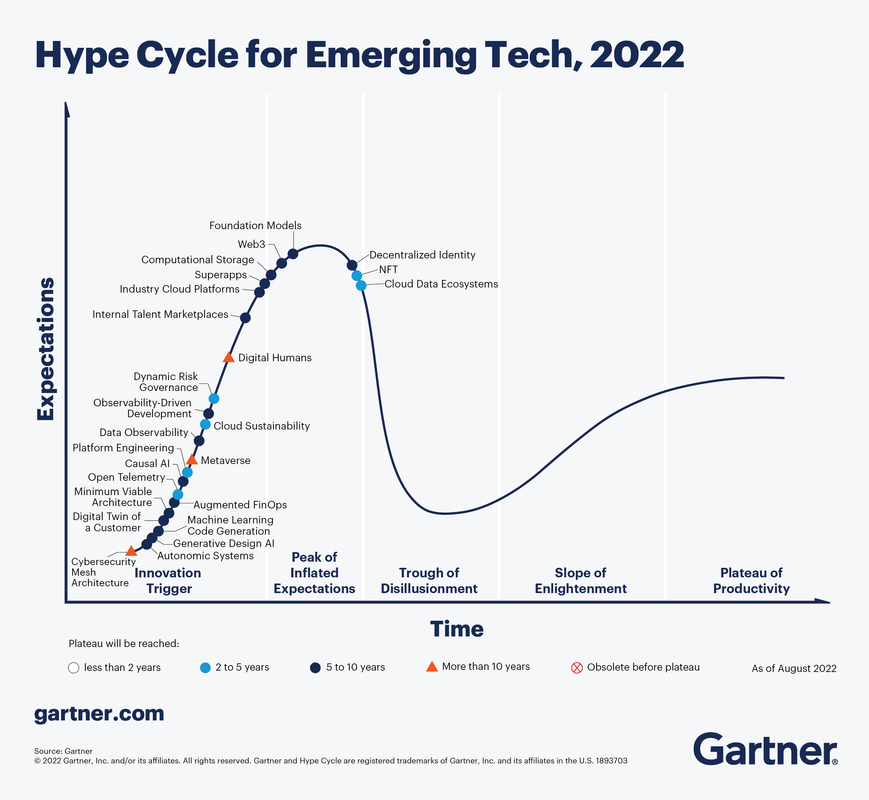
Notes:
https://www.gartner.com/en/newsroom/press-releases/2021-08-23-gartner-identifies-key-emerging-technologies-spurring-innovation-through-trust-growth-and-change
https://en.wikipedia.org/wiki/Gartner_hype_cycle
How do Hype Cycles work?
Each Hype Cycle drills down into the five key phases of a technology’s life cycle.
Innovation Trigger: A potential technology breakthrough kicks things off. Early proof-of-concept stories and media interest trigger significant publicity. Often no usable products exist and commercial viability is unproven.
Peak of Inflated Expectations: Early publicity produces a number of success stories — often accompanied by scores of failures. Some companies take action; many do not.
Trough of Disillusionment: Interest wanes as experiments and implementations fail to deliver. Producers of the technology shake out or fail. Investments continue only if the surviving providers improve their products to the satisfaction of early adopters.
Slope of Enlightenment: More instances of how the technology can benefit the enterprise start to crystallize and become more widely understood. Second- and third-generation products appear from technology providers. More enterprises fund pilots; conservative companies remain cautious.
Plateau of Productivity: Mainstream adoption starts to take off. Criteria for assessing provider viability are more clearly defined. The technology's broad market applicability and relevance are clearly paying off.

Slide 15
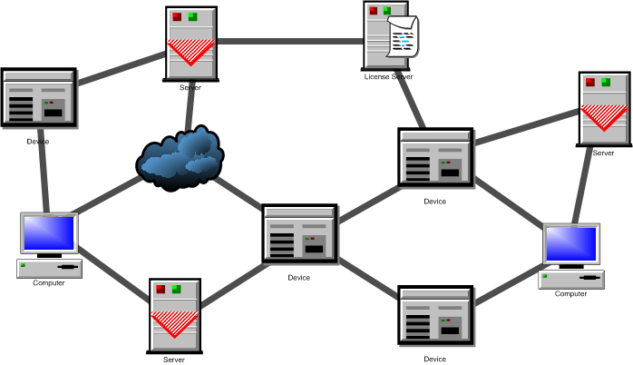
What is a distributed system? (1)
A network of processes/resources.
The nodes are processes/resources, and the edges are communication channels.

Slide 16
What is a distributed system? (2)
The logical distribution of functional capabilities
  Multiple processes
  Interprocess communication
  Disjoint address space
  Collective goal

Slide 17
What is a distributed system? (2)
Collective Goal?
Don’t hold your breath:
  Biocomputing
    Using biologically derived molecules
  Nanocomputing:
    the manipulation of matter on an atomic and molecular scale
  Quantum computing
    use of quantum-mechanical phenomena, such as superposition and entanglement
  …
It all boils down to…
  Divide-and-conquer
  Throwing more hardware at the problem
Notes:
* Biocomputing may refer to:
Biocomputers, systems of biologically derived molecules that perform computational processes
DNA computing, a form of biological computing that uses DNA
Bioinformatics, the application of statistics and computer science to the field of molecular biology
* Nanocomputing
Computation that use nanotechnology
Nanotechnology (sometimes shortened to "nanotech") is the manipulation of matter on an atomic and molecular scale. The earliest, widespread description of nanotechnology^{[1][2]} referred to the particular technological goal of precisely manipulating atoms and molecules for fabrication of macroscale products, also now referred to as molecular nanotechnology.
* A quantum computer (also known as a quantum supercomputer) is a computation device that makes direct use of quantum-mechanical phenomena, such as superposition and entanglement, to perform operations on data. Quantum computers are different from digital computers based on transistors. Whereas digital computers require data to be encoded into binary digits (bits), quantum computation uses quantum properties to represent data and perform operations on these data.

Slide 18
What is a distributed system? (2)
Divide and Conquer
“Work”
Partition
w₁
w₂
w₃
“worker”
“worker”
“worker”
r₁
r₂
r₃
Combine
“Result”
Reference: Lecture Note by Jimmy Lin, Univ. of Maryland

Slide 19
What is a distributed system? (2)
Different Workers
Different threads in the same core
Different cores in the same CPU
Different CPUs in a multi-processor system
Different machines in a distributed system
Reference: Lecture Note by Jimmy Lin, Univ. of Maryland

Slide 20
What is a distributed system? (2)
Choices, Choices, Choices
Commodity vs. “exotic” hardware
Number of machines vs. processor vs. cores
Memory vs. disk vs. network bandwidth
Different programming models
Reference: Lecture Note by Jimmy Lin, Univ. of Maryland

Slide 21
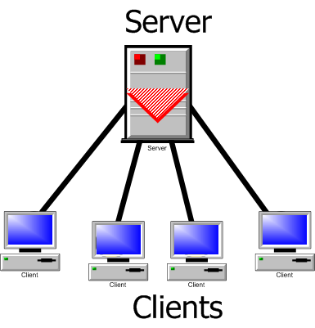
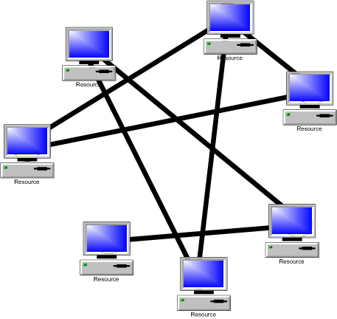
A classification
Client-server model
Peer-to-peer model

Slide 22
Parallel vs. Distributed
In both parallel and distributed systems, the events are partially ordered.
In parallel systems, the primarily issue is speed-up
In distributed systems the primary issues are fault-tolerance and availability of services

Slide 23
Possible Services
Internet banking
Web search
Net meeting
Distance education
Internet auction
Google earth
Google sky
And so on…

Slide 24
More Examples
Large networks are very commonplace these days. Think of the world wide web. Other examples are:
  Ubiquitous Computing
  Cloud computing
  Grid computing, Grid computing networks
    Ex. Computational grids (OSG (Open Science Grid), Teragrid, SETI@home)
  Sensor networks
  Network of mobile robots
  And so on…
Notes:
Google processes 20 PB a day (2008)
Kazaa (formally, KaZaA)
BitTorrent

Slide 25
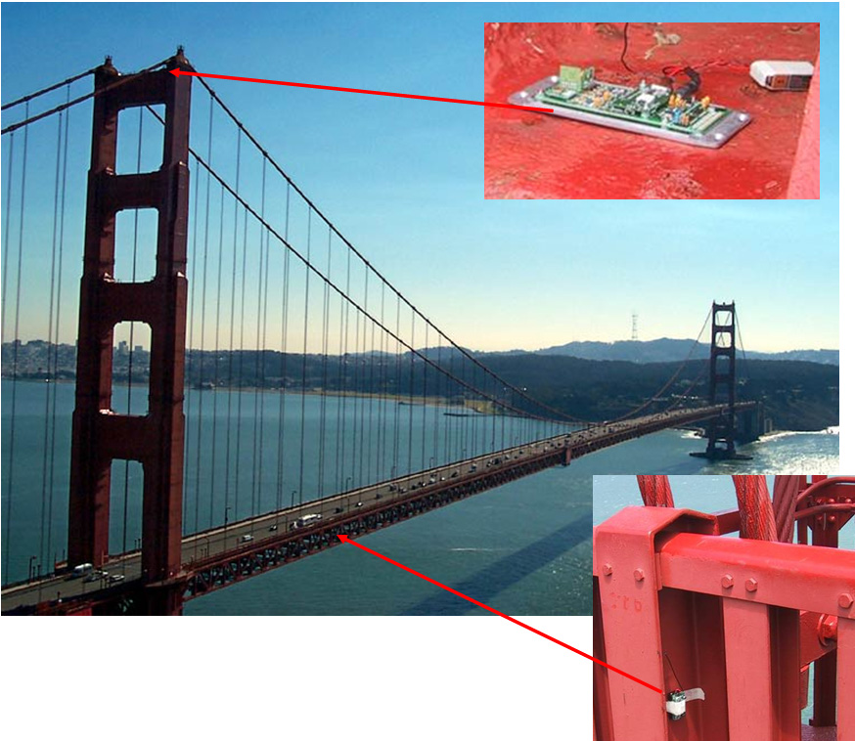
Sensor Network
Checking the structural integrity

Slide 26
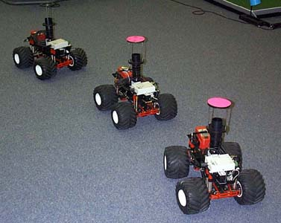
Mobile robots

Slide 27

Cloud Computing
Image Source: www.vemurivenkatrao.com/nature/cloud/

Slide 28
Important issues
Knowledge is local
Clocks are not synchronized
No shared address space
Topology and routing
Scalability
Fault tolerance

Slide 29
Some common sub-problems
Leader election
Mutual exclusion
Time synchronization
Distributed snapshot
Replica management

Slide 30
Objective of the course
Understand how a system works, why it fails, and how we can guarantee our design.
We are not discussing implementation or programming, although they are also important issues

Slide 31
Implementation
Practical distributed systems must have a real network as its backbone. However, such systems can be simulated on a shared-memory multiprocessor, or even on a uniprocessor.

