Slide 1
Spanning Tree Protocols
Hwajung Lee
Modified from Slides Courtesy of Cisco Networking Academy

Slide 2
Contents
Spanning Tree Concepts
Varieties of Spanning Tree Protocols
Spanning Tree Configuration
Summary
Notes:
*In networks with redundancy STP helps prevent:
Switching Loops
Layer 2 Broadcast Storms
*BID (Bridge ID) = Used to determine the Root Bridge:
1. Bridge Priority Number = 32768 (default) Lowest
2. Extended System ID = ID for VLANs
3. MAC Address = Lowest MAC Address
*Port Costs:
10 Gig = 2
1 Gig = 4
100 Mb = 19
10 Mb = 100
*Port Designations:
Root Port = Closest to the root bridge
Designated Port = Forwarding
Non-Designated Port = Blocking

Slide 3
Chapter 2: Objectives
Describe the issues with implementing a redundant network.
Describe IEEE 802.1D STP operation.
Describe the different spanning tree varieties.
Describe PVST+ operation in a switched LAN environment.
Describe Rapid PVST+ operation in a switched LAN environment.
Configure PVST+ in a switched LAN environment.
Configure Rapid PVST+ in a switched LAN environment.
Notes:
Chapter 2 Objectives

Slide 4
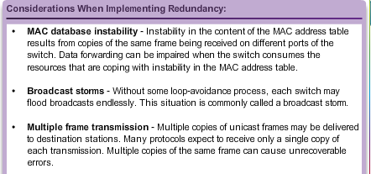
Purpose of Spanning Tree
Redundancy at OSI Layers 1 and 2
Multiple cabled paths between switches:
Provide physical redundancy in a switched network.
Improves the reliability and availability of the network.
Enables users to access network resources, despite path disruption.
Notes:
2.1.1.1 Redundancy of OSI Layers 1 and 2

Slide 5
Purpose of Spanning Tree
Issues with Layer 1 Redundancy: MAC Database Instability
Ethernet frames do not have a time to live (TTL) attribute.
  Frames continue to propagate between switches endlessly, or until a link is disrupted and breaks the loop.
  Results in MAC database instability.
  Can occur due to broadcast frames forwarding.
If there is more than one path for the frame to be forwarded out, an endless loop can result.
  When a loop occurs, it is possible for the MAC address table on a switch to constantly change with the updates from the broadcast frames, resulting in MAC database instability.
Notes:
2.1.1.2 Issues with Layer 1 Redundancy: MAC Database Instability

Slide 6
Purpose of Spanning Tree
Issues with Layer 1 Redundancy: Broadcast Storms
A broadcast storm occurs when there are so many broadcast frames caught in a Layer 2 loop that all available bandwidth is consumed. It is also known as denial of service
A broadcast storm is inevitable on a looped network.
  As more devices send broadcasts over the network, more traffic is caught within the loop; thus consuming more resources.
  This eventually creates a broadcast storm that causes the network to fail.
Notes:
2.1.1.3 Issues with Layer 1 Redundancy: Broadcast Storms

Slide 7
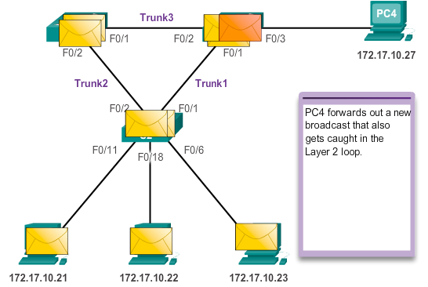
Purpose of Spanning Tree
Issues with Layer 1 Redundancy: Broadcast Storms
Notes:
2.1.1.3 Issues with Layer 1 Redundancy: Broadcast Storms (cont.)

Slide 8
Purpose of Spanning Tree
Issues with Layer 1 Redundancy: Duplicate Unicast Frames
Unicast frames sent onto a looped network can result in duplicate frames arriving at the destination device.
Most upper layer protocols are not designed to recognize, or cope with, duplicate transmissions.
Layer 2 LAN protocols, such as Ethernet, lack a mechanism to recognize and eliminate endlessly looping frames.
Notes:
2.1.1.4 Issues with Layer 1 Redundancy: Duplicate Unicast Frames

Slide 9
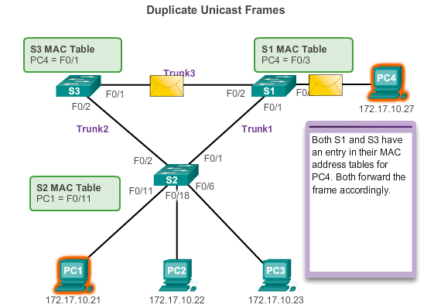
Purpose of Spanning Tree
Issues with Layer 1 Redundancy: Duplicate Unicast Frames
Notes:
2.1.1.4 Issues with Layer 1 Redundancy: Duplicate Unicast Frames (cont.)

Slide 10
STP Operation
Spanning Tree Algorithm: Introduction
STP ensures that there is only one logical path between all destinations on the network by intentionally blocking redundant paths that could cause a loop.
A port is considered blocked when user data is prevented from entering or leaving that port. This does not include bridge protocol data unit (BPDU) frames that are used by STP to prevent loops.
The physical paths still exist to provide redundancy, but these paths are disabled to prevent the loops from occurring.
If the path is ever needed to compensate for a network cable or switch failure, STP recalculates the paths and unblocks the necessary ports to allow the redundant path to become active.
Notes:
2.1.2.1 Spanning Tree Algorithm Introduction

Slide 11
Minimum Spanning Trees (MST)
To find the minimum number of edges necessary to connect all the edges in a graph.
It can be implemented using DFS or BFS.
A
A
B
C
B
C
D
E
D
E
Extra Edges
Minimum Number of Edges

Slide 12
Searches
Depth-first search
  The algorithm acts as through it wants to get as far away from the starting point as quickly as possible.
  Can use a stack
Breadth-first search
  The algorithm likes to stay as close as possible to the starting points.
  Can use a queue

Slide 13
Depth-First Search
Stack Contents
B
F
H
Event | Stack
Visit A | A
Visit B | AB
Visit F | ABF
Visit H | ABFH
Pop H | ABF
Pop F | AB
Pop B | A
Visit C | AC
Pop C | A
Visit D | AD
Visit G | ADG
Visit I | ADGI
Pop I | ADG
Pop G | AD
Pop D | A
Visit E | AE
Pop E | A
Pop A | Empty
C
A
D
G
I
E

Slide 14
Breadth-First Search
Queue Contents
B
F
H
Event | Queue (Front to Rear)
Visit A
Visit B | B
Visit C | BC
Visit D | BCD
Visit E | BCDE
Remove B | CDE
Visit F | CDEF
Remove C | DEF
Remove D | EF
Visit G | EFG
Remove E | FG
Remove F | G
Visit H | GH
Remove G | H
Visit I | HI
Remove H | I
Remove I | Empty
Done
C
A
D
G
I
E

Slide 15
Minimum Spanning Trees with Weighted Graphs
To find the minimum cost to connect all the edges in a graph.
1
A
1
A
3
B
1
6
4
B
1
C
C
5
1
1
7
2
D
1
E
D
1
E
Weighted Graph
Minimum Cost = 4

Slide 16
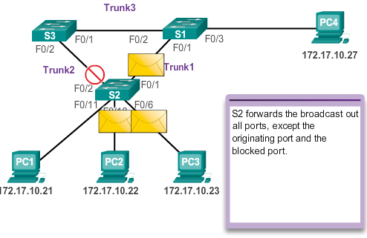
STP Operation
Spanning Tree Algorithm: Introduction
Notes:
2.1.2.1 Spanning Tree Algorithm Introduction (cont.)

Slide 17
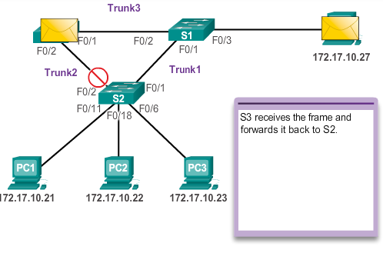
STP Operation
Spanning Tree Algorithm: Introduction
Notes:
2.1.2.1 Spanning Tree Algorithm Introduction (cont.)

Slide 18
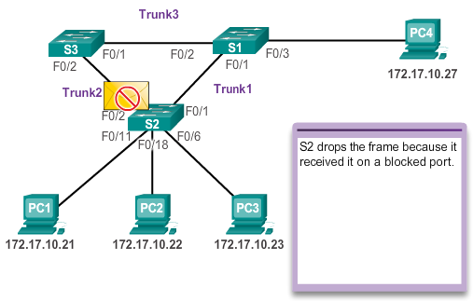
STP Operation
Spanning Tree Algorithm: Introduction
Notes:
2.1.2.1 Spanning Tree Algorithm Introduction (cont.)

Slide 19
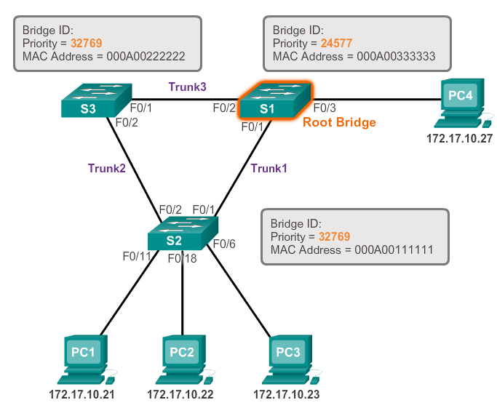
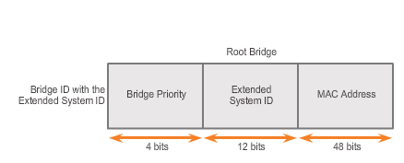
STP Operation
Spanning Tree Algorithm: Root Bridge
Notes:
2.1.2.3 Spanning Tree Algorithm: Root Bridge

Slide 20
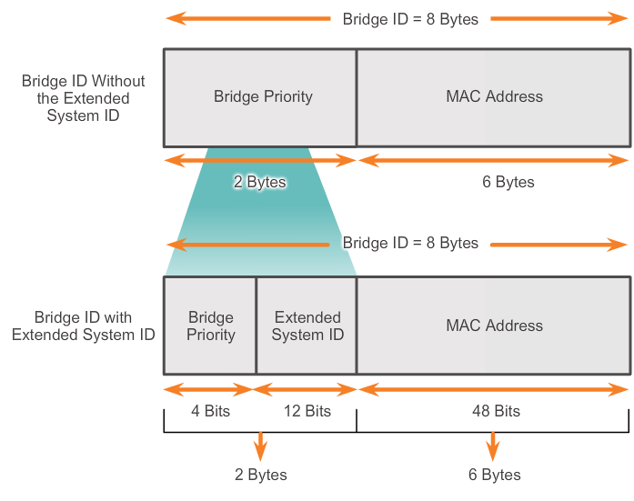
STP Operation
Extended System ID
STP was enhanced to include support for VLANs, requiring the VLAN ID to be included in the BPDU frame through the use of the extended system ID
Notes:
2.1.2.7 Extended System ID

Slide 21
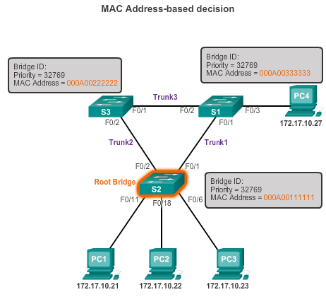
STP Operation
Extended System ID
In the example, the priority of all the switches is 32769. The value is based on the 32768 default priority and the VLAN 1 assignment associated with each switch (32768+1).
Notes:
2.1.2.7 Extended System ID

Slide 22
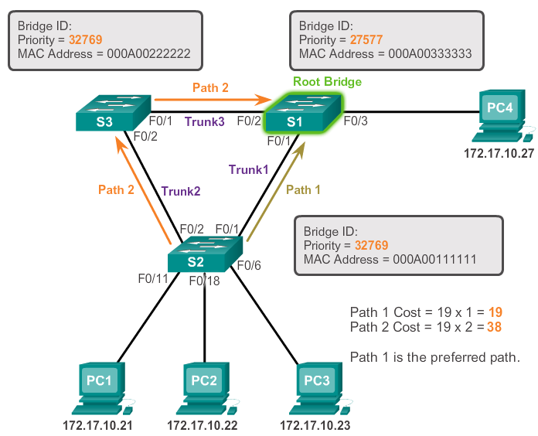
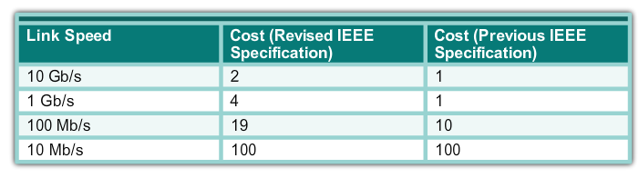
STP Operation
Spanning Tree Algorithm: Path Cost
Notes:
2.1.2.4 Spanning Tree Algorithm: Path Cost

Slide 23
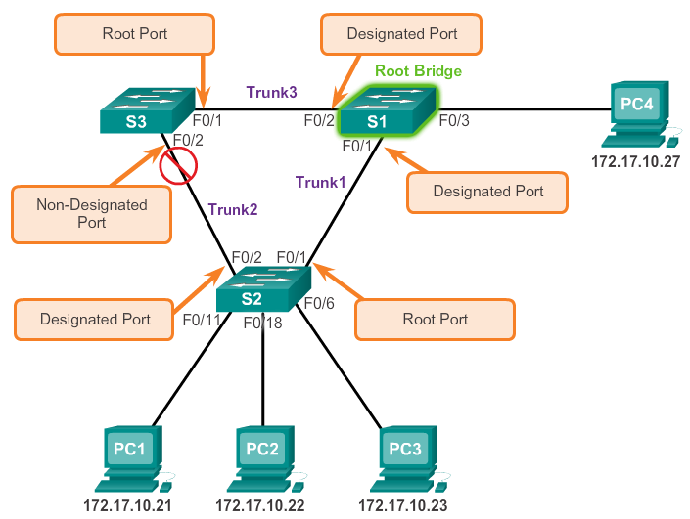
STP Operation
Spanning Tree Algorithm: Port Roles
Notes:
2.1.2.2 Spanning Tree Algorithm: Port Roles

Slide 24
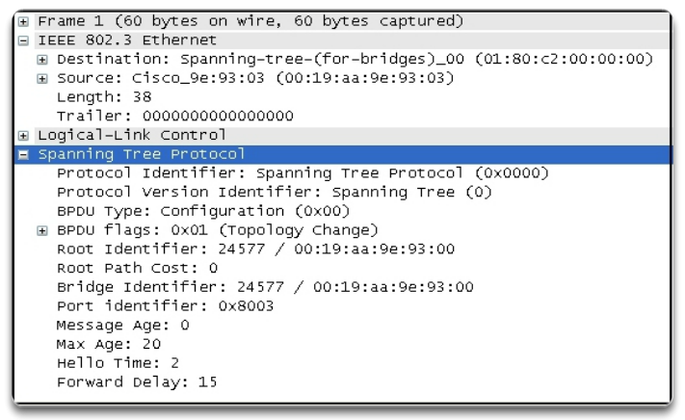
STP Operation
802.1D BPDU Frame Format
Notes:
2.1.2.5 802.1D BPDU Frame Format

Slide 25
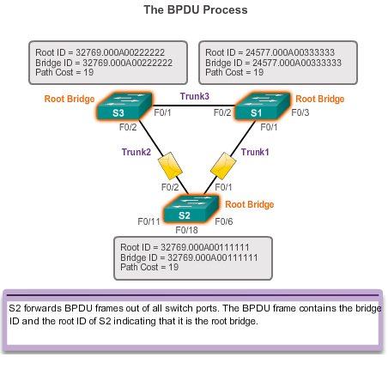
STP Operation
BPDU Propagation and Process
Notes:
2.1.2.6 BPDU Propagation and Process

Slide 26
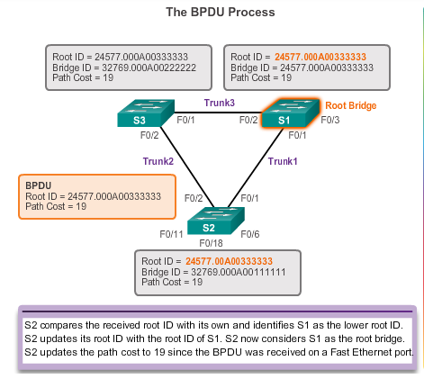
STP Operation
BPDU Propagation and Process
Notes:
2.1.2.6 BPDU Propagation and Process

Slide 27
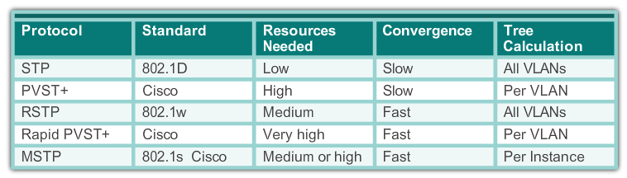
STP Overview
Characteristics of the Spanning Tree Protocols
Notes:
2.2.1.2 Characteristics of the Spanning Tree Protocols

Slide 28
PVST+
Overview of PVST+
Networks running PVST+ have these characteristics:
A network can run an independent IEEE 802.1D STP instance for each VLAN in the network.
Optimum load balancing can result.
One spanning-tree instance for each VLAN maintained can mean a considerable waste of CPU cycles for all the switches in the network. In addition to the bandwidth that is used for each instance to send its own BPDU.
Notes:
2.2.2.1Overview of PVST+

Slide 29
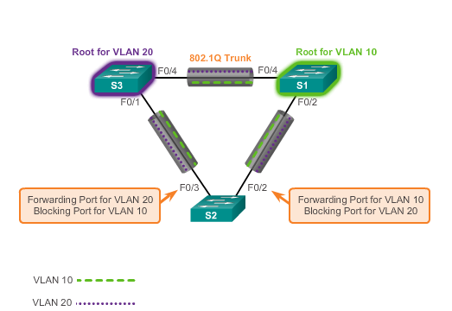
PVST+
Overview of PVST+
Notes:
2.2.2.1 Overview of PVST+

Slide 30
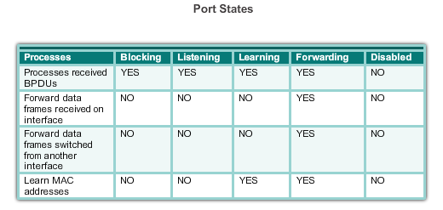
PVST+
Port States and PVST+ Operation
STP introduces the five port states:
Notes:
2.2.2.2 Port States and PVST+ Operation

Slide 31
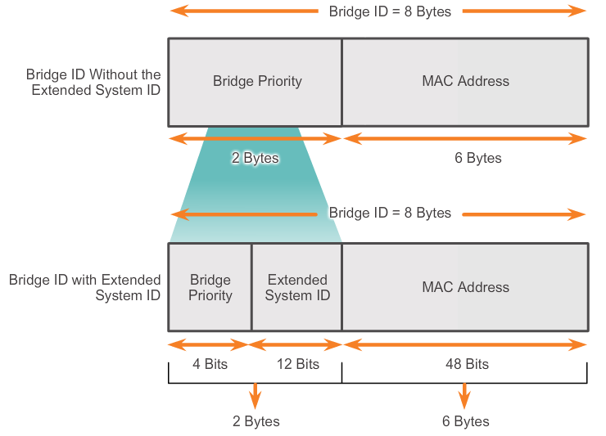
PVST+
Extended System ID and PVST+ Operation
In a PVST+ environment, the extended switch ID ensures each switch has a unique BID for each VLAN.
For example, the VLAN 2 default BID would be 32770; priority 32768, plus the extended system ID of 2.
Notes:
2.2.2.3 Extended System ID and PVST+ Operation

Slide 32
Rapid PVST+
Overview of Rapid PVST+
RSTP is the preferred protocol for preventing Layer 2 loops in a switched network environment.
With Rapid PVST+, an independent instance of RSTP runs for each VLAN.
RSTP supports a new port type: an alternate port in discarding state.
There are no blocking ports. RSTP defines port states as discarding, learning, or forwarding.
RSTP (802.1w) supersedes STP (802.1D) while retaining backward compatibility
RSTP keeps the same BPDU format as IEEE 802.1D, except that the version field is set to 2 to indicate RSTP, and the flags field uses all 8 bits.
Notes:
2.2.3.1 Overview of Rapid PVST+

Slide 33
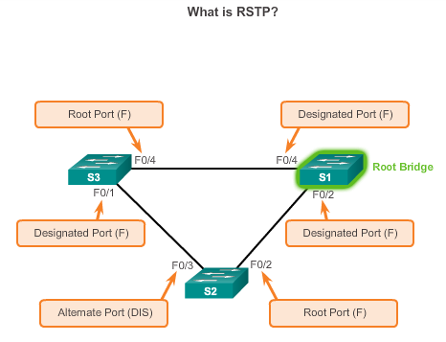
Rapid PVST+
Overview of Rapid PVST+
Notes:
2.2.3.1 Overview of Rapid PVST+

Slide 34
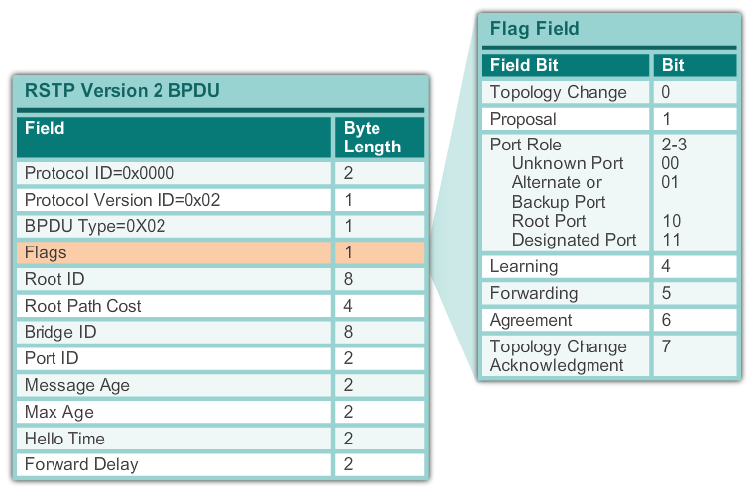
Rapid PVST+
RSTP BPDU
Notes:
2.2.3.2 RSPT BPDU

Slide 35
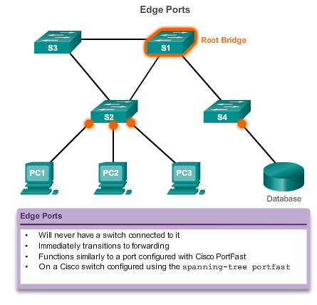
Rapid PVST+
Edge Ports
Notes:
2.2.3.3 Edge Ports

Slide 36
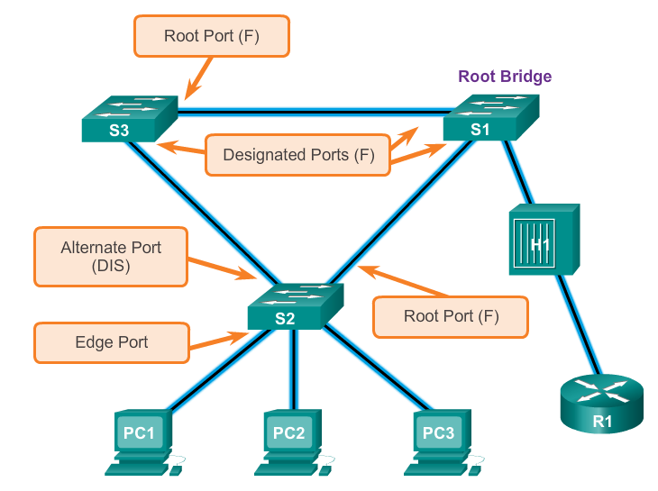
Rapid PVST+
Link Types
The link type can determine whether the port can immediately transition to forwarding state. Edge port connections and point-to-point connections are candidates for rapid transition to forwarding state.
Notes:
2.2.3.4 Link Types

Slide 37
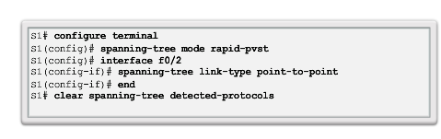
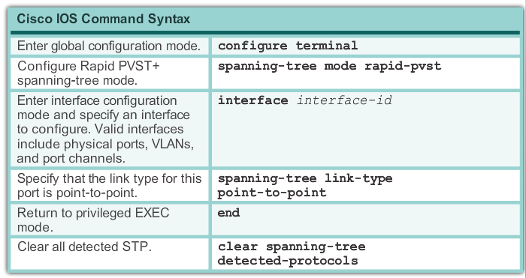
Rapid PVST+ Configuration
Spanning Tree Mode
Rapid PVST+ is the Cisco implementation of RSTP. It supports RSTP on a per-VLAN basis.
Notes:
2.3.2.1 Spanning Tree Mode

Slide 38
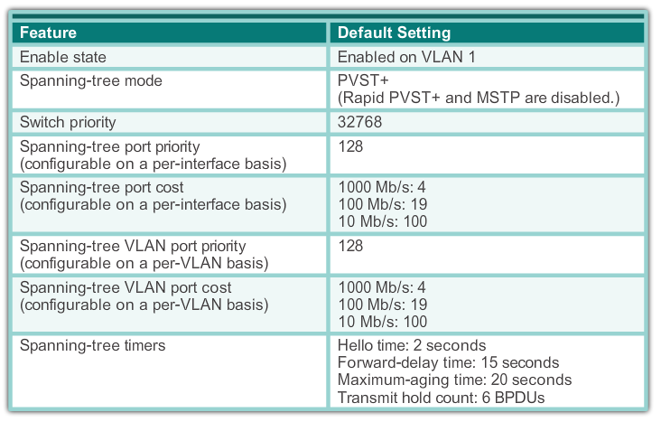
PVST+ Configuration
Catalyst 2960 Default Configuration
Notes:
2.3.1.1 Catalyst 2960 Default Configuration

Slide 39
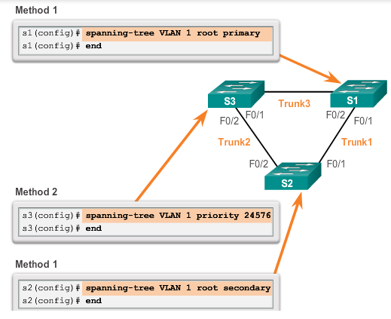
PVST+ Configuration
Configuring and Verifying the Bridge ID
Notes:
2.3.1.2 Configuring and Verifying the Bridge ID

Slide 40
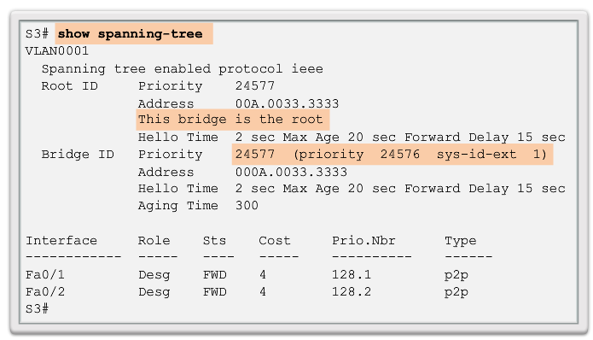
PVST+ Configuration
Configuring and Verifying the Bridge ID
Notes:
2.3.1.2 Configuring and Verifying the Bridge ID

Slide 41
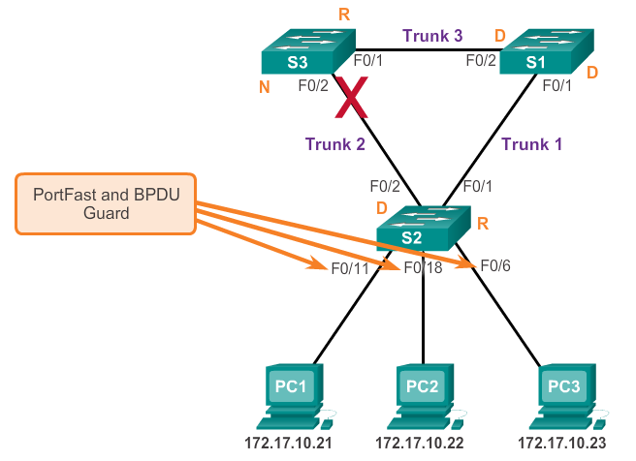
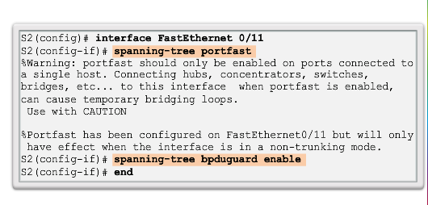
PVST+ Configuration
PortFast and BPDU Guard
When a switch port is configured with PortFast that port transitions from blocking to forwarding state immediately.
BPDU guard puts the port in an error-disabled state on receipt of a BPDU.
Notes:
2.3.1.3 PortFast and BPDU Guard

Slide 42
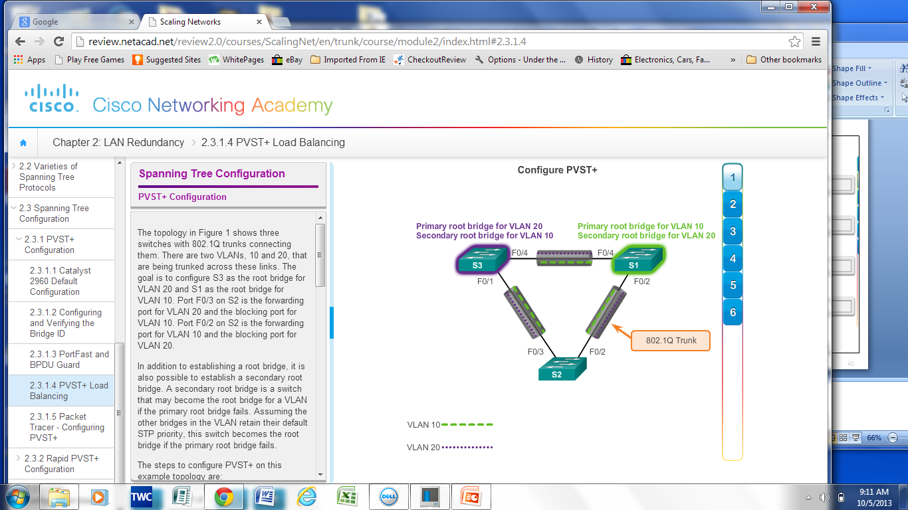
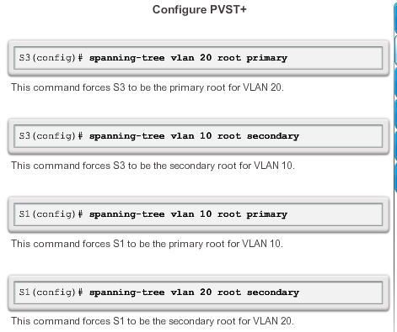
PVST+ Configuration
PVST+ Load Balancing
Notes:
2.3.1.4 PVST+ Load Balancing

Slide 43
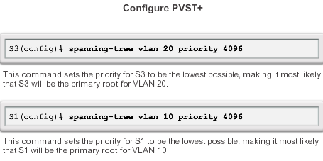
PVST+ Configuration
PVST+ Load Balancing
Another method to specify the root bridge is to set the spanning tree priority on each switch to the lowest value so that the switch is selected as the primary bridge for its associated VLAN.
Notes:
2.3.1.4 PVST+ Load Balancing (cont.)

Slide 44
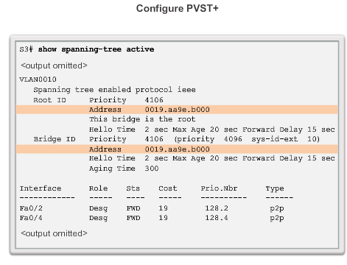
PVST+ Configuration
PVST+ Load Balancing
Display and verify spanning tree configuration details.
Notes:
2.3.1.4 PVST+ Load Balancing (cont.)

Slide 45
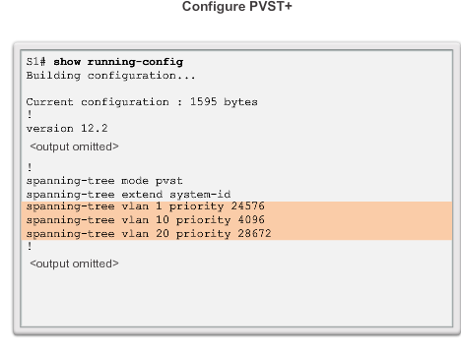
PVST+ Configuration
PVST+ Load Balancing
Notes:
2.3.1.4 PVST+ Load Balancing (cont.)

Slide 46
Sample Configuration – PVST+
S2(config)#vlan 1
S2(config)#spanning-tree mode pvst
S2(config)#int fa0/1
S2(config-if)#switchport mode access
S2(config-if)#switchport access vlan 1
S2(config-if)#spanning-tree portfast
S2(config-if)#spanning-tree bpduguard enable
S2(config)#int gi0/1
S2(config-if)#switchport mode trunk
S2(config-if)#switchport trunk allowed vlan 1-10
S1(config)#vlan 1
S1(config)#spanning-tree mode pvst
S1(config)#spanning-tree vlan 1 root primary
S1(config)#spanning-tree vlan 5 root secondary

Slide 47
Sample Configuration – rapid-pvst+
S2(config)#vlan 1
S2(config)#spanning-tree mode rapid-pvst
S2(config)#int fa0/1
S2(config-if)#switchport mode access
S2(config-if)#switchport access vlan 1
S2(config-if)#spanning-tree portfast
S2(config-if)#spanning-tree bpduguard enable
S2(config)#int gi0/1
S2(config-if)#switchport mode trunk
S2(config-if)#switchport trunk allowed vlan 1-10
S2(config-if)#spanning-tree link-type point-to-point
S2(config)#clear spanning-tree detected-protocols
S1(config)#vlan 1
S1(config)#spanning-tree mode rapid-pvst
S1(config)#spanning-tree vlan 1 root primary
S1(config)#spanning-tree vlan 5 root secondary
S1(config)#int gi0/1
S1(config-if)#switchport mode trunk
S1(config-if)#switchport trunk allowed vlan 1-10
S1(config-if)#spanning-tree link-type point-to-point
S1(config)#clear spanning-tree detected-protocols
Edge Port
Non-Edge Port
Non-Edge Port

Slide 48
Summary
IEEE 802.1D is implemented on Cisco switches on a per-VLAN basis in the form of PVST+. This is the default configuration on Cisco switches.
RSTP, can be implemented on Cisco switches on a per-VLAN basis in the form of Rapid PVST+.
With PVST+ and Rapid PVST+, root bridges can be configured proactively to enable spanning tree load balancing.
Notes:
Chapter 2 Summary

Slide 49
Notes:
HSRP Sample Instructions (Hot Standby Routing Protocol)
1. Configure router R1 G0/0 interface with the following hot standby attributes:
standby 1 ip address 192.168.1.1
standby 1 priority 105
standby 1 preempt
standby 1 track g0/1
2. Configure router R2 G0/0 interface with the following hot standby attributes:
standby 1 ip address 192.168.1.1
3. Change the default gateway on PC-A to 192.168.1.1
4. Disable either of the Ethernet links to R1 and test to see if you can still ping the ISP.

Slide 50
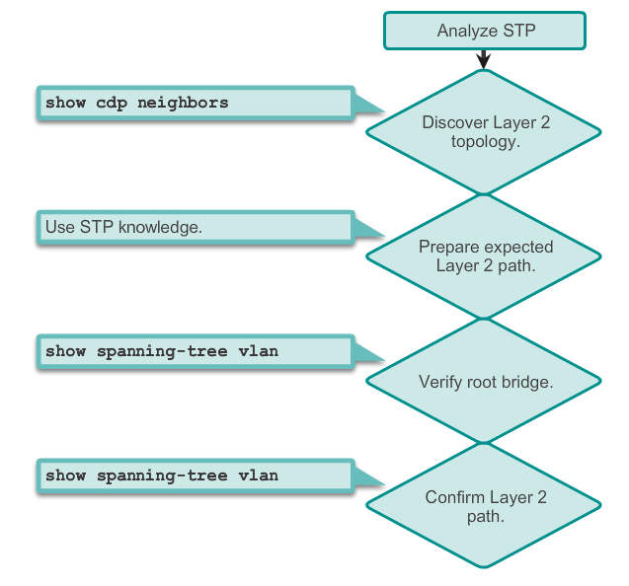
STP Configuration Issues
Analyzing the STP Topology
Notes:
2.3.3.1 Analyzing the STP Topology

Slide 51
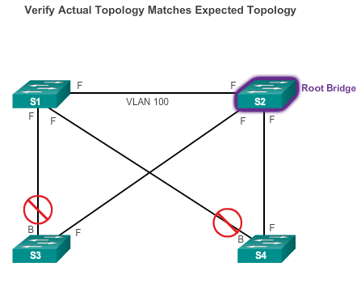
STP Configuration Issues
Expected Topology versus Actual Topology
Notes:
2.3.3.2 Expected Topology versus Actual Topology

Slide 52
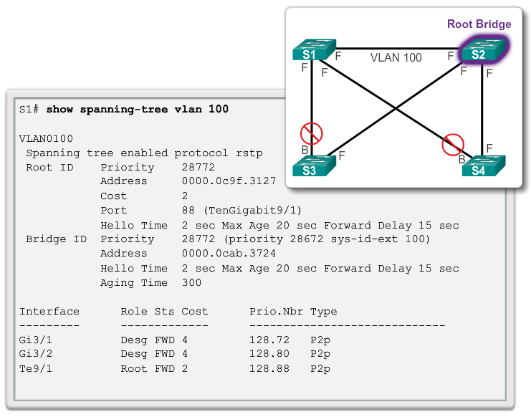
STP Configuration Issues
Overview of Spanning Tree Status
Notes:
2.3.3.3 Overview of Spanning Tree Status

Slide 53
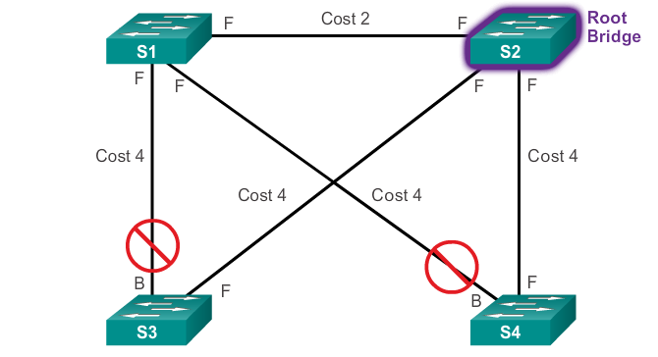
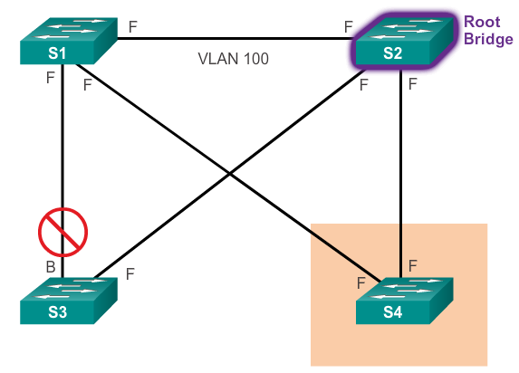
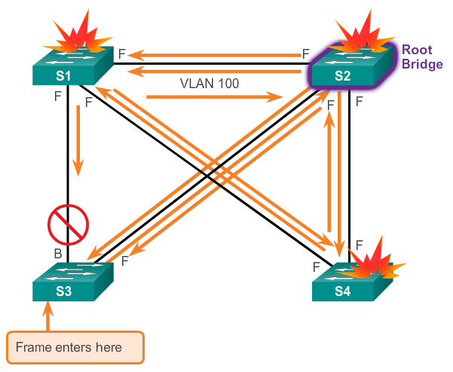
STP Configuration Issues
Spanning-Tree Failure Consequences
STP erroneously moves one or more ports into the forwarding state.
Any frame that is flooded by a switch enters the loop.
Notes:
2.3.3.4 Spanning Tree Failure Consequences

Slide 54
STP Configuration Issues
Repairing a Spanning Tree Problem
One way to correct spanning-tree failure is to manually remove redundant links in the switched network, either physically or through configuration, until all loops are eliminated from the topology.
Before restoring the redundant links, determine and correct the cause of the spanning-tree failure.
Carefully monitor the network to ensure that the problem is fixed.
Notes:
2.3.3.5 Repairing a Spanning Tree Problem

Slide 55
2.4 First-Hop Redundancy Protocols
Notes:
2.4 First-Hop Redundancy Protocols

Slide 56
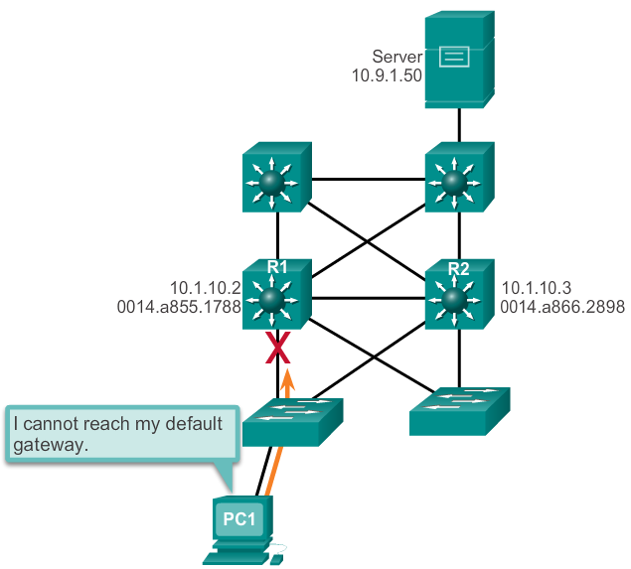
Concept of First-Hop Redundancy Protocols
Default Gateway Limitations
If the default gateway cannot be reached, the local device is unable to send packets off the local network segment.
Even if a redundant router exists that could serve as a default gateway for that segment, there is no dynamic method by which these devices can determine the address of a new default gateway.
Notes:
2.4.1.1 Default Gateway Limitations

Slide 57
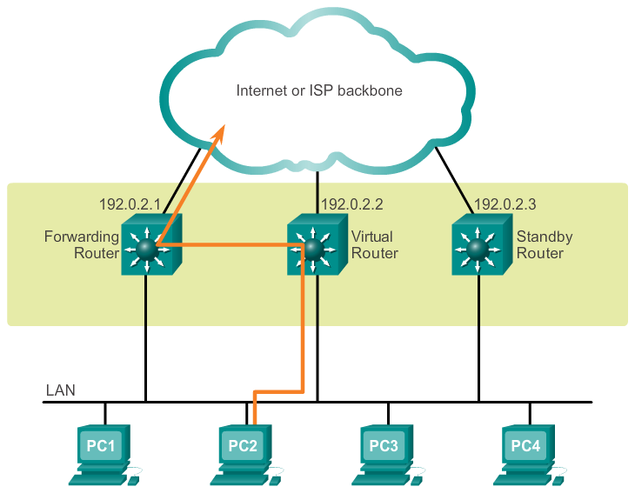
Concept of First-Hop Redundancy Protocols
Router Redundancy
Multiple routers are configured to work together to present the illusion of a single router to the hosts on the LAN.
The ability of a network to dynamically recover from the failure of a device acting as a default gateway is known as first-hop redundancy.
Notes:
2.4.1.2 Router Redundancy

Slide 58
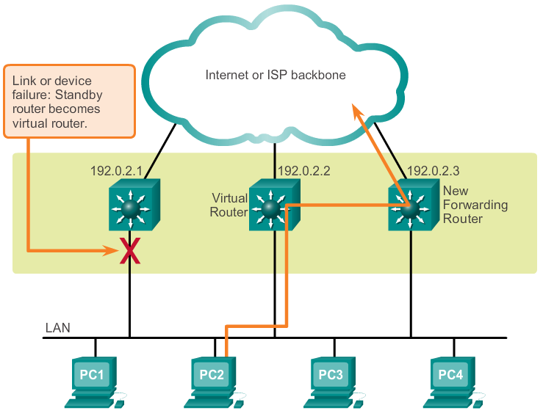
Concept of First-Hop Redundancy Protocols
Steps for Router Failover
Notes:
2.4.1.3 Steps for Router Failover

Slide 59
Varieties of First-Hop Redundancy Protocols
First-Hop Redundancy Protocols
Hot Standby Router Protocol (HSRP)
HSRP for IPv6
Virtual Router Redundancy Protocol version 2 (VRRPv2)
VRRPv3
Gateway Load Balancing Protocol (GLBP)
GLBP for IPv6
ICMP Router Discovery Protocol (IRDP)
Notes:
2.4.2.1 First-Hop Redundancy Protocols

Slide 60
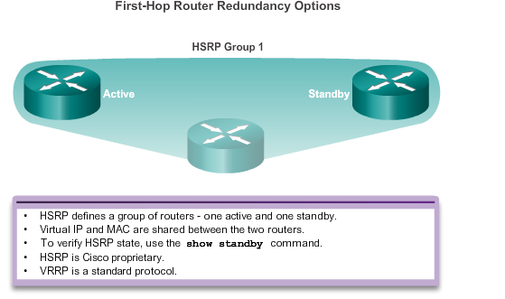
Varieties of First-Hop Redundancy Protocols
First-Hop Redundancy Protocols
Notes:
2.4.2.1 First-Hop Redundancy Protocols (cont.)

Slide 61
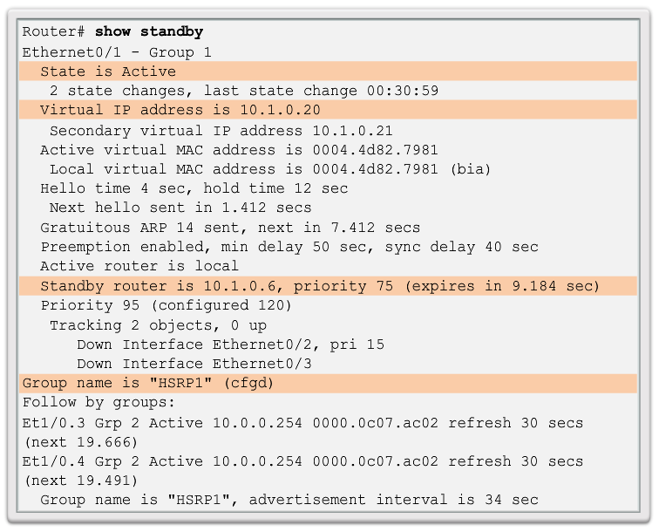
FHRP Verification
HSRP Verification
Notes:
2.4.3.1 HSRP Verification

Slide 62
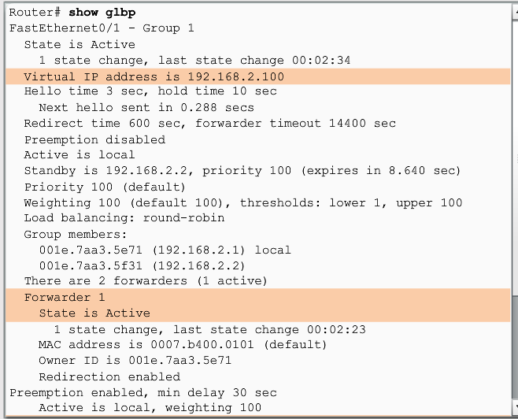
FHRP Verification
GLBP Verification
Gateway Load Balancing Protocol (GLBP) is a Cisco proprietary solution to allow automatic selection and simultaneous use of multiple available gateways in addition to automatic failover between those gateways.
Notes:
2.4.3.2 GLBP Verification

Slide 63
Graphs
Graphs are one of the most versatile structures used in computer programming.
Notation: G = (V, E) where V is a set of vertices (also called nodes) and E is a set of edges.

Slide 64
Searches
Depth-first search
  The algorithm acts as through it wants to get as far away from the starting point as quickly as possible.
  Can use a stack
Breadth-first search
  The algorithm likes to stay as close as possible to the starting points.
  Can use a queue

Slide 65
Depth-First Search
Stack Contents
B
F
H
Event | Stack
Visit A | A
Visit B | AB
Visit F | ABF
Visit H | ABFH
Pop H | ABF
Pop F | AB
Pop B | A
Visit C | AC
Pop C | A
Visit D | AD
Visit G | ADG
Visit I | ADGI
Pop I | ADG
Pop G | AD
Pop D | A
Visit E | AE
Pop E | A
Pop A | Empty
C
A
D
G
I
E
To see a source code for DFS,
click here

Slide 66
Breadth-First Search
Queue Contents
B
F
H
Event | Queue (Front to Rear)
Visit A
Visit B | B
Visit C | BC
Visit D | BCD
Visit E | BCDE
Remove B | CDE
Visit F | CDEF
Remove C | DEF
Remove D | EF
Visit G | EFG
Remove E | FG
Remove F | G
Visit H | GH
Remove G | H
Visit I | HI
Remove H | I
Remove I | Empty
Done
C
A
D
G
I
E
To see a source code for BFS,
click here

Slide 67
Minimum Spanning Trees (MST)
To find the minimum number of edges necessary to connect all the edges in a graph.
It can be implemented using DFS or BFS.
A
A
B
C
B
C
D
E
D
E
Extra Edges
Minimum Number of Edges

Slide 68
Cisco Version
a shortest-distance-to-root spanning tree.
Notes:
Cisco Version (Reference: http://comet.lehman.cuny.edu/griffeth/classes/Spring07/Lectures/070410.pdf)
Not a min-weight spanning tree, but a shortest-distance-to-root spanning tree
All processes send a BPDU (Basic Protocol Data Unit) at each round (actually, default is every 2 seconds – but we will describe this as a synchronous algorithm, running in rounds). The BPDU contains the id (MAC address) of the sending process, the id of the process it thinks is the root, and the distance from the sending process to its presumed root.
id:Int
id:Int
cost:Int
When a process receives a BPDU, it compares the ID of the root (designated by the neighbor that sent the BPDU) to the local value for the ID of the root. If the new root ID is lower, it replaces its local root ID with the new one and adds one to the cost in the incoming BPDU and makes that its cost to the root. If it receives different BPDU’s having different roots, it uses the “best,” i.e., the one with the lowest root ID and the lowest distance (if root Ids are the same). Finally it designates the port to which the sending neighbor is connected as the root port. (Effectively choosing its parent)
Note that this is essentially BFS.
Designated ports are then chosen: for each network it is on, the bridge checks incoming BPDUs. If its own cost is lowest, or if it is tied with another bridge on cost and its id is smaller, it is the designated bridge, and its port on that network segment is the designated port. If it has multiple ports on the network segment, it chooses the one with the lowest id.
Relationship to BFS:
If we ignore all BPDU’s except those carrying the ID of the eventual root, it will look just like BFS. This is the basic idea behind simulation, which I introduce next.

Slide 69
References
Cisco Version
  http://comet.lehman.cuny.edu/griffeth/classes/Spring07/Lectures/070410.pdf
Samples
  danscourses.com

