Slide 1
Link Aggregation
Hwajung Lee
Modified from Slides Courtesy of Cisco Networking Academy

Slide 2
Contents
Link Aggregation Concepts
Link Aggregation Configuration
Summary
Notes:
*In networks with redundancy STP helps prevent:
Switching Loops
Layer 2 Broadcast Storms
*BID (Bridge ID) = Used to determine the Root Bridge:
1. Bridge Priority Number = 32768 (default) Lowest
2. Extended System ID = ID for VLANs
3. MAC Address = Lowest MAC Address
*Port Costs:
10 Gig = 2
1 Gig = 4
100 Mb = 19
10 Mb = 100
*Port Designations:
Root Port = Closest to the root bridge
Designated Port = Forwarding
Non-Designated Port = Blocking

Slide 3
Chapter 3: Objectives
Explain the operation of link aggregation in a switched LAN environment.
Describe EtherChannel technology.
Configure link aggregation to improve performance on high-traffic switch links.
Configure link aggregation with EtherChannel.
Verify and troubleshoot link aggregation with EtherChannel.
Notes:
Chapter 3 Objectives

Slide 4
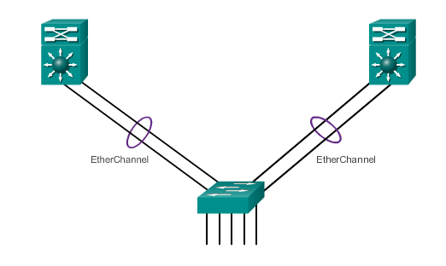
Link Aggregation
Introduction to Link Aggregation
Link aggregation allows the creation of logical links made up of several physical links.
EtherChannel is a form of link aggregation used in switched networks.
Notes:
3.1.1.1 Introduction to Link Aggregation

Slide 5
Link Aggregation
Advantages of EtherChannel
Most configurations are done on the EtherChannel interface ensuring consistency throughout links.
Relies on existing switch ports – no need for upgrades.
Load-balances between links on the same EtherChannnel.
Creates an aggregation viewed as one logical link by STP.
Provides redundancy because the overall link is viewed as one logical connection. If one physical link within channel goes down, this does not cause a change in the topology and does not require STP recalculation.
Notes:
3.1.1.2 Advantages of EtherChannel

Slide 6
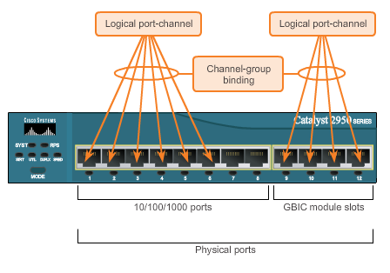
EtherChannel Operation
Implementation Restrictions
EtherChannel implemented by grouping multiple physical ports into one or more logical EtherChannel links.
Interface types cannot be mixed.
EtherChannel provides full-duplex bandwidth up to 800 Mb/s (Fast EtherChannel) or 8 Gb/s (Gigabit EtherChannel).
EtherChannel can consist of up to 16 compatibly-configured Ethernet ports.
The Cisco IOS switch currently supports six EtherChannels.
Notes:
3.1.2.1 Implementation Restrictions

Slide 7
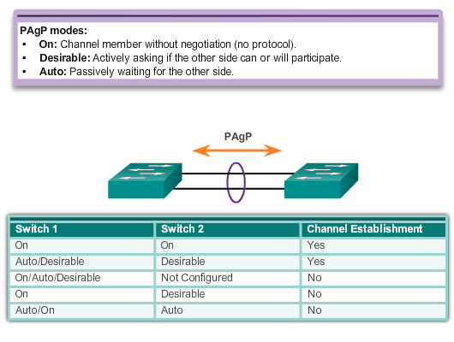
EtherChannel Operation
Port Aggregation Protocol (PAgP)
Notes:
3.1.2.2 Port Aggregation Protocol

Slide 8
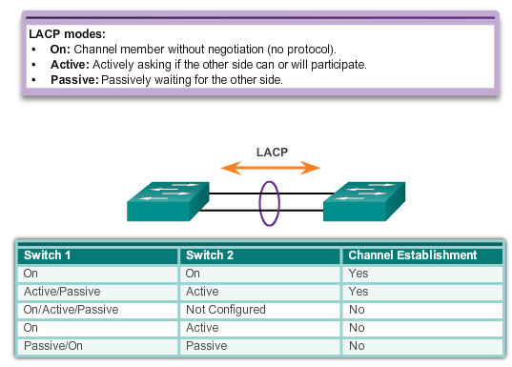
EtherChannel Operation
Link Aggregation Control Protocol (LACP)
Notes:
3.1.2.3 Link Aggregation Control Protocol

Slide 9
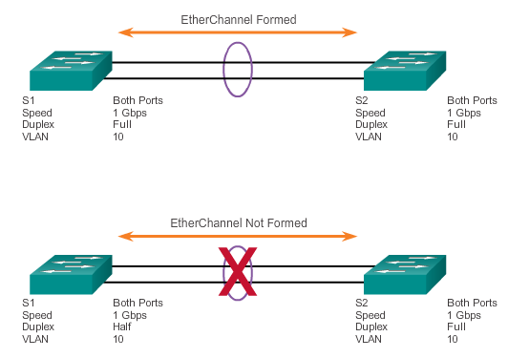
Configuring EtherChannel
Configuration Guidelines
EtherChannel must be supported.
Speed and duplex must match.
VLAN match – All interfaces are in the same VLAN.
Range of VLAN – Same range on all interfaces.
Notes:
3.2.1.1 Configuration Guidelines

Slide 10
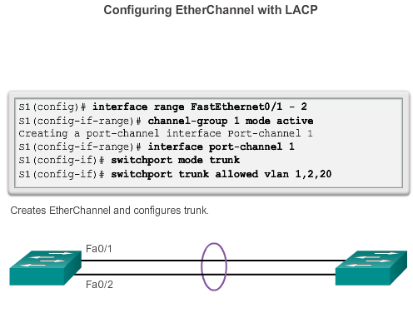
Configuring EtherChannel
Configuring Interfaces
Notes:
3.2.1.2 Configuring Interfaces

Slide 11
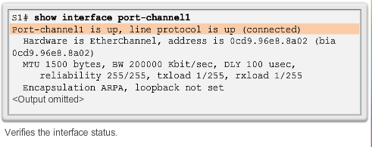
Verifying and Troubleshooting EtherChannel
Verifying EtherChannel
show interface Port-channel – Displays the general status of the EtherChannel interface.
show etherchannel summary – Displays one line of information per port channel.
show etherchannel port-channel – Displays information about a specific port channel interface.
show interfaces etherchannel – Provides information about the role of the interface in the EtherChannel.
Notes:
3.2.2.1 Verifying EtherChannel

Slide 12
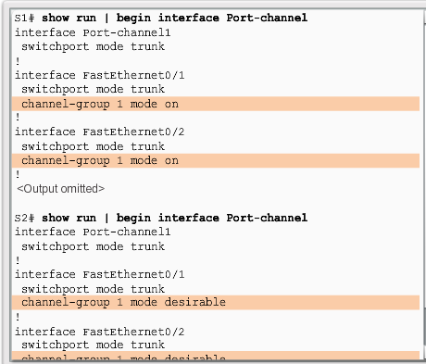
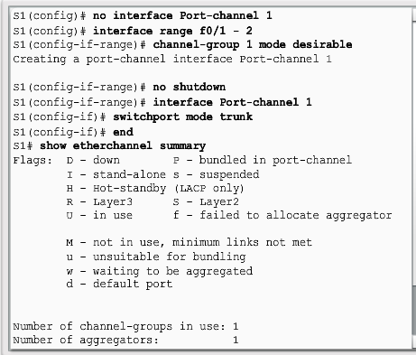
Verifying and Troubleshooting EtherChannel
Troubleshooting EtherChannel
Notes:
3.2.2.2 Troubleshooting EtherChannel

Slide 13
Sample CLI commands
S1(config)# vlan 10
S1(config-vlan)# vlan 20
S1(config-vlan)# exit
S1(config)# int f0/1
S1(config-if)# switchport mode access
S1(config-if)# switchport access vlan 10
S1(config-if)# int f0/10
S1(config-if)# switchport mode access
S1(config-if)# switchport access vlan 20
<repeat commands above on other switches>
S1(config)# int range g0/1-2
S1(config-if)# channel-group 1 mode active (← or passive, auto, desirable, on)
S1(config-if)# exit
S1(config)# int port-channel 1
S1(config-if)# switchport mode trunk
S1(config-if)# switchport trunk allowed vlan 10,20

Slide 14
Summary
This chapter described:
EtherChannel and how to encompass both the PAgP-based and the LACP-based link aggregation methods
EtherChannel technologies and the various means available to implement them
The configuration, verification, and troubleshooting of EtherChannel
Notes:
Chapter 3 Summary

