Slide 1
Smartphone
Specifications
Hwajung Lee
Key Reference: Prof. Jong-Moon Chung’s Lecture Notes at Yonsei University

Slide 2
Smartphone Specifications (1)
 | Galaxy S6 edge | G4 | iPhone 6 plus
Manufacturer | Samsung | LG | Apple
Released Date | April 2015 | April 2015 | September 2014
Cellular Network | GSM / HSPA / LTE | GSM / HSPA / LTE | GSM / HSPA / LTE / CDMA / EVDO
WLAN (Wi-Fi) | 802.11 a/b/g/n/ac, Dual-Band, Wi-Fi Direct, Hotspot | 802.11 a/b/g/n/ac, Dual-Band, Wi-Fi Direct, DLNA, Hotspot | 802.11 a/b/g/n/ac, Dual-Band, Hotspot
Bluetooth | v4.1, A2DP, LE, apt-X | v4.1, A2DP, LE, apt-X | v4.0, A2DP, LE
Notes:
3G CDMA networks (known as "EV-DO" or "Evolution Data Optimized“)
CDMA (Code Division Multiple Access) and GSM (Global System for Mobiles)
CDMA vs. GSM: What's the Difference?
http://www.pcmag.com/article2/0,2817,2407896,00.asp

Slide 3
Smartphone Specifications (2)
 |  | Galaxy S6 edge | G4 | iPhone 6 plus
Platform | OS | Android OS, v5.0.2 (Lollipop) | Android OS, v5.1 (Lollipop) | iOS 8 upgradable to iOS 8.3
 | Chipset | Exynos 7420 | Qualcomm MSM8992 Snapdragon 808 | Apple A8
 | CPU | Quad-core 1.5 GHz Cortex-A53 & Quad-core 2.1 GHz Cortex-A57 | Dual-core 1.82 GHz Cortex-A57 & Quad-core 1.44 GHz Cortex-A53 | Dual-core 1.4 GHz Cyclone (ARM v8-based)
 | GPU | Mali-T760MP8 | Adreno 418 | PowerVR GX6450 (quad-core graphics)

Slide 4
Smartphone Specifications (3)
 |  | Galaxy S6 edge | G4 | iPhone 6 plus
Display | Type | Super AMOLED | IPS LCD | LED-backlit IPS LCD
 | Size | 5.1 inches | 5.5 inches | 5.5 inches
 | Resolution | 2560 x 1440 Pixels | 2560 x 1440 Pixels | 1920 x 1080 Pixels
 | Protection | Corning Gorilla Glass 4 | Corning Gorilla Glass 3 | Ion-strengthened glass, Oleophobic coating

Slide 5
Smartphone Specifications (4)
 |  | Galaxy S6 edge | G4 | iPhone 6 plus
GPS |  | GPS, A-GPS, GLONASS, Beidou | GPS, A-GPS, GLONASS | GPS, A-GPS, GLONASS
Radio |  | No | Stereo FM radio with RDS | No
Charging feature |  | Wireless Charging (Qi / PMA) | Optional Wireless Charging (Qi-enabled) | -
Battery | Capacity | Li-Ion 2600 mAh | Li-Ion 3000 mAh | Li-Po 2915 mAh
Camera | Primary | 16 MP 5312 x 2988 pixels | 16 MP 5312 x 2988 pixels | 8 MP 3264 x 2448 pixels
 | Secondary | 5 MP 1440p | 8 MP 1080p@30fps | 1.2 MP 720p@30fps

Slide 6
Quick Peek: Mobile Communication (1)
Mobile Phone Evolution
  1st Generation (1G)
    AMPS
  2nd Generation (2G)
    GSM, IS-95 (cdmaOne)
  3rd Generation (3G)
    UMTS (WCDMA), CDMA2000
  4th Generation (4G)
    LTE-A

Slide 7
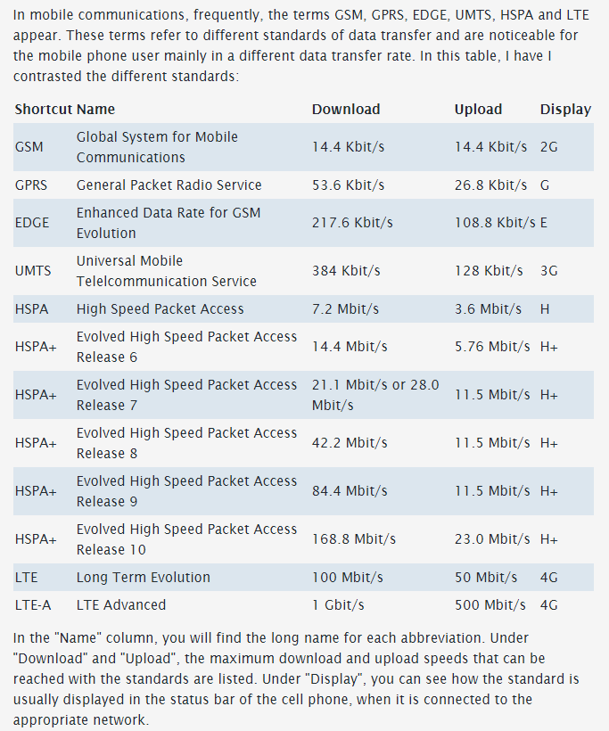
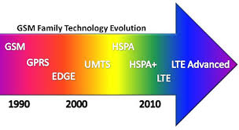
Quick Peek: Mobile Communication (2)
Information Source:
Mobile Communication: What are GSM, GPRS, EDGE, UMTS, HSPA and LTE?
http://www.askingbox.com/info/mobile-communication-what-are-gsm-gprs-edge-umts-hspa-and-lte
Image Source: www.deadzones.com

Slide 8
Quick Peek: Wi-Fi (1)
IEEE 802.11 Network PHY Standards (1/2)
802.11 Protocol | Release Date | Frequency | Bandwidth | Stream Data Rate
802.11-1997 | Jun. 1997 | 2.4 GHz | 22 MHz | 1, 2 Mbps
802.11a | Sep. 1999 | 5 GHz | 20 MHz | 6 ~ 54 Mbps
 |  | 3.7 GHz
802.11b | Sep. 1999 | 2.4 GHz | 22 MHz | 1 ~ 11 Mbps
802.11g | Jun. 2003 | 2.4 GHz | 20 MHz | 6 ~ 54 Mbps
802.11n | Oct. 2009 | 2.4/5 GHz | 20 MHz | 7.2 ~ 72.2 Mbps
 |  |  | 40 MHz | 15 ~ 150 Mbps

Slide 9
Quick Peek: Wi-Fi (2)
IEEE 802.11 Network PHY Standards (2/2)
802.11 Protocol | Release Date | Frequency | Bandwidth | Stream Data Rate
802.11ac | Dec. 2013 | 5 GHz | 20 MHz | 7.2 ~ 96.3 Mbps
 |  |  | 40 MHz | 15 ~ 200 Mbps
 |  |  | 80 MHz | 32.5 ~ 433.3 Mbps
 |  |  | 160 MHz | 65 ~ 866.7 Mbps
802.11ad | Coming in 2016 | 60 GHz | 2.16 GHz | Up to 7 Gbps

Slide 10
References
Apple, http://apple.com
Samsung Electronics, http://www.samsung.com
LG Electronics, http://www.lg.com
GSM Arena, http://www.gsmarena.com
Wikipedia, http://www.wikipedia.org

Slide 11
More Smartphone Specifications (1)
 |  | Galaxy Note 5 | Google Nexus 5X | iPhone 6s plus
Manufacturer |  | Samsung | LG | Apple
Released Date |  | August 2015 | September 2015 | September 2015
Platform | Chipset | Exynos 7420 | Qualcomm MSM8992 Snapdragon 808 | Apple A9
 | CPU | Quad-core 1.5 GHz Cortex-A53 & Quad-core 2.1 GHz Cortex-A57 | Dual-core 1.82 GHz Cortex-A57 & Quad-core 1.44 GHz Cortex-A53 | Dual-core 1.84 GHz Twister
 | GPU | Mali-T760MP8 | Adreno 418 | PowerVR GT7600 (six-core graphics)
 | Size* | 14 nm | 20 nm | 14 nm or 16 nm
Size* = Size of semiconductor device fabrication node
Notes:
chipsets are the brain of the device and need to be powerful and low power consumption

Slide 12
More Smartphone Specifications (2)
 |  | Galaxy Note 5 | Google Nexus 5X | iPhone 6s plus
Display | Size | 5.1 inches | 5.2 inches | 5.5 inches
 | Resolution | 2560 x 1440 Pixels | 1920 x 1080 Pixels | 1920 x 1080 Pixels
Battery | Capacity | Li-Po 3000 mAh | Li-Po 2700 mAh | Li-Po 2750 mAh
Camera | Primary | 16 MP | 12.3 MP | 12 MP
 | Secondary | 5 MP | 5 MP | 5 MP

Slide 13
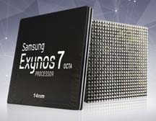
Samsung Exynos 7420
Samsung Exynos Octa 7420
  Released in 2015
  Developed & Manufactured by Samsung
  Based on the ARMv8-A architecture
  By using the big.LITTLE heterogenous computing architecture,
  the Samsung Exynos Octa 7420 has
  4 “big” cores and 4 “little” cores

Slide 14
big.LITTLE Technology
ARM® big.LITTLE™
  Launched by ARM® in 2011
  ARM® big.LITTLE™ processing is a power optimization technology where
  high-performance ARM CPU cores are combined with the most efficient ARM CPU cores to deliver:
    Peak-performance capacity
    Higher sustained performance
    Increased parallel processing performance
    Significantly lower average power

Slide 15
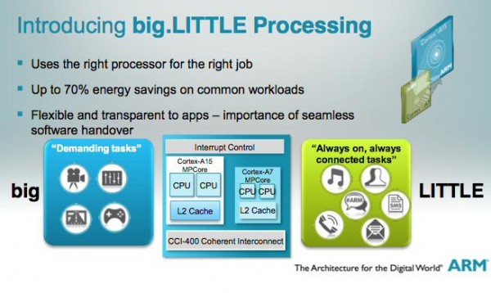
big.LITTLE Technology
ARM® big.LITTLE™
  The "big" or faster cores are used for computation-intensive tasks such as gaming, whereas the "little" or slower cores are used for less intensive tasks
  The latest big.LITTLE software and platforms can save 75% of CPU energy in low to moderate performance scenarios, and can increase performance by 40% in highly threaded workloads

Slide 16
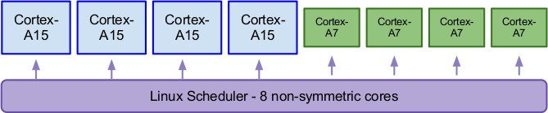
big.LITTLE Technology
 | 1st Generation: ARMv7 | 2rd Generation: ARMv8
High-performance CPU (big) | Cortex-A15, Cortex-A17 | Cortex-A57, Cortex-A72
High-efficiency CPU (LITTLE) |  | Cortex-A53
Ultra high-efficiency CPU (LITTLE) | Cortex-A7 | Cortex-A35
Threads with high priority or computational intensity will be allocated to the "big" cores while threads with less priority or less computational intensity, such as background tasks, can be performed by the "LITTLE" cores

Slide 17
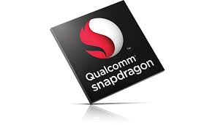
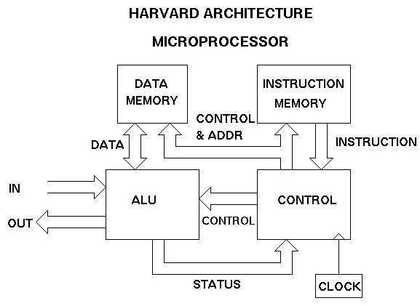
Qualcomm Snapdragon 808
Qualcomm MSM8992 Snapdragon 808
  Released in 2014
  Designed by Qualcomm, Manufactured by TSMC
  Based on the ARMv8-A architecture
  Qualcomm MSM8992 Snapdragon 808 uses the Harvard architecture, which is a computer architecture with physical separate storage and signal pathways for instructions and data
  Qualcomm MSM8992 Snapdragon 808 uses the big.LITTLE heterogenous computing architecture and has
  2 “big” cores and 4 “little” cores

Slide 18

Apple A9
Apple A9
  Introduced on Sept. 9, 2015
  Designed by Apple, Manufactured by Samsung (14 nm) and TSMC (16 nm)
  Based on the ARMv8-A architecture
  Compared to the A8, 70% more CPU performance and 90% more graphics performance can be gained
  Consists of an Apple-designed 64-bit ARM based System-on-Chip (dual-core CPU) called Twister
  New image processor
    Better temporal and spatial noise reduction
    Improved local tone mapping

Slide 19
14 nm Technology (1)
Moore’s Law
  Gordon E. Moore, co-founder of Intel and Fairchild Semiconductor, 1965 paper
  The number of transistors in a dense integrated circuit will double approximately every two years, and this rate of growth is projected to continue for at least another decade

Slide 20
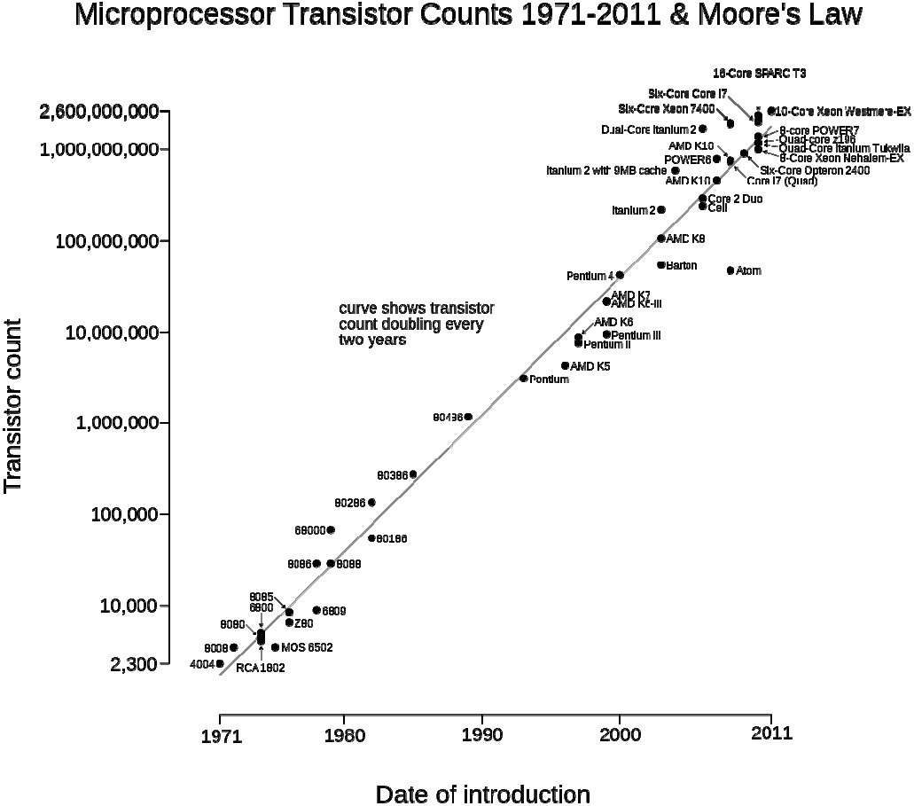
14 nm Technology (2)
Xeon is a brand of x86 microprocessors designed and manufactured by Intel
Xeon is targeted at the non-consumer workstation, server, and embedded system markets
Itanium is a family of 64- bit Intel microprocessors
Itanium2 was jointly developed by HP and Intel
Intel Atom is the brand name for a line of ultra-low-voltage 32-bit and 64-bit CPUs (or microprocessors)
K5 was AMD's first x86 processor to be developed entirely in-house
Pentium is a brand used for a series of x86-compatible microprocessors produced by Intel
Pentium processor is an entry-level product (e.g., for PCs)

Slide 21

14 nm Technology (3)
The 14 nanometer (14 nm) semiconductor device fabrication node is the technology node following the 22 nm/(20 nm) node.
The naming of this technology node as "14 nm" came from the ITRS (International Technology Roadmap for Semiconductors)
The first 14 nm scale devices were shipped to consumers by Intel in 2014

Slide 22
14 nm Technology (4)
ITRS
  The ITRS is sponsored by the five leading chip manufacturing regions in the world: Europe, Japan, Korea, Taiwan, and the United States
  The objective of the ITRS is to ensure cost- effective advancements in the performance of integrated circuit and advanced products and applications that employ such devices, to continue consistent growth and success of this industry

Slide 23
14 nm Technology
Why 14 nm?
  The smaller the transistors, the more transistors in the same area, the faster they switch, the less energy they require, and the cooler the chip runs (given equal numbers of transistors)
  By reducing the distance between transistors you decrease the amount of power required to activate transistors and to get a signal from one to the next. The results make for slimmer and lighter products that have longer battery life

Slide 24
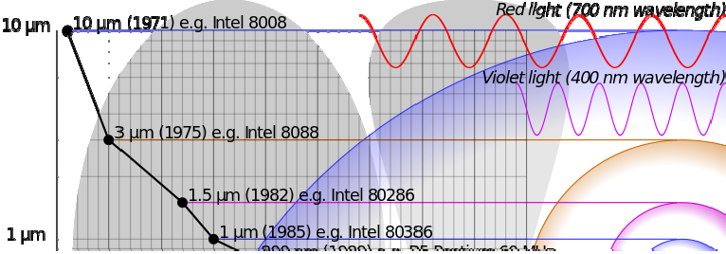
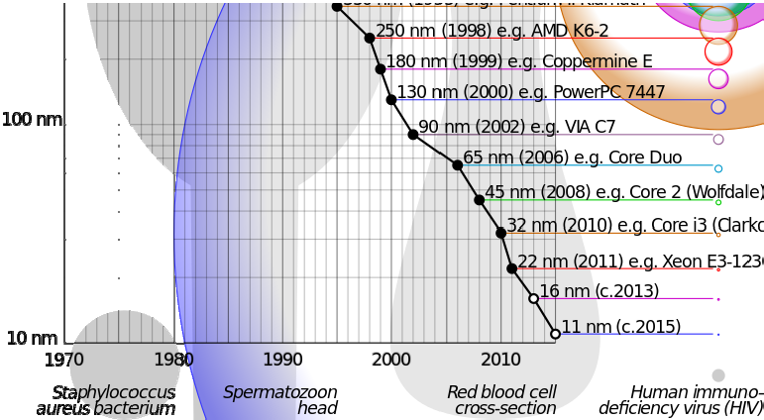
14 nm Technology
How much smaller?
  A normal red blood cell is 6~8 µm in diameter
  A typical human eye will respond to wavelengths from about 390 to 700 nm
  Bacterial ribosome is about 20 nm
14 nm Broadwell
Exynos 7420 Apple A9 Snapdragon 820

Slide 25
14 nm Technology
Size History of Semiconductors
1100
1000 nm
Estimated value
1000
900
800
700
600 nm
600
500
Semiconductor Feature Sizes [nm]
400
350 nm
300
250 nm
200
180 nm
130 nm
90 nm
100
65 nm
45 nm
32 nm _{22 nm}
14 nm 11 nm
6 nm
4 nm
0
1990
1995
2000
2005
2010
2015
2020
Year

Slide 26
Recap: More Smartphones
 |  | Galaxy Note 5 | Nexus 5X | iPhone 6s plus
Manufacturer |  | Samsung | LG | Apple
Released Date |  | August 2015 | September 2015 | September 2015
Platform | Chipset | Exynos 7420 | Qualcomm MSM8992 Snapdragon 808 | Apple A9

Slide 27
References (1)
Apple, http://apple.com
Samsung Electronics, http://www.samsung.com
LG Electronics, http://www.lg.com
GSM Arena, http://www.gsmarena.com
Qualcomm, http://www.qualcomm.com
ARM, http://www.arm.com
Intel, http://www.intel.com
ITRS, http://www.itrs2.net
Wikipedia, http://www.wikipedia.org
Specout, System on a Chip Detail, http://system-on-a-chip.specout.com/l/1107/Qualcomm-Snapdragon-808-MSM8992 [Accessed Nov 16, 2015]

Slide 28
References (2)
Specout, System on a Chip Detail, http://system-on-a-chip.specout.com/l/1145/Samsung-Exynos-Octa-7420 [Accessed Nov 16, 2015]
ANANDTECH, The Apple iPhone 6s and iPhone 6s Plus Review, http://www.anandtech.com/show/9686/the-apple-iphone-6s-and-iphone-6s-plus- review/4 [Accessed Nov 16, 2015]
Trustedreviews, Intel's 14nm revolution: why you should care, http://www.trustedreviews.com/opinions/intel-s-14nm-revolution-everything-you- need-to-know [Accessed November 16, 2015]
ANANDTECH, Intel’s 14nm Technology in Detail, http://www.anandtech.com/show/8367/intels-14nm-technology-in-detail [Accessed November 16, 2015]
PCMag, Definition of:process technology, http://www.pcmag.com/encyclopedia/term/49759/process-technology [Accessed November 16, 2015]

Slide 29
References (3)
Image sources
IPhone 6S Rose Gold, World Super Cars at English Wikipedia [CC BY-SA 3.0 (http://creativecommons.org/licenses/by-sa/3.0)], via Wikimedia Commons
Nexus 5X (White), By LG Electronics [CC BY 2.0 (http://creativecommons.org/licenses/by/2.0)], via Wikimedia Commons
Qualcomm Snapdragon Logo By Qualcomm (Pagina Oficial de Qualcomm) [CC BY- SA 3.0 (http://creativecommons.org/licenses/by-sa/3.0)], via Wikimedia Commons
Apple A9, http://www.forbes.com/sites/aarontilley/2015/11/13/qualcomm-snapdragon-820-vs-apple-a9-chip/#314dc5c5541b
Global Task Scheduling, By Linaro [Public domain], via Wikimedia Commons
ARM Logo, By Unkown (SVG erstellt durch Benutzer:Afrank99) [Public domain], via Wikimedia Commons
Intel logo, By http://www.tecnologiabit.com/intel-programa-el-retiro-del-mercado-de- ocho-cpus-socket-775/ [FAL], via Wikimedia Commons

Slide 30
References (4)
Image sources
Transistor Count and Moore's Law – 2011, By Wgsimon (Own work) [CC BY-SA 3.0 (http://creativecommons.org/licenses/by-sa/3.0) or GFDL (http://www.gnu.org/copyleft/fdl.html)], via Wikimedia Commons
Comparison semiconductor process nodes, By Cmglee (Own work) [CC BY-SA 3.0 (http://creativecommons.org/licenses/by-sa/3.0) or GFDL (http://www.gnu.org/copyleft/fdl.html)], via Wikimedia Commons
Harvard Architecture, https://www.classle.net/#!/classle/book/harvard-architecture-digital-signal-processors/

Slide 31

GPS
GPS (Global Positioning System)
  Created by the U.S. Army in 1978
  GPS device communicates with 4 or more satellites to determine its exact location
  Location Coordinates
    Longitude, Latitude

Slide 32
A-GPS
A-GPS (Assisted GPS)
  Uses information from GPS satellites by using position information from the mobile network assistant servers
  Works the same way as GPS
  Location Coordinates: Longitude, Latitude
  Accurate time information of the mobile network can be used

Slide 33
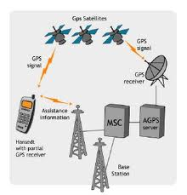
A-GPS
A-GPS (Assisted GPS)
Assistance Types
  MSB (Mobile Station Based)
    Mobile station helps in acquiring GPS satellite information quickly
  MSA (Mobile Station Assisted)
    Mobile server helps calculation of position by using GPS receiver signal information

Slide 34
GPS vs. A-GPS
 | A-GPS | GPS
Signal Information | GPS satellite signals & assistance servers | GPS satellite signals
Speed | Faster location coordinate determination (by using connectivity with cellular base stations) | May take several minutes to determine location (requires connectivity with 4 or more satellites)

Slide 35
GPS vs. A-GPS
 | A-GPS | GPS
Reliability | A-GPS could be slightly less accurate than GPS | Can achieve within 1 meter accuracy (with sufficient GPS signals)
Cost | Cost of mobile network usage | No cost
Usage | Mobile phones | Cars, planes, ships, boats

Slide 36
GLONASS & BeiDou
GLONASS (Global Navigation Satellite System)
  Satellite navigation system for vehicle and aviation navigation
  Operated by the Russian Aerospace Defense Force
BeiDou Navigation Satellite System
  Second generation satellite navigation system of China

Slide 37
References
P. Misra and P. Enge, Global Positioning System: Signals, Measurements, and Performance. Ganga-Jamuna, 2001.
Y. Zhao, “Standardization of Mobile Phone Positioning for 3G Systems," IEEE Communications Magazine, vol. 40, no. 7, pp. 108-116, Jul. 2002.
Wikipedia, http://www.wikipedia.org
Image sources
GPS Logo, http://upload.wikimedia.org/wikipedia/commons/2/2f/NAVSTAR_GPS_logo_shield- official.jpg
A-GPS figure, https://en.wikipedia.org/wiki/Assisted_GPS

Slide 38
DLNA
DLNA (Digital Living Network Alliance)
  Supports wireless networking service applications
  DLNA Service Examples
    Video streaming from PC/laptop to a TV
    Play music on a Hi-Fi system directly from a MP3 in a smartphone
    Print a photo directly to a printer from a smartphone
    etc.

Slide 39

RDS & Shatterproof Glass
RDS (Radio Data System)
  Protocol standard that enables small amounts of digital information transfer
  (e.g., program information, time, station ID) in conventional FM broadcast radios
Shatterproof Glass
  Shatterproof Glass serves as the best surface for smartphones as it provides a very smooth (luxurious) seamless surface

Slide 40
Gorilla Glass & Oleophobic Coating
Gorilla Glass
  Specialized toughened shatterproof glass that is scratch- resistant to prevent deep scratches that can weaken glass
  Introduced at CES (Consumer Electronic Show) 2013 by Corning
Oleophobic Coating
  Physical property of a molecule that is repelled from Oil (means “fear of oil”)
  Used on the smartphone’s surface for fingerprint- resistance & anti-smudging
Notes:
CES 2013: Consumer Electronic Show 2013

Slide 41
AMOLED
AMOLED (Active-Matrix Organic Light-Emitting Diode)
  AMOLED display technology is used in TVs and smartphones
  OLED (Organic Light-Emitting Diode) is a thin-film-display technology that uses organic compounds to form the electro luminescent material
Notes:
From wikipedia
AMOLED displays provide higher refresh rates than passive-matrix,[not specific enough to verify] often reducing the response time to less than a millisecond, and they consume significantly lesspower.^{[11]} This advantage makes active-matrix OLEDs well-suited for portable electronics, where power consumption is critical to battery life.
AMOLED displays may be difficult to view in direct sunlight compared with LCDs because of their reduced maximum brightness.^{[13]} Samsung's Super AMOLED technology addresses this issue by reducing the size of gaps between layers of the screen.^{[14][15]}

Slide 42
Super AMOLED
Super AMOLED
  Super AMOLED is an AMOLED display with an integrated digitizer
    Touch detection layer is (not overlaid) integrated into the smartphone screen
  Characteristics
    Thinner Display
    Lower Power Consumption
    Improves the sunlight reflection characteristics to improve the screen’s outdoor viewing properties

Slide 43

IPS
IPS (In-Plane Switching)
  LCD (Liquid Crystal Display) screen technology used for liquid crystal layer molecule orientation (arranging and switching between the glass substrates)
  Characteristics
    Accurate color and consistent image from wide viewing angles
    When screen is touched there is no tailing or lighten effect on the screen
    Clear images and stable response time

Slide 44
LED-Backlit LCD Display
LED-Backlit LCD Display
  LED backlighting flat panel display tech.
  Improvements Compared to CCFL (Cold Cathode Fluorescent) Backlit LCDs (which was commonly used in LCDs)
    Improved images with greater dynamic contrast & wider dimming range
    Slimmer screen ➔Reduced weight
    and more…

Slide 45
LED-Backlit LCD Display
More Improvements
  RGB-LED backlighting results in wider color gamut (range of colors identifiable by the human eye)
  Reduced heat emission
➔ Reduced power consumption
  More reliable and longer product lifespan

Slide 46

Qi
Qi (氣 = Natural Energy [in Chinese])
  WPC (Wireless Power Consortium) standard for inductive electrical power transfer over distances up to 4 cm
  Low power for inductive transfer commonly uses power delivery below 5 W
  Qi System
    Power Transmission Pad
    Power Receiver (commonly in a Mobile Device)

Slide 47

WPC
WPC (Wireless Power Consortium)
  Established December 17, 2008
  WPC Objective
    Create a universal wireless power charging standard
    ➔Various mobile electronics placed on top of a single power transfer pad can be recharge by magnetic induction
  Uses the Qi standard

Slide 48

PMA
PMA (Power Matters Alliance)
  Global non-profit industry organization founded by Procter
  & Gamble and Powermat Technologies in March 2012
  PMA’s mission is to advance standards and protocols for wireless power transfer

Slide 49
References
C. Rus, K. Kontola, I. D. D. Curcio, and I. Defee, “Mobile TV Content to Home WLAN,” IEEE Transactions on Consumer Electronics, vol. 54, no. 3, pp. 1038– 1041, Aug. 2008.
WPC, Benefits, http://www.wirelesspowerconsortium.com/about/benefits.html [Accessed June 1, 2015]
PMA, About PMA, http://merger.powermatters.org/index.php/about/about-2 [Accessed June 1, 2015]
The Digital Living Network Alliance, http://www.dlna.org
Wikipedia, http://www.wikipedia.org

