Slide 1
Smartphone
Operating Systems
Hwajung Lee
Key Reference: Prof. Jong-Moon Chung’s Lecture Notes at Yonsei University

Slide 2
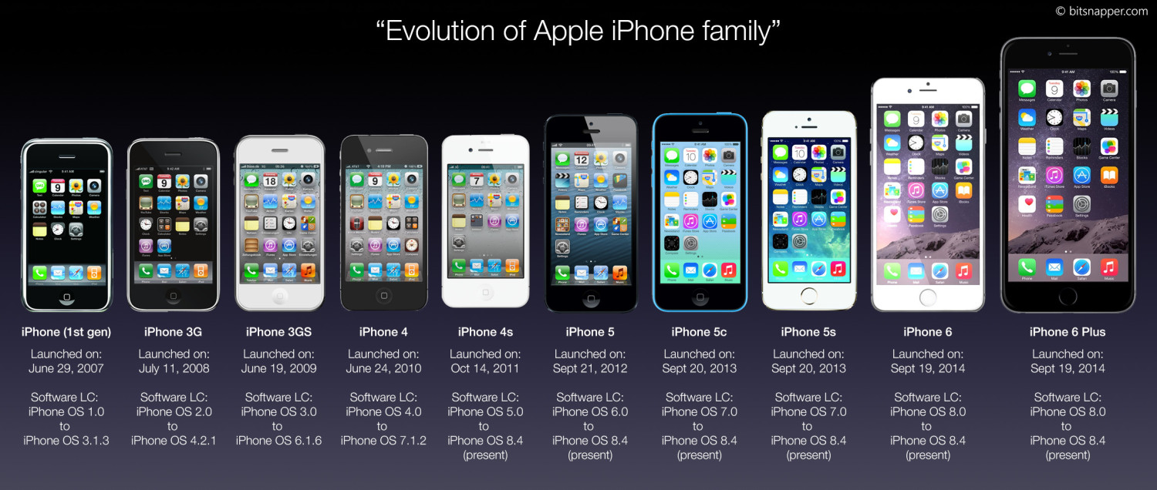
iPhone Evolution
Notes:
iPhone 6s plus
Released in Sept 2015
iOS 9.0~
iPhone SE
- Released March 31, 2016
iPhone 7 Plus
Will be Released in Sept 7 2016
5.5 inch
http://www.telegraph.co.uk/technology/0/iphone-7-rumours-apple-release-date-price-and-features/ [Accessed on 9/6/2016]

Slide 3
iOS Evolution

Slide 4
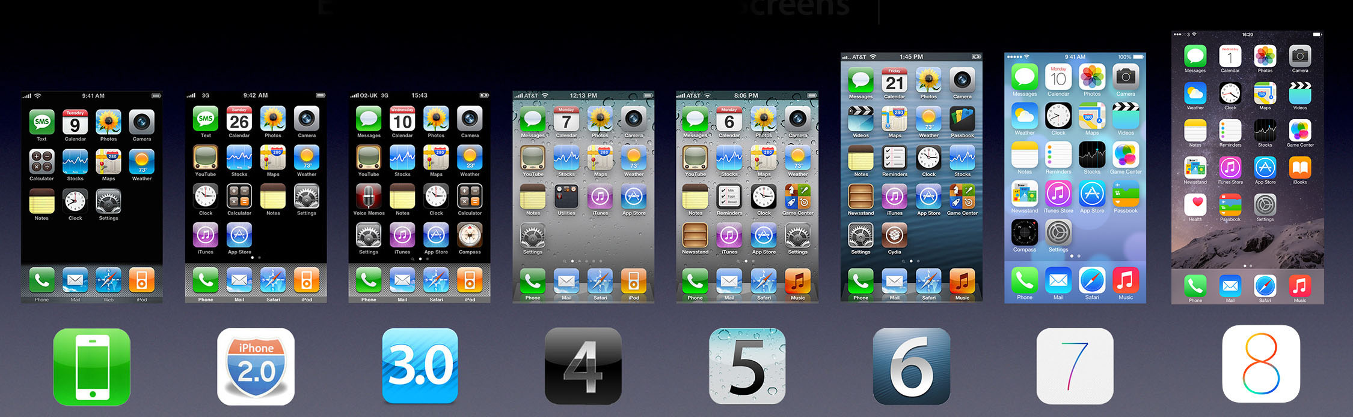
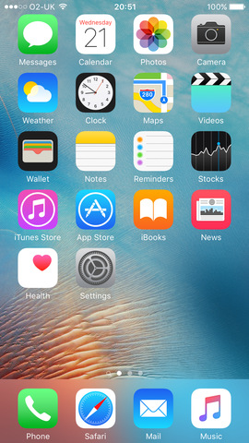

iOS Evolution
Notes:
iOS 10
Will be Released in Sept 2016
http://www.independent.co.uk/life-style/gadgets-and-tech/the-top-9-ways-your-iphone-is-going-to-change-when-ios-10-comes-out-a7228381.html [Accessed on 9/6/2016]

Slide 5
iOS Evolution
iOS
  Steve Jobs introduced the iPhone on January 9, 2007
  The iPhone and iPad started a new era of smart devices, mobile apps, and mobile computing

Slide 6
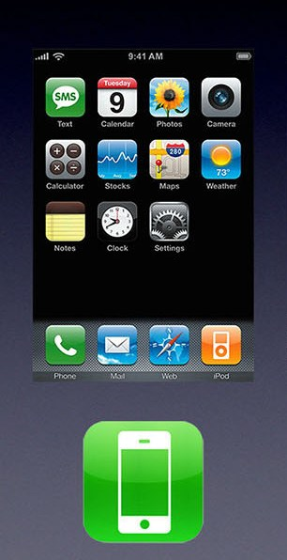
iOS Evolution
iOS 1
  Released in June 2007
  OS of the first iPhone
  Core iOS user interface
    Capacitive touchscreen
    Pinch-to-Zoom
    Inertial Scrolling
  Mobile Safari web browser
  Visual Voicemail
  Google Maps

Slide 7
iOS Evolution
iOS 1.1
  Released in September 2007
  iTunes Wi-Fi Music Store
  iPod Touch compatibility
iOS 1.1.3
  Released in January 2008
  ‘Locate Me’ feature
  Web clips on home screen
  Re-arrange icons
Notes:
iOS 1.1.3
Google Maps on iPhone gains the 'Locate Me' feature which can determine the phone's approximate location, using a combination of cellular triangulation and Wi-Fi data from Skyhook Wireless; also adds hybrid map support and the 'Drop Pin' feature

Slide 8
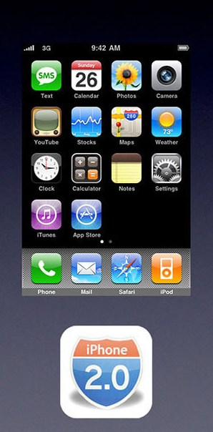
iOS Evolution
iOS 2 (1/2)
  Released in July 2008
  App Store
    Improved app browsing and installation
    Revolution in mobile app distribution
  iOS SDK (Software Development Kit)
    More functional apps
    Improved appearance
Notes:
Apple Worldwide Developers Conference (WWDC)

Slide 9
iOS Evolution
iOS 2 (2/2)
  Contact Search
  Microsoft Exchange support
  MobileMe
    A subscription-based collection of online services and software offered by Apple Inc.
    Later, the services were being gradually transitioned and replaced by iCloud.
Notes:
MS Exchange - When you add your Exchange ActiveSync account, you can sync your Mail, Contacts, Calendars, Reminders, and Notes wirelessly with your iOS device.
MobileMe (formerly .Mac and iTools) was a subscription-based collection of online services and software offered by Apple Inc. All services were being gradually transitioned and replaced by iCloud and the service ceased as of June 30, 2012, with transfers to iCloud available until July 31, 2012. Afterwards, all data was deleted, and the email addresses of accounts not transferred to iCloud were marked as unused.

Slide 10
iOS Evolution
iOS 2.1
  Released in September 2008
  Battery life and speed fixes
  iTunes Genius playlists
  Dropped call fixes
iOS 2.2
  Released in November 2008
  Google street view
  Podcast downloads

Slide 11
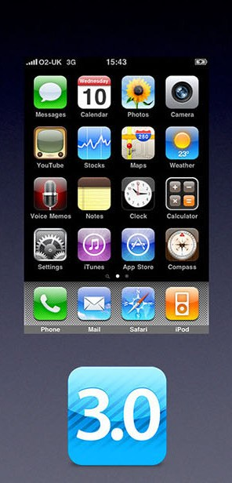
iOS Evolution
iOS 3 (1/2)
  Released in June 2009
  Cut, Copy, and Paste
  New text-selection metaphor that works well with touch
  Push notifications for 3rd party apps
  Voice Control

Slide 12
iOS Evolution
iOS 3 (2/2)
  MMS (Multimedia Message Service) functionality including vCards, picture, audio files, video
    Optional Subject line in the Message Settings
    Photos can be taken/sent directly from the Messages app
    MMS messages are played/viewed in the Message app
  USB & Bluetooth tethering
  Landscape keyboard
  Find my iPhone
Notes:
MMS functionality including sending vCards, pictures, audio files, video (depends on mobile network availability).^{P2,P3}
Optional Subject line in the Messages settings.
Photos can be taken/sent directly from the Messages app.
MMS messages are played/viewed in the Messages app.

Slide 13
iOS Evolution
iOS 3.2
  Released in April 2010
  Support for iPad resolution
    Initial release on iPad (1st generation)
  Allow user to change home screen background
  Location-based services rely on Apple’s own databases instead of Google and Skyhook Wireless
  Bluetooth keyboard support
  iBooks

Slide 14
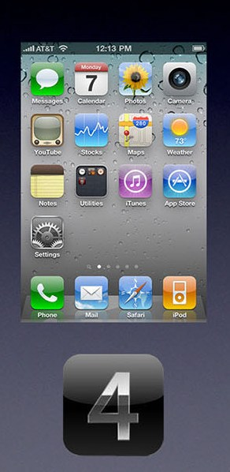
iOS Evolution
iOS 4 (1/2)
  Released in June 2010
  Multitasking
  Fast App Switching/Saved State ➔ Allows apps to save current status for easy reuse when returning to app after multitasking
  Retina Display support

Slide 15
iOS Evolution
iOS 4 (2/2)
  FaceTime video chat using Wi-Fi
  Home Screen Folders
  Drag and drop an app icon on top of another app icon to form an app folder

Slide 16
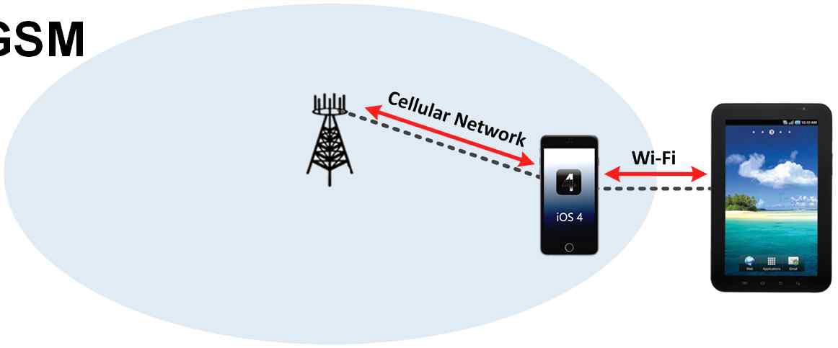
iOS Evolution
iOS 4.2.5
  Released in February 2011
  Personal hotspot using CDMA
iOS 4.3
  Released in March 2011
  Personal hotspot using GSM
Notes:
CDMA (Code Division Multiple Access) and GSM (Global System for Mobiles)
CDMA vs. GSM: What's the Difference?
http://www.pcmag.com/article2/0,2817,2407896,00.asp
In the U.S., Sprint, Verizon and U.S. Cellular use CDMA. AT&T and T-Mobile use GSM. [As of Feb 2015]
It's much easier to swap phones on GSM networks, because GSM carriers put customer information on a removable SIM card.
The SIM cards are generally there for Sprint's and Verizon's 4G LTE networks, because the LTE standard also uses SIM cards.

Slide 17
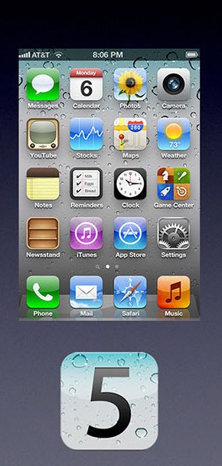
iOS Evolution
iOS 5 (1/2)
  Released in October 2011
  iCloud
    File backup
    Multiple device sync
  Siri
    Siri virtual assistant replaces Voice Control

Slide 18
iOS Evolution
iOS 5 (2/2)
  iMessage
    Free multimedia message exchanges
  No More PC Activation Requirement
    iOS 5 devices do not need to be physically tethered to a computer via USB when activated

Slide 19
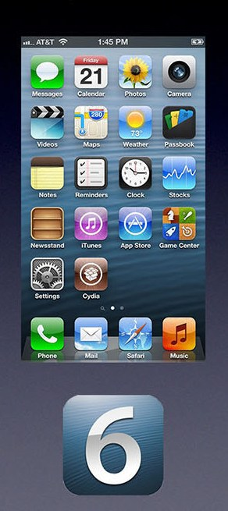
iOS Evolution
iOS 6 (1/2)
  Released in September 2012
  Maps
  ➔Departure from Google Maps
  FaceTime over mobile cellular networks
  Improved Apple ID integration
Notes:
Improved Apple ID integration
Made it More security, more controllable
Made it More identifiable

Slide 20
iOS Evolution
iOS 6 (2/2)
  Passbook
    Mobile payment (tickets, coupons, boarding passes, etc.) and rewards cards
  Siri enhancements
  Sports scores, schedules, and player data
  Restaurant reviews from Yelp
  Reservations from OpenTable
  Siri car control (future development): this is still evolving

Slide 21
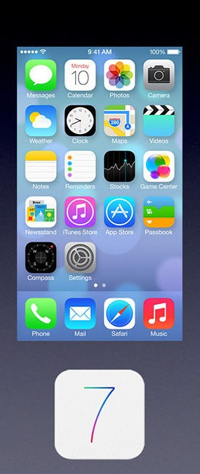
iOS Evolution
iOS 7 (1/2)
  Released in September 2013
  Touch ID
    Fingerprint biometric sensor to unlock phone
    Password-less purchases from the App Store
  AirDrop
    Ad-hoc sharing of images, videos, and files

Slide 22
iOS Evolution
iOS 7 (2/2)
  FaceTime Audio
  Audio-only version of FaceTime between Apple users via Wi-Fi, 3G, or LTE

Slide 23
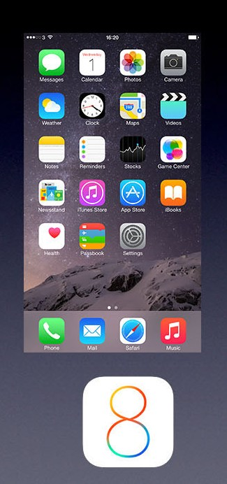
iOS Evolution
iOS 8 (1/2)
  Released in September 2014
  Continuity
    Works with Apple’s new Mac OS X 10.10 Yosemite for enhanced interactivity between iPhone or iPad and Mac computer
      Send and receive text messages from a Mac
      Take phone calls from a Mac

Slide 24
iOS Evolution
iOS 8 (2/2)
  Third party keyboard support
  HealthKit
    Hub for third-party fitness trackers data
  HomeKit
    Home automation (future development)
    iPhone can serve as a remote control for the entire home

Slide 25
iOS Evolution
Any key features of the following iOS?
iOS 9
iOS 9.3.5
iOS 10

Slide 26
References
Apple, http://apple.com
The Verge, iOS : A visual history, http://www.theverge.com/2011/12/13/2612736/ios-history-iphone-ipad [Accessed June 1, 2015]
Wikipedia, http://www.wikipedia.org, https://en.wikipedia.org/wiki/IOS_version_history
Image Sources
Evolution of Apple iPhone Family, http://bitsnapper.com/ios-101-day-0-setting-up-the-garage/
Evolution of Apple iOS Family, http://tech.everyeye.it/articoli/speciale-ios-9-come-sara-il-prossimo-sistema-operativo-di-apple-26373.html
iOS 9, https://en.wikipedia.org/wiki/IOS_9

Slide 27
Android Evolution

Slide 28
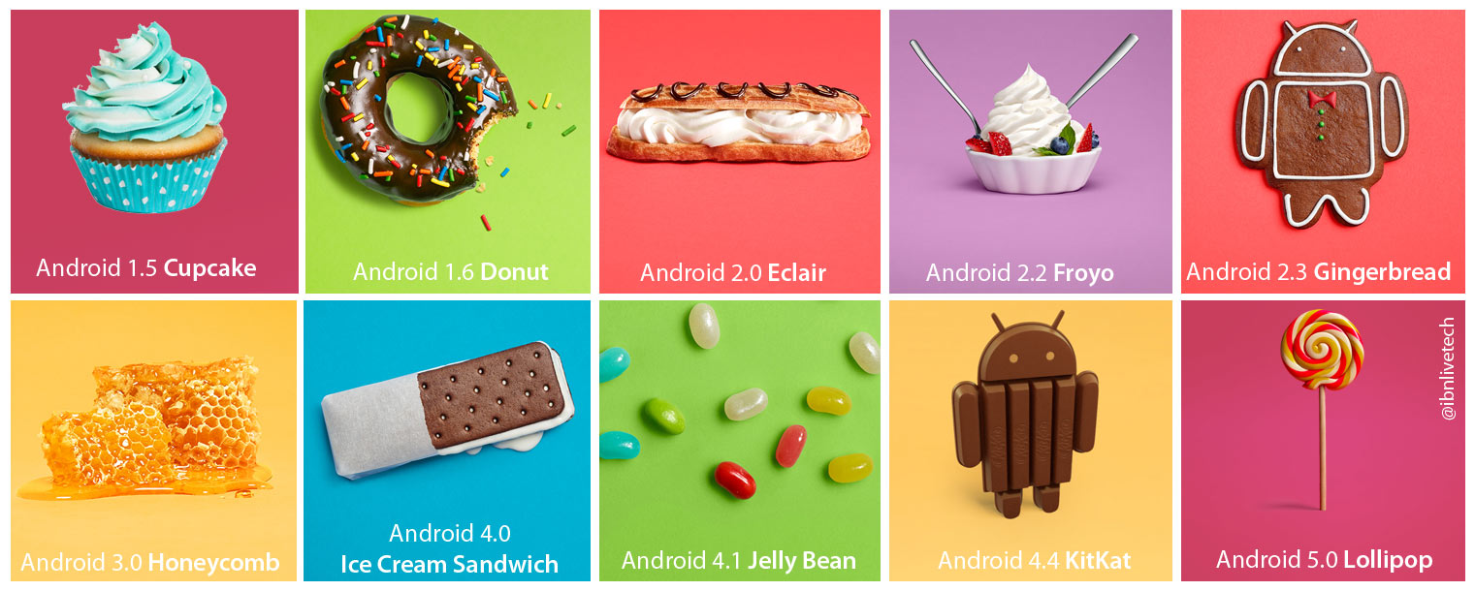
Android Evolution
Notes:
The Android SDK is available for Windows, Mac and Linux, so you don’t need to pay for new hardware to start writing applications.
Android programming is based on Java programming language. So if you have basic understanding on Java programming , you’re halfway there!
By distributing your application on Android Market, it’s available to hundreds and thousands of users instantly. You’re not just limited to one store.

Slide 29
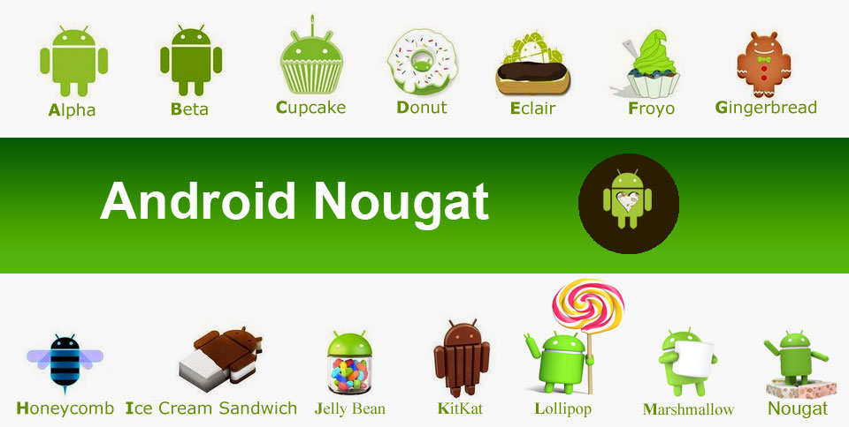
Android Evolution

Slide 30
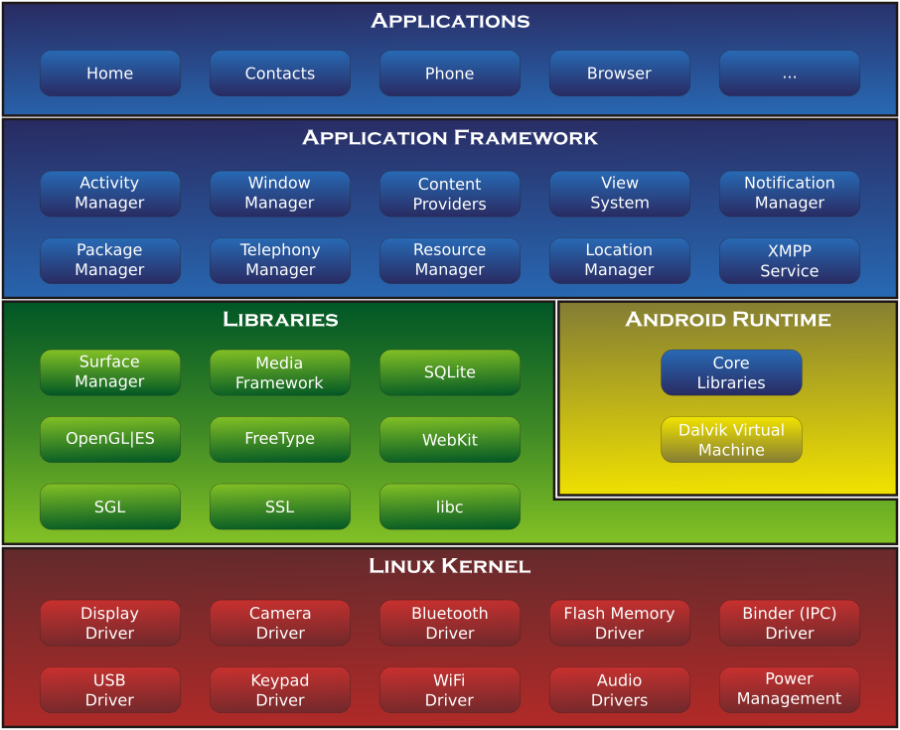
Android Evolution
Android’s Architecture Diagram

Slide 31
Android Evolution
Android
Android Beta
  Released in November 2007
  Beginning of the Android mobile OS (Operating System)
Android 1.0
  Released in September 2008
  First commercial Android OS
Android versions are linked with API Levels

Slide 32
Android Evolution
API Level
API (Application Programming Interface)
API Level is a general indicator of how much the Programmer can communicate with built in functions of a device
Higher API levels indicate increased functionality control

Slide 33
Android Versions | Name | *Release Date | API Level | Kernel Version
1.5 | Cupcake | April 30, 2009 | 3 | 2.6.27
1.6 | Donut | September 15, 2009 | 4 | 2.6.29
2.0–2.1 | Eclair | October 26, 2009 | 5-7 | 2.6.29
2.2 | Froyo | May 20, 2010 | 8 | 2.6.32
2.3–2.3.2 | Gingerbread | December 6, 2010 | 9 | 2.6.35
2.3.3–2.3.7 | Gingerbread | February 9, 2011 | 10 | 2.6.35
3.0 | Honeycomb | Feb 11, 2011 | 11 | 2.6.36
3.1 | Honeycomb | May 10, 2011 | 12 | 2.6.36
3.2 | Honeycomb | July 15, 2011 | 13 | 2.6.36
4.0-4.0.2 | Ice Cream Sandwich | October 11, 2011 | 14 | 3.0.1
4.0.3-4.0.4 | Ice Cream Sandwich | December 16, 2011 | 15 | 3.0.1
4.1.X | Jelly Bean | July 9, 2012 | 16 | 3.0.31
4.2.X | Jelly Bean | November 13, 2012 | 17 | 3.4.0
4.3 | Jelly Bean | July 24, 2012 | 18 | 3.4.39
4.4 | Kit Kat | September 2013 | 19, 20 | 3.10
5.0-5.0.2 | Lollipop | November 3, 2014 | 21 | 3.16.1
5.1-5.1.1 | Lollipop | March 9, 2015 | 22
6.0-6.0.1 | Marshmallow | October 5, 2015 | 23 | 3.18.10
7.0 | Nougat | August 22, 2016 | 24
*Depending on sources,
the release dates might have
a difference in several days range

Slide 34
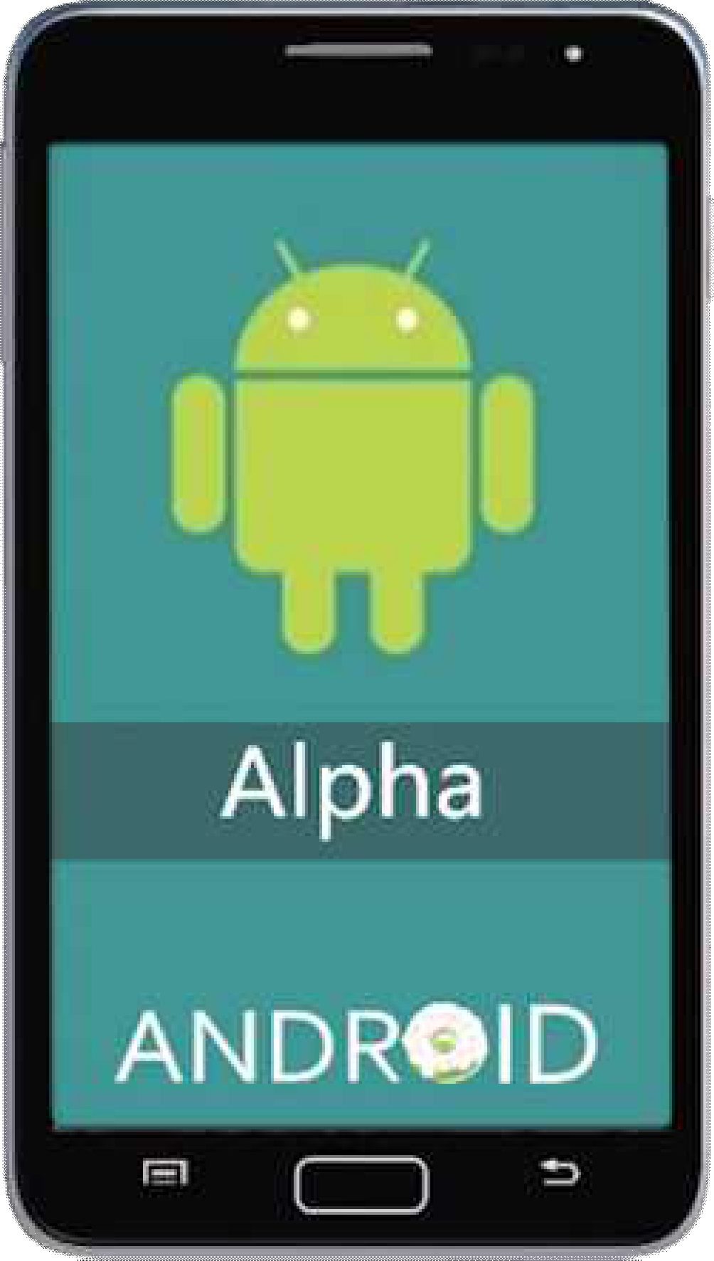
Android Evolution
Android 1.0 (API level 1) (1/2)
Grouping of Folders
➔ Single Folder Icon
Access to web e-mail servers
Wi-Fi and Bluetooth support
Google Sync
  Wireless synchronization of Gmail, People, and Calendar

Slide 35
Android Evolution
Android 1.0 (API level 1) (2/2)
Basic Applications
  Calendar, Maps, Street View, Talk Voice Dialer, Wallpaper
Additional Applications
  (Phone) Dialer
  (Launcher) Home Screen
  (Gallery) Pictures
  Alarm Clock
  Calculator
Notes:
Phone dialer application
https://www.microsoft.com/en-us/store/p/phone-dialer/9wzdncrfj12m
Launcher which had a Home Screen feature application
http://www.androidcentral.com/best-android-launchers
Launchers are the way Android users customize their smartphone and tablet experience. There's superficial stuff, like changing screen transitions, icons, and fonts, but the best Android launchers out there enable users to tweak the device's behavior to suit their daily usage, so long as you're willing to put the time into defining those customizations. Some launchers act very similarly to the one that came with your device, while others completely change the way you interact with your home screen. You can make your home screens as simple or complicated as you wish, while tweaking every little detail or just taking what's given to you by default — all by installing one single app.
In the Gallery side, Pictures application

Slide 36
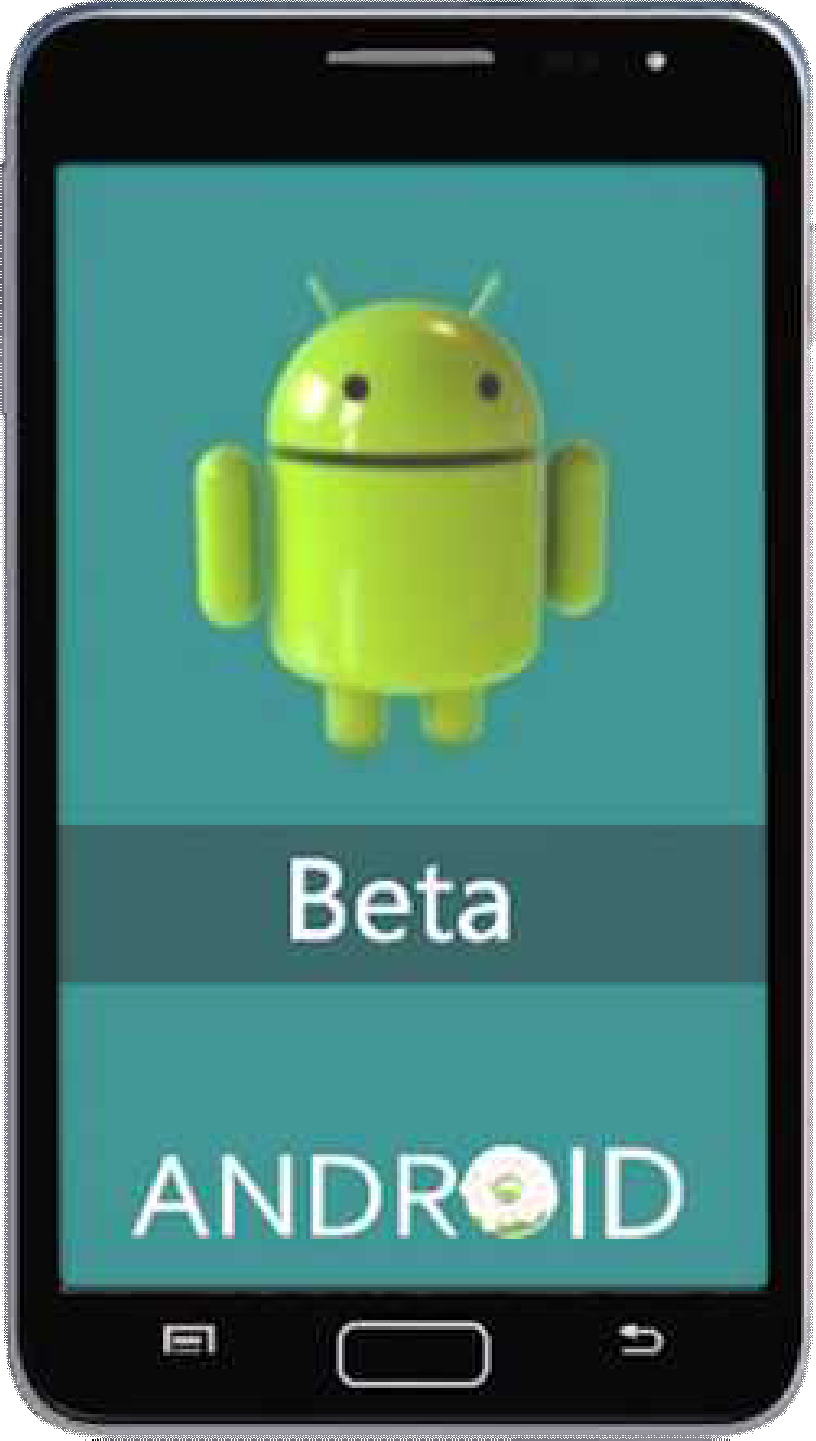
Android Evolution
Android 1.1 (API level 2)
Released in February 2009
Released on the HTC Dream smartphone
Attachments in messages can be saved

Slide 37

Android Evolution
Android 1.5 Cupcake (API level 3) (1/4)
Released in April 2009
Web Browser Copy and Paste
User pictures added for Favorites in Contacts
Screen Transitions with Animation
Starting with Android 1.5 "Cupcake," Android versions were each given a confectionery code name in alphabetical order

Slide 38
Android Evolution
Android 1.5 Cupcake (API level 3) (2/4)
Auto-pairing and stereo support for Bluetooth A2DP and AVRCP profiles
  A2DP (Advanced Audio Distribution Profile)
    Defines how multimedia audio can be streamed from one device (e.g., smartphone) to another device (e.g., wireless headset, hearing aid, car audio) over Bluetooth

Slide 39
Android Evolution
Android 1.5 Cupcake (API level 3) (3/4)
AVRCP (Audio/Video Remote Control Profile)
  Enables a single remote controller to control all local A/V equipment (e.g., TVs, Hi-Fi equipment)
  Can be used with A2DP
Third-Party Virtual Keyboards
  Text Prediction
  Custom Words User Dictionary

Slide 40
Android Evolution
Android 1.5 Cupcake (API level 3) (4/4)
Widget
  Miniature application that can be inserted into another application
  Receives periodic updates
  Used in home screen customization
  Touching leads to direct app access
  Widget Examples
    Weather widgets
    Clock widgets
    Sports score trackers

Slide 41
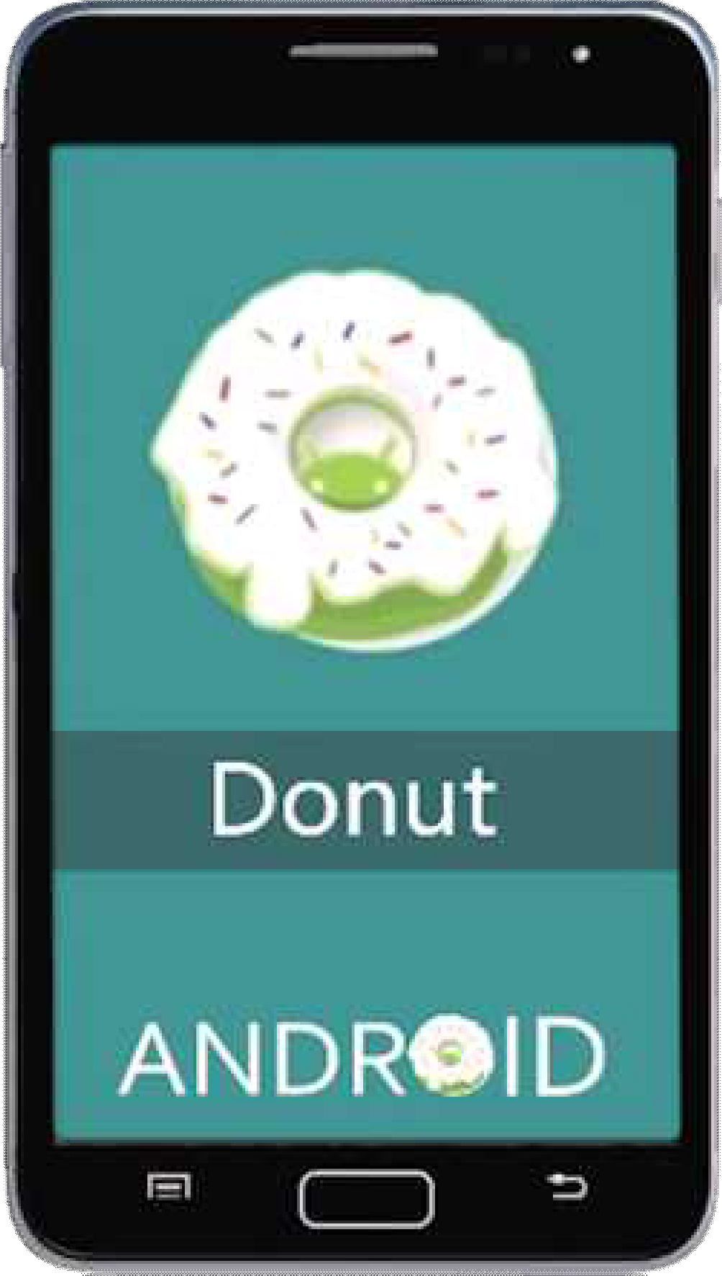
Android Evolution
Android 1.6 Donut (API level 4) (1/3)
Released in September 2009
Text-to-Speech Engine
Multi-Lingual Speech Synthesis Engine
  Android applications can “Speak” a string of text
Enhanced fully integrated Gallery, Camera, and Camcorder
  Faster camera access

Slide 42
Android Evolution
Android 1.6 Donut (API level 4) (2/3)
Multiple photo selection for deletion
CDMA/EVDO and 802.1x support
VPN (Virtual Private Network) support
  Virtual point-to-point private dedicated network connection setup in a public network
  Virtual tunneling protocols and packet traffic encryption commonly used
Notes:
CDMA (Code Division Multiple Access)
EVDO (EVolution Data Optimized)
1xEV-DO (EVDO) is a 3G standard for CDMA-based networks. As a 3G technology, it focuses on bringing high-speed data to CDMA networks. See: 3G. EVDO provides data rates over 10 times faster than 1xRTT, the previous data technology for CDMA networks.

Slide 43
Android Evolution
Android 1.6 Donut (API level 4) (3/3)
WVGA (Wide Video Graphics Array) Screen support
  Wider VGA screen with same 480 Pixel Height
  Aspect Ratio 3:2
• 720x480
  Aspect Ratio 5:3
• 800x480
  Approximate Aspect Ratio 16:9
• 848x480, 852x480, 853x480, 854x480

Slide 44
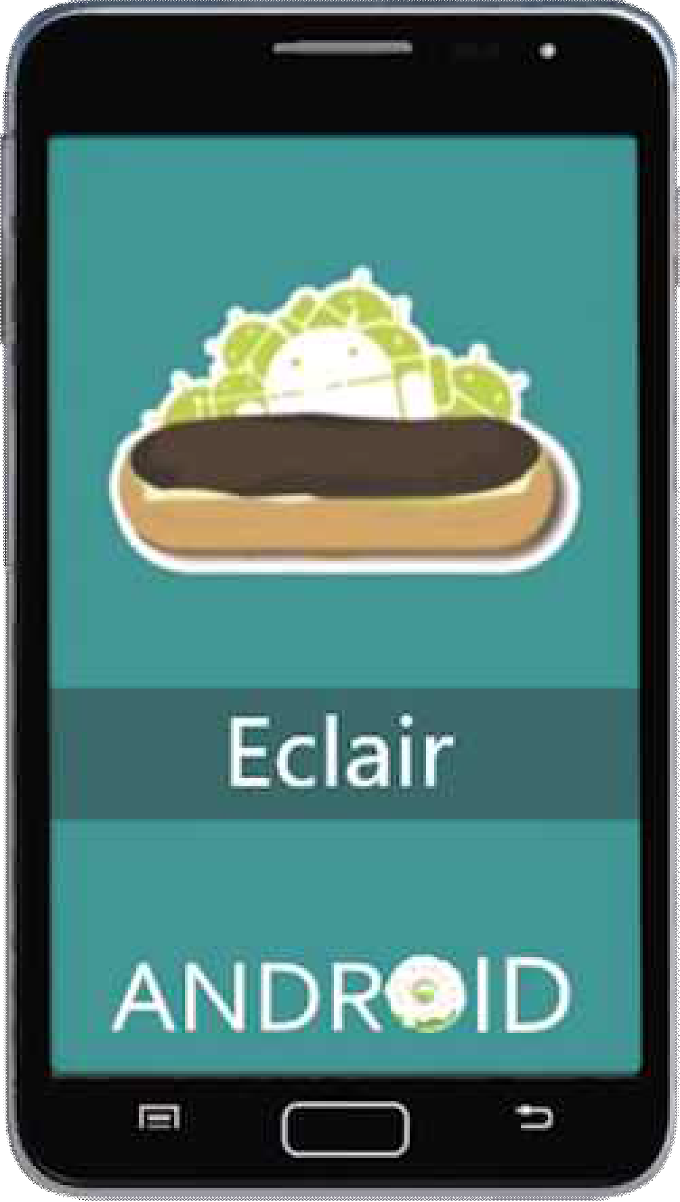
Android Evolution
Android 2.0 Éclair (API level 5) (1/4)
Released in October 2009
Account Sync
  Multiple User Accounts on a single device
  Synchronization of e-mail and contacts
Bluetooth 2.1 support

Slide 45

Android Evolution
Android 2.0 Éclair (API level 5) (2/4)
Can search all saved SMS and MMS messages
New Camera Features
  Flash Support
  Digital Zoom
  Scene Mode
  White Balance
  Color Effect
  Macro Focus

Slide 46
Android Evolution
Android 2.0 Éclair (API level 5) (3/4)
Enhanced Google Maps
Enhanced Virtual Keyboard
  Improved Typing Speed using dictionary suggestions
    Includes words used by the user
    Includes user contacts names

Slide 47
Android Evolution
Android 2.0 Éclair (API level 5) (4/4)
Motion Event class
➔Track multi-touch events
Live Wallpapers
  Home-Screen Background Animation
Microsoft Exchange e-mail support

Slide 48
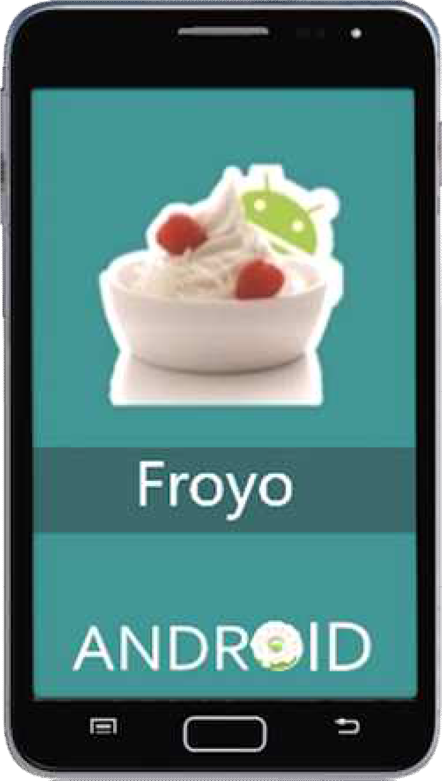
Android Evolution
Android 2.2~2.2.3 Froyo (API level 8) (1/2)
Released in May 2010
Android C2DM (Cloud to Device Messaging) support
  Enables push notification for third-party developers
  Used in E-mail, Contacts, and Calendar

Slide 49
Android Evolution
Android 2.2~2.2.3 Froyo (API level 8) (2/2)
Adobe Flash support
USB Tethering
Wi-Fi Hotspot
Multiple Keyboard Languages and Dictionary Quick switching

Slide 50

Android Evolution
Android 2.3~2.3.2 Gingerbread (API level 9) (1/3)
Released in December 2010
Front and Back Camera support
Improved Virtual Keyboard
  Intuitive text input
  Improved accuracy
  Improved suggested text and voice input mode

Slide 51
Android Evolution
Android 2.3~2.3.2 Gingerbread (API level 9) (2/3)
Easy-to-use Copy & Paste
  Word selection by
Press-Hold → Copy → Paste
SIP based VoIP (Voice over IP) support
  SIP (Session Initiation Protocol) supports signaling and controlling of IP multimedia communication sessions
  VoIP, Video Call, Instant Messaging

Slide 52
Android Evolution
Android 2.3~2.3.2 Gingerbread (API level 9) (3/3)
More Sensor support
  Gyroscope, Barometer, etc.
NFC (Near Field Communication)
  Used to exchange small information segments
  Application examples
    Payments, Posters, Stickers, Advertisement
Notes:
Gyroscope sensor
http://www5.epsondevice.com/en/information/technical_info/gyro/
Sense rotating motion

Slide 53
Android Evolution
Android 2.3.4 Gingerbread (API level 10)
Released in April 2011
Support for Voice or
Video Chat using Google Talk
  Google Talk is an Instant Messaging service
  Provides text and voice communication

Slide 54
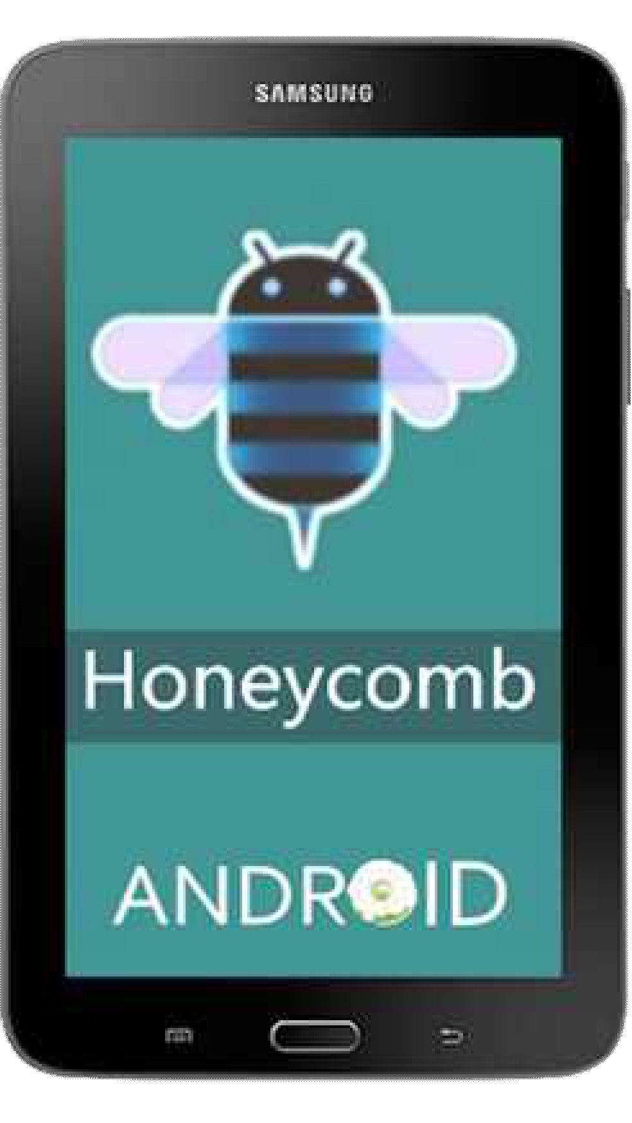
Android Evolution
Android 3.0 Honeycomb (API level 11) (1/4)
Released in February 2011
Simplified multitasking
First Tablet only Android OS
  Optimized for Smart Tablets

Slide 55
Android Evolution
Android 3.0 Honeycomb (API level 11) (2/4)
Action Bar
  Top of the Screen Access
    Contextual options, Navigation, Widgets, etc.
System Bar
  Bottom of the Screen Access
    Notifications, Status, and Soft Navigation Buttons, etc.

Slide 56
Android Evolution
Android 3.0 Honeycomb (API level 11) (3/4)
Improved Tablet Keyboard
  Improvements for faster, more efficient, and more accurate typing on larger Tablet screens
Camera Features Quick Access
  Camera exposure, focus, flash, zoom, front-facing camera, time-lapse, etc.

Slide 57
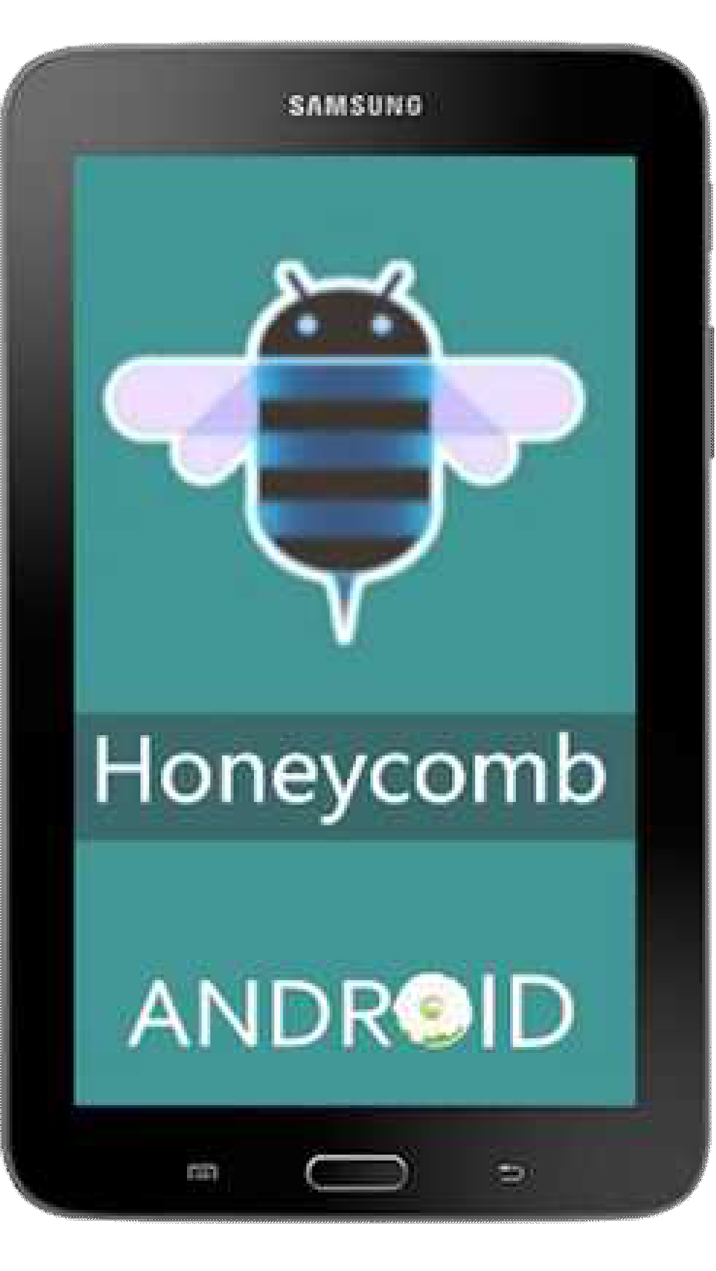
Android Evolution
Android 3.0 Honeycomb (API level 11) (4/4)
Multi-Core Processor support
External I/O Device support (3.1 Honeycomb, API level 12, May 10, 2011)
  Keyboards, Pointing Devices, Joysticks, Gamepads, etc.

Slide 58
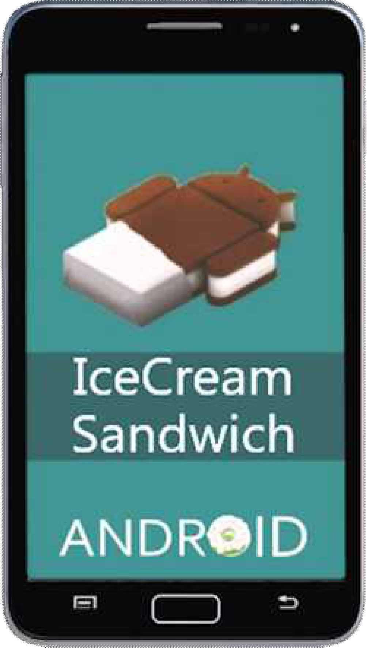
Android Evolution
Android 4.0~4.0.2 Ice Cream Sandwich (API level 14) (1/3)
Released in October 2011
Easier-to-Create Folders
  Drag-and-Drop creation
Enhanced Visual Voicemail
  Controllable Speed-Up or Slow-Down Voicemail messages

Slide 59
Android Evolution
Android 4.0~4.0.2 Ice Cream Sandwich (API level 14) (2/3)
Face Unlock
  Facial recognition based smartphone unlocking
Improved Camera functionality
  Zero shutter lag, time lapse settings, panorama mode, zoom control during recording

Slide 60
Android Evolution
Android 4.0~4.0.2 Ice Cream Sandwich (API level 14) (3/3)
Location and Person based gallery layout
Built-in Photo Editor
Wi-Fi Direct
Notes:
Wi-Fi CERTIFIED Wi-Fi Direct® is a certification mark for devices supporting a technology that enables Wi-Fi devices to connect directly, making it simple and convenient to do things like print, share, sync and display. Products bearing the Wi-Fi Direct certification mark can connect to one another without joining a traditional home, office or hotspot network.

Slide 61
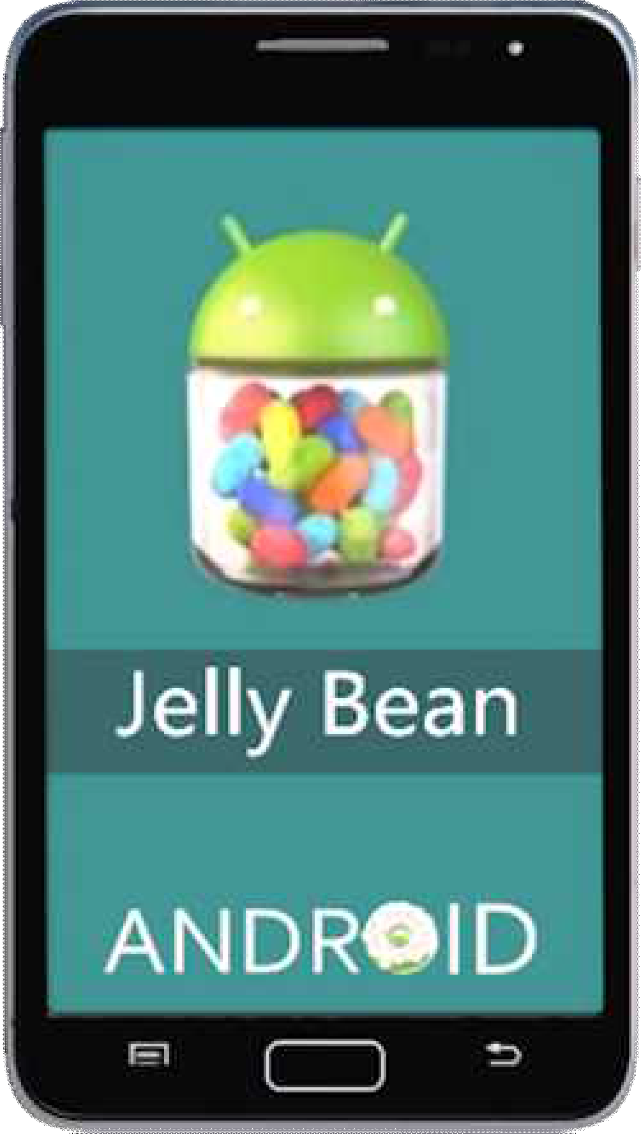
Android Evolution
Android 4.1 Jelly Bean (API level 16) (1/3)
Released in July 2012
Bi-directional text and other language support
Bluetooth data transfer

Slide 62
Android Evolution
Android 4.1 Jelly Bean (API level 16) (2/3)
Android Beam
  Instant file sharing of two NFC enabled phones by touching each other
Keymaps (Keyboard maps)
  Additional international keymaps and special layout keyboard types can be installed

Slide 63
Android Evolution
Android 4.1 Jelly Bean (API level 16) (3/3)
Multi-Channel Audio
  Supported on smartphones with Multi-Channel Audio output through HDMI
  For non-equipped devices, Android automatically down- mixes the audio to fit the number of audio channels supported by the smartphone

Slide 64
Android Evolution
Android 4.3 Jelly Bean (API level 18)
BLE (Bluetooth Low Energy) support
AVRCP 1.3 support
  AVRCP (Bluetooth Audio/Video Remote Control Profile)

Slide 65
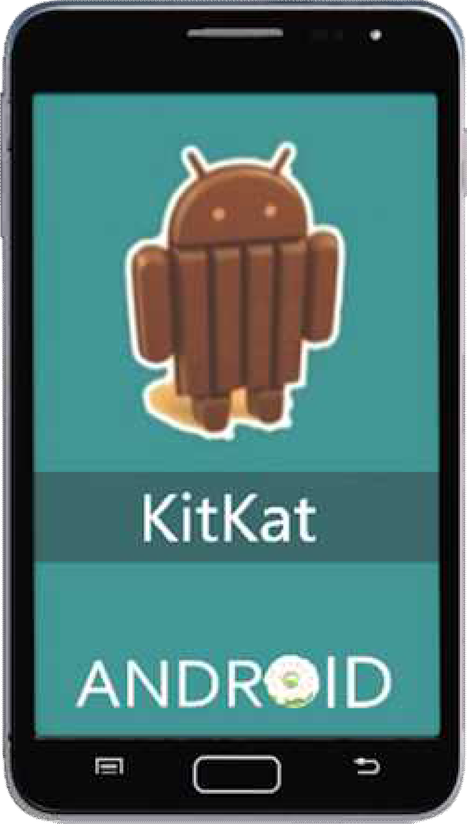
Android Evolution
Android 4.4 KitKat (API level 19) (1/3)
Released in October 2013
Wireless Printing
Step detector and counter
NFC Host Card emulation
  Smartphones are capable of replacing smart cards
Sensor batching
  Collects and delivers sensor events efficiently in batches

Slide 66
Android Evolution
Android 4.4 KitKat (API level 19) (2/3)
Loudness Enhancer
  Increase the loudness of speech in media playback apps
Built-in Screen Recording
  Primarily for developers ➔Use of ADB (Android Debug Bridge) is required
Bluetooth MAP (Message Access Profile)
  Apps can exchange messages with a nearby device

Slide 67
Android Evolution
Android 4.4 KitKat (API level 20) (3/3)
Released in June 2014
Wearable Extensions
  Android Wear platform for smartwatches

Slide 68
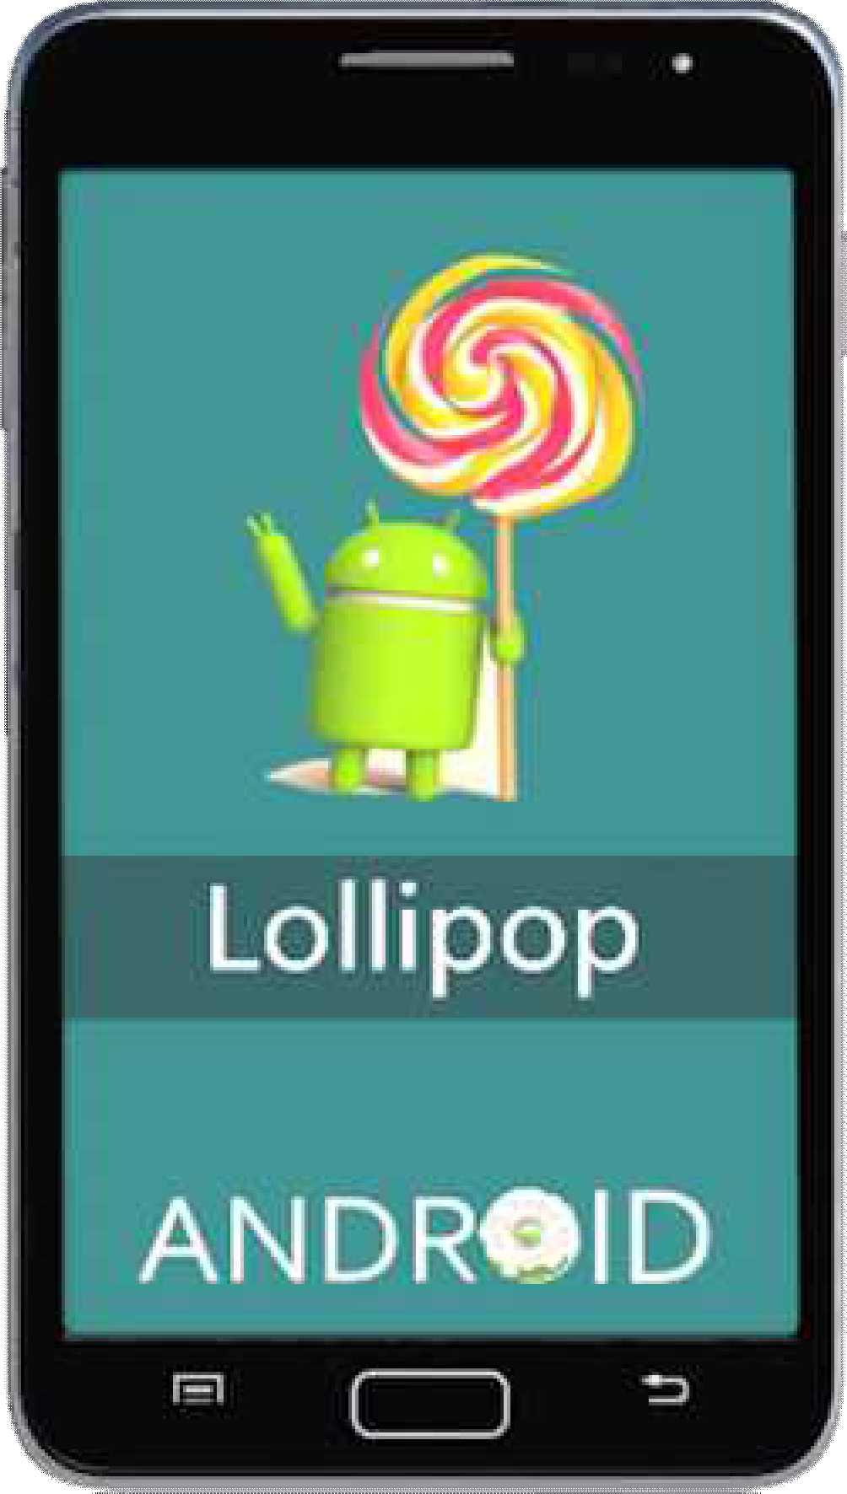
Android Evolution
Android 5.0~5.0.2 Lollipop (API level 21) (1/3)
Released in November 2014
64 bit CPU support
Audio Input and Output through USB devices

Slide 69
Android Evolution
Android 5.0~5.0.2 Lollipop (API level 21) (2/3)
3rd-party applications can read and modify data on external storages (e.g., SD cards)
Memory of recently used applications
  Even after restarting the device the memory of recently used apps is maintained

Slide 70
Android Evolution
Android 5.0~5.0.2 Lollipop (API level 21) (3/3)
Addition of 15 new languages
  Basque, Bengali, Burmese, Chinese (Hong Kong), Galician, Icelandic, Kannada, Kyrgyz, Macedonian,
Malayalam, Marathi, Nepali, Sinhala, Tamil, and Telugu

Slide 71
Android Evolution
Android 6.0 Marshmallow
Android 7.0 Nougat

Slide 72
References
Android Developers, http://developer.android.com
Android, https://www.android.com
V3, Top 10 reasons to be excited by Android Ice Cream Sandwich, http://www.v3.co.uk/v3-uk/news/2119111/reasons-excited-android-ice-cream- sandwich20150513 [Accessed June 1, 2015]
Wikipedia, http://www.wikipedia.org
Image Sources
Android’s Architecture Diagram, https://en.wikipedia.org/wiki/Android_(operating_system)

Slide 73
Android vs. iOS

Slide 74
Android vs. iOS
 | Android | iOS
Developer | Google | Apple
OS family | Linux | OS X, UNIX
Customizability | High | Low
Initial release | Sept. 23, 2008 | July 29, 2007
Programming Language | C, C++, Java | C, C++, Objective-C, Swift

Slide 75
Android vs. iOS
 | Android | iOS
Source model | Open Source | Closed but has Open Source components
Internet Browsing | Google Chrome | Mobile Safari
Voice Commands | Google Now | Siri
Video Chat | Google Hangouts | Facetime
App Store | Google Play & other app stores (e.g., Amazon) | Apple App Store

Slide 76
Android vs. iOS
 | Android | iOS
Latest Release | Android 7.0 (Nougat) August 2016 | iOS 10 September 2016
Device Manufacturer | Google, LG, Samsung, HTC, Sony, ASUS, Motorola, and many more | Apple
Website | android.com | apple.com

Slide 77
Android vs. iOS
Apps Available on iOS vs. Android
Most popular apps are available on both Android & iOS
Google’s app store is more open and tends to include some apps that are not available in iOS (e.g., Adobe Flash Player and BitTorrent)

Slide 78
Android vs. iOS
Apps Available on iOS vs. Android
iPad has an advantage in tablets, as more apps are designed specifically iPads
Many Android tablet apps are scaled up versions of apps that were made for Android smartphones
Developers at smaller companies may first develop their app for an iPhone or iPad and then conduct development in Android

Slide 79
Android vs. iOS
Mobile Payments
Google Wallet is used in Android
  Supported on smartphones equipped with NFC (Near- Field Communication)
Apple Pay is used in iOS
  Integrated with fingerprint identification

Slide 80
Android vs. iOS
Building & Publishing Apps
Android
  Android apps are programmed in C, C++, and Java
  Free download of Android source code and Android SDK
  One-time $25 registration fee for app developers that need to publish an app

Slide 81
Android vs. iOS
Building and Publishing Apps
iOS
  iOS apps are programmed using Objective-C and Swift
  Developers need to annually pay $99 for access to the iOS SDK and publish in Apple's App store
  iOS SDK is only available for the Mac platform

Slide 82
Android vs. iOS
Android Pros & Cons
Variety in Hardware selection
  Various Android devices are available
  Various hardware capabilities, screen sizes and features
  Various prices
Customizable User Interface
  Easy to customize Home screen
    Adjustable app icons and widgets

Slide 83
Android vs. iOS
iOS Pros & Cons
Massive App Ecosystem
  Very Large Apple App store
  App quality check
Locked Down Interface
  No third-party apps can be pre-installed by the mobile operator
  Limited home screen customization options
- Rows of app icons

Slide 84
Android vs. iOS
iOS Pros & Cons
Software Upgrades
  Very good software upgrade system
  Good upgrade notifications and reminders
  Device capability considered in upgrades
Privacy Control
  iOS provides good control of user private information (e.g., contacts and location)

Slide 85
References
Apple, http://apple.com
Android Developers, http://developer.android.com
Android, https://www.android.com
Diffen, Android vs. iOS, http://www.diffen.com/difference/Android_vs_iOS [Accessed June 1, 2015]
Forbes, iOS 8 vs Android 5.0 Lollipop Review: Material Difference, http://www.forbes.com/sites/gordonkelly/2014/11/07/ios-8-vs-android-5-0-lollipop- review [Accessed June 1, 2015]
Wikipedia, http://www.wikipedia.org
Image Sources
  History of Android, http://bitsnapper.com/ios-101-day-0-setting-up-the-garage/
  Android Nougat, http://www.nashvillechatterclass.com/android-nougat-release-date-set-august-no-love-nexus-5-users/10761/

