Slide 1
Wireless Communication
Hwajung Lee
Key Reference:
Prof. Jong-Moon Chung’s Lecture Notes at Yonsei University

Slide 2
Wireless Communications
Bluetooth
Wi-Fi
Mobile Communications
LTE
LTE-Advanced

Slide 3

Wi-Fi
WLAN
WLAN (Wireless Local Area Network) is a wireless networking technology that links two or more computing devices using a wireless distribution method within a limited local area
Applications Areas: Home, School, Computer Laboratory, Office Building, etc.

Slide 4
Wi-Fi
Wi-Fi
Wi-Fi (or WiFi) is a WLAN technology that allows electronic devices to network mainly using the ISM radio bands
  2.4 GHz UHF (Ultra High Frequency)
  5 GHz SHF (Super High Frequency)
Notes:
ISM radio band:
The industrial, scientific, and medical radio band (ISM band) refers to a group of radio bands or parts of the radio spectrum that are internationally reserved for the use of radio frequency (RF) energy intended for scientific, medical and industrial requirements rather than for communications.
https://en.wikipedia.org/wiki/ISM_band

Slide 5
Wi-Fi
Wi-Fi Transmission
5 GHz offers higher throughput at shorter distances
2.4 GHz provides increased coverage and improved solid object penetration
Beamforming and other multiple antenna technologies like MIMO are used to increase the date rate and QoS

Slide 6
Wi-Fi
Wireless AP (Access Point)
A device that allows Wi-Fi devices to connect to a wired network
AP usually connects to a router or may have built in router capabilities

Slide 7

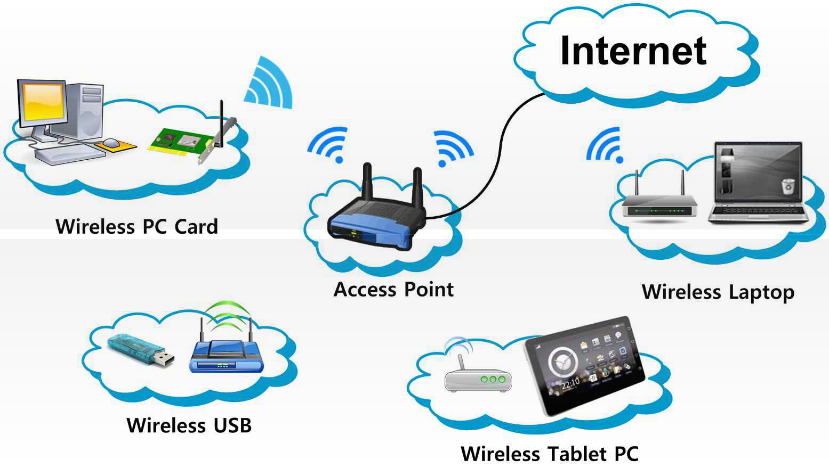
Wi-Fi
Wi-Fi
Example of an AP network

Slide 8
Wi-Fi
Infrastructure Mode
In infrastructure mode, Wi-Fi devices can
  communicate with each other and
  communicate with a wired network
BSS (Basic Service Set)
  In infrastructure mode, commonly one AP is connected by wire to the Internet, and a set of Wi-Fi devices connect to the AP
Notes:
A network connection mode that we normally use “with AP” is Infrastructure Mode.
In infrastructure mode, Wi-Fi devices can
communicate with each other and
communicate with a wired network
We call this setup a BSS.

Slide 9
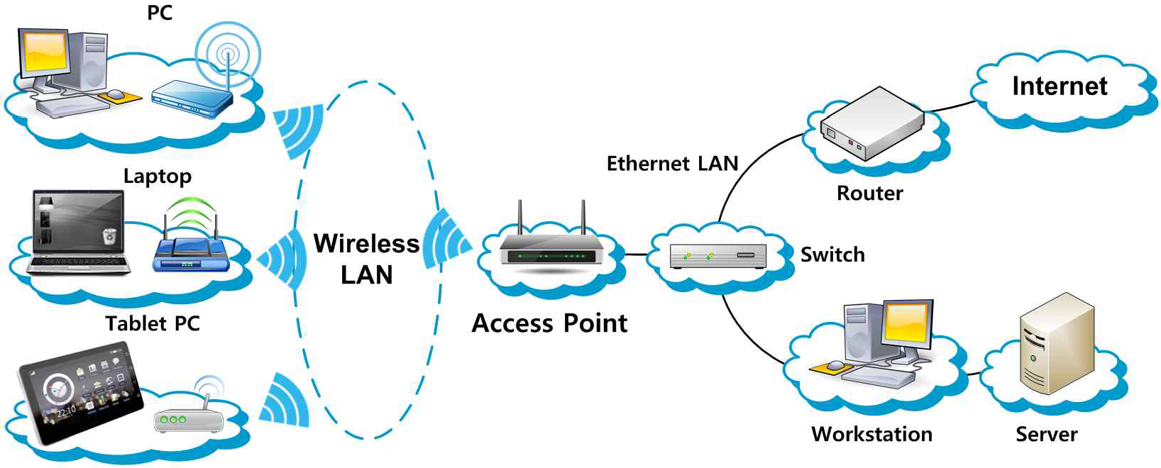
Wi-Fi
Wi-Fi
Example of Infrastructure mode

Slide 10
Wi-Fi
Ad-Hoc Mode
Wi-Fi devices or stations communicate directly with each other, without help from an AP (Access Point) ➔ Used where Infrastructure Mode network setup is not needed or not possible
Also referred to as peer-to-peer mode
IBSS (Independent Basic Service Set)
  Ad-hoc mode network is referred to as an IBSS

Slide 11
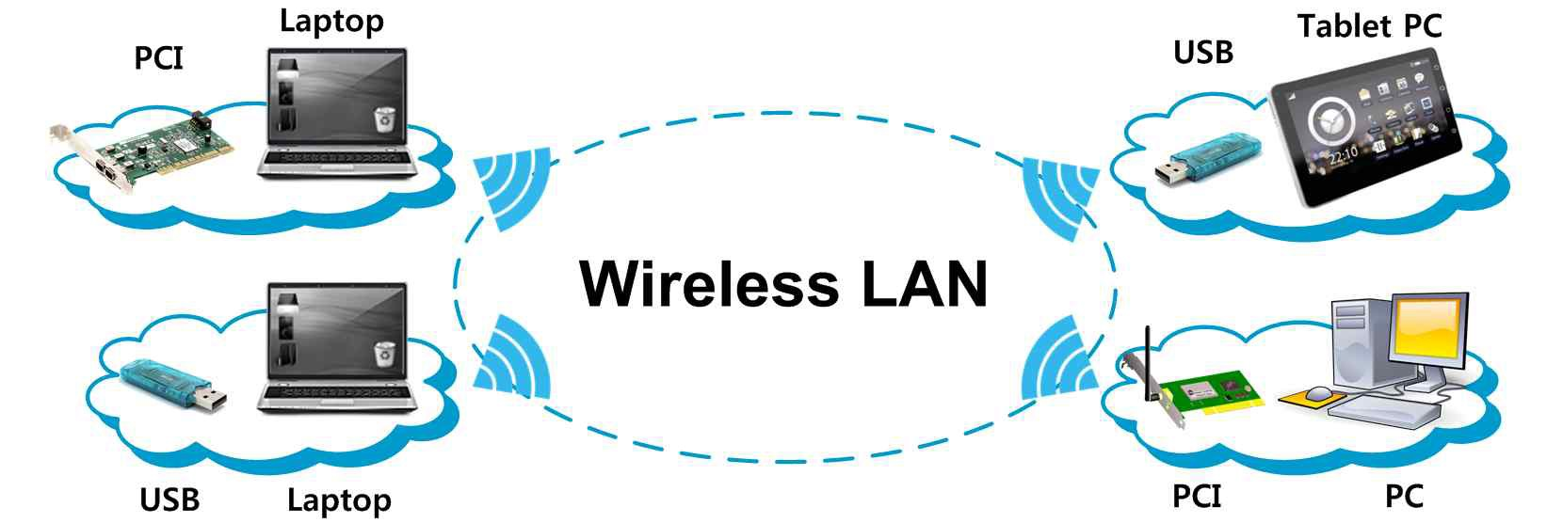
Wi-Fi
Wi-Fi
Example of Ad-Hoc mode

Slide 12
Wi-Fi
BSS & ESS
BSS (Basic Service Set) is the basic building block of an 802.11 WLAN
    In infrastructure mode, a BSS is formed by a single AP (Access Point) and all associated STAs (stations)
    AP acts as a Master and controls all STAs within the BSS
ESS (Extended Service Set) is a set of two or more BSSs that form a single network
➔ Extends the range of Wi-Fi STA mobility
Notes:
IEEE: Institute of Electrical and Electronic Engineers

Slide 13
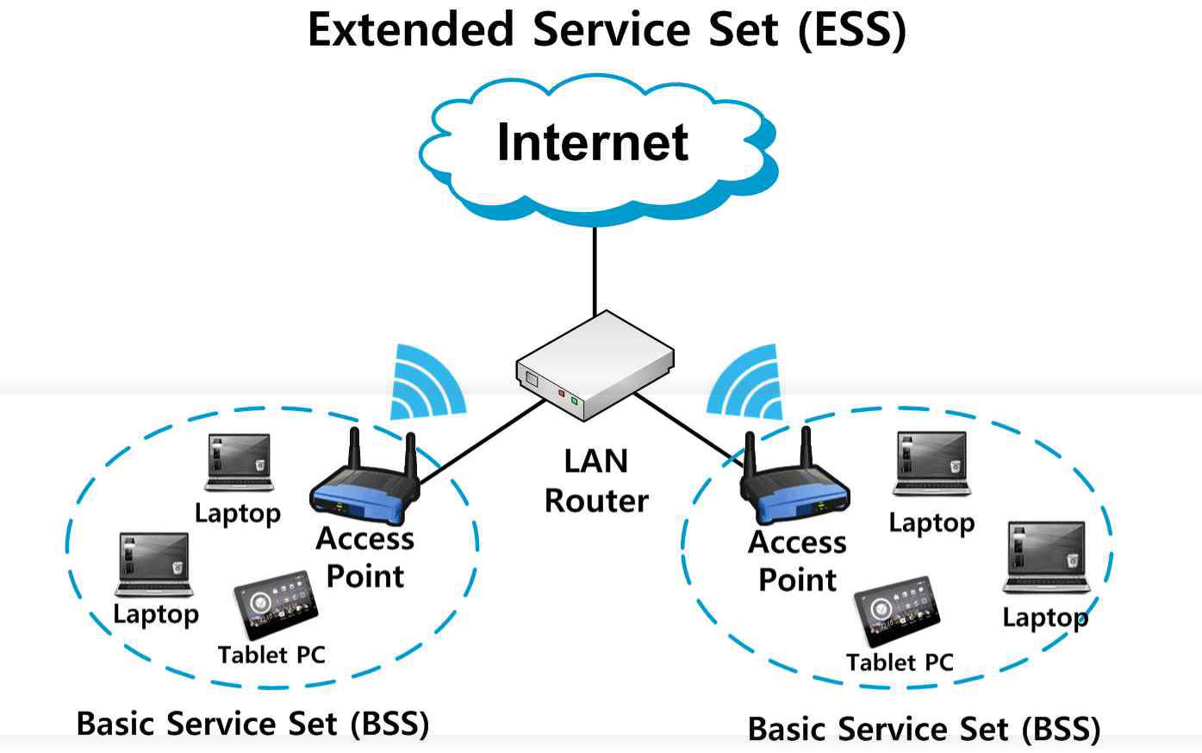
Wi-Fi
Wi-Fi
Example of ESS

Slide 14
Wi-Fi
IEEE 802.11 Network PHY Standards (1/2)
802.11 Protocol | Release Date | Frequency | Bandwidth | Stream Data Rate
802.11-1997 | Jun. 1997 | 2.4 GHz | 22 MHz | 1, 2 Mbps
802.11a | Sep. 1999 | 5 GHz | 20 MHz | 6 ~ 54 Mbps
 |  | 3.7 GHz
802.11b | Sep. 1999 | 2.4 GHz | 22 MHz | 1 ~ 11 Mbps
802.11g | Jun. 2003 | 2.4 GHz | 20 MHz | 6 ~ 54 Mbps
802.11n | Oct. 2009 | 2.4/5 GHz | 20 MHz | 7.2 ~ 72.2 Mbps
 |  |  | 40 MHz | 15 ~ 150 Mbps

Slide 15
Wi-Fi
IEEE 802.11 Network PHY Standards (2/2)
802.11 Protocol | Release Date | Frequency | Bandwidth | Stream Data Rate
802.11ac | Dec. 2013 | 5 GHz | 20 MHz | 7.2 ~ 96.3 Mbps
 |  |  | 40 MHz | 15 ~ 200 Mbps
 |  |  | 80 MHz | 32.5 ~ 433.3 Mbps
 |  |  | 160 MHz | 65 ~ 866.7 Mbps
802.11ad | 2012, 2016 | 60 GHz | 2.16 GHz | Up to 7 Gbps
802.11ay | 2017 | 60 GHz | 8 GHz | Up to 100 Gbps

Slide 16
Wi-Fi
IEEE 802.11 Network PHY Standards (1/2)
802.11 protocol | Frequency | Modulation | Approximate Range
 |  |  | Indoor (m) | Outdoor (m)
802.11-1997 | 2.4 GHz | DSSS, FHSS | 20 | 100
802.11a | 5 GHz | OFDM | 35 | 120
 | 3.7 GHz |  | - | 5000
802.11b | 2.4 GHz | DSSS | 35 | 140
802.11g | 2.4 GHz | OFDM, DSSS | 38 | 140
Notes:
DSSS: Direct Sequence Spread Spectrum
FHSS: Frequency Hopping Spread Spectrum
OFDM: Orthogonal Frequency Division Multiplexing

Slide 17
Wi-Fi
IEEE 802.11 Network PHY Standards (2/2)
802.11 protocol | Frequency | Modulation | Approximate Range
 |  |  | Indoor (m) | Outdoor (m)
802.11n | 2.4/5 GHz | OFDM (MIMO-4)* | 70 | 250
802.11ac | 5 GHz | OFDM (MIMO-8)* | 35 | -
802.11ad | 60 GHz | OFDM (> 10 X 10 MIMO) | 10 | 10
*MIMO-4 and MIMO-8 represent that the allowable MIMO streams are 4 and 8, respectively.

Slide 18
Wi-Fi
Wi-Fi uses the ISM Band
ISM (Industrial, Scientific and Medical) bands are radio frequency bands reserved internationally for the use
of industrial, scientific, and medical purposes
Devices using ISM bands will experience interference from other products operating in the same frequency band

Slide 19
Wi-Fi
ISM Band
Frequency range |  | Bandwidth | Center Frequency | Availability
6.765 MHz | 6.795 MHz | 30 kHz | 6.780 MHz | Subject to local acceptance
13.553 MHz | 13.567 MHz | 14 kHz | 13.560 MHz | Worldwide
26.957 MHz | 27.283 MHz | 326 kHz | 27.120 MHz | Worldwide
40.660 MHz | 40.700 MHz | 40 kHz | 40.680 MHz | Worldwide
433.050 MHz | 434.790 MHz | 1.74 MHz | 433.920 MHz | local acceptance
902.000 MHz | 928.000 MHz | 26 MHz | 915.000 MHz | local acceptance
2.400 GHz | 2.500 GHz | 100 MHz | 2.450 GHz | Worldwide

Slide 20
Wi-Fi
ISM Band
Frequency range |  | Bandwidth | Center Frequency | Availability
5.725 GHz | 5.875 GHz | 150 MHz | 5.800 GHz | Worldwide
24.000 GHz | 24.250 GHz | 250 MHz | 24.125 GHz | Worldwide
61.000 GHz | 61.500 GHz | 500 MHz | 61.250 GHz | Subject to local acceptance
122.000 GHz | 123.000 GHz | 1 GHz | 122.500 GHz | Subject to local acceptance
244.000 GHz | 246.000 GHz | 2 GHz | 245.000 GHz | Subject to local acceptance

Slide 21
Wi-Fi
Wi-Fi Interference
Devices operating in the 2.4 GHz range include
  IEEE802.15.4 devices: ZigBee, 6LoWPAN
  Microwave ovens
  Bluetooth
  Baby monitors
  Cordless telephones
  Amateur radio equipment
  etc.

Slide 22
Wi-Fi
Dual Band
Unlike ordinary Wi-Fi equipment that only supports one signal band, dual band is the capability to transmit on the 5 GHz band of 802.11a, 802.11n, and 802.11ac and also the 2.4 GHz band used by 802.11b, 802.11g, and 802.11n

Slide 23
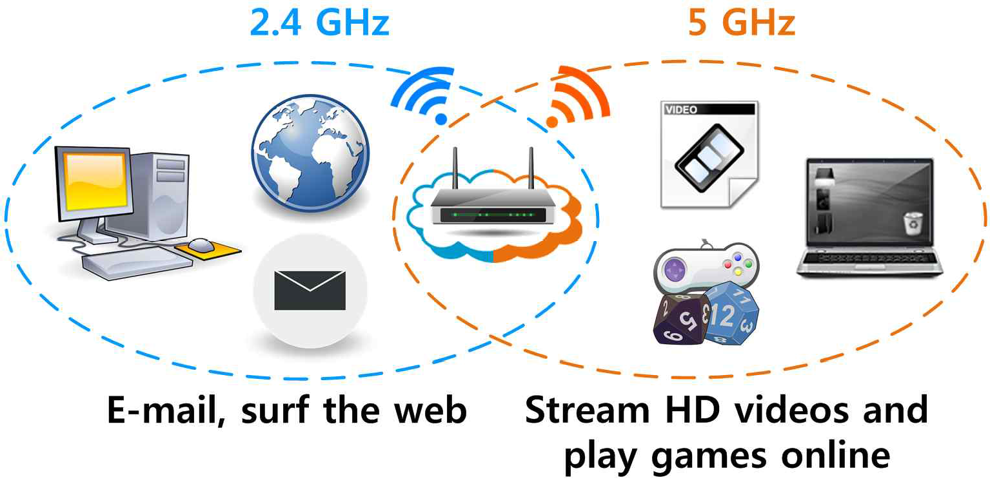
Wi-Fi
Wi-Fi
Example of Dual Band

Slide 24
Wi-Fi
Wi-Fi Direct
Wi-Fi Direct devices can connect directly to one another without access to a traditional network
Devices can make a one-to-one connection, or a group of several devices can connect simultaneously
Notes:
More advanced Ad-hoc

Slide 25
Wi-Fi
Wi-Fi Direct
With optional services, users can send files, print documents, play media, and display screens between and among devices

Slide 26
Wi-Fi
Tethering (Hotspot)
Tethering refers to connecting one device to another
In the context of mobile phones or Internet tablets, tethering allows sharing the Internet connection of the phone or tablet with other devices such as laptops

Slide 27
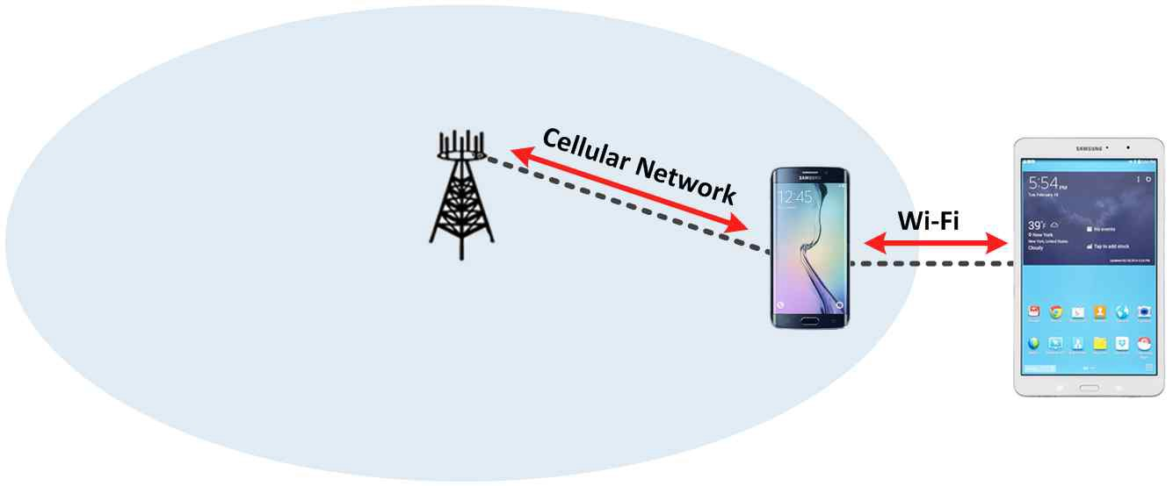
Wi-Fi
Tethering (Hotspot)
A Wi-Fi STA can make connection to the Internet by connecting to a smartphone using Wi-Fi

Slide 28
References
M. Gast, 802.1 wireless networks: the definitive guide. O'Reilly Media, 2005.
B. P. Crow, I. Widjaja, J. G. Kim, and P.T. Sakai, “IEEE 802.11 Wireless Local Area Networks,” IEEE Communication Magazine, vol. 35, no. 9, pp. 116-126, Sep. 1997.
E. Ferro and F. Potorti, “Bluetooth and Wi-Fi wireless protocols: a survey and a comparison,” IEEE Wireless Communications, vol. 12, no. 1, pp. 12-26, Feb. 2005.
Webopedia, Extended Service Set, http://www.webopedia.com/TERM/E/Extended_Service_Set.html [Accessed June 1, 2015]
Speedguide, Wi-Fi 5 GHz vs 2.4 GHz, http://www.speedguide.net/faq/is-5ghz- wireless-better-than-24ghz-340 [Accessed June 1, 2015]
Wi-Fi Alliance, http://www.wi-fi.org
Wikipedia, http://www.wikipedia.org
William Stallings, Data and Computer Communications, 10th Ed. Prentice Hall, 2014.

Slide 29
References
Image sources
Wi-Fi Icon, By Canopus49 (Own work) [CC BY-SA 3.0 (http://creativecommons.org/licenses/by-sa/3.0)], via Wikimedia Commons
USB, By TEL0000 (Own work) [Public domain], via Wikimedia Commons
PCI, By Evan-Amos (Own work) [Public domain], via Wikimedia Commons
Laptop PC Icon, By Everaldo Coelho (YellowIcon) [LGPL (http://www.gnu.org/licenses/lgpl.html)], via Wikimedia Commons

