Slide 1
Wireless Communication
Hwajung Lee
Key Reference:
Prof. Jong-Moon Chung’s Lecture Notes at Yonsei University

Slide 2
Wireless Communications
Bluetooth
Wi-Fi
Mobile Communications
LTE
LTE-Advanced

Slide 3
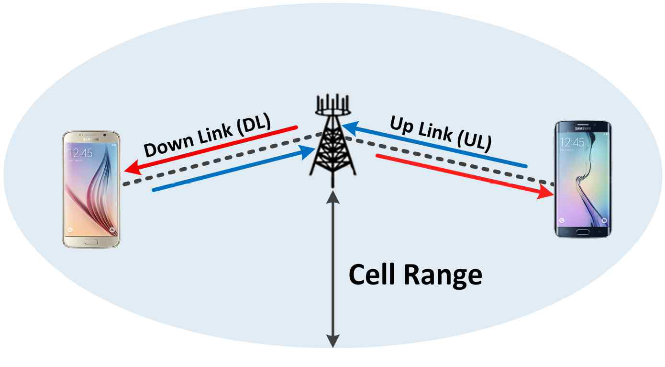
Mobile Communications Handover
Mobile Communications
Downlink & Uplink

Slide 4
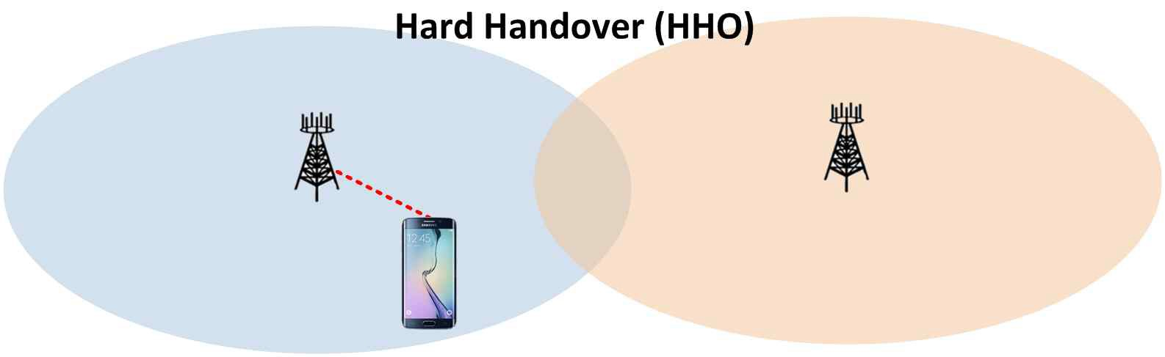
Mobile Communications Handover
Mobile Communications
Handover

Slide 5
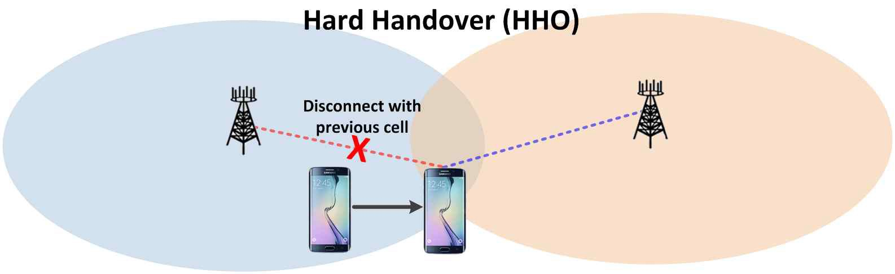
Mobile Communications Handover
Mobile Communications
Handover

Slide 6
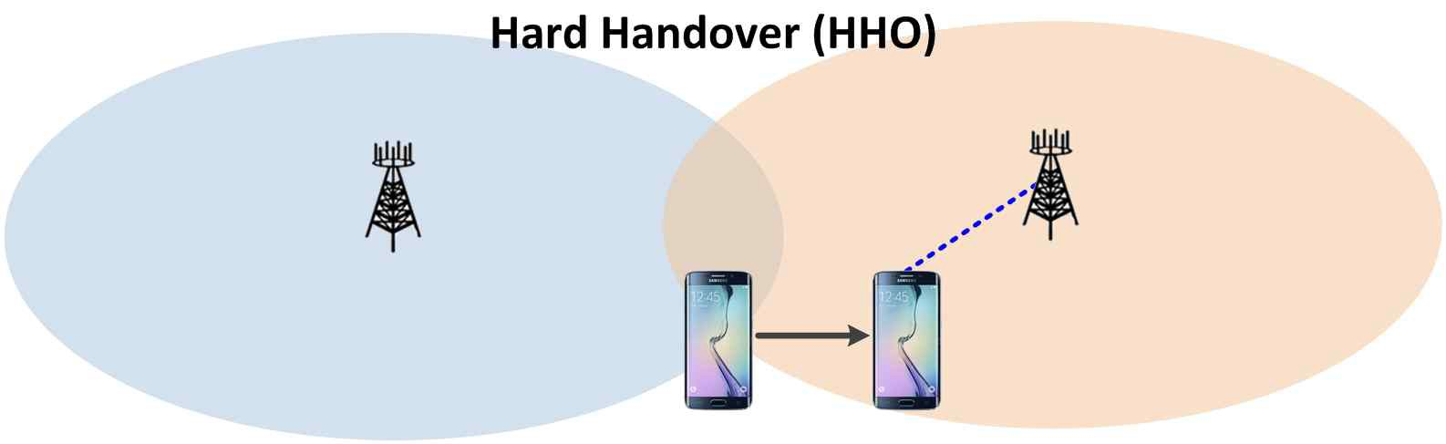
Mobile Communications Handover
Mobile Communications
Handover

Slide 7
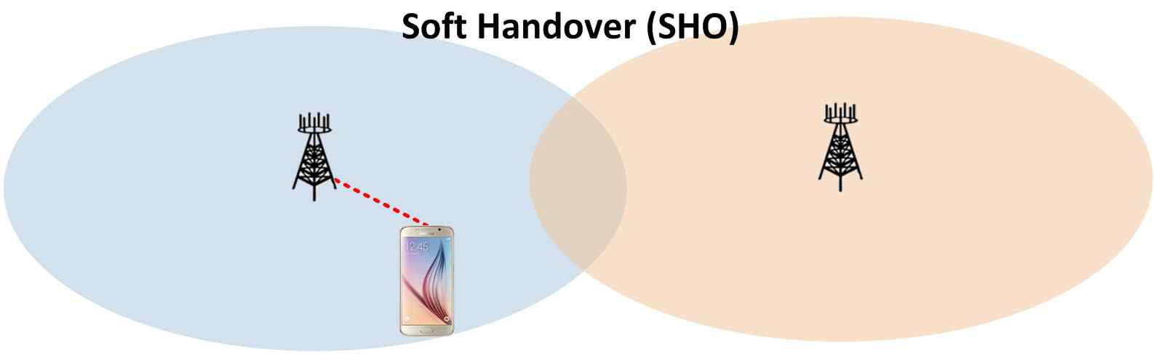
Mobile Communications Handover
Mobile Communications
Handover

Slide 8
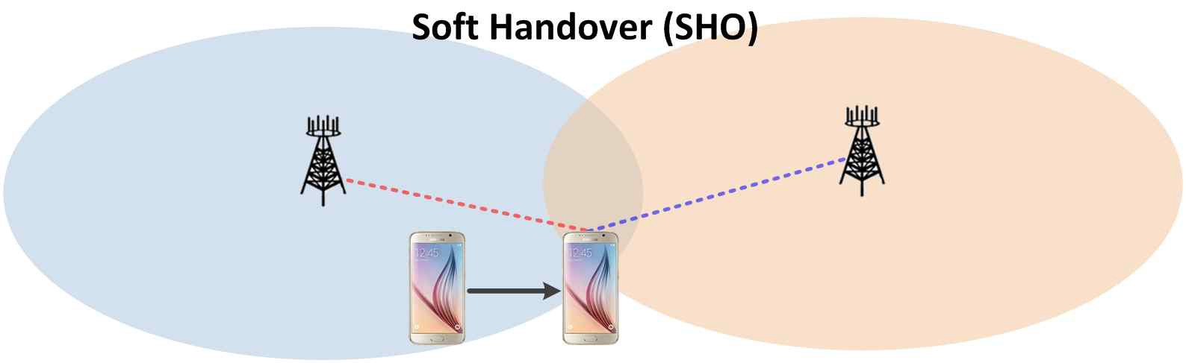
Mobile Communications Handover
Mobile Communications
Handover

Slide 9
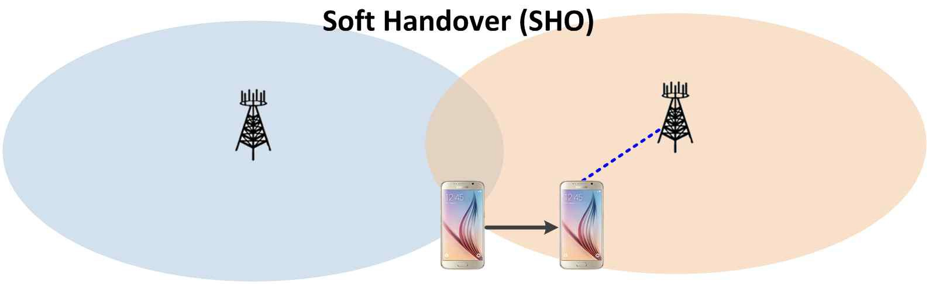
Mobile Communications Handover
Mobile Communications
Handover

Slide 10
Basic Mobile Communications Structure
Structure of the mobile phone cellular network
  A network of radio base stations forming the base station subsystem.
  The core circuit switched network for handling voice calls and text
  A packet switched network for handling mobile data
  The public switched telephone network (PSTN) to connect subscribers to the wider telephony network
Notes:
Source:
https://en.wikipedia.org/wiki/Cellular_network
This network is the foundation of the GSM system network. There are many functions that are performed by this network in order to make sure customers get the desired service including mobility management, registration, call set-up, and handover.
Any phone connects to the network via an RBS (Radio Base Station) at a corner of the corresponding cell which in turn connects to the Mobile switching center (MSC). The MSC provides a connection to the public switched telephone network (PSTN). The link from a phone to the RBS is called an uplink while the other way is termed downlink.
Radio channels effectively use the transmission medium through the use of the following multiplexing and access schemes: frequency division multiple access (FDMA), time division multiple access (TDMA), code division multiple access (CDMA), and space division multiple access (SDMA).

Slide 11
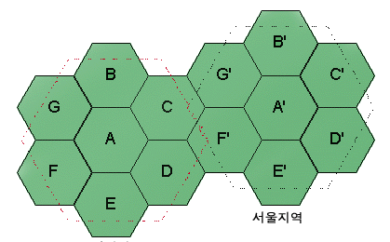
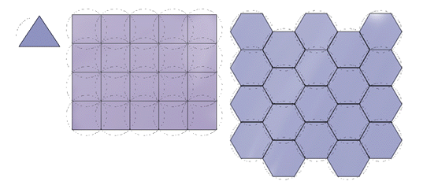
What is Cellular?
(a)
(b)
(c)
Possible Cell Arrangement
Notes:
Reference:
http://www.rfdh.com/tech/cdma.htm

Slide 12
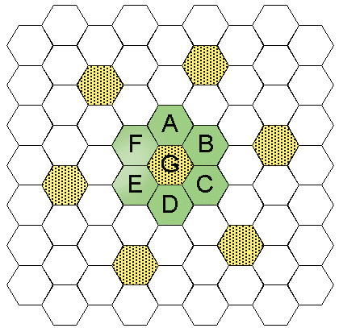

Slide 13
To Overcome the Limited Frequency Band
Cellular Technology
  Increase reusability by increase the number of cells
Multiple Access Technology
  Allow multiple users to share a frequency band

Slide 14
Types of Multiple Access Technology
FDMA (Frequency Division Multiple Access)
TDMA (Time Division Multiple Access)
CDMA (Code Division Multiple Access)

Slide 15
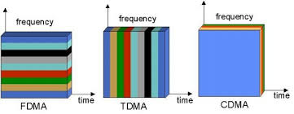
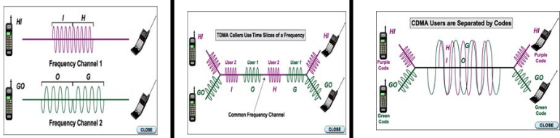
FDMA, TDMA, and CDMA
Notes:
Reference:
SlidePlayer.com

Slide 16
FDMA
Filter is needed at the receiver.
In a given frequency band
  Large number of subchannels = Large number of users supported
    Narrower subchannels ➔ Low quality of sound & More interference
    Closer subchannels ➔ More interference
Due to interference, a guard band is necessary
Notes:
Reference:
http://blog.naver.com/ktec21/80073496592

Slide 17
FDMA
Max Frequency of Human Voice: 3.4KHz
Example of Frequency Bands
  AMPS (Advanced Mobile Phone Service)
    In the United Stated
    30KHz
  NTT (Nippon Telephone & Telegraph)
    In Japan
    25KHz
  NMT (Nordic Mobile Telephone)
    In Europe
    20KHz

Slide 18
TDMA
Time slot, Time gate
IS-54 TDMA
  In the US
  Sets of 3 time slots in 30KHz
IS-136 TDMA
  In the US
  Sets of 6 time slots in 30KHz
GSM (Global System for Mobile)
  In Europe
  Sets of 8 time slots in 200KHz

Slide 19
CDMA
Multiple signals in the same frequency band and in the same time slot.
Each signal uses a different code (i.e., a spread spectrum code)
Originally Spread Spectrum technology for a military use.
  More secure against an eavesdropping
  More resilient against a noise
The receiver, must know:
  Spread spectrum code
  The time the code was generated ➔ Need to be synchronized
    Currently use GPS (Global Positioning System)

Slide 20
CDMA
Spread Spectrum
  (ex) a signal with 10KHz ➔ (125 times) 1.25MHz, a signal strength becomes a lot weaker. Like dropping a drop of ink in a water cup. Since the signal is extremely weak, it sounds like one of a noise
  ➔ (advantage)
    interference between signals will decrease.
    Impact of a noise will affect to a small portion of the signal ➔ improve the quality of sounds

Slide 21
CDMA
White Noise (= Write Gaussian Noise)
  Well-known noise ➔ it can be eliminated using a filter
Spread Spectrum
  Using PN Sequence (Pseudo random Noise Sequence)
    (ex) water in the water + a drop of ink example
    Original Signal (Analog) → Convert to a digital signal → XOR with PN Sequence → Modulated Analog signal
  Receiver: Accept only the signal with the same PN sequence
    i.e. the receiver can demodulate the CDMA signal which it knows the PN sequence.
  Each communication pair uses a different PN Sequence

Slide 22

CDMA: Spread Codes

Slide 23
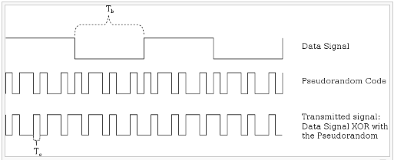
CDMA: Generation of a CDMA Signal
Notes:
Reference:
https://en.wikipedia.org/wiki/Code_division_multiple_access

Slide 24
CDMA: Example
User 1
  Data = 01
  Spread Code (PN Sequence) = 10101010
  CDMA Signal with XOR =
User 2
  Data = 11
  Spread Code (PN Sequence) = 00001111
  CDMA Signal with XOR =
User 3
  Data = 00
  Spread Code (PN Sequence) = 11001100
  CDMA Signal with XOR =

Slide 25
CDMA: Combining CDMA Signals
Convert 1s and 0s to a digital signal
  1: -A pulse
  0: A pulse
Add
  CDMA Signal of User 1 =
  CDMA Signal of User 2 =
  CDMA Signal of User 3 =
Combined Signal =

Slide 26
CDMA: At the Receiver
Receiver of User 1
  Receive the combined signal =
  Multiply the Spread Code (PN Sequence) to the received signal
    PN Sequence of the User 1 = 10101010
  Recover the original signal from the User 1 =

Slide 27
CDMA: Convert to a digital signal
PCM (Pulse Code Modulation)
  Let’s say max frequency of Human Voice is 4KHz
  ➔ sampling using Nyquist Sampling Theorem ➔ 8KHz
  ➔ If 8 bit coding ➔ 64Kbps
Vocoder: To improve efficiency of using frequency band
  In transmitting the 64Kbps data,
  It selectively switches to one of 8.6Kbps, 4.0Kbps, 2.0Kbps, and 0.8Kbps speed depending on characteristics of a human voice such as pause, speaking slowly, …
  Statistically we speak 30~50% of time in a phone call.
  Actual data transfer speed options are: 9.6, 4.8, 2.4, 1.2 kbps
    By adding CRC (Cyclic Redundancy Check) and 0 bit
Notes:
Nyquist Sampling Theorem:
Suppose the highest frequency component, in hertz, for a given analog signal is f_{max}. According to the Nyquist Theorem, the sampling rate must be at least 2f_{max}, or twice the highest analog frequency component. The sampling in an analog-to-digital converter is actuated by a pulse generator (clock).

Slide 28

Mobile Communications
Mobile Phone Evolution
1st Generation (1G)
  AMPS
2nd Generation (2G)
  GSM, IS-95 (cdmaOne)
3rd Generation (3G)
  UMTS (WCDMA), CDMA2000
4th Generation (4G)
  LTE-A
Notes:
http://www.pcmag.com/article2/0,2817,2407896,00.asp
CDMA family
Sprint, Verizon
No sim card
Voice and Data: Not at the same time
GSM family
AT&T, T Mobile
Sim card
Voice and Data: can use at the same time
4G LTE standard
Use SIM card

Slide 29
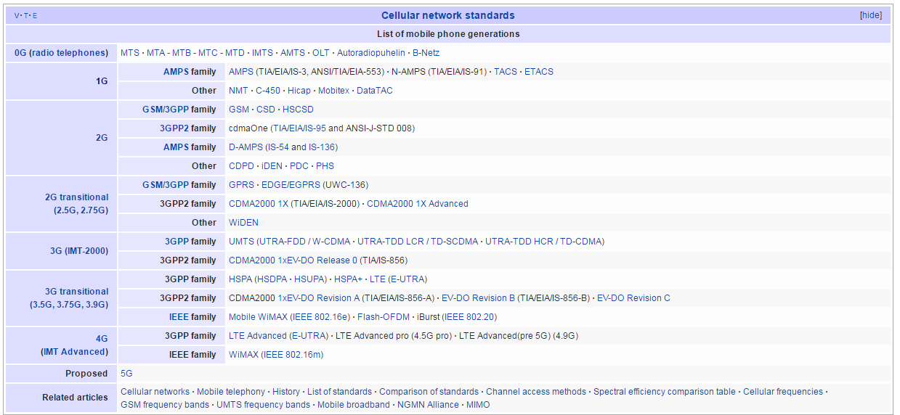
List of Mobile Phone Generations
Notes:
Source: Wikipedia,
https://en.wikipedia.org/wiki/List_of_mobile_phone_generations

Slide 30
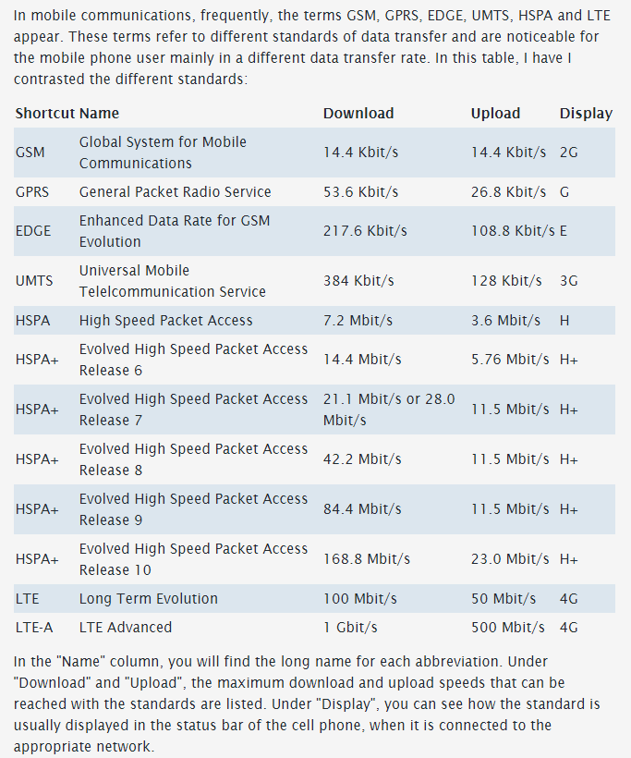
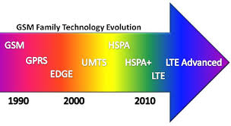
Mobile Communication (2)
Information Source:
Mobile Communication: What are GSM, GPRS, EDGE, UMTS, HSPA and LTE?
http://www.askingbox.com/info/mobile-communication-what-are-gsm-gprs-edge-umts-hspa-and-lte
Image Source: www.deadzones.com

Slide 31
AMPS
Advanced Mobile Phone System (AMPS)
1st Generation (1G) mobile cellular phone
Analog standard using FDMA (Frequency Division Multiple Access)
Developed by Bell Labs
Introduced in North America in Oct. 1983

Slide 32
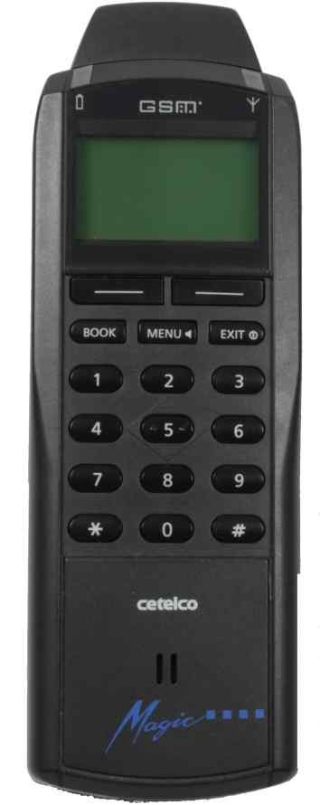
GSM
GSM
Global System for Mobile Communications (GSM)
2nd Generation (2G) mobile cellular phone: Digital system
Introduced in Finland in 1991
Dominant global standard
  Over 90% market share
  Operated in over 219 countries & territories

Slide 33
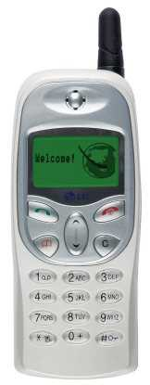
GSM
GSM
Global System for Mobile Communications (GSM)
GSM uses TDMA & FDMA combined
  TDMA (Time Division Multiple Access)
  FDMA (Frequency Division Multiple Access)

Slide 34

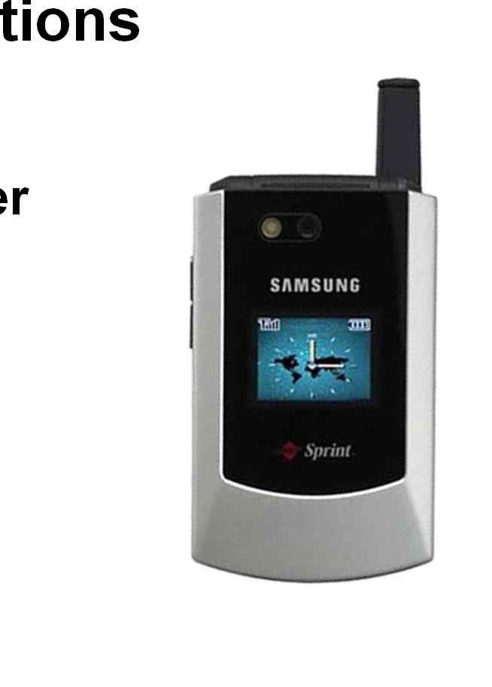
GSM
Global System for Mobile Communication (GSM)
GSM supports voice calls and data transfer speeds up to 9.6 kbps, and SMS (Short Message Service)

Slide 35
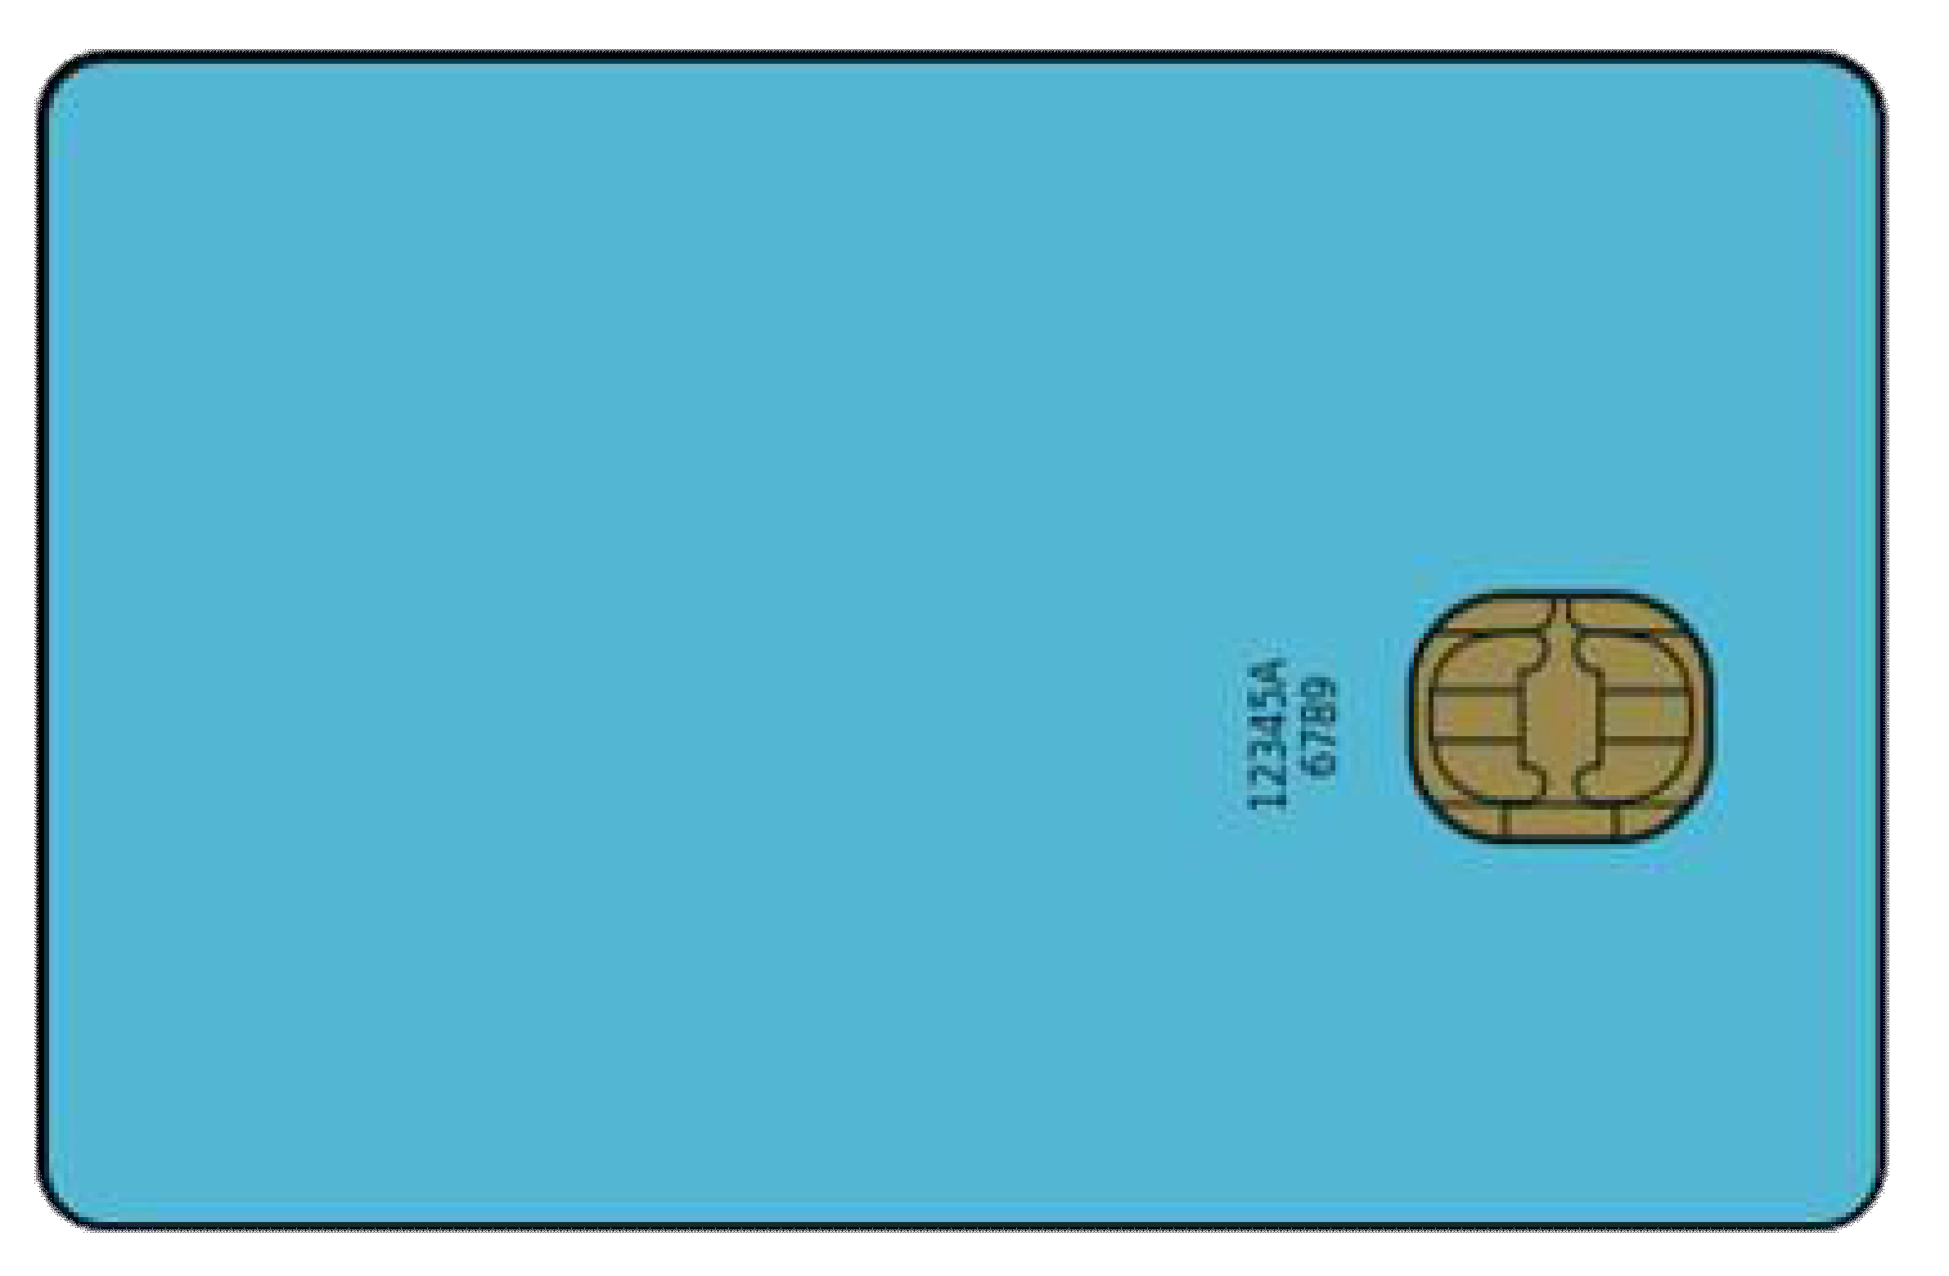
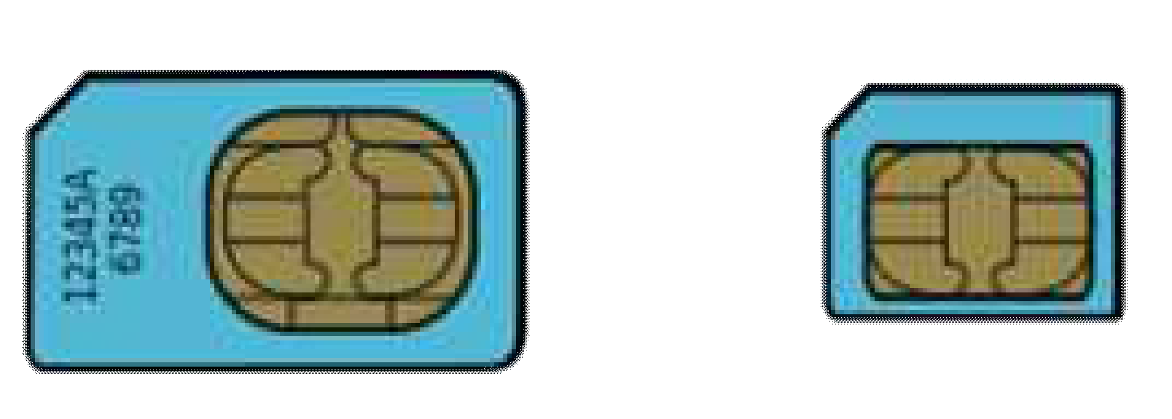
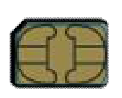
GSM
GSM
SIM (Subscriber Identity Module)
SIM is a detachable smart card
SIM contains user subscription information and phone book

Slide 36
GSM
GSM
SIM Advantages
SIM enables a user to maintain user information even after switching cellular phones
Or, by changing ones SIM a user can change cellular phone operators while using the same the mobile phone

Slide 37
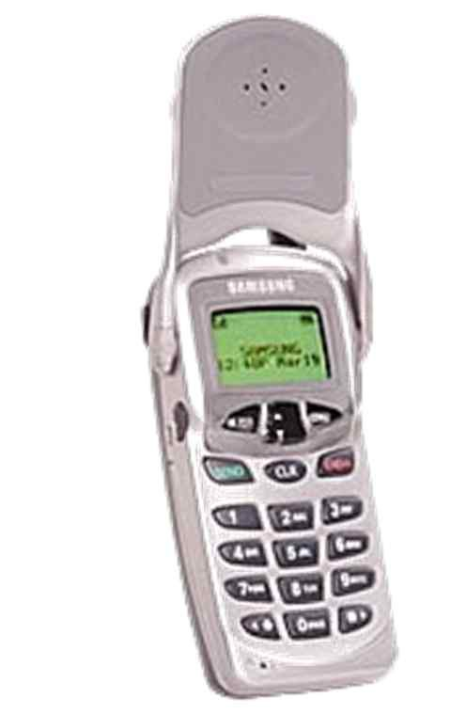
IS-95: cdmaOne
IS-95
IS-95 (Interim Standard 95) is the first CDMA based 2G digital cellular standard
  Why CDMA?
    CDMA performs well against (narrow band) interference and (multipath) signal fading
cdmaOne is the brand name for IS-95 that was developed by Qualcomm

Slide 38
IS-95: cdmaOne
IS-95
Hutchison launched the first commercial cdmaOne network in Hong Kong in September 1995
IS-95 traffic channels support voice or data at bit rates of up to 14.4 kbps

Slide 39
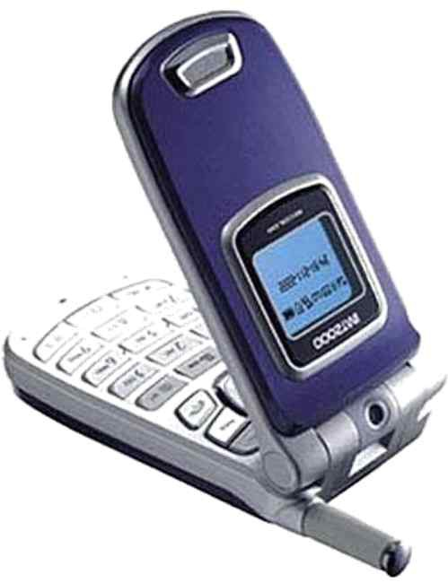
UMTS
Universal Mobile Telecommunications System (UMTS)
3rd Generation (3G) mobile cellular system
Evolution of GSM
UTRA (UMTS Terrestrial Radio Access) supports several different terrestrial air interfaces

Slide 40

UMTS
Universal Mobile Telecommunications System (UMTS)
Multiuser Access in UTRA can be supported by UTRA-FDD or UTRA-TDD
  FDD (Frequency Division Duplex)
  TDD (Time Division Duplex)

Slide 41
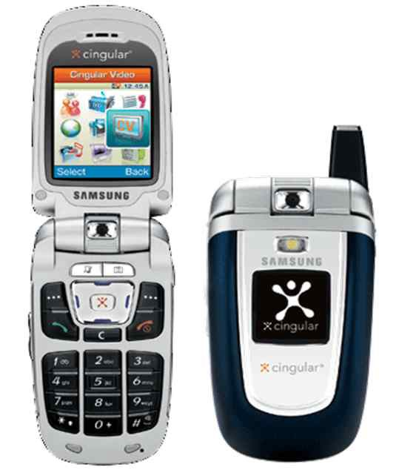
UMTS: WCDMA
WCDMA (Wideband Code Division Multiple Access)
3rd Generation (3G) mobile cellular system that uses the UTRA-FDD mode
3GPP (3rd Generation Partnership Project) Release 99
  Up to 2 Mbps data rate

Slide 42
UMTS: WCDMA
WCDMA
First commercial network opened in Japan is 2001
Seamless mobility for voice and packet data applications
QoS (Quality of Service) differentiation for high efficiency of service delivery
Simultaneous voice and data support
Interworks with existing GSM networks

Slide 43
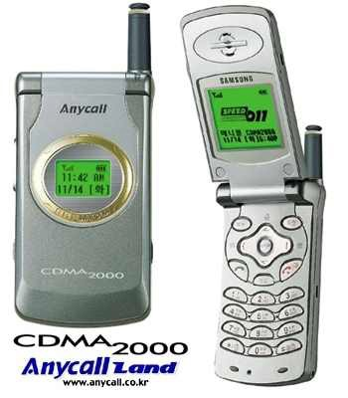
CDMA2000
CDMA2000
3G mobile cellular system
Standardized by 3GPP2
Evolution of IS-95 cdmaOne standards
  Uses CDMA & TDMA
    CDMA (Code Division Multiple Access)
    TDMA (Time Division Multiple Access)
Notes:
3GPP2: 3rd Generation Partnership Project 2

Slide 44
CDMA2000
CDMA2000
Initially used in North America and South Korea (Republic of Korea)

Slide 45
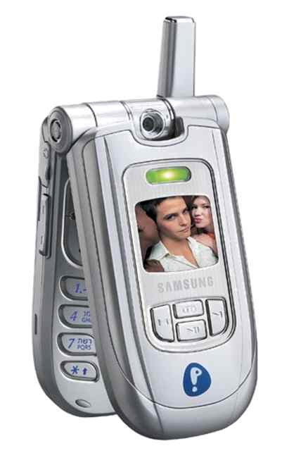
CDMA2000
CDMA2000 1xEV-DO
CDMA2000 1xEV-DO (Evolution-Data Optimized) enables 2.4 Mbps data rate
CDMA2000 1xEV-DO network launched in South Korea on January 2002

Slide 46
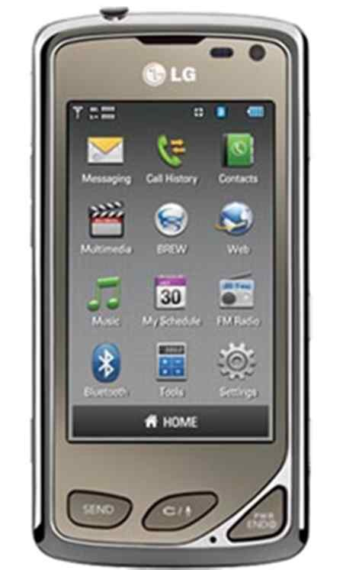
CDMA2000
CDMA2000 1xEV-DO
Regarded as the first 3G system based on ITU standards
  ITU (International Telecommunication Union) is the specialized agency for information and communication technology of the UN (United Nations)

Slide 47
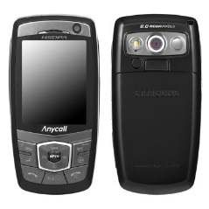
HSDPA
High-Speed Downlink Packet Access (HSDPA)
Enhanced 3G mobile communications protocol
Evolution of UMTS for higher data speeds and capacity
Belongs to the HSPA (High-Speed Packet Access) family of protocols

Slide 48
HSDPA
High-Speed Downlink Packet Access (HSDPA)
HSDPA commercial networks became available in 2005
Peak Data Rate
  Downlink: 14 Mbps (Release 5)

Slide 49
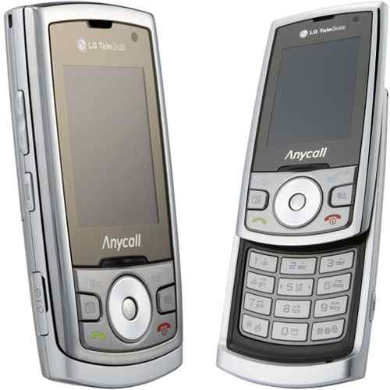
EV-DO Rev. A
EV-DO Rev. A (Revision A)
Peak Data Rate
  Downlink: 3.1 Mbps
  Uplink: 1.8 Mbps
Launched in the USA on October 2006
VoIP support based on low latency and low bit rate communications

Slide 50
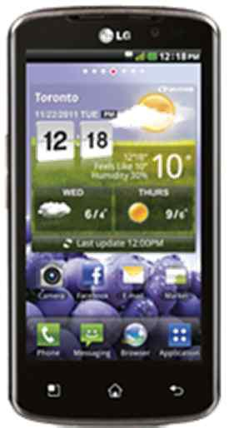
EV-DO Rev. A
EV-DO Rev. A
Enhanced Access Channel MAC
  Decreased connection establishment time
Multi-User Packet technology enables the ability for more than one user to share the same timeslot
QoS (Quality of Service) flags included for QoS control

Slide 51
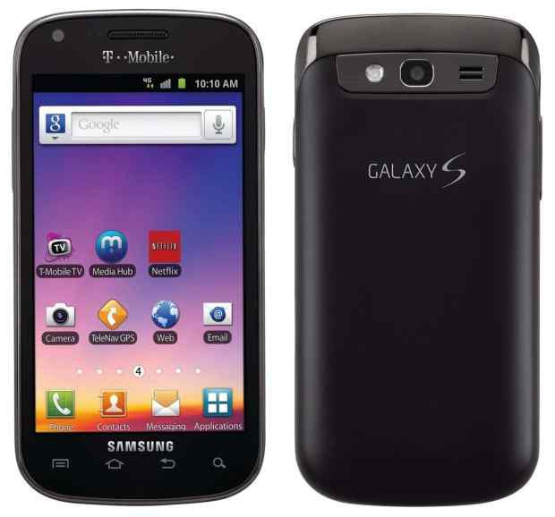
HSPA+
Evolved High-Speed Packet Access (HSPA+)
HSPA+ all IP network first launched in Hong Kong in 2009
WCDMA (UMTS) based 3G enhancement
HSPA+ is a HSPA evolution

Slide 52
HSPA+
Evolved High-Speed Packet Access (HSPA+)
Peak Data Rate
  Downlink: 168 Mbps
  Uplink: 22 Mbps
MIMO (Multiple-Input & Multiple-Output) multiple-antenna technique applied
  Why MIMO? MIMO uses uncorrelated multiple antennas both at the transmitter and receiver to increase the data rate while using the same signal bandwidth as a single antenna system.

Slide 53
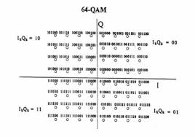
HSPA+
Evolved High-Speed Packet Access (HSPA+)
Higher Date Rate Accomplished by
  MIMO multiple-antenna technique
  Higher order modulation (64QAM)
  Dual-Cell HSDPA is used to combine
  multiple cells into one
Notes:
64 QAM
https://en.wikipedia.org/wiki/Quadrature_amplitude_modulation
64-QAM modulation: In case of a 64-QAM modulation, a group of 6 bits is mapped into a single constellation symbol with real and imaginary parts m_{I}(k) and m_{Q}(k). The signal constellation is shown in the following figure. A=1/√42.

Slide 54
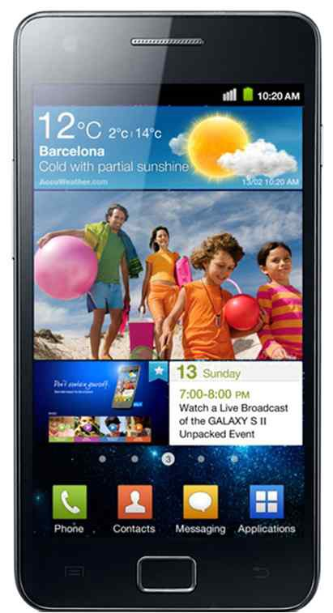
EV-DO Rev B
EV-DO Rev. B (Revision B)
EV-DO Rev. B was first deployed in Indonesia on January 2010
Multi-Carrier evolution of Rev. A
Higher data rates per carrier
  Downlink Peak
    4.9 Mbps per carrier
  Uplink Peak
    1.8 Mbps per carrier

Slide 55
EV-DO Rev B
EV-DO Rev. B
Reduced latency from statistical multiplexing across channels
➔Reduced delay ➔Improved QoS
Longer talk-time & standby time
Hybrid frequency re-use & Reduced interference at Cell Edges and Adjacent Sectors ➔ Improved QoS at the Cell Edge

Slide 56
EV-DO Rev B
EV-DO Rev. B
More Efficient Asymmetric Data Rate Support
  Downlink ≠ Uplink Data Rates
  Asymmetric Service Examples
    File transfer
    Web browsing
    Multimedia content delivery
    etc.

Slide 57
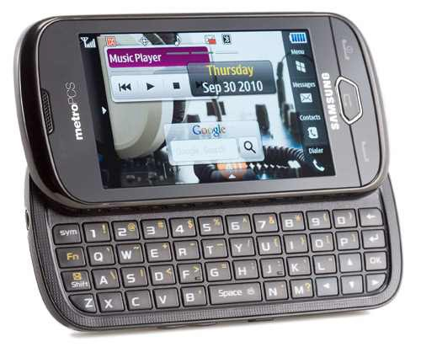
EV-DO Rev B
LTE
Long-Term Evolution (LTE)
LTE launched in North American on September 2010 with the Samsung SCH-R900
Deployed on both GSM and the CDMA mobile operators

Slide 58
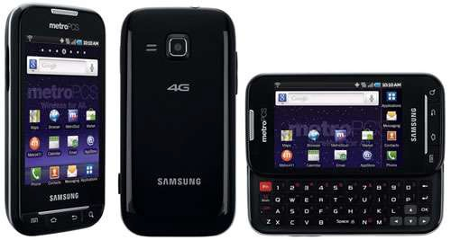
EV-DO Rev B
Long-Term Evolution (LTE)
Peak Data Rate (Release 8)
  Downlink: 300 Mbps
  Uplink: 75 Mbps

Slide 59
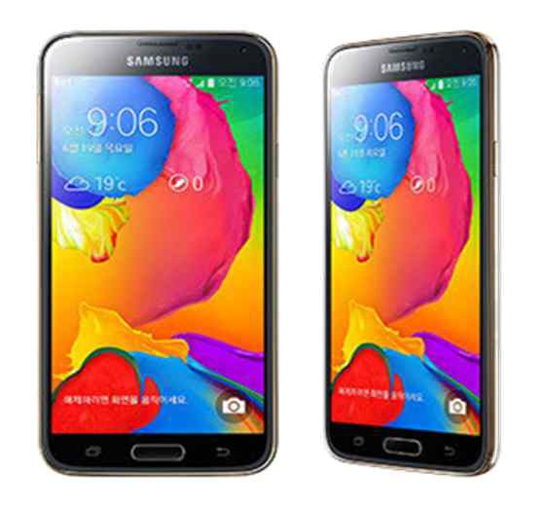
LTE-A
LTE-A (LTE-Advanced)
Considered as a 4G technology based on the ITU-R IMT-Advanced process
Peak Data Rate (Release 10)
  Downlink: 3 Gbps
  Uplink: 1.5 Gbps

Slide 60
LTE-A
LTE-A (LTE-Advanced)
LTE-A incorporates higher order MIMO (4×4 and beyond) and allows multiple carriers to be bonded into a single stream

Slide 61
References
H. Holma and A. Toskala, HSDPA/HSUPA for UMTS: High Speed Radio Access for Mobile Communications. John Wiley & Sons, 2007.
A. R. Mishra, Advanced Cellular Network Planning and Optimisation: 2G/2.5G/3G...Evolution to 4G. John Wiley & Sons, 2006.
A. R. Mishra, Fundamentals of Cellular Network Planning and Optimisation: 2G/2.5G/3G...Evolution to 4G. John Wiley & Sons, 2004.
R. Steele, P. Gould, and C. Lee, GSM, cdmaOne and 3G Systems. John Wiley & Sons, 2000.
J. Korhonen, Introduction to 3G Mobile Communications. Artech House, 2003.
H. Holma and A. Toskala, WCDMA for UMTS: Radio Access for Third Generation Mobile Communications. John Wiley & Sons, 2000.
“HSPA Evolution brings Mobile Broadband to Consumer Mass Markets,” Nokia, White Paper, 2008.
Image Source: FDMA, TDMA, CDMA comparison, slidePlayer.com

