Slide 1
Cloud Computing
Hwajung Lee
Key Reference:
Prof. Jong-Moon Chung’s Lecture Notes at Yonsei University

Slide 2
Cloud Computing
Cloud Introduction
Cloud Service Model
Big Data
Hadoop
MapReduce
HDFS (Hadoop Distributed File System)

Slide 3
Cloud Introduction

Slide 4

Cloud Computing
What does Cloud Computing do?
Provides online data storage
Enables configuration and accessing of online applications
Provides a variety of software usage
Provides computing platform and computing infrastructure

Slide 5
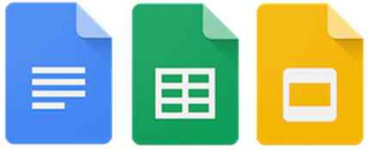
Cloud Computing
Application Example
Using Gmail on my smartphone to check e-mails
Receive an e-mail with a MS Power Point attachment file
However, MS Power Point and Windows OS is not installed on my smartphone!
Google Drive service’s Google Docs, Sheets, and Slides can be used to open the file

Slide 6
Cloud Computing
What is a Cloud?
Cloud can provide services through a public or private Network or the Internet, where the service hosting system is at a remote location
Cloud can support various applications
  E-mail, Web Conferencing, Games, Database Management, CRM (Customer Relationship Management), etc.

Slide 7









Cloud Computing
Cloud Computing
Cloud Models

Slide 8
Cloud Computing
Cloud Models
Public Cloud
  Enables public systems and service access
  Open architecture (e.g., e-mail)
  Could be less secure due to openness
Private Cloud
  Enables service access within an organization
  Due to its private nature, it is more secure

Slide 9
Cloud Computing
Cloud Models
Community Cloud
  Cloud accessible by a group of organizations
Hybrid Cloud
  Hybrid Cloud = Public Cloud + Private Cloud
  Private cloud supports critical activities
  Public cloud supports non-critical activities

Slide 10










Cloud Computing
Cloud Service Models
The lower service model supports the management, computing power, security of its upper service model
CRM, E-mail
Games, Virtual Desktop
Database, Web Server
Deployment tools
Virtual Machine, Servers
Storage, Networks
SaaS: Software as a Service
PaaS: Platform as a Service
IaaS: Infrastructure as a Service

Slide 11
Cloud Computing
Software as a Service (SaaS)
Provides a variety of software applications as a service to
end users
Platform as a Service (PasS)
Provides a program executable platform for applications, development tools, etc.
Infrastructure as a Service (IaaS)
Provides the fundamental computing and security resources for the entire cloud
Backup storage, computing power, VM (Virtual Machines), etc.

Slide 12
Cloud Computing
Cloud Service Models
There are many other service models
XaaS = Anything as a Service
  NaaS ➔ N for Network as a Service
  DaaS ➔ D for Database as a Service
  BaaS ➔ B for Business as a Service
  etc.

Slide 13

























Cloud Computing
Cloud Benefits

Slide 14








Cloud Computing
Characteristics
On Demand Self-Service
Broad Networks Access
Rapid Elasticity
Advanced Security

Slide 15
Cloud Service Models

Slide 16
Cloud Computing
Cloud Service Models
The lower service model supports the management, computing power, security of its upper service model
CRM, E-mail
Games, Virtual Desktop
Database, Web Server
Deployment tools
Virtual Machine, Servers
Storage, Networks
SaaS: Software as a Service
PaaS: Platform as a Service
IaaS: Infrastructure as a Service

Slide 17
IaaS
IaaS (Infrastructure as a Service)
Infrastructure support over the Internet
Cloud’s Computing & Storage Resources
  Computing Power
  Storage Services
  Software Packages & Bundles
  VLAN (Virtual Local Area Network)
  VM (Virtual Machine) Features

Slide 18
IaaS
VM (Virtual Machine) Administration
IaaS enables control of computing resources through Administrative Access to VMs
➔ Server Virtualization features
Access to computing resources are enabled by Administrative Access to VMs
VM Administrative Command examples
  Save data on cloud server
  Start web server
  Install new application

Slide 19
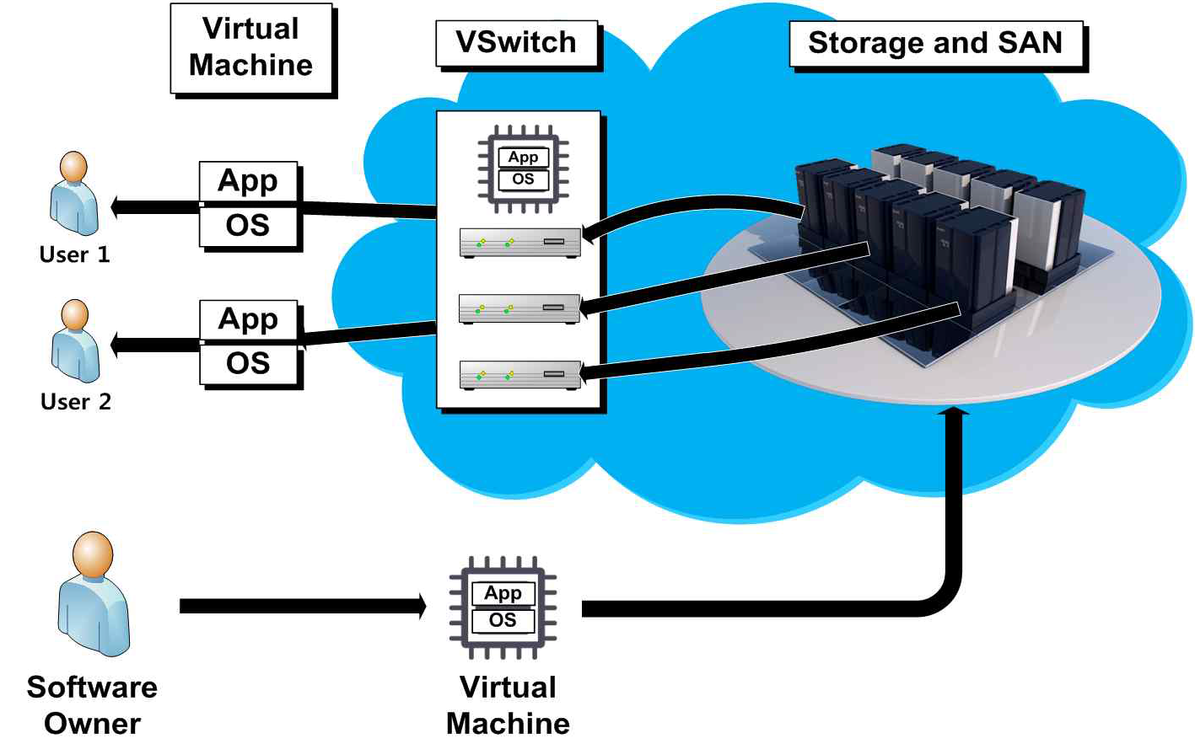
IaaS
IaaS Procedures

Slide 20
IaaS
IaaS Benefits
Flexible and Efficient Renting of Computer & Server Hardware
  Rentable Resources
    VM, Storage, Bandwidth,
IP Addresses, Monitoring Services, Firewalls, etc.
  Rent Payment Basis
    Resource type
    Usage time
    Service packages

Slide 21
IaaS
IaaS Benefits
Portability & Interoperability with Legacy Applications
  Enables portability based on infrastructure resources that are used through Internet connections
  Enables a method to maintain interoperability with legacy applications and workloads between IaaS clouds

Slide 22
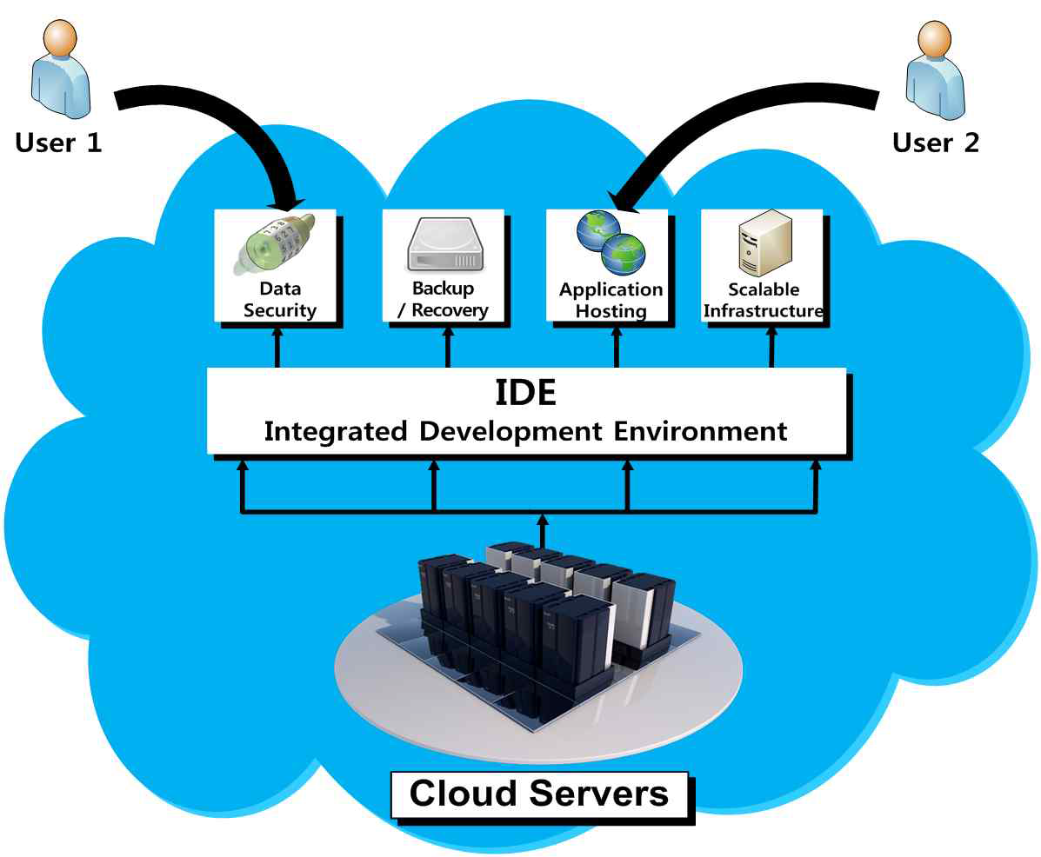
PaaS
PaaS
(Platform as a Service)
Provides development & deployment tools for application development
Provides runtime environment for apps.

Slide 23

Cloud Services
PaaS Types
Application Delivery-Only Environment
Stand Alone Development Environment
Add-on Development Facilities
Open Platform as a Service

Slide 24
PaaS
PaaS Types (cont.)
Application Delivery-Only Environment
  generally focus on hosting services, such as security and on-demand scalability
Stand-Alone Development Environment
  do not include technical, licensing or financial dependencies on specific SaaS applications or web services, and are intended to provide a generalized development environment

Slide 25
PaaS
PaaS Types
Open Platform as a Service
  Provides open source software to run applications for PaaS providers
Add-On Development Facilities
  allow customization of existing SaaS applications, often requiring PaaS developers and their users to purchase subscriptions to the add-on SaaS application

Slide 26









PaaS
PaaS Benefits

Slide 27
PaaS
Benefits
Lower Administrative Overhead
  User does not need to be involved in any administration of the platform
Lower Total Cost of Ownership
  User does not need to purchase any hardware, memory, or server

Slide 28
PaaS
Benefits
Scalable Solutions
  Application resource demand based automatic resource scale control
More Current System Software
  Cloud provider needs to maintain software upgrades & patch installations

Slide 29
SaaS
SaaS (Software as a Service)
Provides software applications as a service to the user
Software that is deployed on a cloud server which is accessible through the Internet

Slide 30
SaaS
Characteristics
On Demand Availability
  Cloud software is available anywhere that the cloud is reachable via Internet
Easy Maintenance
  No user software upgrade or maintenance needed
➔ All supported by the cloud
Flexible Scale Up or Scale Down
Centralized Management & Data

Slide 31
SaaS
Characteristics
Enables a Shared Data Model
  Multiple users can share a single data model and database
Cost Effectiveness
  Pay based on usage
  No risk in buying the wrong software
Multitenant Program Solutions
  Multiple uses are ensured to use the same software version
➔ No version mismatch problems

Slide 32
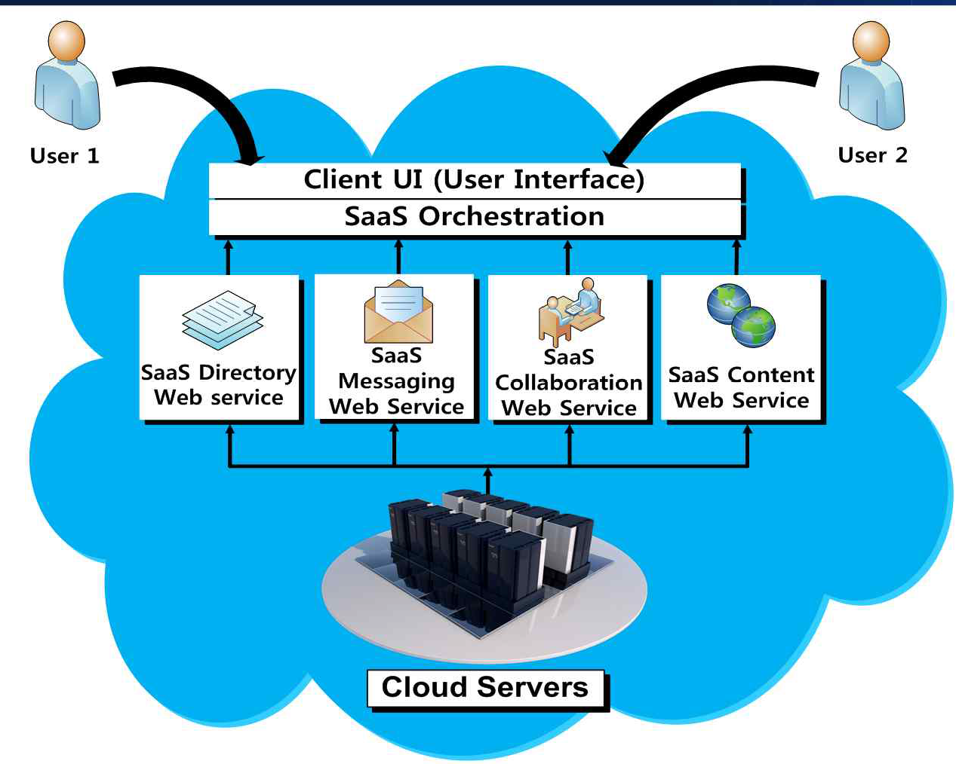
Software-as-a-service
Open SaaS Applications

Slide 33
References
K. Kumar and Y. H. Lu, “Cloud Computing for Mobile Users: Can Offloading Computation Save Energy?,” Computer, vol. 43, no. 4, pp. 51–56, Apr. 2010.
Wikipedia, http://www.wikipedia.org
Apple, iCloud, https://www.icloud.com
Google, Google Cloud, https://cloud.google.com/products [Accessed June 1, 2015]
Virtualization, Cisco’s IaaS cloud, http://www.virtualization.co.kr/data/file/01_2/1889266503_6f489654_1.jpg [Accessed June 1, 2015]
Tutorialspoint, Cloud computing, http://www.tutorialspoint.com/cloud_computing/cloud_computing_tutorial.pdf [Accessed June 1, 2015]

Slide 34
References
Image sources
AWS Simple Icons Storage Amazon S3 Bucket with Objects, By Amazon Web Services LLC [CC BY-SA 3.0 (http://creativecommons.org/licenses/by-sa/3.0)], via Wikimedia Commons
iCloud Logo, By EEIM (Own work) [Public domain], via Wikimedia Commons
MobileMe Logo, By Apple Inc. [Public domain], via Wikimedia Commons

