Slide 1
Chapter 6: Multiarea OSPF
Scaling Networks
Notes:
Cisco Networking Academy program
Scaling Networks
Chapter 6

Slide 2
Chapter 6
6.0 Introduction
6.1 Multiarea OSPF
6.2 Configuring Multiarea OSPF
6.3 Summary
Notes:
Chapter 6

Slide 3
Chapter 6: Objectives
After completing this chapter, students will be able to:
Explain why multiarea OSPF is used.
Explain how multiarea OSPF uses link-state advertisements in order to maintain routing tables.
Explain how OSPF established neighbor adjacencies in a multiarea OSPF implementation.
Configure multiarea OSPFv2 in a routed network.
Configure multiarea route summarization in a routed network.
Verify multiarea OSPFv2 operations.

Slide 4
6.1 Multiarea OSPF Operation
Notes:
6.1 Multiarea OSPF Operation

Slide 5
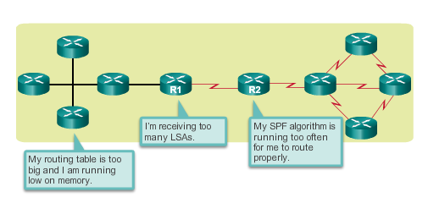
Why Multiarea OSPF?
Single-Area OSPF
Single-area OSPF is useful in smaller networks. If an area becomes too big, the following issues must be addressed:
Large routing table (no summarization by default)
Large link-state database (LSDB)
Frequent SPF algorithm calculations
Notes:
6.1.1.1 Single-Area OSPF

Slide 6
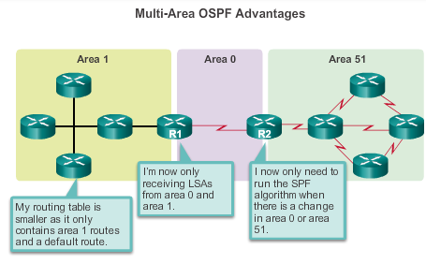
Why Multiarea OSPF?
Multiarea OSPF
Multiarea OSPF requires a hierarchical network design and the main area is called the backbone area, or area 0, and all other areas must connect to the backbone area.
Notes:
6.1.1.2 Multiarea OSPF

Slide 7
Why Multiarea OSPF?
OSPF Two-Layer Area Hierarchy
Multiarea OSPF is implemented in a two-layer area hierarchy:
  Backbone (transit) area
    Area whose primary function is the fast and efficient movement of IP packets.
    Interconnects with other OSPF area types.
    Called OSPF area 0, to which all other areas directly connect.
  Regular (nonbackbone) area
    Connects users and resources.
    A regular area does not allow traffic from another area to use its links to reach other areas.
Notes:
6.1.1.3 OSPF Two-Layer Area Hierarchy

Slide 8
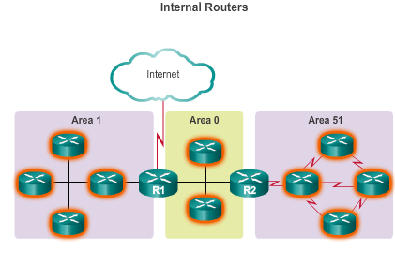
Why Multiarea OSPF?
Types of OSPF Routers
Notes:
6.1.1.4 Types of OSPF Routers

Slide 9
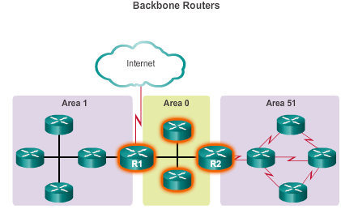
Why Multiarea OSPF?
Types of OSPF Routers (cont.)
Notes:
6.1.1.4 Types of OSPF Routers

Slide 10
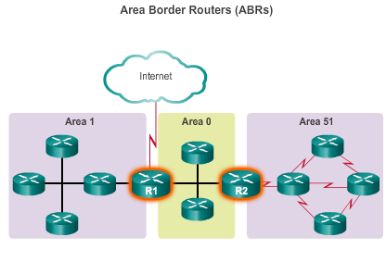
Why Multiarea OSPF?
Types of OSPF Routers (cont.)
Notes:
6.1.1.4 Types of OSPF Routers

Slide 11
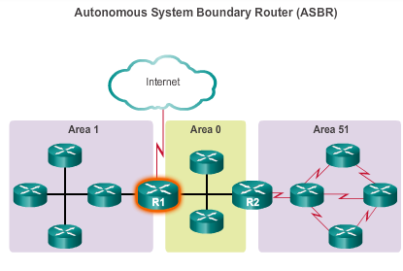
Why Multiarea OSPF?
Types of OSPF Routers (cont.)
Notes:
6.1.1.4 Types of OSPF Routers

Slide 12
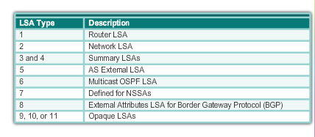
Multiarea OSPF LSA Operation
OSPF LSA Types
Most common and covered in this course – 1 thru 5
Notes:
6.1.2.1 OSPF LSA Types

Slide 13
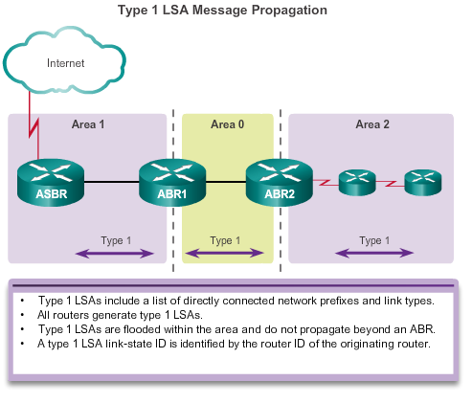
Multiarea OSPF LSA Operation
OSPF LSA Type 1
Notes:
6.1.2.2 OSPF LSA Type 1

Slide 14
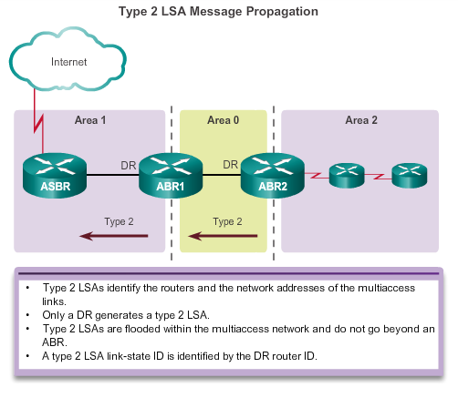
Multiarea OSPF LSA Operation
OSPF LSA Type 2
Notes:
6.1.2.3 OSPF LSA Type 2

Slide 15
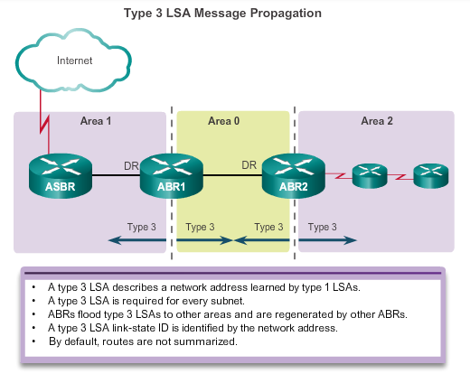
Multiarea OSPF LSA Operation
OSPF LSA Type 3
Notes:
6.1.2.4 OSPF LSA Type 3

Slide 16
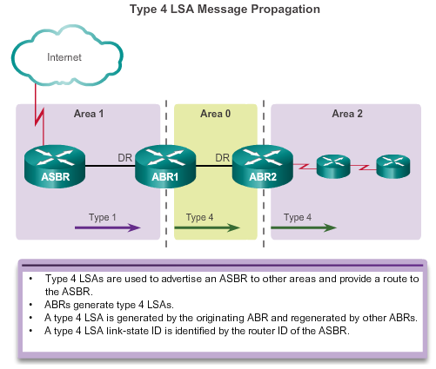
Multiarea OSPF LSA Operation
OSPF LSA Type 4
Notes:
6.1.2.5 OSPF LSA Type 4

Slide 17
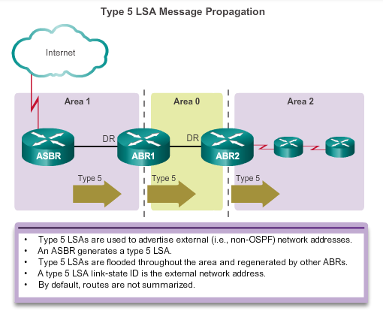
Multiarea OSPF LSA Operation
OSPF LSA Type 5
Notes:
6.1.2.6 OSPF LSA Type 5

Slide 18
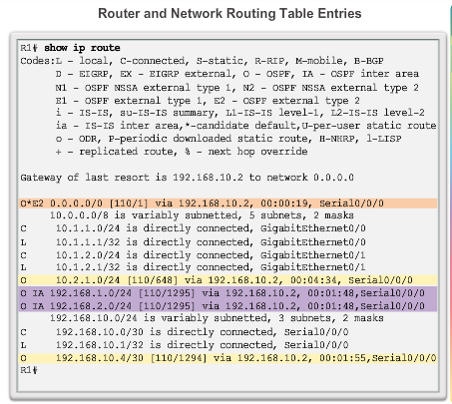
OSPF Routing Tables and Route Types
OSPF Routing Table Entries
  O – Router (type 1) and network (type 2) LSAs describe the details within an area (the route is intra-area).
  O IA – Summary LSAs appear in the routing table as IA (interarea routes)
  O E1 or OE 2 – External LSAs external type 1 (E1) or external type 2 (E2) routes
Notes:
6.1.3.1 OSPF Routing Table Entries

Slide 19
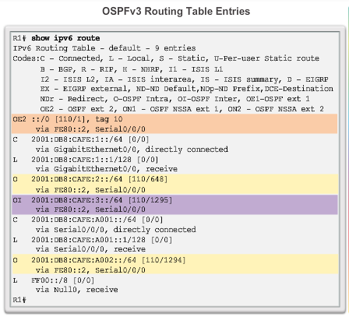
OSPF Routing Tables and Route Types
OSPF Routing Table Entries (cont.)
  O – Router (type 1) and network (type 2) LSAs describe the details within an area (the route is intra-area)
  O IA – Summary LSAs appear in the routing table as IA (interarea routes)
  O E1 or OE 2 – External LSAs external type 1 (E1) or external type 2 (E2) routes
Notes:
6.1.3.1 OSPF Routing Table Entries

Slide 20
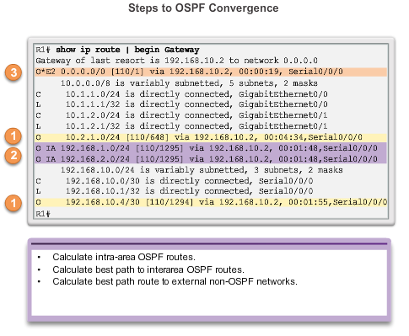
OSPF Routing Tables and Route Types
OSPF Route Calculation
All routers calculate the best paths to destinations within their area (intra-area) and add these entries to the routing table.
All routers calculate the best paths to the other areas within the internetwork (interarea) or type 3 and type 4 LSAs.
All routers calculate the best paths to the external autonomous system (type 5) destinations. These are noted with either an O E1 or an O E2 route designator.
Notes:
6.1.3.2 OSPF Route Calculation

Slide 21
6.2 Configuring Multiarea OSPF
Notes:
6.2 Configuring Multiarea OSPF

Slide 22
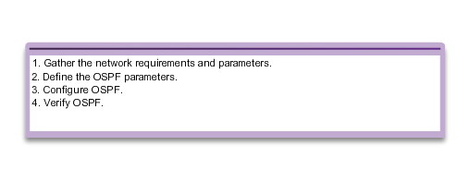
Configuring Multiarea OSPF
Implementing Multiarea OSPF
Implementation Plan Steps
Notes:
6.2.1.1 Implementing Multiarea OSPF

Slide 23
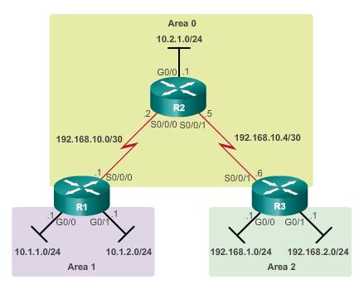
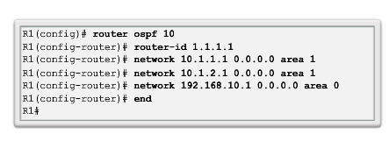
Configuring Multiarea OSPF
Configuring Multiarea OSPF
Notes:
6.2.1.2 Configuring Multiarea OSPF

Slide 24
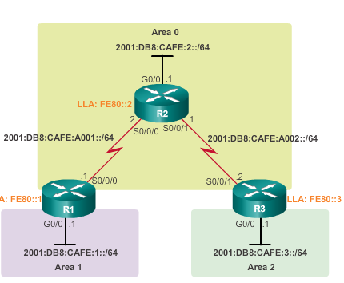
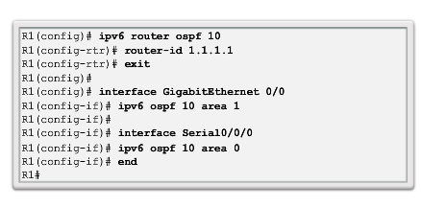
Configuring Multiarea OSPF
Configuring Multiarea OSPFv3
Notes:
6.2.1.3 Configuring Multiarea OSPFv3

Slide 25
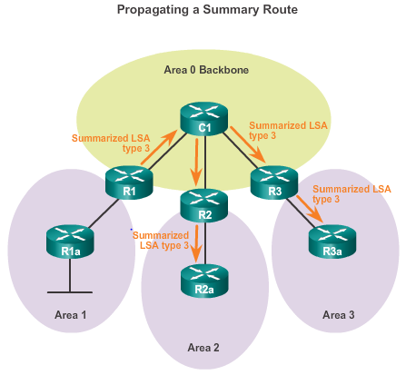
OSPF Route Summarization
OSPF Route Summarization
  R1 forwards a summary LSA to the core router C1.
  C1, in turn, forwards the summary LSA to R2 and R3.
  R2 and R3 then forward it to their respective internal routers.
Notes:
6.2.2.1 OSPF Route Summarization

Slide 26
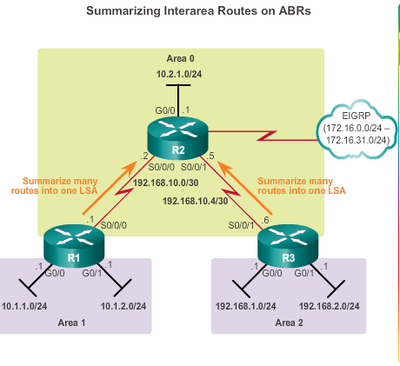
OSPF Route Summarization
Interarea and External Route Summarization
Occurs on ABRs and applies to routes from within each area
Notes:
6.2.2.2 Interarea and External Route Summarization

Slide 27
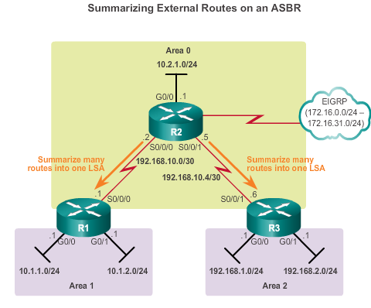
OSPF Route Summarization
Interarea and External Route Summarization (cont.)
Specific to external routes that are injected into OSPF via route redistribution; ASBRs summarize external routes
Notes:
6.2.2.2 Interarea and External Route Summarization

Slide 28
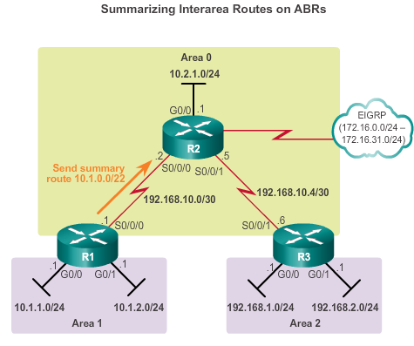
OSPF Route Summarization
Interarea Route Summarization
Notes:
6.2.2.3 Interarea Route Summarization

Slide 29
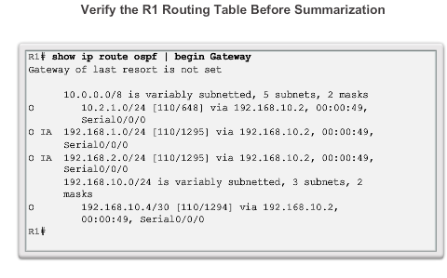
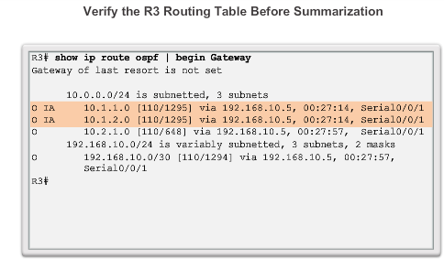
OSPF Route Summarization
Interarea Route Summarization (cont.)
Notes:
6.2.2.3 Interarea Route Summarization

Slide 30
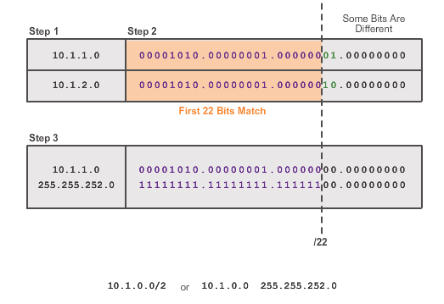
OSPF Route Summarization
Calculating the Summary Route
2
Notes:
6.2.2.4 Calculating the Summary Route

Slide 31
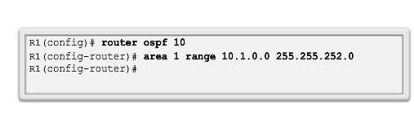
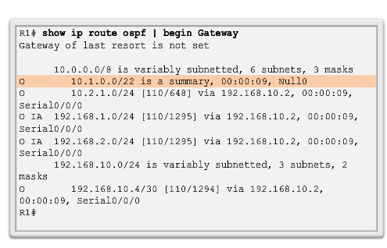
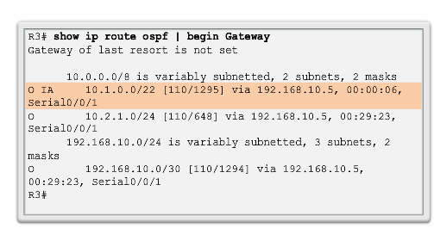
OSPF Route Summarization
Configuring Interarea Route Summarization
R1
R3
Notes:
6.2.2.5 Configuring Interarea Route Summarization

Slide 32
Verifying Multiarea OSPF
Verifying Multiarea OSPF
The same verification commands are used to verify single-area OSPF and can be used to verify multiarea OSPF:
show ip ospf neighbor
show ip ospf
show ip ospf interface
Commands specific to multiarea information include:
show ip protocols
show ip ospf interface brief
show ip route ospf
show ip ospf database
Note: For OSPFv3, substitute ip with ipv6.
Notes:
6.2.3.1 Verifying Multiarea OSPF

Slide 33
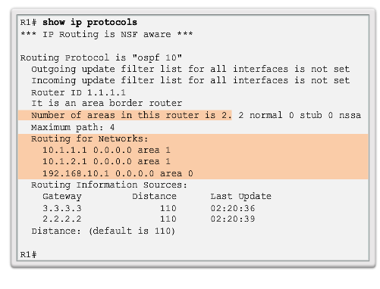
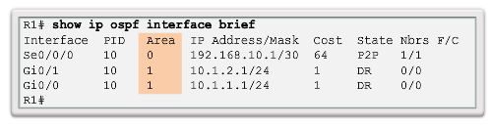
Verifying Multiarea OSPF
Verifying General Multiarea OSPF Settings
Notes:
6.2.3.2 Verify General Multiarea OSPF Settings

Slide 34
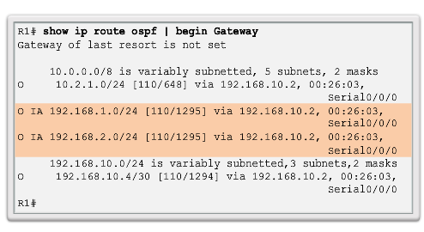
Verifying Multiarea OSPF
Verify the OSPF Routes
Notes:
6.2.3.3 Verify the OSPF Routes

Slide 35
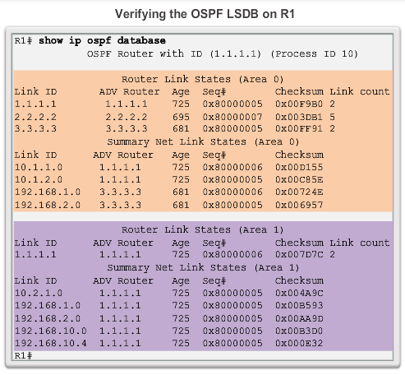
Verifying Multiarea OSPF
Verifying the Multiarea OSPF LSDB
Notes:
6.2.3.4 Verify the Multiarea OSPF LSDB

Slide 36
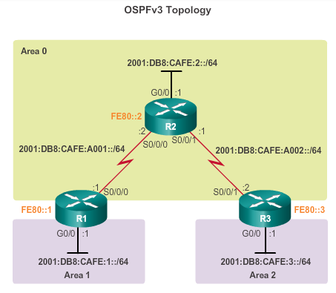
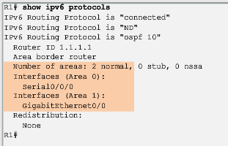
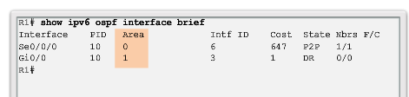
Verifying Multiarea OSPF
Verifying Multiarea OSPFv3
Notes:
6.2.3.5 Verifying Multiarea OSPFv3

Slide 37
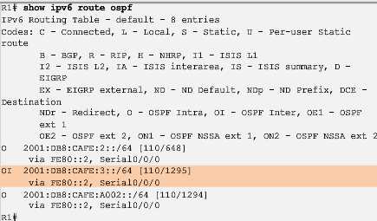
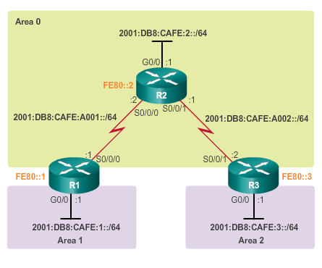
Verifying Multiarea OSPF
Verifying Multiarea OSPFv3 (cont.)
Notes:
6.2.3.5 Verifying Multiarea OSPFv3

Slide 38
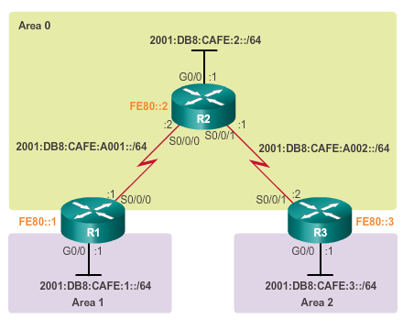
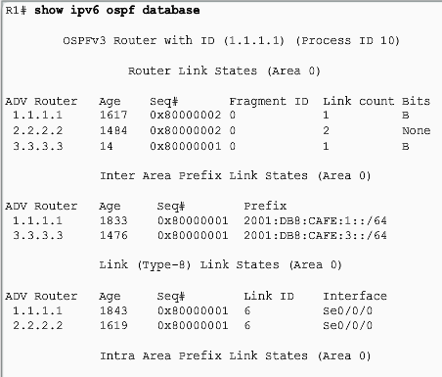
Verifying Multiarea OSPF
Verifying Multiarea OSPFv3 (cont.)
Notes:
6.2.3.5 Verifying Multiarea OSPFv3

Slide 39
Chapter 6: Summary
Multiarea OSPF Summary
Better choice for larger networks than single-area.
Solves the issues of large routing table, large LSDB, and frequent SPF algorithm calculations.
Main area is called the backbone area, or area 0.
Recalculating the database is kept within an area.
Four different types of OSPF routers:
  Internal router
  Backbone router
  ABR
  ASBR
A router simply becomes an ABR when it has two network statements in different areas.
Notes:
Chapter 6 Summary

Slide 40
Chapter 6: Summary
Multiarea OSPF Summary (cont.)
Link-state advertisements (LSAs) are the building blocks of OSPF.
  Type 1 LSAs are referred to as the router link entries.
  Type 2 LSAs are referred to as the network link entries and are flooded by a DR.
  Type 3 LSAs are referred to as the summary link entries and are created and propagated by ABRs.
  A type 4 summary LSA is generated by an ABR only when an ASBR exists within an area.
  Type 5 external LSAs describe routes to networks outside the OSPF autonomous system, originated by the ASBR and are flooded to the entire autonomous system.
SPF tree is used to determine the best paths.
OSPF routes in an IPv4 routing table are identified using the following descriptors: O, O IA, O E1, or O E2.
Notes:
Chapter 6 Summary

Slide 41
Chapter 6: Summary
Multiarea OSPF Summary (cont.)
The following example displays a multiarea OSPF configuration:
  R1(config)# router ospf 10
  R1(config-router)# router-id 1.1.1.1
  R1(config-router)# network 10.1.1.1 0.0.0.0 area 1
  R1(config-router)# network 10.1.2.1 0.0.0.0 area 1
  R1(config-router)# network 192.168.10.1 0.0.0.0 area 0
Does not perform autosummarization, but can be manually configured using the summary-address address mask router configuration mode command
Notes:
Chapter 6 Summary

Slide 42
Chapter 6: Summary
Multiarea OSPF Summary (cont.)
The following commands are used to verify OSPF configurations:
  show ip ospf neighbor
  show ip ospf
  show ip ospf interface
  show ip protocols
  show ip ospf interface brief
  show ip route ospf
  show ip ospf database
Notes:
Chapter 6 Summary

Slide 43


