Slide 1
ITEC452
Distributed Computing
Lecture 1
Introduction to Distributed Systems
Hwajung Lee

Slide 2
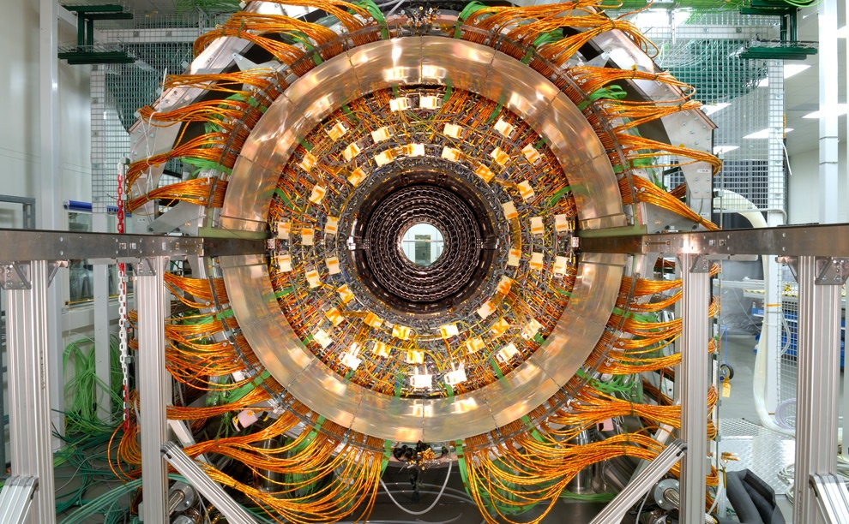
Maximilien Brice, © CERN

Slide 3
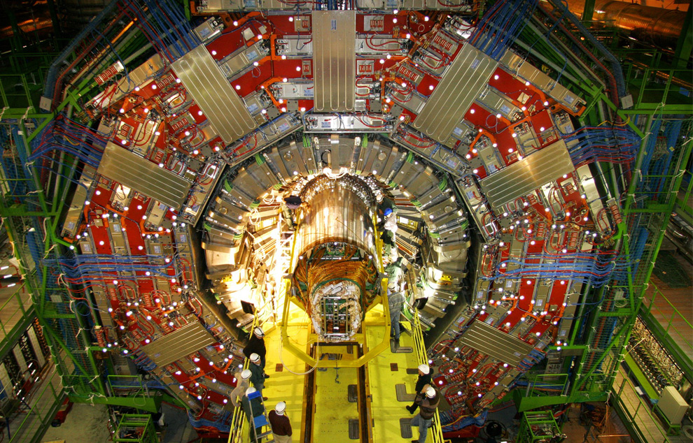
Maximilien Brice, © CERN

Slide 4
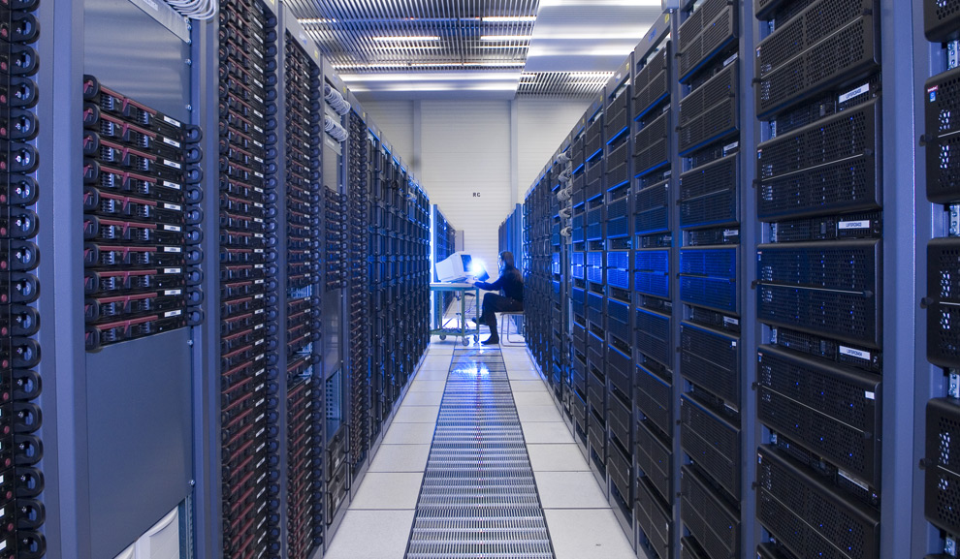
Maximilien Brice, © CERN

Slide 5
Why distributed systems ?
Fact: Processor population is exploding. Technology has dramatically reduced the price of processors.
Geographic distribution of processes
Resource sharing as used in P2P networks
Computation speed up (as in a grid)
Fault tolerance

Slide 6
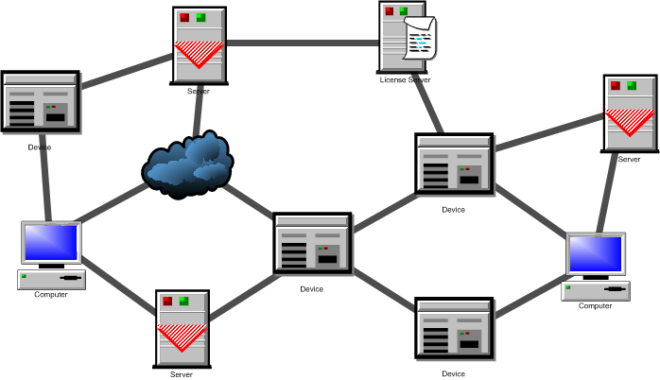
What is a distributed system? (1)
A network of processes/resources.
The nodes are processes/resources, and the edges are communication channels.

Slide 7
What is a distributed system? (2)
The logical distribution of functional capabilities
  Multiple processes
  Interprocess communication
  Disjoint address space
  Collective goal

Slide 8
What is a distributed system? (2)
Collective Goal?
Don’t hold your breath:
  Biocomputing
  Nanocomputing
  Quantum computing
  …
It all boils down to…
  Divide-and-conquer
  Throwing more hardware at the problem
Reference: Lecture Note by Jimmy Lin, Univ. of Maryland

Slide 9
What is a distributed system? (2)
Divide and Conquer
“Work”
Partition
w₁
w₂
w₃
“worker”
“worker”
“worker”
r₁
r₂
r₃
Combine
“Result”
Reference: Lecture Note by Jimmy Lin, Univ. of Maryland

Slide 10
What is a distributed system? (2)
Different Workers
Different threads in the same core
Different cores in the same CPU
Different CPUs in a multi-processor system
Different machines in a distributed system
Reference: Lecture Note by Jimmy Lin, Univ. of Maryland

Slide 11
What is a distributed system? (2)
Choices, Choices, Choices
Commodity vs. “exotic” hardware
Number of machines vs. processor vs. cores
Bandwidth of memory vs. disk vs. network
Different programming models
Reference: Lecture Note by Jimmy Lin, Univ. of Maryland

Slide 12
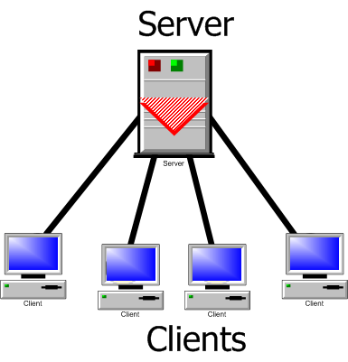
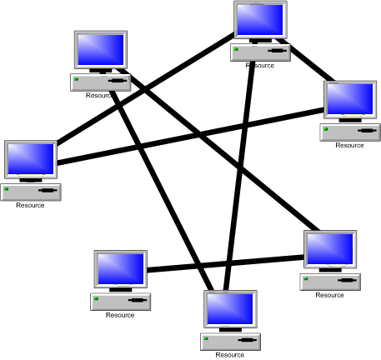
A classification
Client-server model
Peer-to-peer model

Slide 13
Parallel vs. Distributed
In both parallel and distributed systems, the events are partially ordered.
In parallel systems, the primarily issue is speed-up
In distributed systems the primary issues are fault-tolerance and availability of services

Slide 14
Important services
Internet banking
Web search
Net meeting
Distance education
Internet auction
Google earth
Google sky
And so on…

Slide 15
Examples
Large networks are very commonplace these days. Think of the world wide web. Other examples are:
  Ubiquitous Computing
  Cloud computing
  Grid computing, Grid computing networks
    Ex. Computational grids (OSG, Teragrid, SETI@home)
  Sensor networks
  Network of mobile robots
  And so on…
Notes:
Google processes 20 PB a day (2008)
Kazaa (formally, KaZaA)
BitTorrent

Slide 16
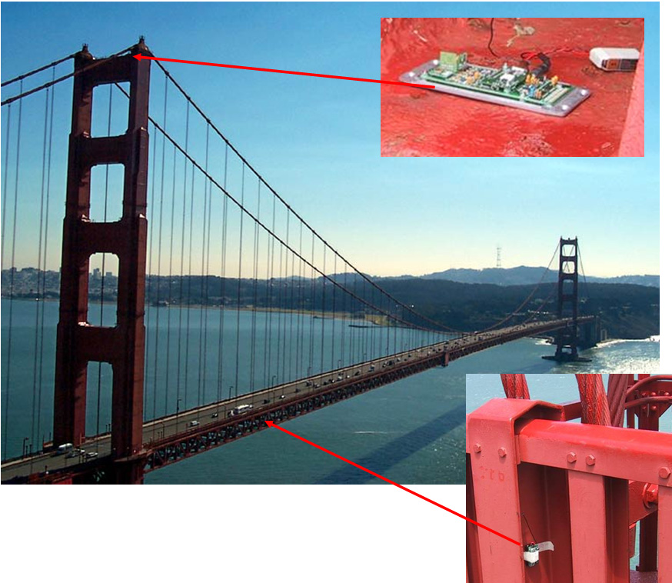
Sensor Network
Checking the structural integrity

Slide 17
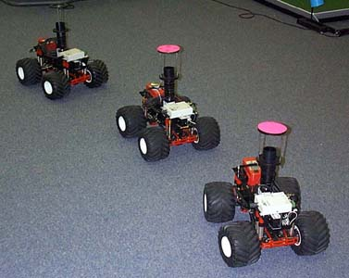
Mobile robots

Slide 18

Cloud Computing
Image Source: www.vemurivenkatrao.com/nature/cloud/

Slide 19
Important issues
Knowledge is local
Clocks are not synchronized
No shared address space
Topology and routing
Scalability
Fault tolerance

Slide 20
Some common sub-problems
Leader election
Mutual exclusion
Time synchronization
Distributed snapshot
Replica management

Slide 21
Objective of the course
Understand how a system works, why it fails, and how we can guarantee our design.
We are not discussing implementation or programming, although they are also important issues

Slide 22
Implementation
Practical distributed systems must have a real network as its backbone. However, such systems can be simulated on a shared-memory multiprocessor, or even on a uniprocessor.
(How will you do it?)

