Slide 1
ITEC452
Distributed Computing
Lecture 7
Interprocess Communication (IPC): An Overview
Hwajung Lee

Slide 2
Introduction to IPC (1)
Interprocess Communication (IPC) is at the heart of distributed computing.
Processes and Threads
  Process is the execution of a program
  Threads are lightweight processes
    Like a process, each thread maintains a separate flow of control, but threads share a common address space

Slide 3
Introduction to IPC (2)
Client-Server Model
  a widely accepted model for designing distributed system
  Example: a search engine like Google®

Slide 4
Introduction to IPC (3)
Middleware
  Processes, processors, and objects may be scattered anywhere in a network.
  From developing distributed applications, transparency is a desirable property.
  The layer of software that makes it possible is called middleware.
Applications
Middleware
OS of Machine 1
OS of Machine 2
OS of Machine 3
Network

Slide 5
Introduction to IPC (4)
  Some important middleware services address the following issues:
    How does a process locate another named process or object anywhere on the Internet?
    How does a process in the application layer communicate with another process anywhere on the Internet?
    How to isolate the application programs from differences in programming languages and communication protocols?
    How is the security of the communication guaranteed without any knowledge about the trustworthiness of the operating systems at the two endpoints?

Slide 6
Four General Approaches of IPC
Shared Memory
Messages
Pipes
Sockets

Slide 7
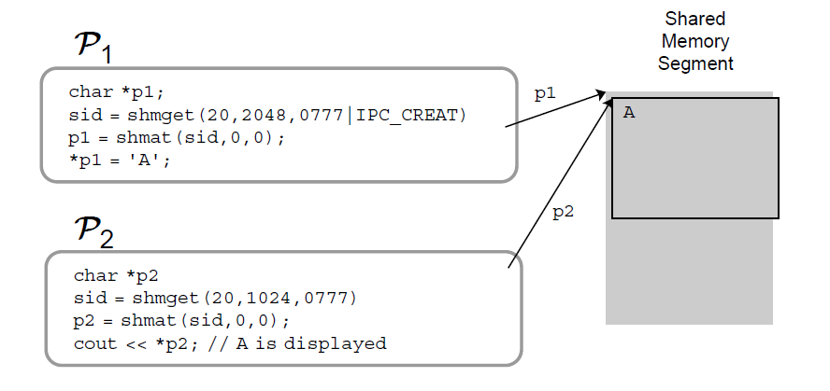
Shared Memory
  Two or several processes can map a segment of their virtual space into an identical segment of physical memory.
    Shared memory is the most efficient way of IPC
    But it may require synchronization
Image Source: http://medusa.sdsu.edu/cs570/Lectures/Chapter9.pdf
Notes:
Octal number (0-7)
http://linux.die.net/man/2/shmget
shmget - allocates a shared memory segment
Synopsis
#include <sys/ipc.h>
#include <sys/shm.h>
int shmget(key_t key, size_t size, int shmflg);
Description
shmget() returns the identifier of the shared memory segment associated with the value of the argument key. A new shared memory segment, with size equal to the value of size rounded up to a multiple of PAGE_SIZE, is created if key has the valueIPC_PRIVATE or key isn't IPC_PRIVATE, no shared memory segment corresponding to key exists, and IPC_CREAT is specified in shmflg.
If shmflg specifies both IPC_CREAT and IPC_EXCL and a shared memory segment already exists for key, then shmget() fails witherrno set to EEXIST. (This is analogous to the effect of the combination O_CREAT | O_EXCL for open(2).)
The value shmflg is composed of:
IPC_CREATto create a new segment. If this flag is not used, then shmget() will find the segment associated with key and check to see if the user has permission to access the segment.
IPC_EXCL
used with IPC_CREAT to ensure failure if the segment already exists.
mode_flags
(least significant 9 bits) specifying the permissions granted to the owner, group, and world. These bits have the same format, and the same meaning, as the mode argument of open(2). Presently, the execute permissions are not used by the system.

Slide 8
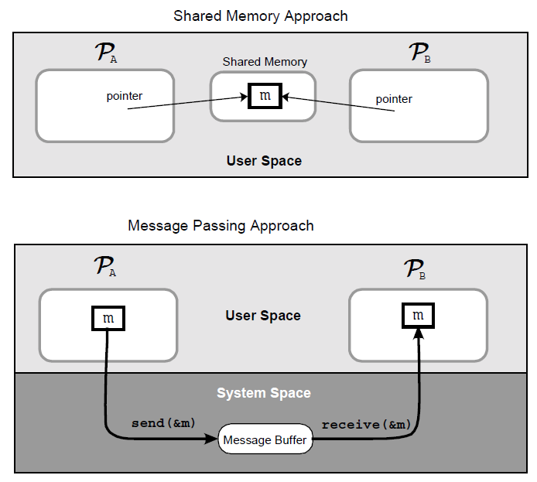
Messages (1)
Most distributed applications are implemented using message passing.
  Messages are less efficient than shared memory (require buffering and synchronization), but sometimes are more suitable due to the built-in synchronization
Image Source: http://medusa.sdsu.edu/cs570/Lectures/Chapter9.pdf

Slide 9
Messages (2)
  The messaging layer is logically located just above the TCP/IP or the UDP/IP layer, but below the application layer.
  The implementation of sockets at the TCP or the UDP layer helps processes address one another using specific socket addresses.
Image Source: http://medusa.sdsu.edu/cs570/Lectures/Chapter9.pdf

Slide 10
Messages (3)
Two Types of Messages
  Transient Messages
    A message is lost unless the receiver is active at the time of the message delivery and retrieves it during the life of the application
  Persistent Messages
    Messages are not lost, but saved in a buffer at the time of message delivery

Slide 11
Messages (4)
Stream
  Sequence of data items.
  Communication using streams requires a connection establishment between a sender of a receiver

Slide 12
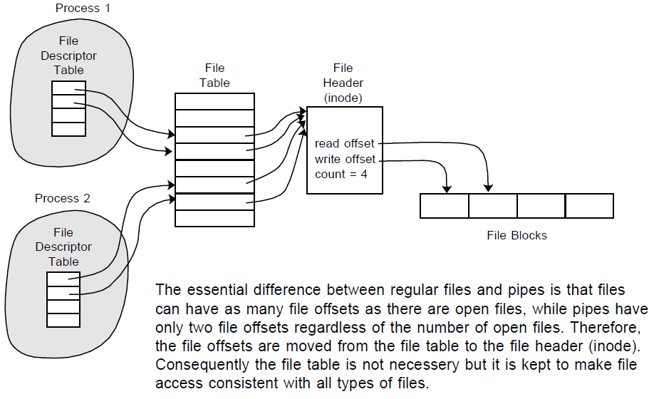
Pipes (1)
Pipes are implemented in file system.
  Pipes are basically files with only two file offsets: one for reading, another for writing.
  Writing to a pipe and reading from a pipe is strictly in FIFO manner.
Image Source: http://medusa.sdsu.edu/cs570/Lectures/Chapter9.pdf

Slide 13
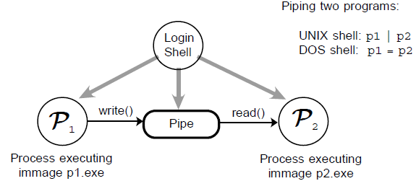
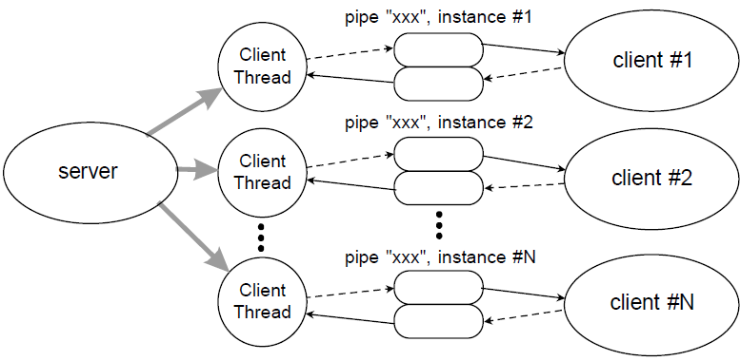
Pipes (2)
Two Types of Pipes
cat file > my_pipe
Anonymous (Unnamed) Pipes
Named Pipes
Unidirectional
To communicate two related processes in both directions, two anonymous pipes must be created.
Full-duplex or half-duplex
Image Source: http://medusa.sdsu.edu/cs570/Lectures/Chapter9.pdf
For example, one can create a pipe and
set up gzip to compress things piped to it:
mkfifo my_pipe
gzip -9 -c < my_pipe > out.gz &
cat file > my_pipe
rm my_pipe
Notes:
Named pipes
http://en.wikipedia.org/wiki/Named_pipe
It is explicitly created using mkfifo()^{[1]} or mknod(),^{[2]}
For example, one can create a pipe and set up gzip to compress things piped to it:
mkfifo my_pipe
gzip -9 -c < my_pipe > out.gz &
In a separate process shell, independently, one could send the data to be compressed:
cat file > my_pipe
The named pipe can be deleted just like any file:
rm my_pipe

Slide 14
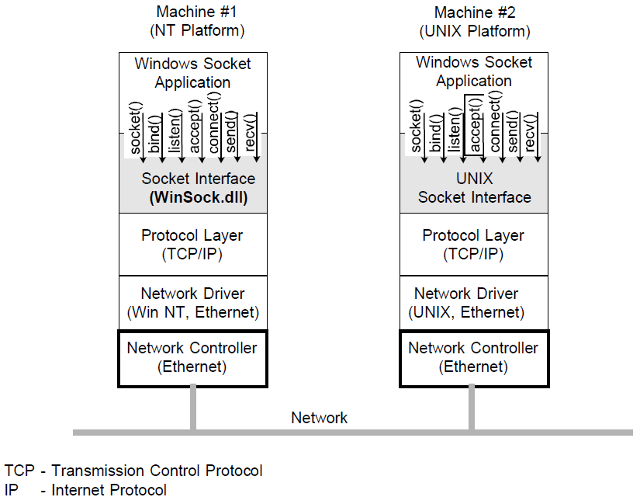
Sockets (1)
Sockets are abstract endpoints of communication between a pair of processes.
  originally used in BSD 4.2 (1983)
  by now widely accepted in other operating systems.
  typically used in server/client communication.
Note: BSD (Berkeley Software Distribution)
Image Source: http://medusa.sdsu.edu/cs570/Lectures/Chapter9.pdf

Slide 15
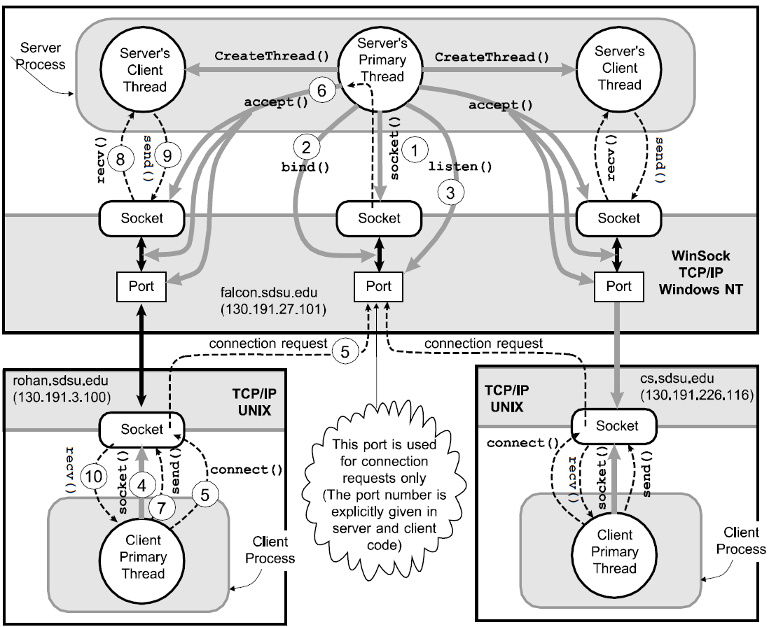
Sockets (2)
Image Source: http://medusa.sdsu.edu/cs570/Lectures/Chapter9.pdf
Notes:
Sockets are typically used in server/client communication: server creates socket and binds it to a
communication port and waits for connection request from a client (passive role - waits for client
to initiate the connection). Client also creates a socket of the same type, then requests a connection
to the known port on the known machine (active role - client initiates the connection). Once
the server accepts the client's connection request, it will create another socket and bind it to another
port, which will be used for further communication with the client. Once this is done, data
can flow between the client's socket and the server's second socket. The server's first socket remains
open, waiting requests from new clients. Waiting for new requests and communicating with
clients with established connection is normally done through different threads (see diagram on the
page 9-19).

Slide 16
More IPCs (1)
Remote Procedure Call (RPC)
  A procedure call that helps a client communicate with a server running on a different machine that may belong to a different network and a different administrative domain
  The task of packing the parameters of the call into a message is called parameter marshalling.
Remote Method Invocation (RMI)
  A generalization of RPC in an object-oriented environment.

Slide 17
More IPCs (2)
Web Services
  Most web services are based on XML that is widely used for cross-platform data communication including:
    Simple Object Access Protocol (SOAP)
      SOAP allows a one-way message containing a structured data to be sent from one process to another using any transport protocol like TCP.

Slide 18
More IPCs (3)
    Web Service Description Language (WSDL)
      It describes the public interface to the web service.
      An XML-based service description that explains how a client should communicate using the web service
    Universal Description Discovery, and Integration specification (UDDI)
    Java Web Services

Slide 19
More IPCs (4)
Event Notification
  Event notification systems help establish a form of asynchronous communication among distributed objects on heterogeneous platforms.
  Jini®, also called Apache River, a product of Sun Microsystems, provides event notification service for Java-based platforms. It allows subscribers in one JVM to receive notification of events of interest from another JVM.

Slide 20
More IPCs (5)
Common Object Request Broker Architecture (CORBA)
  The framework of a middleware that enables clients to transparently access remote objects across a distributed computing platform, regardless of the machines on which they are running or the language in which they are written.
    Its specifications were drown by the Object Management Group (OMG) consisting of some 700 companies.
    The core of CORBA is the Object Request Broker (ORB).
Notes:
www.corba.org

Slide 21
More IPCs (6)
Mobile Agents
  A piece of code that migrates from one machine to another.
  The code, which is an executable program, is called a script
  Agents carry data values or procedure arguments or results across machines
  The use of an interpretable language like Tcl makes it easy to support mobile agent based communication on heterogeneous platforms.

Slide 22
More IPCs (7)
Basic Group Communication Services
  With the rapid growth of the World Wide Web and electronic commerce, group oriented activities have substantially increased in recent years.
  Multicasts are useful in the implementation of specific group service.

Slide 23
More IPCs (7)
Basic Group Communication Services
  With the rapid growth of the World Wide Web and electronic commerce, group oriented activities have substantially increased in recent years.
  Multicasts are useful in the implementation of specific group service. If interested, read Chapter 15.

