Slide 1
What it’s like working in the “IC”
Guest Speaker
Mike McCoy
RU ‘08

Slide 2






Who am I?
BS - Radford ’08 - Information Systems
  Co-founder of RU Collegiate Entrepreneurs (CE)
MS – Johns Hopkins University ‘12 - Systems Engineering
Internships
Career
‘08
‘14
‘10
‘16
Sr. Program Manager
‘14

Slide 3


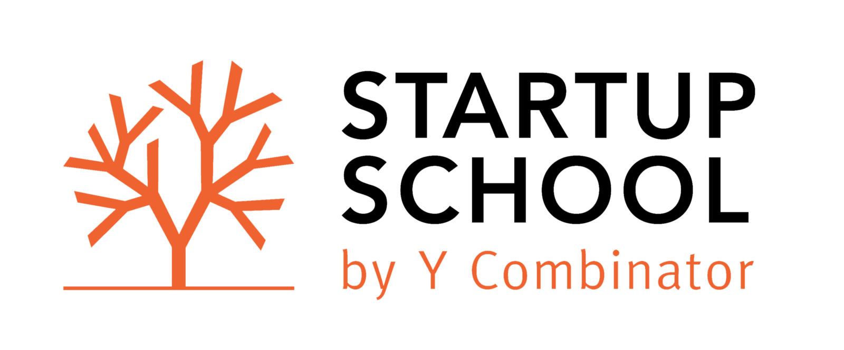


My New Startup: Voicipe
Hands-free voice-controlled recipe reader
Focus on cooking. Reduce Prep-time. No screen locking.
Supports 200+ internet recipe providers
Won 2nd place at Startup Weekend 2016 in San Francisco
10-week online “Startup School” by Y-Combinator
8-week “Idea validation” by DC I-Corps (NSF)

Slide 4
What do I do?
Innovation Specialist
Program Management
Systems Engineering
Strategic Consulting
Cloud Migration
100% System Uptime
Intelligence Community
Departments
Services
Agencies
US
Federal Government

Slide 5
Why am I here?
Speaking at JumpStart conference (to be rescheduled)
  How to Start a Business
  How to Kickstart the Job Search from a Recruiters Perspective
Speak to students: What does my work environment look for?
  ITEC 225 - Web Programming I
  ITEC 325 - Web Programming II
  ITEC 445 - System & DB Security
  ITEC 452 - Distributed Computing
  IT Career Prep Class
  MGMT 250 – Innovation & Entrepreneurship
Recruit rising IT grads for employment
  Opportunity to get a “TS” clearance (Rare & Lucrative!)

Slide 6
Working in the “IC”
Very fulfilling
Security clearance required
  Majority of companies will only hire people that are already “cleared”
  Primarily only large companies will sponsor clearances
  Takes 8+ months
  Lie detector test
No cell phones
Lots of options & job security
Outstanding pay & benefits
  3 to 7 weeks PTO
  3-15% 401k company contribution
  Fully-paid health care
  Education/training/conference allowance
Good work/life balance
  40 hours/week
  Flex-off
  No night/weekend work

Slide 7
What kind of work?
Software Development
Cloud Engineering
Systems Engineering : DevOps!
Network Engineering
Cyber Security
System Administration
Database Administrators
Automated Testing
Project management

Slide 8
Class-Specific Discussion
  Web Programming I
  Web Programming II
    Technologies used
    “Full stack developer”
    How we build systems & web apps
  System & DB Security
    Security = #1
    Deployment process - waterfall
    Vulnerability scanning tools
  Distributed Computing
    $600M AWS contract
    Cloud migration process
    Load balancing for uptime
    Cloud optimization
IT Career Prep Class
  Resume review and feedback
Innovation & Entrepreneurship
  Books:
    Startup Owners Manual
    Lean Startup
    Running Lean
    The Magic of Thinking Big

Slide 9
Q&A
Ask me anything.
What do you want to know more of?
Yes! – Send me your resume!
Michael.McCoy@LTConsultingLLC.net

