Slide 1
ITEC324 Principle of CS III
Chapter 2 (Horstmann’s Book) – Part 1
The Object-Oriented Design Process
Hwajung Lee

Slide 2
Chapter Topics 1
From Problem to Code
Use Cases
Identifying Classes
Identifying Responsibilities
Relationships Between Classes

Slide 3
Chapter Topics 2
CRC Cards
UML Class Diagrams
Sequence Diagrams
State Diagrams
Using javadoc for Design Documentation
Case Study: A Voice Mail System

Slide 4
From Problem to Code
Three Phases:
  Analysis
  Design
  Implementation
Case Study: Voice Mail System

Slide 5
From Problem to Code
1. Analysis Phase
Functional Specification
  Completely defines tasks to be solved
  Free from internal contradictions
  Readable both by domain experts and software developers
  Reviewable by diverse interested parties
  Testable against reality
Artifact
  Use cases

Slide 6
From Problem to Code
2. Design Phase
Goals
  Identify classes
  Identify behavior of classes
  Identify relationships among classes
Artifacts
  Textual description of classes and key methods
  Diagrams of class relationships
  Diagrams of important usage scenarios
  State diagrams for objects with highly state-dependent

Slide 7
From Problem to Code
3. Implementation Phase
Implement and test classes
Combine classes into program
Avoid "big bang" integration
Prototypes can be very useful

Slide 8
1. Anaysis Phase

Slide 9
Use Cases
Analysis technique
Each use case focuses on a specific scenario
Use case = sequence of actions
Action = interaction between actor and computer system
Each action yields a result
Each result has a value to one of the actors
Use variations for exceptional situations

Slide 10
Sample Use Case
Leave a Message
  Caller dials main number of voice mail system
  System speaks prompt
  Enter mailbox number followed by #
  User types extension number
  System speaks
  You have reached mailbox xxxx. Please leave a message now
  Caller speaks message
  Caller hangs up
  System places message in mailbox

Slide 11
Sample Use Case -- Variations
Variation #1
1.1. In step 3, user enters invalid extension number
1.2. Voice mail system speaks
You have typed an invalid mailbox number.
1.3. Continue with step 2.
Variation #2
2.1. After step 4, caller hangs up instead of speaking message
2.3. Voice mail system discards empty message

Slide 12
2. Design Phase

Slide 13
Identifying Classes
Rule of thumb: Look for nouns in problem description
  Mailbox
  Message
  User
  Passcode
  Extension
  Menu
Focus on concepts, not implementation
  MessageQueue stores messages
  Don't worry yet how the queue is implemented

Slide 14
Identifying Classes
Categories of Classes
Tangible Things
Agents
Events and Transactions
Users and Roles
Systems
System interfaces and devices
Foundational Classes

Slide 15
Identifying Responsibilities
Rule of thumb: Look for verbs in problem description
Behavior of MessageQueue:
  Add message to tail
  Remove message from head
  Test whether queue is empty

Slide 16
Identifying Responsibilities
OO Principle: A responsibility must belong to exactly one class
  Example: Add message to mailbox
    Who is responsible: Message or Mailbox?

Slide 17
Class Relationships
Dependency
  "uses"
Aggregation
  "has"
Inheritance
  "is"

Slide 18
Class Relationships
Dependency Relationship 1
C depends on D: Method of C manipulates objects of D
  Example: Mailbox depends on Message
  If C doesn't use D, then C can be developed without knowing about D

Slide 19
Class Relationships
Dependency Relationship 2
Minimize dependency: reduce coupling
Example: Replace
public class Message
{
void print() {System.out.println(text);}
}
with
public String getText()
Removes dependence on System, PrintStream

Slide 20
Class Relationships
Aggregation
Object of a class contains objects of another class
  Example: MessageQueue aggregates Messages
  Example: Mailbox aggregates MessageQueue
Implemented through instance fields

Slide 21
Class Relationships
Aggregation: Multiplicities
1 : 1 or 1 : 0...1 relationship:
public class Mailbox
{
. . .
private Greeting myGreeting;
}
1 : n relationship:
public class MessageQueue
{
. . .
private ArrayList<Message> elements;
}

Slide 22
Class Relationships
Inheritance
More general class = superclass
More specialized class = subclass
Subclass supports all method interfaces of superclass (but implementations may differ)
Subclass may have added methods, added state
Subclass inherits from superclass
  Example: ForwardedMessage inherits from Message
  Example: Greeting does not inherit from Message (Can't store greetings in mailbox)

Slide 23
CRC Cards (1)
Design Technique
CRC = Classes, Responsibilities, Collaborators
Developed by Beck and Cunningham
Use an index card for each class
Class name on top of card
Responsibilities on left
Collaborators on right

Slide 24
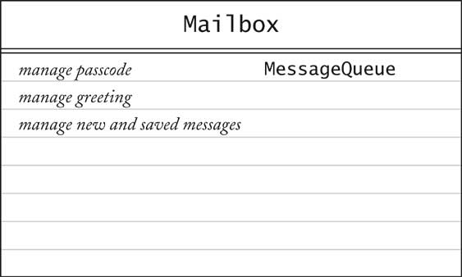
CRC Cards (2)
Responsibilities should be high level
1 - 3 responsibilities per card
Collaborators are for the class, not for each responsibility

Slide 25
Walkthroughs (1)
Use case: "Leave a message"
  Caller connects to voice mail system
  Caller dials extension number
  "Someone" must locate mailbox
  Neither Mailbox nor Message can do this
  New class: MailSystem
    Responsibility: manage mailboxes
Notes:
Since Walkthough is a part of a design phases, we need to think about interaction between classes.
Use Cases are written in an analysis phases. Note that we use the pre-written Use Cases as one of references to tailor our Design.

Slide 26
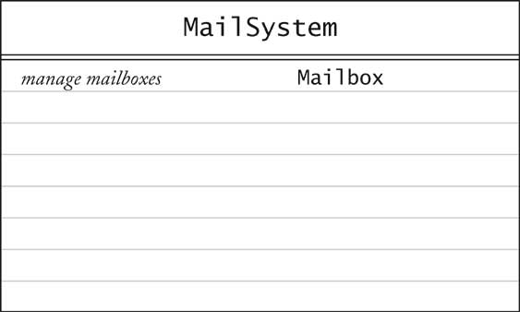
Walkthroughs (2)

Slide 27
UML Diagrams
UML = Unified Modeling Language
Unifies notations developed by the "3 Amigos" Booch, Rumbaugh, Jacobson
Many diagram types
We'll use three types:
  Class Diagrams
  Sequence Diagrams
  State Diagrams

Slide 28
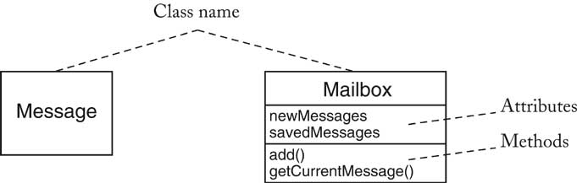
Class Diagrams
Rectangle with class name
Optional compartments
  Attributes
  Methods
Include only key attributes and methods

Slide 29
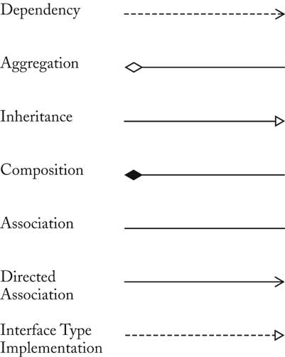
Class Relationships

Slide 30
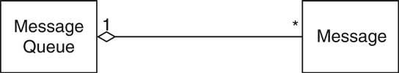
Multiplicities
any number (0 or more): *
one or more: 1..*
zero or one: 0..1
exactly one: 1

Slide 31
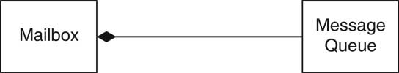
Composition
Special form of aggregation
Contained objects don't exist outside container
Example: message queues permanently contained in mail box

Slide 32
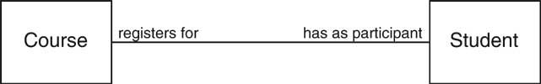
Association (1)
Some designers don't like aggregation
More general association relationship
Association can have roles

Slide 33
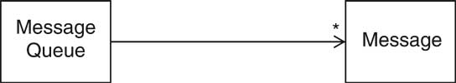
Association (2)
Some associations are bidirectional
Can navigate from either class to the other
  Example: Course has set of students, student has set of courses
Some associations are directed
Navigation is unidirectional
  Example: Message doesn't know about message queue containing it

Slide 34
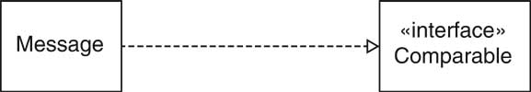
Interface Types
Interface type describes a set of methods
No implementation, no state
Class implements interface if it implements its methods
In UML, use stereotype «interface»

Slide 35
Tips
Use UML to inform, not to impress
Don't draw a single monster diagram
Each diagram must have a specific purpose
Omit inessential details

Slide 36
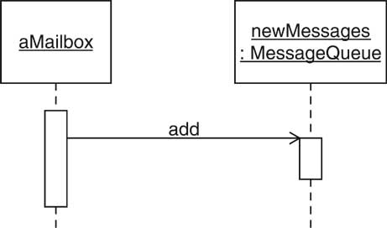
Sequence Diagrams
Each diagram shows dynamics of scenario
Object diagram: class name underlined

Slide 37
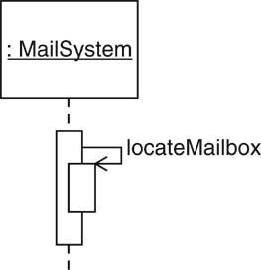
Self call

Slide 38
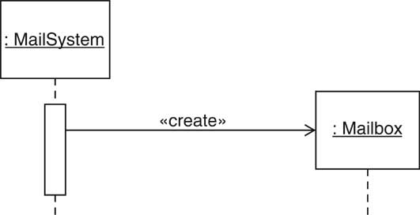
Object Construction

Slide 39
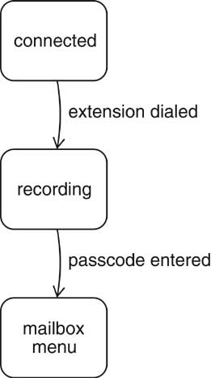
State Diagram
Use for classes whose objects have interesting states

Slide 40
3. Implementation Phase

Slide 41
Design Documentation (1)
Recommendation: Use Javadoc comments
Leave methods blank
/**
Adds a message to the end of the new messages.
@param aMessage a message
*/
public void addMessage(Message aMessage)
{
}
Don't compile file, just run Javadoc
Makes a good starting point for code later

Slide 42
Design Documentation (2)
Please refer details on javadoc in page 6~9 of chapter 1 (Horstmann’s book)
Ch1/helloworld/Greeter.java (page 6)

Slide 43
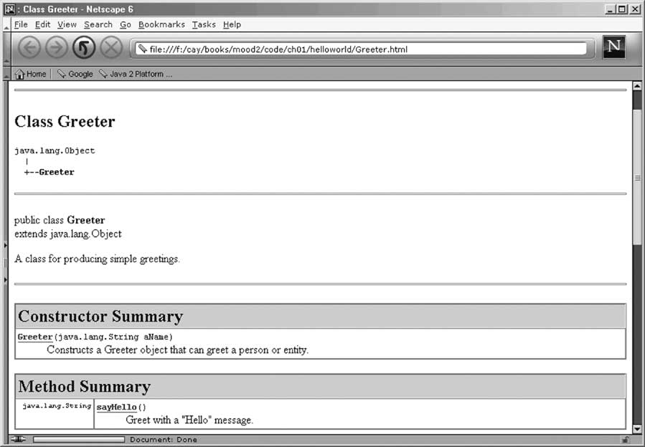
Design Documentation (3)

Slide 44
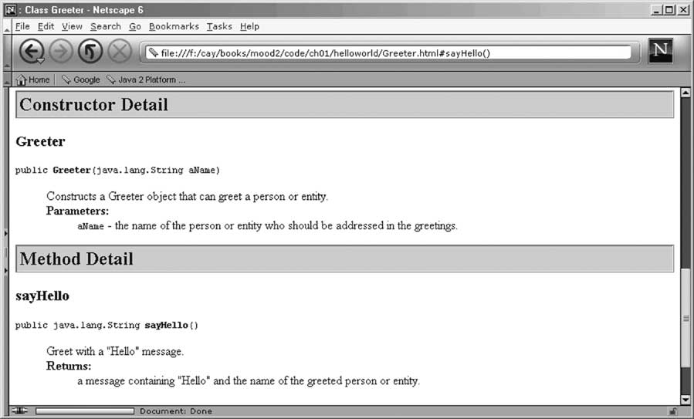
Design Documentation (4)

