Slide 1
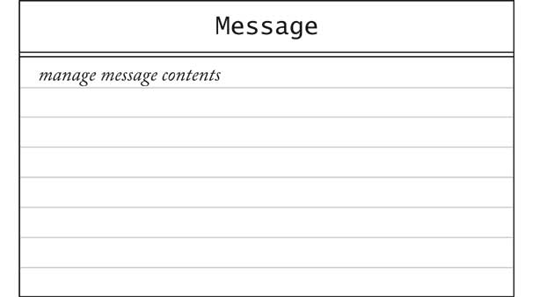
CRC Card: Message

Slide 2
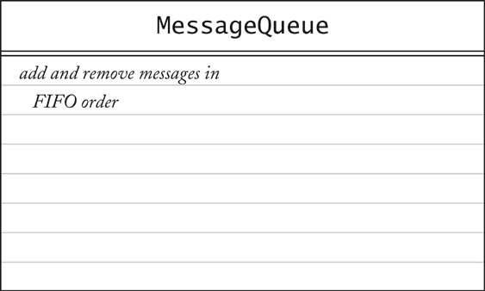
CRC Cards: MessageQueue

Slide 3
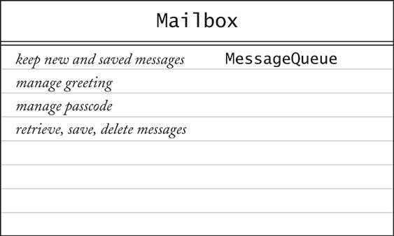
CRC Card: Mailbox

Slide 4
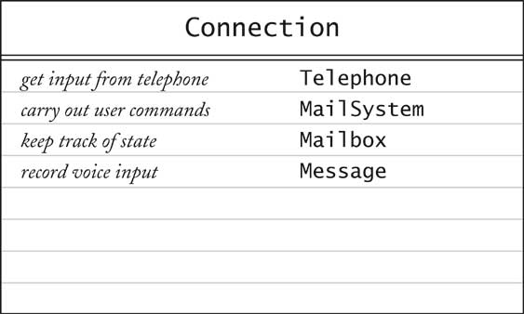
CRC Card: Connection

Slide 5
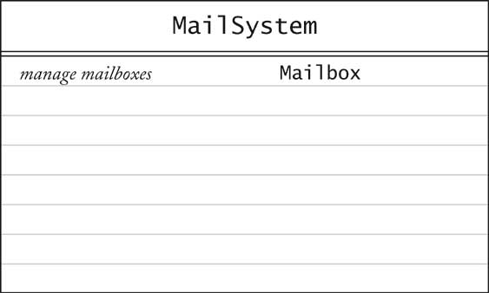
CRC Cards: MailSystem

Slide 6
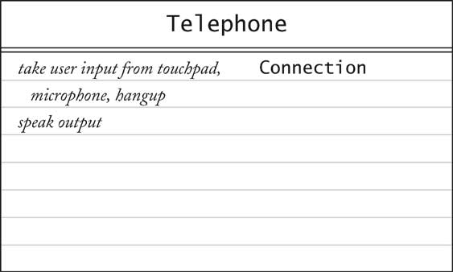
CRC Card: Telephone

