Slide 1
ITEC324 Principle of CS III
Chapter 2 (Horstmann’s Book) Implementing Connection Class
Hwajung Lee

Slide 2
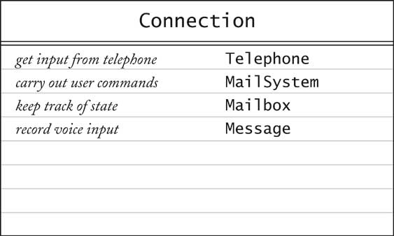
Result of Use Case Analysis

Slide 3
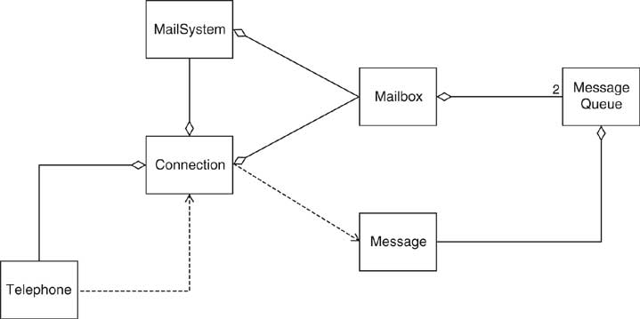
UML Class Diagram for Voice Mail System

Slide 4
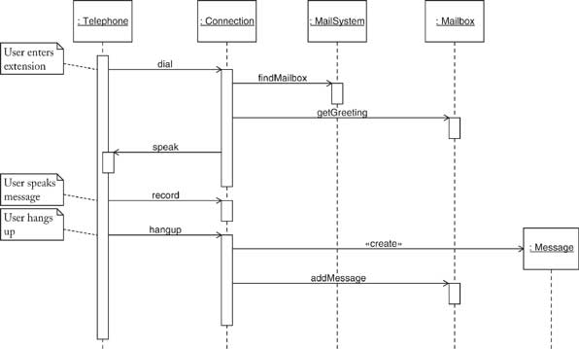
Sequence Diagram for Use Case: Leave a message

Slide 5
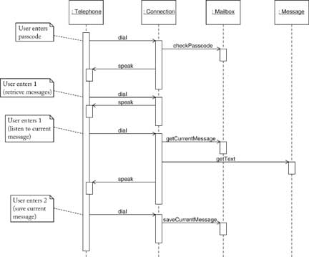
Sequence Diagram for Use Case: Retrieve messages

Slide 6
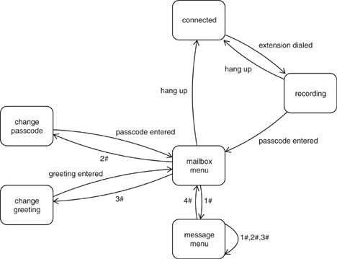
Connection State Diagram

