Slide 1
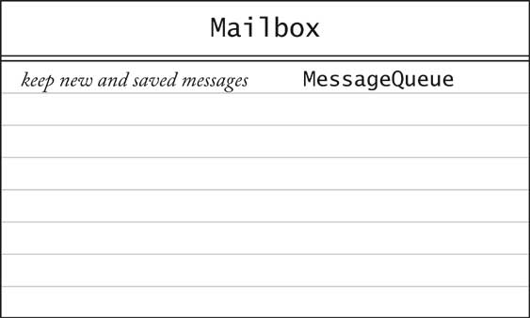
Initial CRC Cards: Mailbox

Slide 2
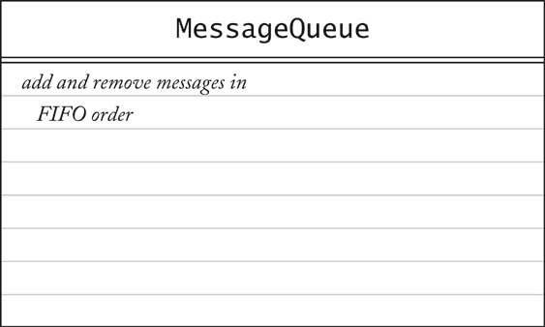
Initial CRC Cards: MessageQueue

Slide 3
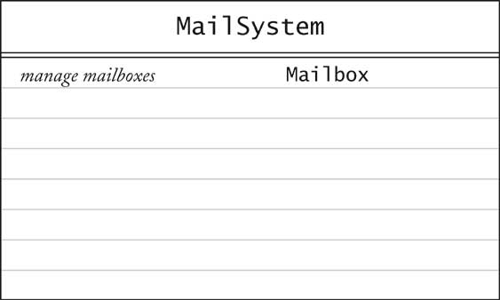
Initial CRC Cards: MailSystem

Slide 4
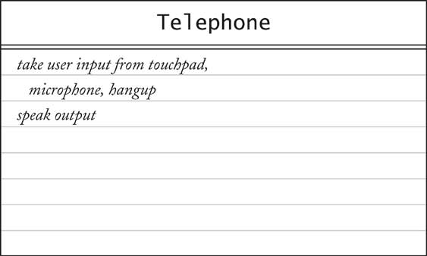
Initial CRC Cards: Telephone

Slide 5
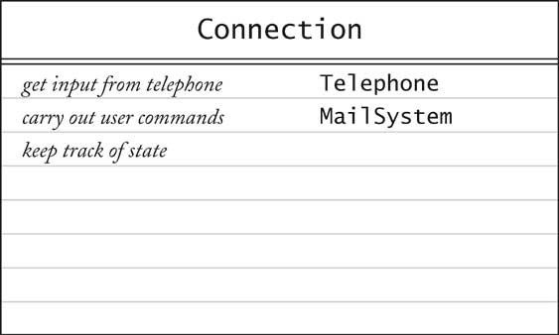
Initial CRC Cards: Connection

