Slide 1

Lecture 1
Overview of Communication Networks and Services

Slide 2

What is Computer Networks?
A collection of autonomous computers interconnected by a single or multiple technologies
  Interconnected via:
    Copper wire
    Fiber optics
    Microwaves
    Infrared
    Communication satellites, etc.

Slide 3
Services & Applications
Service: Basic information transfer capability
  Internet transfer of individual block of information
  Internet reliable transfer of a stream of bytes
  Real-time transfer of a voice signal
Applications build on communication services
  E-mail & web build on reliable stream service
  Fax and modems build on basic telephone service
New applications build on multiple networks
  SMS builds on Internet reliable stream service and cellular telephone text messaging

Slide 4
What is a protocol?
Communications between computers requires very specific unambiguous rules
A protocol is a set of rules that governs how two or more communicating parties are to interact
  Internet Protocol (IP)
  Transmission Control Protocol (TCP)
  HyperText Transfer Protocol (HTTP)
  Simple Mail Transfer Protocol (SMTP)

Slide 5
What is a communication network?
The equipment (hardware & software) and facilities that provide the basic communication service
Virtually invisible to the user; Usually represented by a cloud
Equipment
  Routers, servers, switches, multiplexers, hubs, modems, …
Facilities
  Copper wires, coaxial cables, optical fiber
  Ducts, conduits, telephone poles …
How are communication networks designed and operated?

Slide 6
OSI Reference Model
Application
Application
Layer
Presentation
Layer
Session
Layer
Transport
Layer
Network
Layer
Data Link
Layer
Physical
Layer

Slide 7
OSI Reference Model & TCP/IP Protocol Stack
OSI 7 Layers
TCP/IP Protocol
Application
Application
Application
Layer
Application
Layer
Presentation
Layer
Session
Layer
Transport
Layer
TCP
UDP
Network
Layer
IP Layer
Data Link
Layer
Network
Interface
Layer
Physical
Layer

Slide 8
Communication Network Architecture
Network architecture: the plan that specifies how the network is built and operated
Architecture is driven by the network services
Overall communication process is complex
Network architecture partitions overall communication process into separate functional areas called layers
Next we will trace evolution of three network architectures: telegraph, telephone, and computer networks

Slide 9
Network Architecture Evolution
Telegraph Networks
  Message switching & digital transmission
Telephone Networks
  Circuit Switching
  Analog transmission → digital transmission
  Mobile communications
Internet
  Packet switching & computer applications
Next-Generation Internet
  Multiservice packet switching network

Slide 10
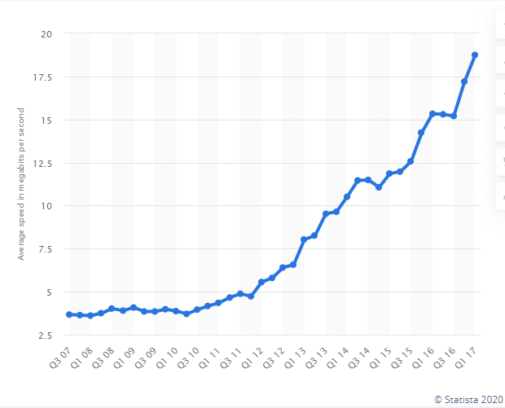
Network Architecture Evolution
?
Information transfer
per second (bits/second)
Telegraph
networks
Next
Generation
Internet
Telephone
networks
Internet, Optical
& Wireless
networks
[Source] https://www.statista.com/statistics/616210/average-internet-connection-speed-in-the-us/
    https://ourworldindata.org/internet

Slide 11
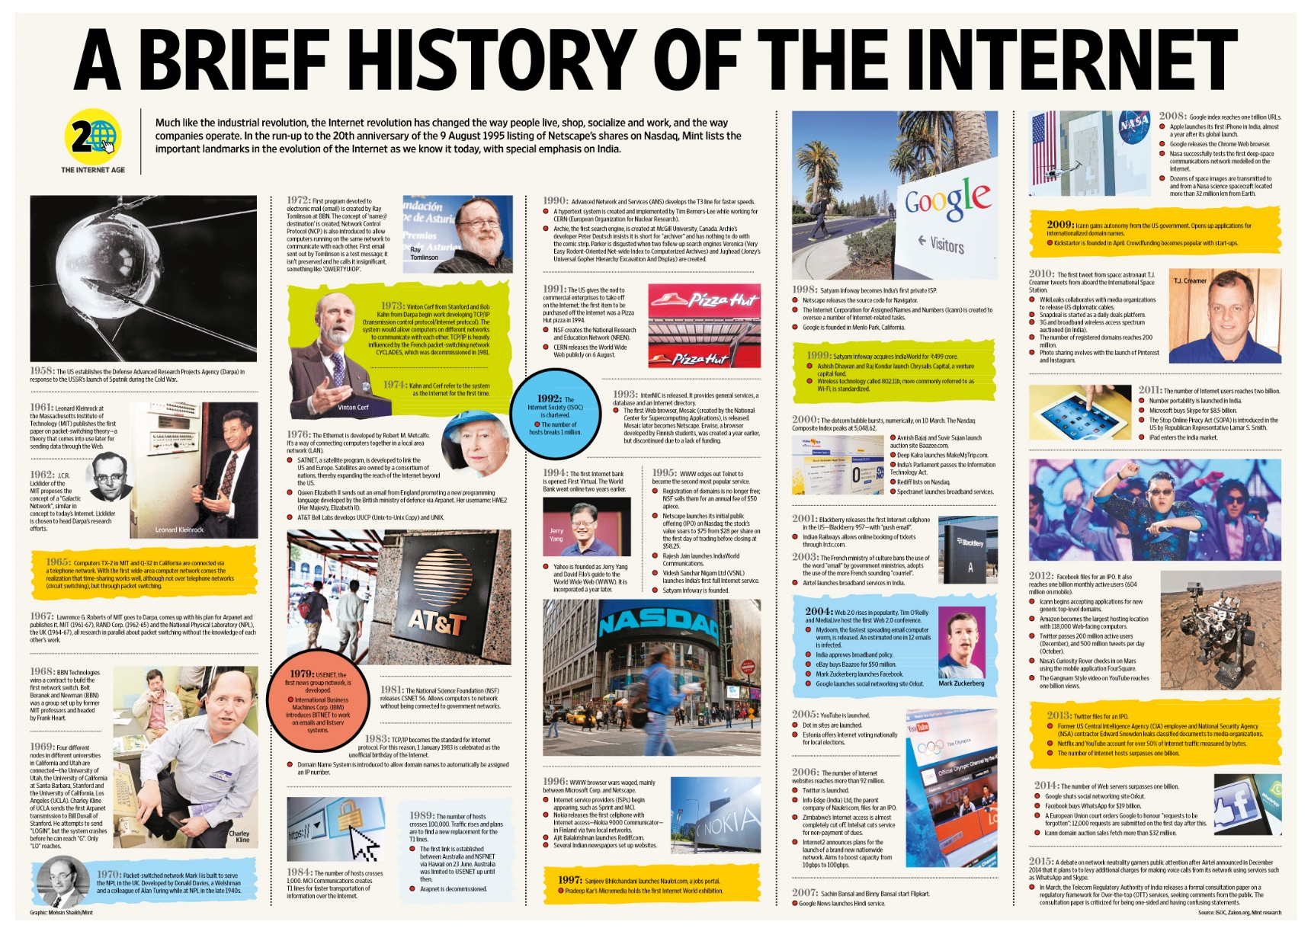
Brief History of the Internet
[Source] https://www.dugcampbell.com/history-of-the-internet/

Slide 12
Brief History of the Internet

Slide 13
Brief History of the Internet

Slide 14
Brief History of the Internet

Slide 15
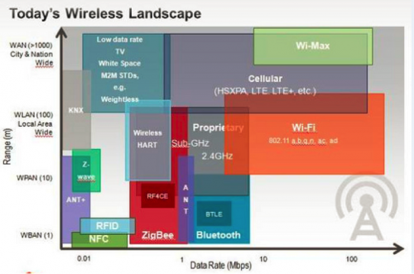
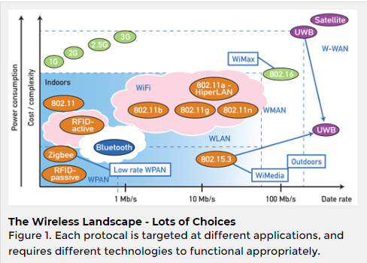
Wireless Communication Landscape
[Source] https://gblogs.cisco.com/uki/wireless-wireless-everywhere/
[Source] https://www.controlglobal.com/articles/2013/verhappen-wireless/

Slide 16
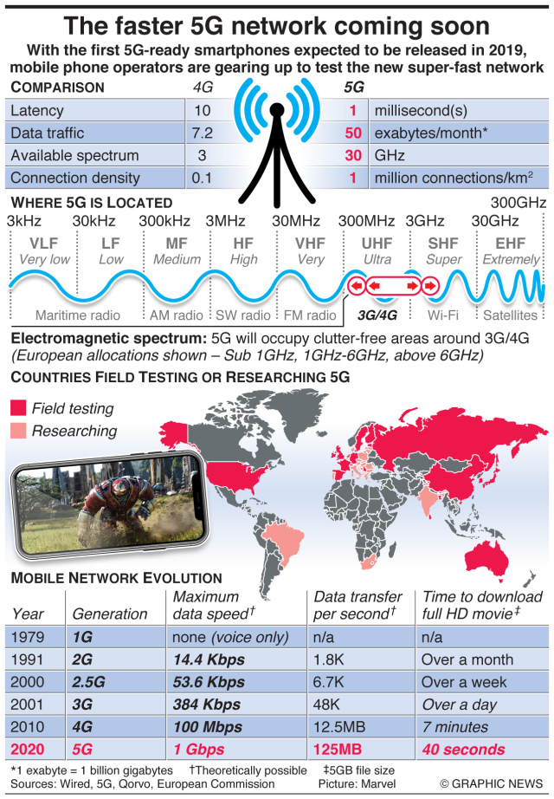
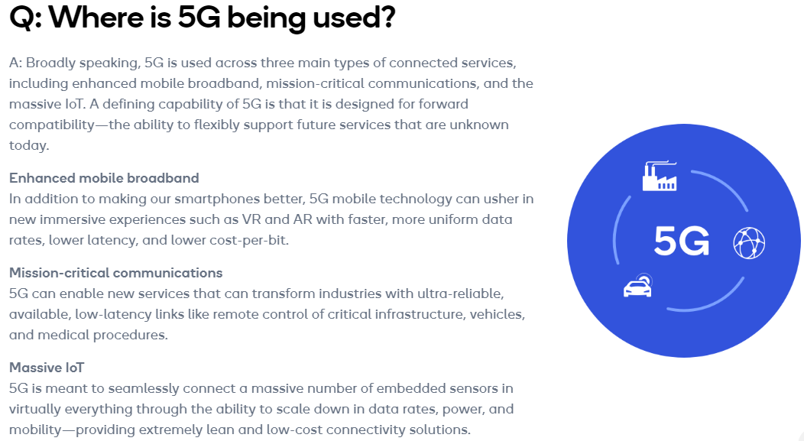
5G Network
[Source] https://www.qualcomm.com/invention/5g/what-is-5g#:~:text=A%3A%205G%20is%20the%205th,machines%2C%20objects%2C%20and%20devices.
[Source] https://engtechmag.files.wordpress.co/2018/09/gn38319c_en.jpg

Slide 17
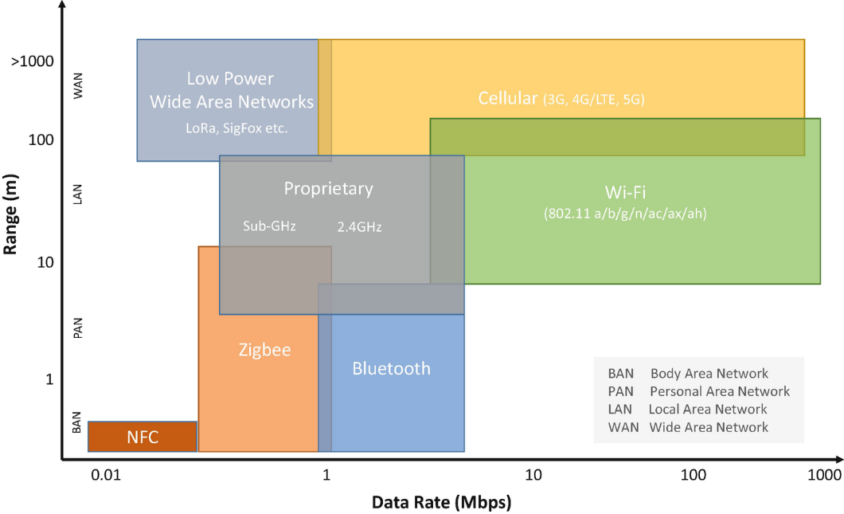
5G Network
[Source] https://link.springer.com/chapter/10.1007/978-1-4842-2896-8_5 (August 14, 2019)

Slide 18
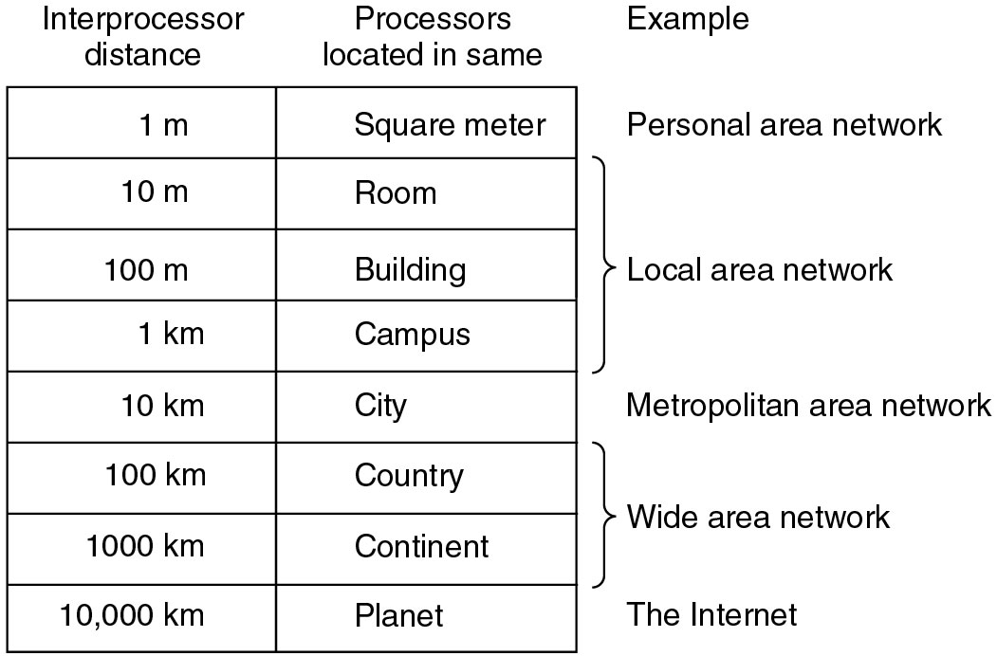
Classification of interconnected processors by scale.

Slide 19
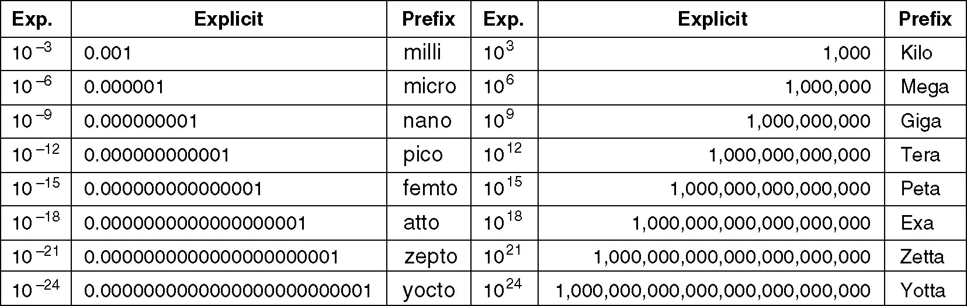
Metric Units
The principal metric prefixes.

Slide 20
Ethernet Local Area Network
In 1980s, affordable workstations available
Need for low-cost, high-speed networks
  To interconnect local workstations
  To access local shared resources (printers, storage, servers)
Low cost, high-speed communications with low error rate possible using coaxial cable
Ethernet is the standard for high-speed wired access to computer networks

Slide 21
Ethernet Medium Access Control
Network interface card (NIC) connects workstation to LAN
Each NIC has globally unique address
Frames are broadcast into coaxial cable
NICs listen to medium for frames with their address
Transmitting NICs listen for collisions with other stations, and abort and reschedule retransmissions
Transceivers

Slide 22
The Internet
Different network types emerged for data transfer between computers
Each network has its protocols and is possibly built on different technologies
Internetworking protocols required to enable communications between computers attached to different networks
Internet: a network of networks

Slide 23

Internet Protocol (IP)
Routers (gateways) interconnect different networks
Host computers prepare IP packets and transmit them over their attached network
Routers forward IP packets across networks
Best-effort IP transfer service, no retransmission
Net 1
Net 2
Router

Slide 24
Names and IP Addresses
Routing is done based on 32-bit IP addresses
Dotted-decimal notation
  128.100.11.1
Hosts are also identified by name
  Easier to remember
  Hierarchical name structure
  tesla.comm.utoronto.edu
Domain Name System (DNS) provided conversion between names and addresses

Slide 25
Internet Applications
All Internet applications run on TCP or UDP
TCP: HTTP (web); SMTP (e-mail); FTP (file transfer; telnet (remote terminal)
UDP: DNS, RTP (voice & multimedia)
TCP & UDP incorporated into computer operating systems
Any application designed to operate over TCP or UDP will run over the Internet!!!

Slide 26
Standards
New technologies very costly and risky
Standards allow players to share risk and benefits of a new market
  Reduced cost of entry
  Interoperability and network effect
  Compete on innovation
  Completing the value chain
    Chips, systems, equipment vendors, service providers
Example
  802.11 wireless LAN products

Slide 27
Standards Bodies
Internet Engineering Task Force
  Internet standards development
  Request for Comments (RFCs): www.ietf.org
International Telecommunications Union
  International telecom standards
IEEE 802 Committee
  Local area and metropolitan area network standards
  https://en.wikipedia.org/wiki/IEEE_802 (As of February 2019)
Industry Organizations
  MPLS Forum, WiFi Alliance, World Wide Web Consortium

