Slide 1

Lecture 2-2
Domain Name System

Slide 2

Domain Name System (DNS)
Developed by Postel & Mockapetris
www.internic.net is a good site to browse
The phone book of the internet
  But more restrictive … Each entry must be
    Unique
    Authentic
  Universal Resolvability is ensured
  Distributed Database

Slide 3
History of DNS
Early Internet had no Domain Name System – Just HOSTS file
  Win: C:\WINNT\system32\drivers\etc\HOSTS
  Unix/Linux: /etc/hosts
Ancient History: Before DNS,
  The master HOSTS file was maintained by SRI International
  Periodically, every computer in the internet reloaded HOSTS file
~1984 someone realized that millions of computers and domains needed a central database – DNS was born
Still, when a host needs to translate yahoo.com,
  First, HOSTS file is scanned
  Then DNS is used.

Slide 4
DNS Tree

Slide 5
Basic DNS Registry Structure

Slide 6
DNS
13 Identical Root Servers
  All Top Level Domain (TLD) Registries
  Database for each TLD
    .com .org .edu .biz …. (gTLDs)
    .fr .ca etc. country-specific TLDs, or ccTLDs
Root Servers are
  Authoritative
  Maintained by ICANN, www.icann.org
  (International Corporation for Assigned Names and Numbers)

Slide 7
Map of the Root DNS Servers
Click here to see the exact location of Root Servers ( http://www.root-servers.org/ )

Slide 8
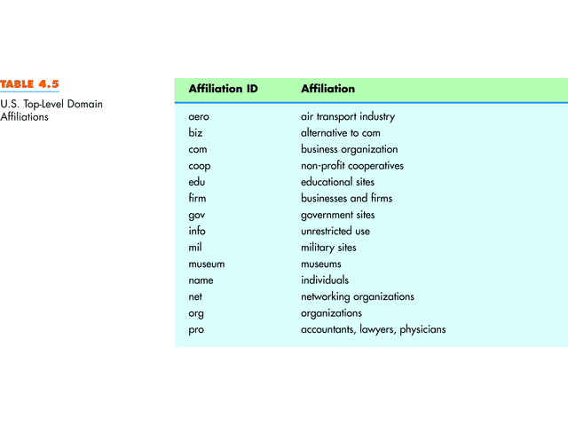
U.S. Top Level Domains

Slide 9
Domain Names
Hierarchical, right to left
  nth level ……. Top Level Domain (Label)
  yadda.yadda.yadda.yadda……….edu
TLD, or Label may be up to 63 chars long
Total length of name must be <= 255 chars
Total length <= 127 labels
DNS Names are either
  Relative (newriver)
  Fully qualified (newriver.radford.edu, an actual host or server)

Slide 10
DNS Zones
The root zone.
.edu
radford.edu
Network Lab in DA214

Slide 11
DNS Servers
Each DNS zone has
  A domain name
  At least a primary server
  Probably a secondary server as well
A computer that maintains a single master list of DNS Names and IP Addresses for a zone
  Has Authority for that Zone
  Is known as the primary server for the zone

Slide 12
Address “Translation”
Domain Name System (DNS)
  Given a Domain Name (e.g., yahoo.com), lookup the IP address.
  Command nslookup <somedomain.com> returns:
    DNS Server name & IP addr
    IP address(es) of the domain
Microsoft Windows 2000 [Version 5.00.2195]
(C) Copyright 1985-2000 Microsoft Corp.
H:\>nslookup yahoo.com
Server: newriver.radford.edu
Address: 137.45.26.19
Non-authoritative answer:
Name: yahoo.com
Addresses: 64.58.79.230, 66.218.71.198

Slide 13

nslookup – DNS Translation
Manual Page for nslookup can be found at
http://cr.yp.to/djbdns/intro-dns.html
http://www.kloth.net/services/nslookup-man.php
It is for Unix shell, but most operation is same for WIN2K or up.
The command nslookup allows DNS translation to a DOS cmd window.

Slide 14
nslookup
H:\>nslookup
Default Server: newriver.radford.edu
Address: 137.45.26.19
> ?
Commands: (identifiers are shown in uppercase, [] means optional)
NAME - print info about the host/domain NAME using default server
NAME1 NAME2 - as above, but use NAME2 as server
help or ? - print info on common commands
set OPTION - set an option
all - print options, current server and host
[no]debug - print debugging information
[no]d2 - print exhaustive debugging information
[no]defname - append domain name to each query
[no]recurse - ask for recursive answer to query
[no]search - use domain search list
[no]vc - always use a virtual circuit
domain=NAME - set default domain name to NAME
srchlist=N1[/N2/.../N6] - set domain to N1 and search list to N1,N2, etc.
root=NAME - set root server to NAME
retry=X - set number of retries to X
timeout=X - set initial time-out interval to X seconds
type=X - set query type (ex. A,ANY,CNAME,MX,NS,PTR,SOA,SRV)
querytype=X - same as type
class=X - set query class (ex. IN (Internet), ANY)
[no]msxfr - use MS fast zone transfer
ixfrver=X - current version to use in IXFR transfer request
server NAME - set default server to NAME, using current default server
lserver NAME - set default server to NAME, using initial server
finger [USER] - finger the optional NAME at the current default host
root - set current default server to the root
ls [opt] DOMAIN [> FILE] - list addresses in DOMAIN (optional: output to FILE)
-a - list canonical names and aliases
-d - list all records
-t TYPE - list records of the given type (e.g. A,CNAME,MX,NS,PTR etc.)
view FILE - sort an 'ls' output file and view it with pg
exit - exit the program

Slide 15



.arpa
An explicit way to signal for reverse translation
http://cr.yp.to/djbdns/dot-arpa.html
Reverse lookups
http://cr.yp.to/djbdns/intro-dns.html#reverse
Notes:
.arpa (Address and Routing Parameter Area)

Slide 16
Domain Name System (DNS)
DNS Request Message
“The host name is rucs.radford.edu”
Originating
Host
DNS
Server

Slide 17
Domain Name System (DNS)
DNS Table
Host Name
…
…
rucs.radford.edu
…
IP Address
…
…
137.45.192.100
…
DNS Response Message
“The IP address is 137.45.192.100”
Originating
Host
DNS
Server

Slide 18
(Example) Nslookup
Server newriver.radford.edu
  Not authoritative for yahoo.com
  Authoritative for neelix
    Relative form used
C:\>nslookup yahoo.com
Server: newriver.radford.edu
Address: 137.45.26.19
Non-authoritative answer:
Name: yahoo.com
Addresses: 64.58.79.230, 66.218.71.198
C:\>nslookup neelix
Server: newriver.radford.edu
Address: 137.45.26.19
Name: neelix.RADFORD.EDU
Addresses: 137.45.192.213, 137.45.192.215

Slide 19
Application (Host Process) Interfaces
Given a domain Name there are several methods of resolution
  Host table lookup (on Unix, /etc/hosts is a text file )
  Local name server process (on Unix, named)
  Send msg to a DNS primary or secondary server

