Slide 1

Lecture 8
Network Security Basics
Symmetric Key Cryptography
Asymmetric Key Cryptography
Public Key Cryptography
RSA

Slide 2
Network Security
Foundations:
what is security?
cryptography
authentication
message integrity
key distribution and certification
Security in practice:
application layer: secure e-mail
transport layer: Internet commerce, SSL, SET
network layer: IP security

Slide 3
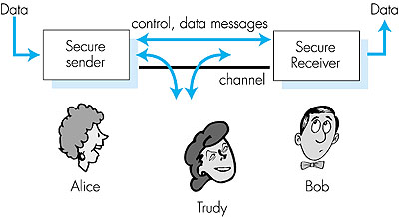
Friends and Enemies: Alice, Bob, Trudy
Figure 7.1 goes here
Well-known in network security world
Bob, Alice (lovers!) want to communicate “securely”
Trudy, the “intruder” may intercept, delete, add messages

Slide 4
What is network security?
Secrecy: only sender, intended receiver should “understand” msg contents
  sender encrypts msg
  receiver decrypts msg
Authentication: sender, receiver want to confirm identity of each other
Message Integrity: sender, receiver want to ensure message not altered (in transit, or afterwards) without detection

Slide 5
Internet security threats
Packet sniffing:
  broadcast media
  promiscuous NIC reads all packets passing by
  can read all unencrypted data (e.g. passwords)
  e.g.: C sniffs B’s packets
A
C
src:B dest:A payload
B

Slide 6
Internet security threats
IP Spoofing:
  can generate “raw” IP packets directly from application, putting any value into IP source address field
  receiver can’t tell if source is spoofed
  e.g.: C pretends to be B
A
C
src:B dest:A payload
B

Slide 7
Internet security threats
Denial of service (DOS):
  flood of maliciously generated packets “swamp” receiver
  Distributed DOS (DDOS): multiple coordinated sources swamp receiver
  e.g., C and remote host SYN-attack A
A
C
SYN
SYN
SYN
SYN
SYN
B
SYN
SYN

Slide 8
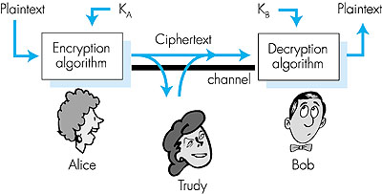
The language of cryptography
plaintext
K
K
plaintext
A
B
ciphertext
Figure 7.3 goes here
Symmetric key crypto: sender, receiver keys identical
Asymmetric key crypto: sender key ≠ receiver key
  (ex) public-key crypto - encrypt key public, decrypt key secret

Slide 9
Symmetric key cryptography
Substitution Cipher: substituting one thing for another
  monoalphabetic cipher: substitute one letter for another
plaintext: abcdefghijklmnopqrstuvwxyz
ciphertext: mnbvcxzasdfghjklpoiuytrewq
E.g.:
Plaintext: bob. i love you. alice
ciphertext: nkn. s gktc wky. mgsbc
How hard to break this simple cipher?:
  brute force (how hard?)
  other?

Slide 10
Symmetric key cryptography
DES: Data Encryption Standard
US encryption standard [NIST]
56-bit symmetric key, 64 bit plaintext input
How secure is DES?
  DES Challenge: 56-bit-key-encrypted phrase (“Strong cryptography makes the world a safer place”) decrypted (brute force) in 4 months
  no known “backdoor” decryption approach
making DES more secure
  use three keys sequentially (3-DES) on each datum
  use cipher-block chaining
➔ AES: Advanced Encryption Standard [NIST]
Notes:
the U.S. National Institute of Standards and Technology (NIST)

Slide 11
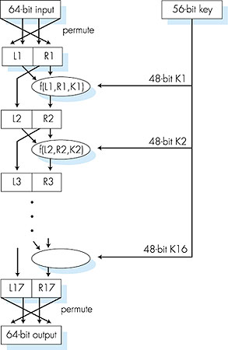
Symmetric key crypto : DES
DES operation
initial permutation
16 identical “rounds” of function application, each using different 48 bits of key
final permutation
➔ AES (Advanced Encryption Standard)

Slide 12
Public Key Cryptography
symmetric key crypto
requires sender, receiver know shared secret key
Q: how to agree on key in first place (particularly if never “met”)?
public key cryptography
radically different approach [Diffie-Hellman76, RSA78]
sender, receiver do not share secret key
encryption key public (known to all)
decryption key private (known only to receiver)

Slide 13
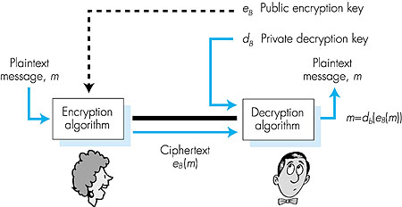
Public key cryptography
Figure 7.7 goes here

Slide 14
Public key encryption algorithms
Two inter-related requirements:
.
.
1
need d ( ) and e ( ) such that
B
B
d (e (m)) = m
B
B
2
need public and private keys
for d ( ) and e ( )
.
.
B
B
RSA: Rivest, Shamir, Adelson algorithm

Slide 15
RSA: Choosing keys
1. Choose two large prime numbers p, q.
(e.g., 1024 bits each)
2. Compute n = pq, z = (p-1)(q-1)
3. Choose e (with e<n) that has no common factors
with z. (e, z are “relatively prime”).
4. Choose d such that ed-1 is exactly divisible by z.
(in other words: ed mod z = 1 ).
5. Public key is (n,e). Private key is (n,d).

Slide 16
RSA: Encryption, Decryption
0. Given (n,e) and (n,d) as computed above
1. To encrypt bit pattern, m, compute
e
e
c = m mod n
(i.e., remainder when m is divided by n)
2. To decrypt received bit pattern, c, compute
d
d
m = c mod n
(i.e., remainder when c is divided by n)
Magic
happens!
e
d
m = (m mod n)
mod n

Slide 17
RSA example
Bob chooses p = 5, q = 7. Then n = 35, z = 24.
e = 5 (so e and z are relatively prime).
d = 29 (so ed - 1 exactly divisible by z).
m
e
e
letter
m
c = m mod n
encrypt:
l
12
248832
17
d
d
c
c
m = c mod n
letter
decrypt:
17
481968572106750915091411825223072000
12
l

Slide 18
RSA: Why?
e
d
m = (m mod n)
mod n
Number theory result: If p,q prime, n = pq, then
y
y mod (p -1)(q -1)
x mod n = x mod n
e
d
ed
(m mod n)
mod n = m mod n
ed mod (p -1)(q -1)
= m mod n
(using number theory result above)
1
= m mod n
(since we chose ed to be divisible by
(p -1)(q -1) with remainder 1 )
= m

Slide 19
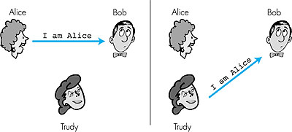
Authentication
Goal: Bob wants Alice to “prove” her identity to him
Protocol ap1.0: Alice says “I am Alice”
Failure scenario??

Slide 20
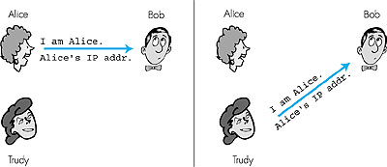
Authentication: another try
Protocol ap2.0: Alice says “I am Alice” and sends her IP
address along to “prove” it.
Failure scenario??

Slide 21
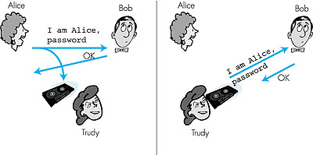
Authentication: another try
Protocol ap3.0: Alice says “I am Alice” and sends her
secret password to “prove” it.
Failure scenario?

Slide 22
Authentication: yet another try
Protocol ap3.1: Alice says “I am Alice” and sends her
encrypted secret password to “prove” it.
I am Alice
encrypt(password)
Failure scenario?

Slide 23

Authentication: yet another try
Goal: avoid playback attack
Nonce: number (R) used only once in a lifetime
ap4.0: to prove Alice “live”, Bob sends Alice nonce, R. Alice
must return R, encrypted with shared secret key
Figure 7.11 goes here
Failures, drawbacks?

Slide 24
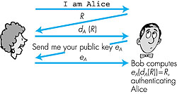
Authentication: ap5.0
ap4.0 requires shared symmetric key
  problem: how do Bob, Alice agree on key
  can we authenticate using public key techniques?
ap5.0: use nonce, public key cryptography
Figure 7.12 goes here

Slide 25
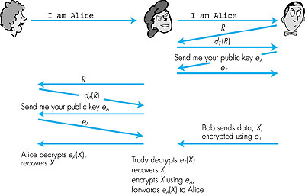
ap5.0: security hole
Man (woman) in the middle attack: Trudy poses as Alice (to Bob) and as Bob (to Alice)
Figure 7.14 goes here
Need “certified” public
keys (more later …)

Slide 26
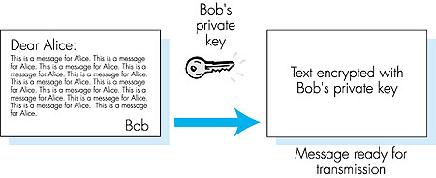
Digital Signatures
Cryptographic technique analogous to hand-written signatures.
Sender (Bob) digitally signs document, establishing he is document owner/creator.
Verifiable, nonforgeable: recipient (Alice) can verify that Bob, and no one else, signed document.
Simple digital signature for message m:
Bob encrypts m with his public key d_{B}, creating signed message, d_{B}(m).
Bob sends m and d_{B}(m) to Alice.

Slide 27
Digital Signatures (more)
Suppose Alice receives msg m, and digital signature d_{B}(m)
Alice verifies m signed by Bob by applying Bob’s public key e_{B} to d_{B}(m) then checks e_{B}(d_{B}(m) ) = m.
If e_{B}(d_{B}(m) ) = m, whoever signed m must have used Bob’s private key.
Alice thus verifies that:
  Bob signed m.
  No one else signed m.
  Bob signed m and not m’.
Non-repudiation:
  Alice can take m, and signature d_{B}(m) to court and prove that Bob signed m.

