Slide 1

Lecture 4
Peer-to-Peer Protocols and Data Link Layer
ARQ Protocols and Reliable Data Transfer
Flow Control

Slide 2

Lecture 4
Peer-to-Peer Protocols and Data Link Layer
ARQ Protocols and Reliable Data Transfer

Slide 3
Peer-to-Peer Protocols
many protocols involve the interaction between two peers
  Service Models are discussed & examples given
  Detailed discussion of ARQ provides example of development of peer-to-peer protocols
  Flow control

Slide 4
Automatic Repeat Request (ARQ)
Purpose: to ensure a sequence of information packets is delivered in order and without errors or duplications despite transmission errors & losses
We will look at:
  Stop-and-Wait ARQ
  Go-Back N ARQ
  Selective Repeat ARQ
Basic elements of ARQ:
  Error-detecting code with high error coverage
  ACKs (positive acknowledgments)
  NAKs (negative acknowlegments)
  Timeout mechanism

Slide 5
Stop-and-Wait ARQ
Transmit a frame, wait for ACK
Packet
Error-free
packet
Information frame
Transmitter
(Process A)
Receiver
(Process B)
Timer set after each frame transmission
Control frame
Header
CRC
Information
packet
Header
CRC
Information frame
Control frame: ACKs

Slide 6
Need for Sequence Numbers
(a) Frame 1 lost
Time-out
Time
A
Frame
0
Frame
1
Frame
1
Frame
2
B
ACK
ACK
(b) ACK lost
Time-out
Time
A
Frame
0
Frame
1
Frame
1
Frame
2
ACK
ACK
ACK
B
  In cases (a) & (b) the transmitting station A acts the same way
  But in case (b) the receiving station B accepts frame 1 twice
  Question: How is the receiver to know the second frame is also frame 1?
  Answer: Add frame sequence number in header
  S_{last} is sequence number of most recent transmitted frame

Slide 7
Sequence Numbers
(c) Premature Time-out
Time-out
Time
A
Frame
0
Frame
0
Frame
1
Frame
2
ACK
ACK
B
  The transmitting station A misinterprets duplicate ACKs
  Incorrectly assumes second ACK acknowledges Frame 1
  Question: How is the receiver to know second ACK is for frame 0?
  Answer: Add frame sequence number in ACK header
  R_{next} is sequence number of next frame expected by the receiver
  Implicitly acknowledges receipt of all prior frames

Slide 8
Stop-and-Wait ARQ
Transmitter
Ready state
Await request from higher layer for packet transfer
When request arrives, transmit frame with updated S_{last} and CRC
Go to Wait State
Wait state
Wait for ACK or timer to expire; block requests from higher layer
If timeout expires
  retransmit frame and reset timer
If ACK received:
  If sequence number is incorrect or if errors detected: ignore ACK
  If sequence number is correct (R_{next} = S_{last} +1): accept frame, go to Ready state
Receiver
Always in Ready State
Wait for arrival of new frame
When frame arrives, check for errors
If no errors detected and sequence number is correct (S_{last}=R_{next}), then
  accept frame,
  update R_{next},
  send ACK frame with R_{next},
  deliver packet to higher layer
If no errors detected and wrong sequence number
  accept frame
  send ACK frame with R_{next}
If errors detected
  discard frame

Slide 9
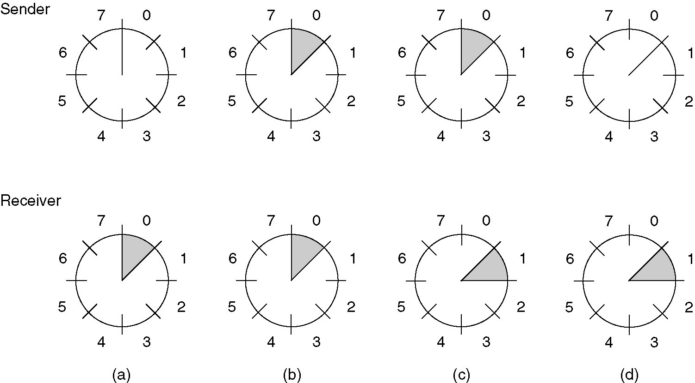
Sliding Window Protocols
Suppose that a sliding window of size is 1, with a 3-bit sequence number.
(a) Initially.
(b) After the first frame has been sent.
(c) After the first frame has been received.
(d) After the first acknowledgement has been received.

Slide 10
Practice on Slide Window Protocols
Draw a series of buffers at a sender and a receiver which illustrates the following (a), (b), (c), and (d).
Suppose that a sliding window of size is has a 3-bit sequence number. Thus, each of them has 8 buffers.
  (a) Initially. The receiver knows that the sender will send a data.
  (b) After the first frame has been sent.
  (c) After the first frame has been received & the ACK has been sent by the receiver.
  (d) After the first acknowledgement has been received.

Slide 11
Stop-and-Wait Efficiency
Last frame bit enters channel
ACK arrives
First frame bit enters channel
Channel idle while transmitter waits for ACK
t
A
B
t
First frame bit arrives at receiver
Receiver processes frame and
prepares ACK
Last frame bit arrives at receiver
10000 bit frame @ 1 Mbps takes 10 ms to transmit
If wait for ACK = 1 ms, then efficiency = 10/11= 91%
If wait for ACK = 20 ms, then efficiency =10/30 = 33%

Slide 12
Applications of Stop-and-Wait ARQ
IBM Binary Synchronous Communications protocol (Bisync): character-oriented data link control
Xmodem: modem file transfer protocol
Trivial File Transfer Protocol (RFC 1350): simple protocol for file transfer over UDP

Slide 13
Go-Back-N
Improve Stop-and-Wait by not waiting!
Keep channel busy by continuing to send frames
Allow a window of up to W_{s} outstanding frames
Use m-bit sequence numbering
If ACK for oldest frame arrives before window is exhausted, we can continue transmitting
If window is exhausted, pull back and retransmit all outstanding frames
Alternative: Use timeout

Slide 14
Go-Back-N ARQ
Go-Back-4:
4 frames are outstanding; so go back 4
fr
0
fr
1
fr
2
fr
3
fr
4
fr
5
fr
6
fr
3
fr
4
fr
5
fr
6
fr
7
fr
8
fr
9
Time
A
B
ACK1
ACK2
ACK3
out of sequence frames
ACK4
ACK5
ACK6
ACK7
ACK8
ACK9
R_{next} 0 1 2 3 3 4 5 6 7 8 9
  Frame transmission are pipelined to keep the channel busy
  Frame with errors and subsequent out-of-sequence frames are ignored
  Transmitter is forced to go back when window of 4 is exhausted

Slide 15
Go-Back-N with Timeout
Problem with Go-Back-N as presented:
  If frame is lost and source does not have frame to send, then window will not be exhausted and recovery will not commence
Use a timeout with each frame
  When timeout expires, resend all outstanding frames

Slide 16
Applications of Go-Back-N ARQ
HDLC (High-Level Data Link Control): bit-oriented data link control
V.42 modem: error control over telephone modem links

Slide 17
Selective Repeat ARQ
Go-Back-N ARQ inefficient because multiple frames are resent when errors or losses occur
Selective Repeat retransmits only an individual frame
  Timeout causes individual corresponding frame to be resent
  NAK causes retransmission of oldest un-acked frame
Receiver maintains a receive window of sequence numbers that can be accepted
  Error-free, but out-of-sequence frames with sequence numbers within the receive window are buffered
  Arrival of frame with R_{next} causes window to slide forward by 1 or more

Slide 18
Selective Repeat ARQ
fr
0
fr
1
fr
2
fr
3
fr
4
fr
5
fr
6
fr
2
fr
7
fr
8
fr
9
fr
10
fr
11
fr
12
Time
A
B
ACK1
ACK2
NAK2
ACK2
ACK2
ACK2
ACK7
ACK8
ACK9
ACK10
ACK11
ACK12

Slide 19
Applications of Selective Repeat ARQ
TCP (Transmission Control Protocol): transport layer protocol uses variation of selective repeat to provide reliable stream service
Service Specific Connection Oriented Protocol: error control for signaling messages in ATM networks

Slide 20

Lecture 4
Peer-to-Peer Protocols and Data Link Layer
ARQ Protocols and Reliable Data Transfer
Flow Control

Slide 21
Lecture 4
Peer-to-Peer Protocols and Data Link Layer
Flow Control

Slide 22
Flow Control
buffer fill
Information frame
Transmitter
Receiver
Control frame
Receiver has limited buffering to store arriving frames
Several situations cause buffer overflow
  Mismatch between sending rate & rate at which user can retrieve data
  Surges in frame arrivals
Flow control prevents buffer overflow by regulating rate at which source is allowed to send information

Slide 23
Window Flow Control
Return of permits
t_{cycle}
A
Time
B
Time
Sliding Window ARQ method with W_{s} equal to buffer available
  Transmitter can never send more than W_{s} frames
ACKs that slide window forward can be viewed as permits to transmit more
Can also pace ACKs as shown above
  Return permits (ACKs) at end of cycle regulates transmission rate
Problems using sliding window for both error & flow control
  Interplay between transmission rate & retransmissions

