Slide 1

Lecture 4
Network Address Translation
Network Address Translation

Slide 2
Network Address Translation (NAT)
Class A, B, and C addresses have been set aside for use within private internets
  Packets with private (“unregistered”) addresses are discarded by routers in the global Internet
NAT (RFC 1631): method for mapping packets from hosts in private internets into packets that can traverse the Internet
  A device (computer, router, firewall) acts as an agent between a private network and a public network
  A number of hosts can share a limited number of registered IP addresses
    Static/Dynamic NAT: map unregistered addresses to registered addresses
    Overloading: maps multiple unregistered addresses into a single registered address (e.g. Home LAN)

Slide 3

NAT Operation (Overloading)
Address Translation Table: 192.168.0.10; x 128.100.10.15; y
192.168.0.13; w 128.100.10.15; z
192.168.0.10;x
128.100.10.15;y
Private Network
NAT Device
Public Network
192.168.0.13;w
128.100.10.15; z
Hosts inside private networks generate packets with private IP address & TCP/UDP port #s
NAT maps each private IP address & port # into shared global IP address & available port #
Translation table allows packets to be routed unambiguously

Slide 4
Routable and Nonroutable Addresses
Nonroutable Address [RFC 1918]
  Internet Router ignore the following addresses.
    10.0.0.0 – 10.255.255.255
    172.16.0.0 – 172.31.255.255
    192.168.0.0 – 192.168.255.255
  Millions of networks can exist with the same nonroutable address.
  “Intranet” : Internal Internet
  NAT (Network Address Translation) router
  Side benefit : “Security”

Slide 5
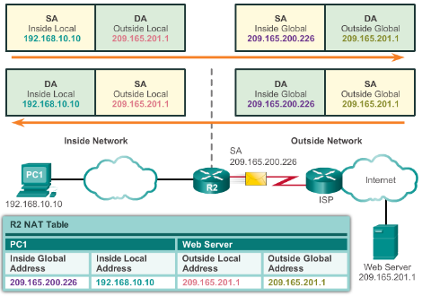
NAT Operation
NAT Characteristics
IPv4 Private Address Space
  10.0.0.0 /8, 172.16.0.0 /12, and 192.168.0.0 /16
What is NAT?
  Process to translate network IPv4 address
  Conserve public IPv4 addresses
  Configured at the border router for translation
NAT Terminology
  Inside address
    Inside local address
    Inside global address
  Outside address
    Outside local address
    Outside global address
Notes:
9.1 – NAT Operation
9.1.1 – NAT Characteristics

Slide 6
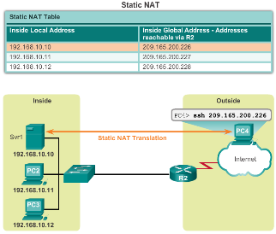
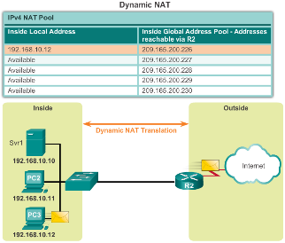
NAT Operation
Types of NAT
Static NAT
  One-to-one mapping of local and global addresses
  Configured by the network administrator and remain constant.
Dynamic NAT
  Uses a pool of public addresses and assigns them on a first-come, first-served basis
  Requires that enough public addresses for the total number of simultaneous user sessions
Port Address Translation (PAT)
  Maps multiple private IPv4 addresses to a single public IPv4 address or a few addresses
  Also known as NAT overload
  Validates that the incoming packets were requested
  Uses port numbers to forward the response packets to the correct internal device
Notes:
9.1 – NAT Operation
9.1.2 – Types of NAT

Slide 7
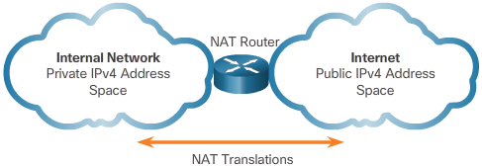
NAT Operation
NAT Advantages
Advantages of NAT
  Conserves the legally registered addressing scheme
  Increases the flexibility of connections to the public network
  Provides consistency for internal network addressing schemes
  Provides network security
Disadvantages of NAT
  Performance is degraded
  End-to-end functionality is degraded
  End-to-end IP traceability is lost
  Tunneling is more complicated
  Initiating TCP connections can be disrupted
Notes:
9.1 – NAT Operation
9.1.3 – NAT Advantages

Slide 8
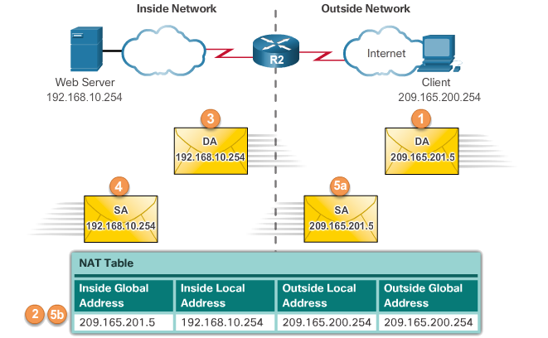
Configuring NAT
Configuring Static NAT
Configuring Static NAT
  Create the mapping between the inside local and inside global addresses
    ip nat inside source static local-ip global-ip
  Define which interfaces belong to the inside network and which belong to the outside network
    ip nat inside
    ip nat outside
Analyzing Static NAT
Verifying Static NAT
  show ip nat translations
  show ip nat statistics
  clear ip nat statistics
Notes:
9.2 – Configuring NAT
9.2.1 – Configuring Static NAT

Slide 9
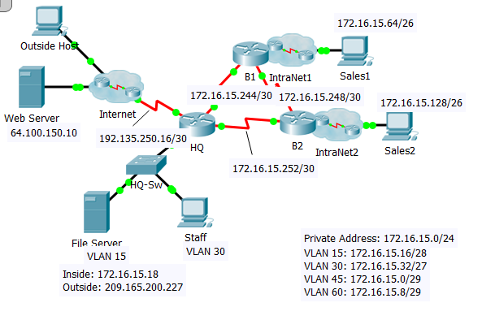
NAT – Sample Configuration
access-list 1 permit 172.16.15.0 0.0.0.255
ip nat pool TEST 209.165.200.225 209.165.200.226 netmask 255.255.255.252
ip nat inside source list 1 pool TEST overload
[ip nat inside source list 1 s 0/1/0 overload]
ip nat inside source static 172.16.15.18 209.165.200.227
interface s0/0/0
ip nat inside
interface s0/0/1
ip nat inside
interface s0/1/0
ip nat outside

Slide 10
Configuring NAT
Configuring Dynamic NAT
Dynamic NAT Operation
  The pool of public IPv4 addresses (inside global address pool) is available to any device on the inside network on a first-come, first-served basis.
  With dynamic NAT, a single inside address is translated to a single outside address.
  The pool must be large enough to accommodate all inside devices.
  A device is unable to communicate to any external networks if no addresses are available in the pool.
Notes:
9.2 – Configuring NAT
9.2.2 – Configuring Dynamic NAT

Slide 11
Configuring NAT
Configuring Dynamic NAT (Cont.)
Configuring Dynamic NAT
  Create the mapping between the inside local and outside local addresses
    ip nat pool name start-ip end-ip {netmask netmask | prefix-length prefix-length}
  Create a standard ACL to permit those addresses to be translated
    access-list access-list-number permit source [source-wildcard]
  Bind the ACL to the pool
    ip nat inside source list access-list-number pool name
  Identify the inside and outside interfaces
    ip nat inside
    ip nat outside
Notes:
9.2 – Configuring NAT
9.2.2 – Configuring Dynamic NAT

Slide 12
Configuring NAT
Configuring Dynamic NAT (Cont.)
Configuring Dynamic NAT
  Create the mapping between the inside local and inside global addresses
    ip nat pool name start-ip end-ip {netmask netmask | prefix-length prefix-length}
  Create a standard ACL to permit those addresses to be translated
    access-list access-list-number permit source [source-wildcard]
  Bind the ACL to the pool
    ip nat inside source list access-list-number pool name
  Identify the inside and outside interfaces
    ip nat inside
    ip nat outside
Notes:
9.2 – Configuring NAT
9.2.2 – Configuring Dynamic NAT

Slide 13
NAT – Sample Configuration
access-list 1 permit 172.16.15.0 0.0.0.255
ip nat pool TEST 209.165.200.225 209.165.200.226 netmask 255.255.255.252
ip nat inside source list 1 pool TEST
ip nat inside source static 172.16.15.18 209.165.200.227
interface s0/0/0
ip nat inside
interface s0/0/1
ip nat inside
interface s0/1/0
ip nat outside

Slide 14
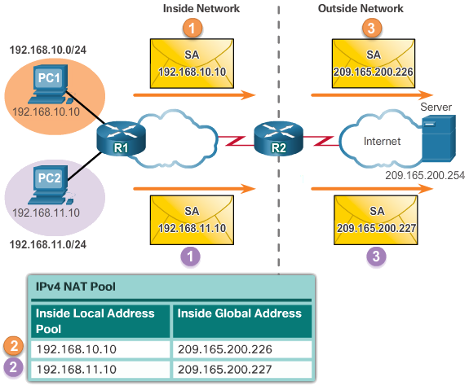
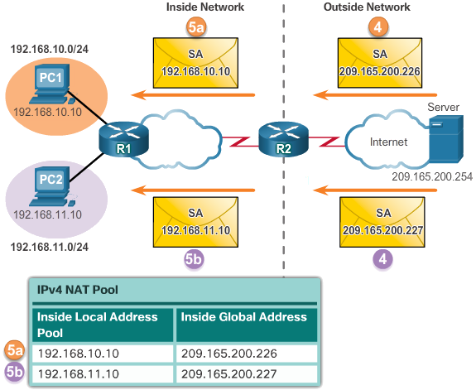
Configuring NAT
Configuring Dynamic NAT (Cont.)
Analyzing Dynamic NAT
Verifying Dynamic NAT
  show ip nat translations
  show ip nat translations verbose
  clear ip nat statistics
  clear ip nat translations *
Notes:
9.2 – Configuring NAT
9.2.2 – Configuring Dynamic NAT

Slide 15
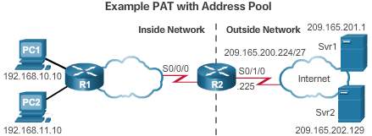
Configuring NAT
Configuring Port Address Translations (PAT)
Configuring PAT: Address Pool
  Create the mapping between the inside local and inside global addresses
    ip nat pool name start-ip end-ip {netmask netmask | prefix-length prefix-length}
  Create a standard ACL to permit those addresses to be translated
    access-list access-list-number permit source [source-wildcard]
  Bind the ACL to the pool
    ip nat inside source list access-list-number pool name overload
  Identify the inside and outside interfaces
    ip nat inside
    ip nat outside
Notes:
9.2 – Configuring NAT
9.2.3 – Configuring Port Address Translations (PAT)

Slide 16
NAT – Sample Configuration
access-list 1 permit 172.16.15.0 0.0.0.255
ip nat pool TEST 209.165.200.225 209.165.200.226 netmask 255.255.255.252
ip nat inside source list 1 pool TEST overload
[ip nat inside source list 1 s 0/1/0 overload]
ip nat inside source static 172.16.15.18 209.165.200.227
interface s0/0/0
ip nat inside
interface s0/0/1
ip nat inside
interface s0/1/0
ip nat outside

Slide 17
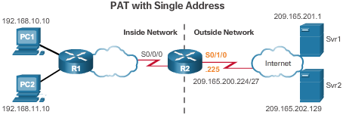
Configuring NAT
Configuring Port Address Translations(PAT)(Cont.)
Configuring PAT: Single Address
  Define a standard ACL to permit those addresses to be translated
    access-list access-list-number permit source [source-wildcard]
  Establish dynamic source translation, specify the ACL, exit interface, and overload option
    ip nat inside source list access-list-number interface type name overload
  Identify the inside and outside interfaces
    ip nat inside
    ip nat outside
Notes:
9.2 – Configuring NAT
9.2.3 – Configuring Port Address Translations (PAT)

Slide 18
NAT – Sample Configuration
access-list 1 permit 172.16.15.0 0.0.0.255
ip nat pool TEST 209.165.200.225 209.165.200.226 netmask 255.255.255.252
ip nat inside source list 1 pool TEST overload
[ip nat inside source list 1 s 0/1/0 overload]
ip nat inside source static 172.16.15.18 209.165.200.227
interface s0/0/0
ip nat inside
interface s0/0/1
ip nat inside
interface s0/1/0
ip nat outside

Slide 19
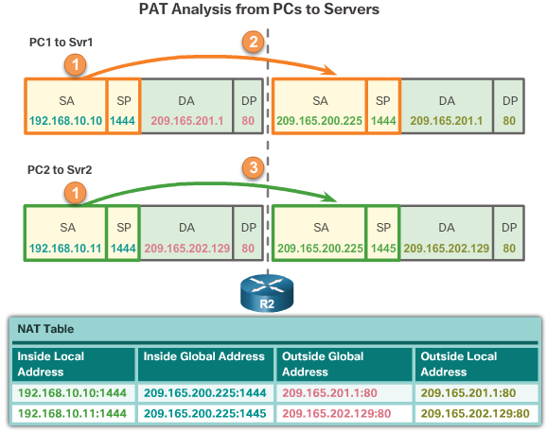
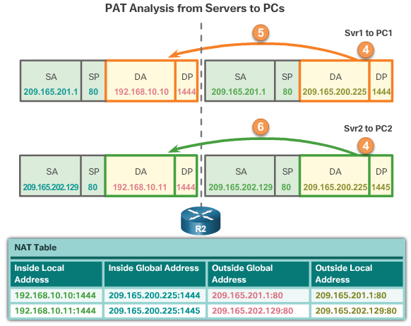
Configuring NAT
Configuring Port Address Translations(PAT)(Cont.)
Analyzing PAT
Verifying PAT
  show ip nat translations
  show ip nat statistics
  slear ip nat statistics
Notes:
9.2 – Configuring NAT
9.2.3 – Configuring Port Address Translations (PAT)

Slide 20
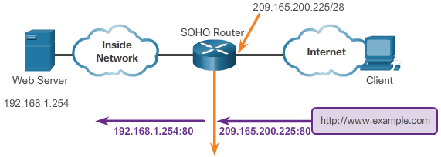
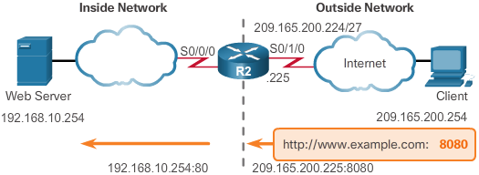
Configuring NAT
Port Forwarding
Port Forwarding
  Port forwarding is the act of forwarding a network port from one network node to another.
  A packet sent to the public IP address and port of a router can be forwarded to a private IP address and port in inside network.
  Port forwarding is helpful in situations where servers have private addresses, not reachable from the outside networks.
Wireless Router Example
Configuring Port Forwarding with IOS
  ip nat inside source [static {tcp | udp local-ip local-port global-ip global-port} [extendable]
Notes:
9.2 – Configuring NAT
9.2.4 – Port Forwarding

Slide 21
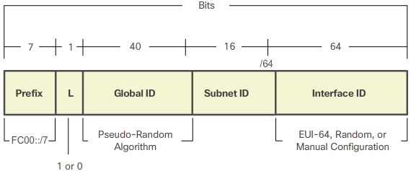
Configuring NAT
Configuring NAT and IPv6
NAT for IPv6?
  IPv6 with a 128-bit address provides 340 undecillion addresses.
  Address space is not an issue for IPv6.
  IPv6 makes IPv4 public-private NAT unnecessary by design; however, IPv6 does implement a form of private addresses, and it is implemented differently than they are for IPv4.
IPv6 Unique Local Address
  IPv6 unique local addresses (ULAs) are designed to allow IPv6 communications within a local site.
  ULAs are not meant to provide additional IPv6 address space.
  ULAs have the prefix FC00::/7, which results in a first hextet range of FC00 to FDFF.
  ULAs are also known as local IPv6 addresses (not to be confused with IPv6 link-local addresses).
Notes:
9.2 – Configuring NAT
9.2.5 – Configuring NAT and IPv6

Slide 22
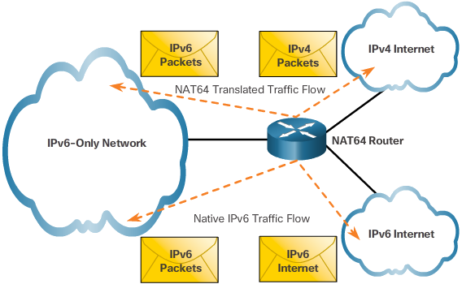
Configuring NAT
Configuring NAT and IPv6 (Cont.)
NAT for IPv6
  IPv6 also uses NAT, but in a much different context.
  In IPv6, NAT is used to provide transparent communication between IPv6 and IPv4.
  NAT64 is not intended to be a permanent solution; it is meant to be a transition mechanism.
  Network Address Translation-Protocol Translation (NAT-PT) was another NAT-based transition mechanism for IPv6, but is now deprecated by IETF.
  NAT64 is now recommended.
Notes:
9.2 – Configuring NAT
9.2.5 – Configuring NAT and IPv6

Slide 23
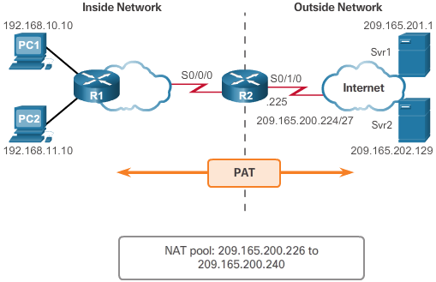
Troubleshooting NAT
Troubleshooting NAT Configurations
Troubleshooting NAT: show commands
  clear ip nat statistics
  clear ip nat translations *
  show ip nat statistics
  Show ip nat translations
Troubleshooting NAT: debug commands
  debug ip nat
Notes:
9.3 – Troubleshooting NAT
9.3.1 – Troubleshooting NAT Configurations

