Slide 1
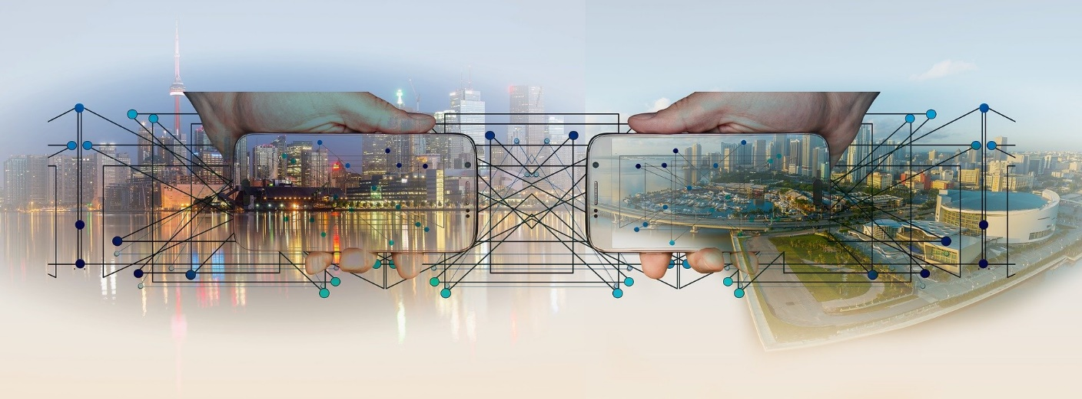
Lecture 6
Distributed Computing

Slide 2
Why distributed systems ?
Fact: Processor population is exploding. Technology has dramatically reduced the price of processors.
Geographic distribution of processes
Resource sharing as used in P2P networks
Computation speed up (as in a grid)
Fault tolerance

Slide 3
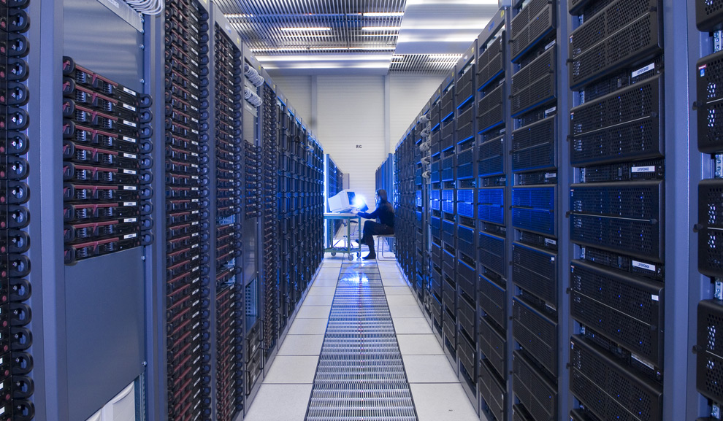
What is Distributed Systems?

Slide 4
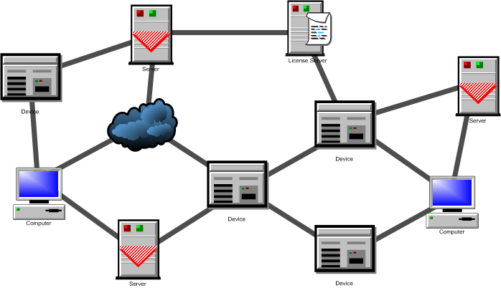
What is a distributed system? (1)
A network of processes/resources.
The nodes are processes/resources, and the edges are communication channels.

Slide 5
What is a distributed system? (2)
The logical distribution of functional capabilities
  Multiple processes
  Interprocess communication
  Disjoint address space
  Collective goal

Slide 6
What is a distributed system? (2)
Collective Goal?
Don’t hold your breath:
  Biocomputing
    Using biologically derived molecules
  Nanocomputing:
    the manipulation of matter on an atomic and molecular scale
  Quantum computing
    use of quantum-mechanical phenomena, such as superposition and entanglement
  …
It all boils down to…
  Divide-and-conquer
  Throwing more hardware at the problem
Notes:
* Biocomputing may refer to:
Biocomputers, systems of biologically derived molecules that perform computational processes
DNA computing, a form of biological computing that uses DNA
Bioinformatics, the application of statistics and computer science to the field of molecular biology
* Nanocomputing
Computation that use nanotechnology
Nanotechnology (sometimes shortened to "nanotech") is the manipulation of matter on an atomic and molecular scale. The earliest, widespread description of nanotechnology^{[1][2]} referred to the particular technological goal of precisely manipulating atoms and molecules for fabrication of macroscale products, also now referred to as molecular nanotechnology.
* A quantum computer (also known as a quantum supercomputer) is a computation device that makes direct use of quantum-mechanical phenomena, such as superposition and entanglement, to perform operations on data. Quantum computers are different from digital computers based on transistors. Whereas digital computers require data to be encoded into binary digits (bits), quantum computation uses quantum properties to represent data and perform operations on these data.

Slide 7
What is a distributed system? (2)
Divide and Conquer
“Work”
Partition
w₁
w₂
w₃
“worker”
“worker”
“worker”
r₁
r₂
r₃
Combine
“Result”
Reference: Lecture Note by Jimmy Lin, Univ. of Maryland

Slide 8
What is a distributed system? (2)
Different Workers
Different threads in the same core
Different cores in the same CPU
Different CPUs in a multi-processor system
Different machines in a distributed system
Reference: Lecture Note by Jimmy Lin, Univ. of Maryland

Slide 9
What is a distributed system? (2)
Choices, Choices, Choices
Commodity vs. “exotic” hardware
Number of machines vs. processor vs. cores
Memory vs. disk vs. network bandwidth
Different programming models
Reference: Lecture Note by Jimmy Lin, Univ. of Maryland

Slide 10
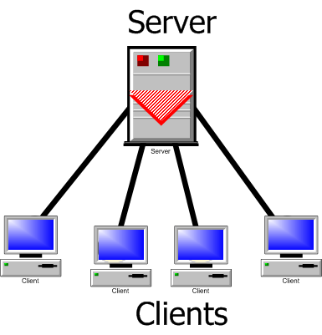
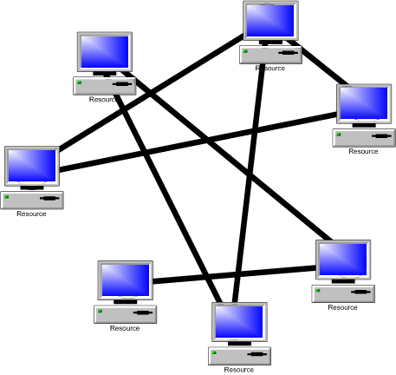
A classification
Client-server model
Peer-to-peer model

Slide 11
Parallel vs. Distributed
In both parallel and distributed systems, the events are partially ordered.
In parallel systems, the primarily issue is speed-up
In distributed systems the primary issues are fault-tolerance and availability of services

Slide 12
Important services
Internet banking
Web search
Net meeting
Distance education
Internet auction
Google earth
Google sky
And so on…

Slide 13
Examples
Large networks are very commonplace these days. Think of the world wide web. Other examples are:
  Ubiquitous Computing
  Cloud computing
  Grid computing, Grid computing networks
    Ex. Computational grids (OSG, Teragrid, SETI@home)
  Sensor networks
  Network of mobile robots
  And so on…
Notes:
Google processes 20 PB a day (2008)
Kazaa (formally, KaZaA)
BitTorrent

Slide 14
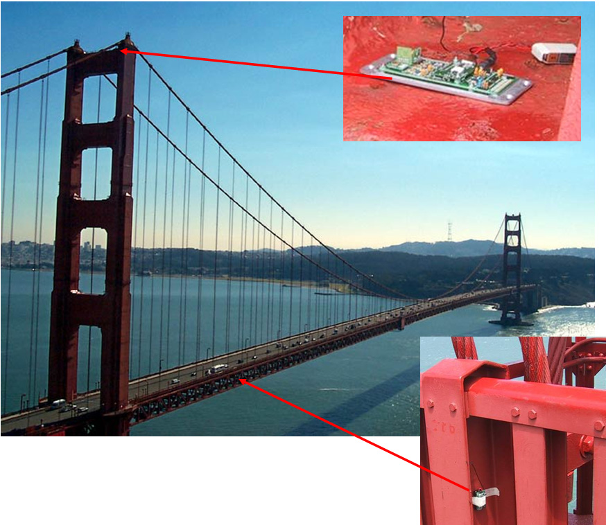
Sensor Network
Checking the structural integrity

Slide 15
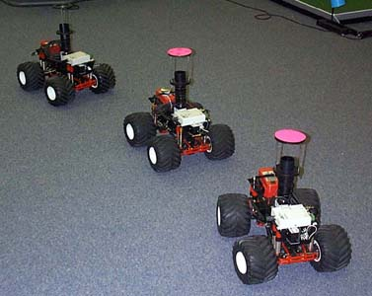
Mobile robots

Slide 16

Cloud Computing
Image Source: www.vemurivenkatrao.com/nature/cloud/

Slide 17
Important issues
Knowledge is local
Clocks are not synchronized
No shared address space
Topology and routing
Scalability
Fault tolerance

Slide 18
Some common sub-problems
Leader election
Mutual exclusion
Time synchronization
Distributed snapshot
Replica management

Slide 19
Objective of the course
Understand how a system works, why it fails, and how we can guarantee our design.
We are not discussing implementation or programming, although they are also important issues

Slide 20
Implementation
Practical distributed systems must have a real network as its backbone. However, such systems can be simulated on a shared-memory multiprocessor, or even on a uniprocessor.

